Slide 1
Chemistry 11
TODAY:
Introductions
Course overview
My expectations
Your expectations

Slide 2
Introductions
My name is…
Bachelor degree in Biochemistry and Molecular Biology from Simon Fraser University, Canada
Last two 2 years, I taught BC Chemistry, Biology, and Mathematics and AP Chemistry in China
My hobbies: teaching, football (soccer), sports, movies
Your homework ☺:

Slide 3
Course Overviews
Any questions….
ASK ME ANYTIME!!!

Slide 4
My Expectations
Materials You Will Need
Classroom/Desks Cleanliness
Food/Drinks
Tardiness
Cheating
Cell phones
English

Slide 5
Materials You Will Need
Textbook

Slide 6
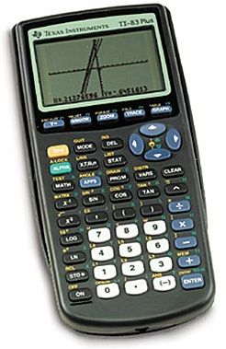
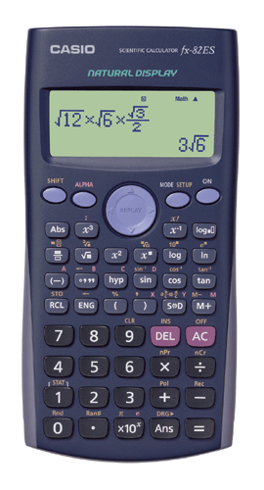
Materials You Will Need
Textbook
Calculators (TI series or scientific)

Slide 7
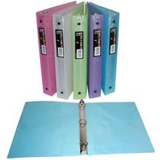
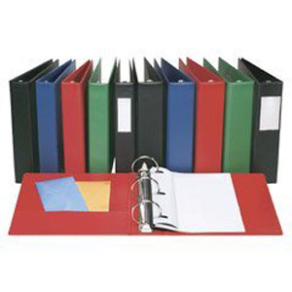
Materials You Will Need
Textbook
Calculators (TI series or scientific)
Folders/binders for worksheets an handouts

Slide 8
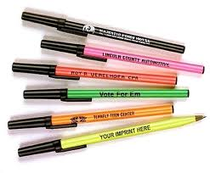
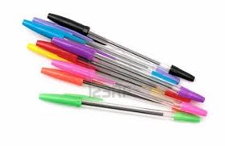
Materials You Will Need
Textbook
Calculators (TI series or scientific)
Folders/binders for worksheets an handouts
Different coloured pens (blue, black, red, green) and pencils

Slide 9
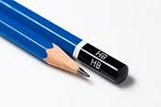
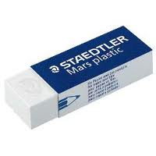
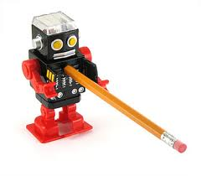
Materials You Will Need
Pencils, Erasers, pencil sharpeners, rulers

Slide 10
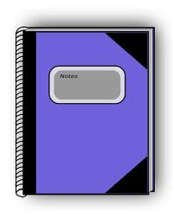
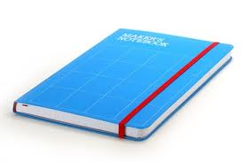
Materials You Will Need
Notebooks for notes

Slide 11
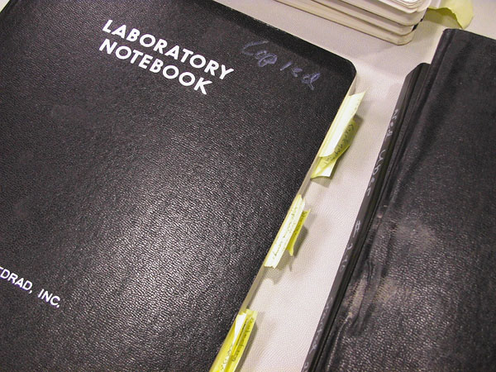
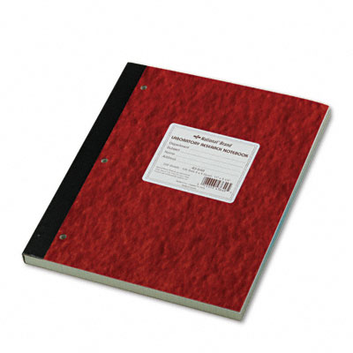
Materials You Will Need
Laboratory notebooks for experiments

Slide 12
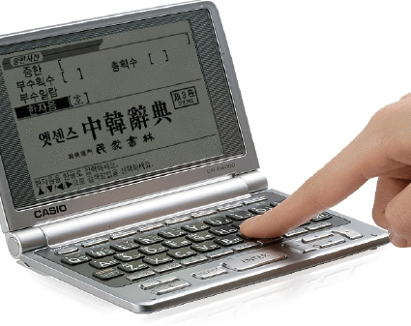
Materials You Will Need
Dictionaries

Slide 13
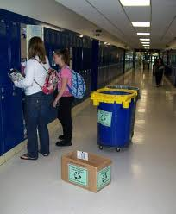
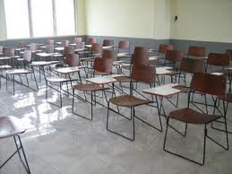
Classroom/Desks Cleanliness
Keep classroom as clean as possible!!
Any garbage goes into garbage bins outside (not beside or under your desks, on window silts, or on the floor!!)
I will make you clean your classrooms if it will be repeatedly dirty/not clean

Slide 14
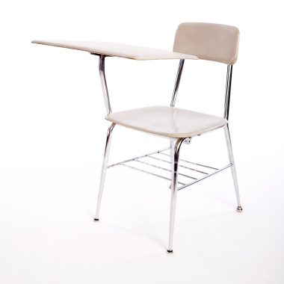
Classroom/Desks Cleanliness
YOUR DESKS:
Only your Chemistry textbook, a chemistry notebook, a calculator, pens, pencils, erasers, rulers

Slide 15
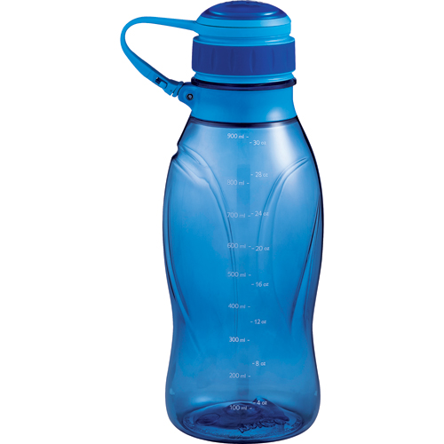
Food/Drinks
No food and drinks during the class!!
Only water is allowed (must be in a clear water bottle)

Slide 16
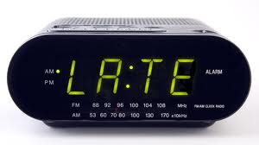
Tardiness
DO NOT BE LATE!! No EXCUSES to be late!!
There will be repercussions if you will be late!
You MUST be in your seat, ready to learn (textbook, notebook, pen, pencil, calculator ready) after the first bell

Slide 17
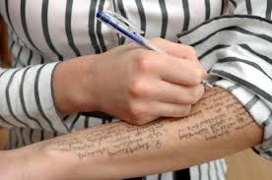
Cheating
DO NOT CHEAT!!!
WHY??
This is the worst thing you can do to your education and your future!

Slide 18
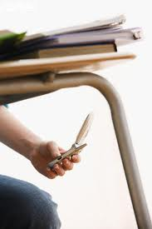
Cell Phones
Out of sight, out of mind!
You can use it only OUTSIDE the school building at lunch, before and after school
NEVER EVER inside the school!!
If I see you use it inside…

Slide 19
English
The use of English will be strictly enforced
You will loose marks/grades for Participation if you repeatedly use Chinese

Slide 20
Textbook Website
http://www.edvantageinteractive.com/sciencemoodle/
Choose Chemistry 11
Enrolment Key: bohr2013

Slide 21
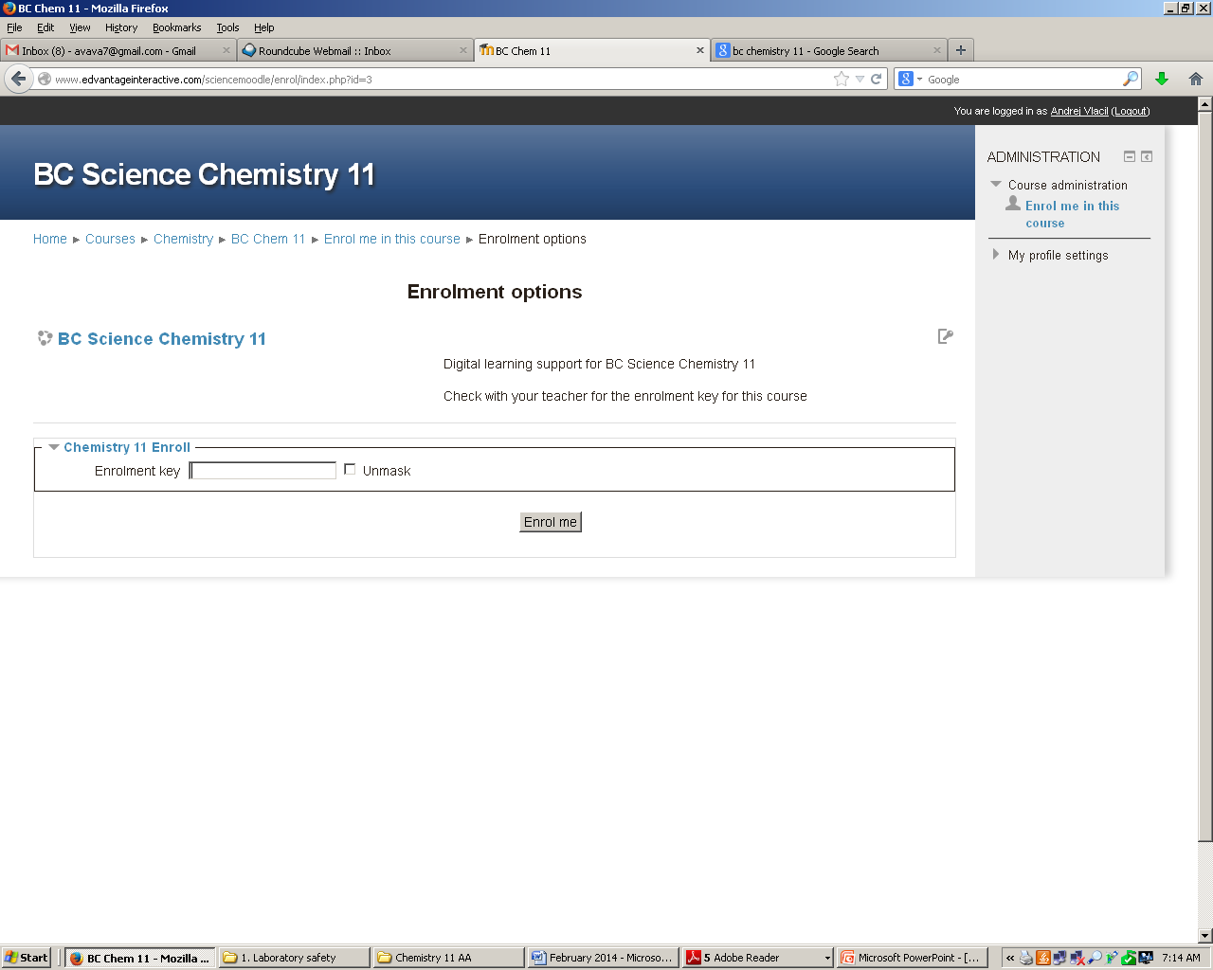
Textbook Website
http://www.edvantageinteractive.com/sciencemoodle/
Choose Chemistry 11
Enrolment Key: bohr2013

Slide 22
Course Website
http://alexanderacademy.weebly.com/
Choose: MR.VLACIL
Password: chem11

Slide 23
Grading Scale for Chemistry 11
Assignments (worksheets, homework, pop-quizzes) 15%
Quizzes (for each chapter, appx. 30) 20%
Chapter Tests (8 of them – 2.5% each) 20%
Labs (15 of them?) 25%
Final Exam 20%
It might change!

Slide 24
Grading Scale for Chemistry 11
A 100% – 86%
B 85% – 73%
C+ 72% – 67%
C 66% – 60%
D 59% - 50%
F 49% - under

