Slide 1
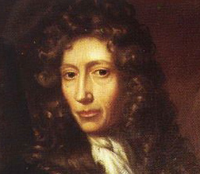
1.2 Laboratory and Reporting Skills

Slide 2
The Scientific Method
Robert Boyle
Observation
Hypothesis
Experimentation
Conclusion/ Statement of Theory
Read page 17 and complete
Quick Check

Slide 3
Observation: Quantitative or Qualitative?

Slide 4
Observation: Quantitative or Qualitative?

Slide 5
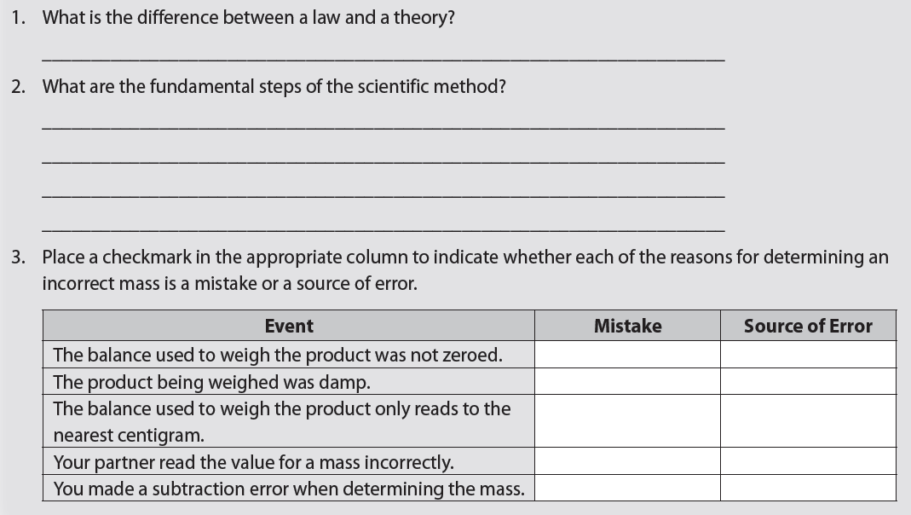
Set of explanations based on experiments
General statement of fact
Observation
Hypothesis
Experimentation
Conclusion/ Statement of Theory

Slide 6
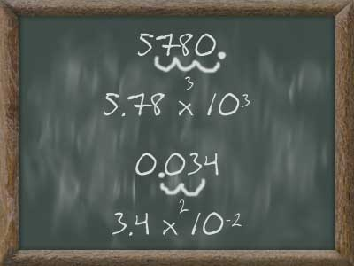
The Scientific Notation

Slide 7
A method for expressing, and working with, very
large or very small numbers.

Slide 8
The Scientific Notation
COEFFICIENT
It must be more than 1 but less than 10

Slide 9
The Scientific Notation
BASE
COEFFICIENT
It must be more than 1 but less than 10

Slide 10
The Scientific Notation
THE EXPONENT or POWER OF TEN
BASE
COEFFICIENT
It must be more than 1 but less than 10

Slide 11
A Reading the Scientific Notation
“5 point 7 times ten to the sixth power”

Slide 12
The Scientific Notation
A Reading the Scientific Notation
The Expanded Notation
“5 point 7 times ten to the sixth”

Slide 13
To write a number in scientific notation:
Put a decimal point after the first digit and drop the zeroes.
To find the exponent, count the number of places from the decimal to the end of the numbers.
146,000,000
146,000,000 = 1.46
In 1.46000000 there are 8 places.
Therefore we write 146,000,000 as 1.46 x 10⁸

Slide 14
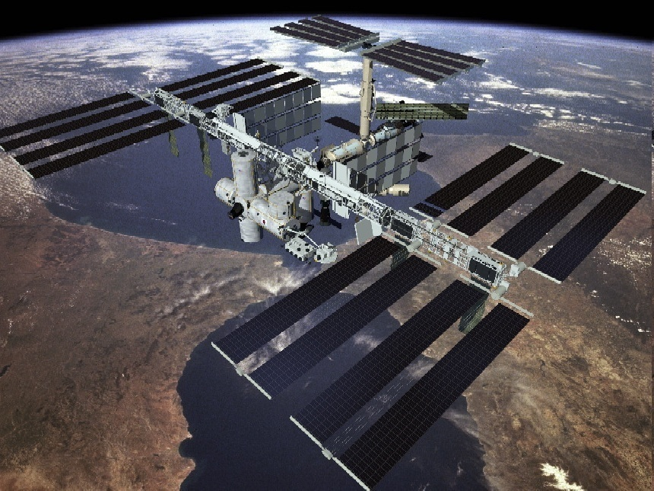
What is 567,000 in scientific notation?
Copyright © 2010 Ryan P. Murphy

Slide 15
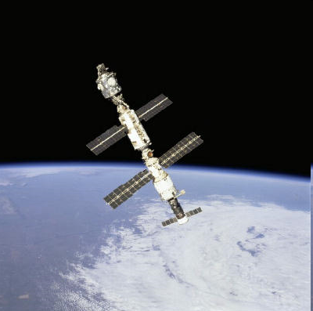
5.67000
5.67 x 10⁵

Slide 16
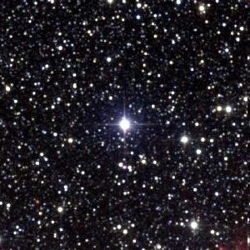
What is 40,100,000,000,000 in scientific notation?
This is the distance from earth to the nearest star Proxima Centauri.
Copyright © 2010 Ryan P. Murphy

Slide 17
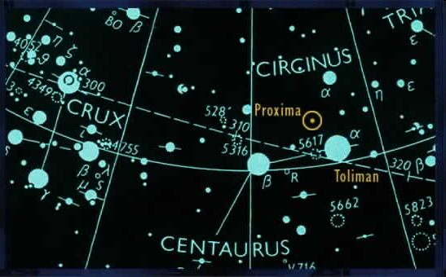
Answer! 40,100,000,000,000 = 4.01 x 10¹³
Copyright © 2010 Ryan P. Murphy

Slide 18
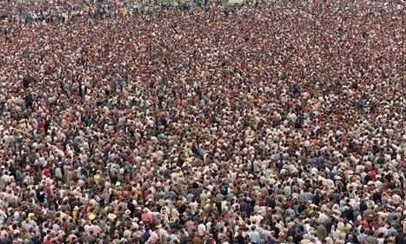
What is 8,000,000,000 in scientific notation?
A projection for the number of people on earth!
Copyright © 2010 Ryan P. Murphy

Slide 19
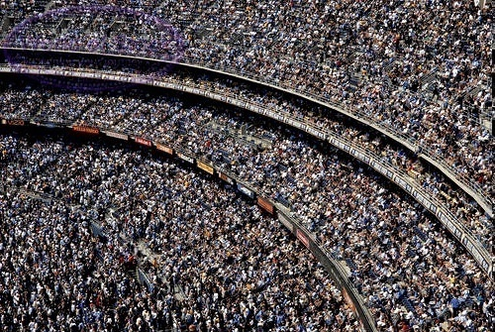
Answer! 8,000,000,000 = 8 x 10⁹
Copyright © 2010 Ryan P. Murphy

Slide 20
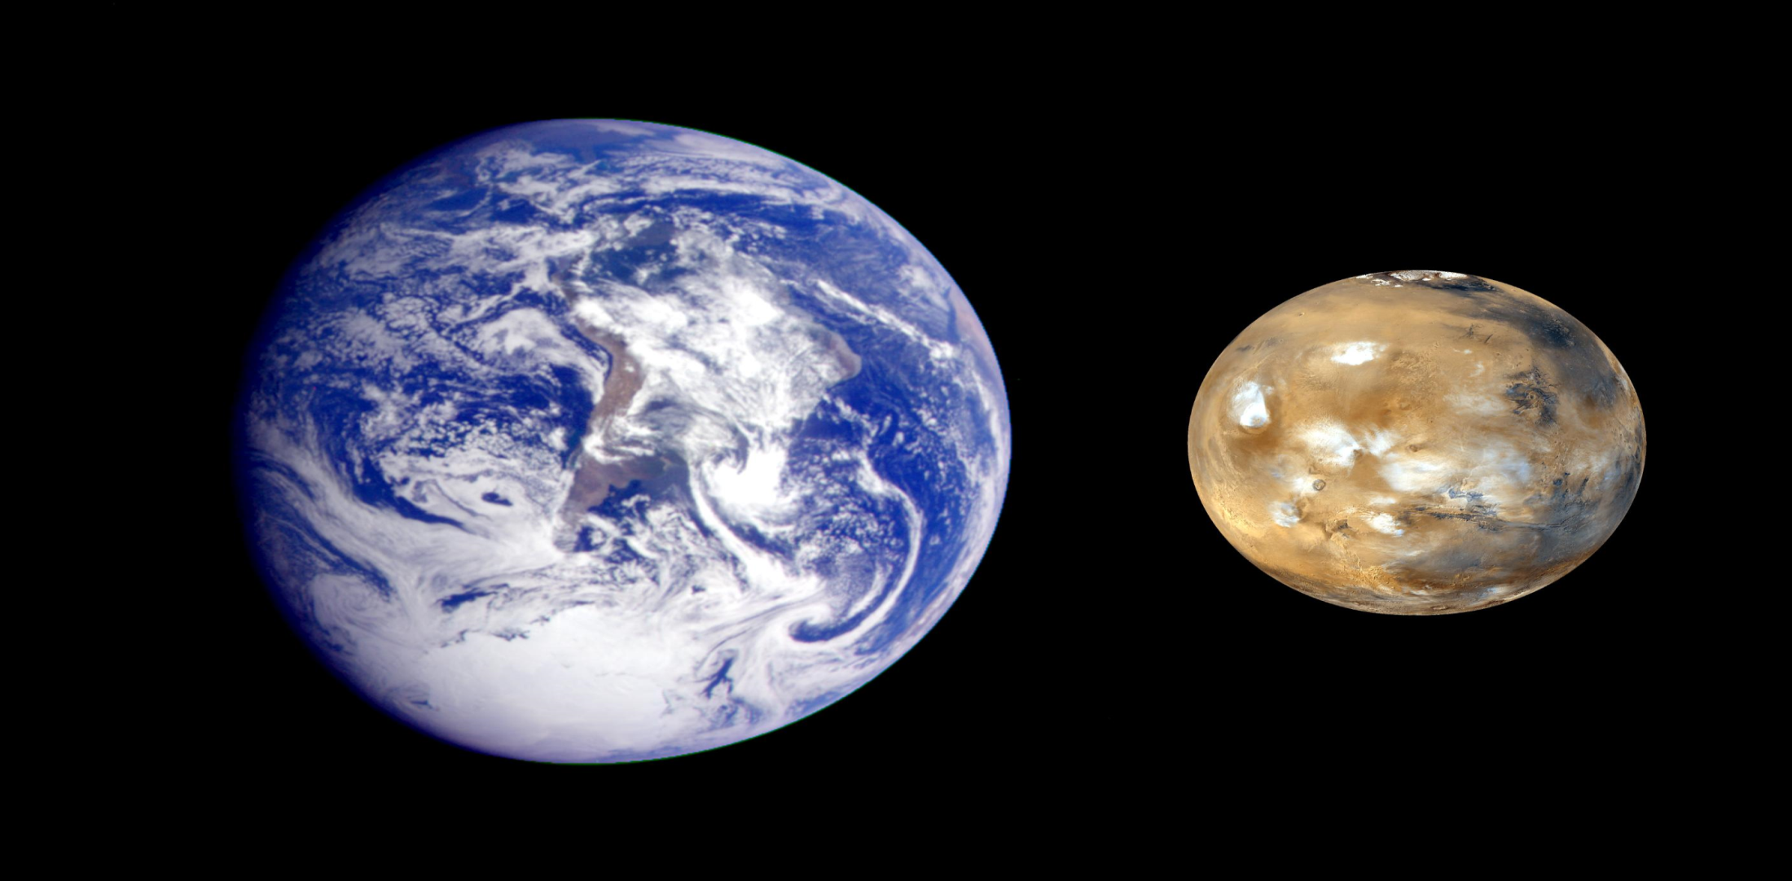
What is 9.9 x 10⁷?
- Work in the opposite direction
This is the distance from the Earth to Mars in Kilometers.
Copyright © 2010 Ryan P. Murphy

Slide 21
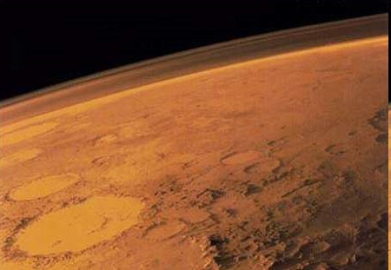
Answer! 9.9 x 10⁷ = 99,000,000
There needs to be six places after the decimal. Since the .9 is the first, you would add 6 zeroes to equal 10⁷.

Slide 22
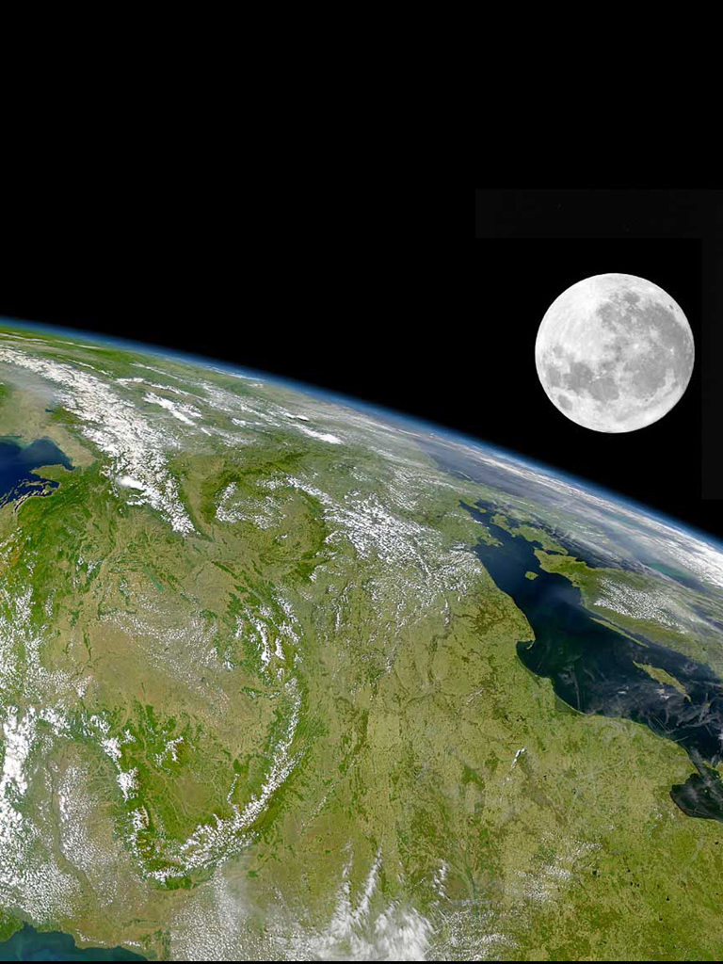
What is 3.844 x 10⁵ ?
The distance in kilometers from the Earth to the Moon.

Slide 23
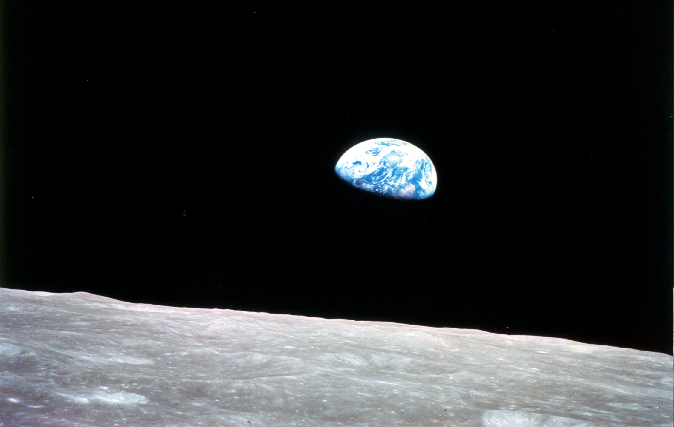
Answer! 3.844 x 10⁵ is 384,400 km

Slide 24
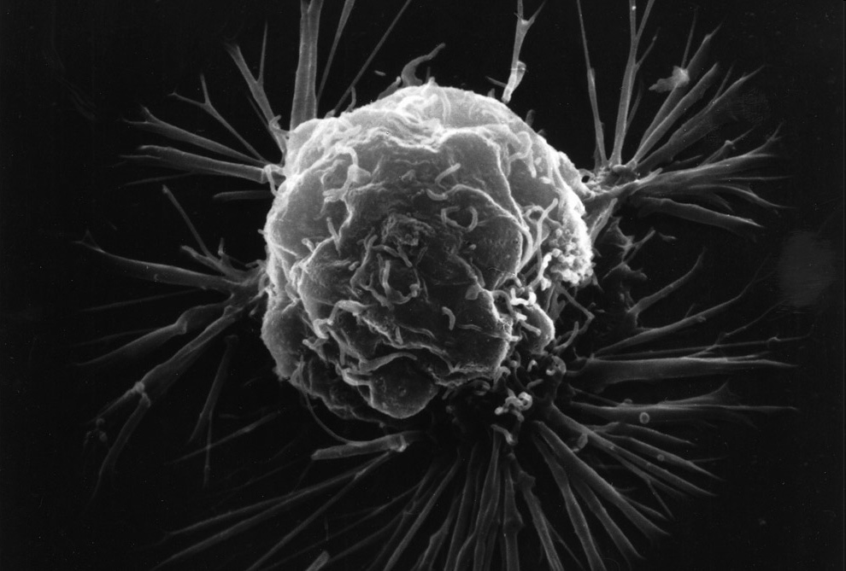
Scientific notation can be used for very small numbers as well.
The decimal number 0.00000065 written in scientific notation would be 6.5 x 10⁻⁷
Copyright © 2010 Ryan P. Murphy

Slide 25
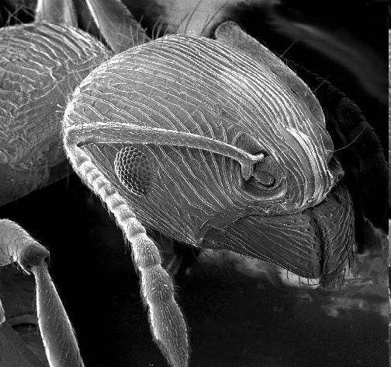
What is 0.00053 in scientific notation?
Copyright © 2010 Ryan P. Murphy

Slide 26
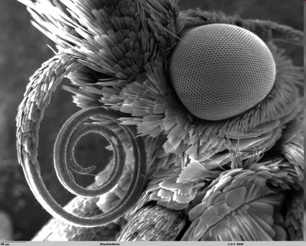
Answer! 0.00053 = 5.3 x 10⁻⁴
Copyright © 2010 Ryan P. Murphy

Slide 27
What is 0.00000042 in scientific notation?
Copyright © 2010 Ryan P. Murphy

Slide 28
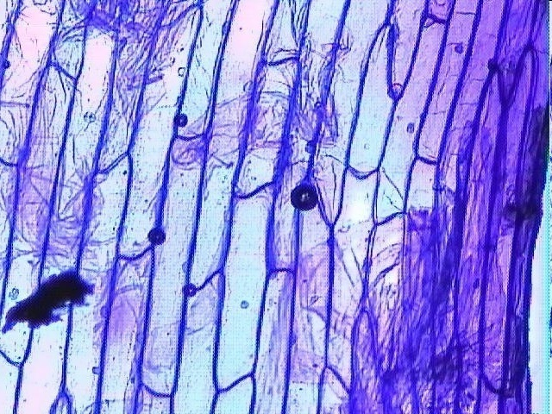
Answer! 0.00000042 is 4.2 × 10⁻⁷
Copyright © 2010 Ryan P. Murphy

Slide 29
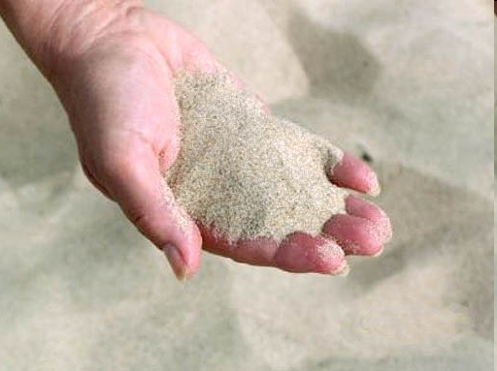
What is 9,780,000,000,000,000,000,000,000,000
in scientific notation?
Copyright © 2010 Ryan P. Murphy

Slide 30
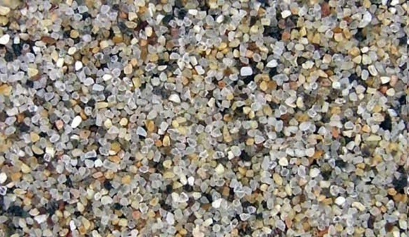
Answer!
9,780,000,000,000,000,000,000,000,000
9.78 x 10²⁷
Copyright © 2010 Ryan P. Murphy

Slide 31
Multiplication and Division in Scientific Notation
To MULTIPLY…
MULTIPLY the coefficients and ADD the exponents

Slide 32
Multiplication and Division in Scientific Notation
To MULTIPLY…
MULTIPLY the coefficients and ADD the exponents
8.0 x 10⁹

Slide 33
Multiplication and Division in Scientific Notation
To MULTIPLY…
MULTIPLY the coefficients and ADD the exponents
8.0 x 10⁹
To DIVIDE…
DIVIDE the coefficients and SUBTRACT the exponents
9.4 x 10²

Slide 34
Multiplication and Division in Scientific Notation
8 x 10⁷
3.0 x 10²
9.3 x 10⁻³
2.0 x 10²
7.5 x 10²

Slide 35
Addition and Subtraction in Scientific Notation
NEVER ADD OR SUBTRACT NUMBERS IF THE EXPONENT ARE NOT THE SAME!
Adjust the numbers, so they have the same exponents
Add/subtract the coefficients, keeping the exponents the same
convert back to scientific notation (if needed)

Slide 36
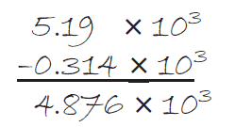
Addition and Subtraction in Scientific Notation
Adjust the numbers, so they have the same exponents
Add/subtract the coefficients, keeping the exponents the same
convert back to scientific notation (if needed)

Slide 37
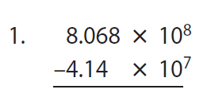
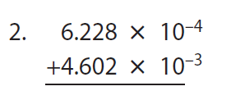
Addition and Subtraction in Scientific Notation
7.654 x 10⁸
5.2248 x 10⁻³

Slide 38
Scientific Notation and Exponents
When one exponent is raised to some power…
the coefficient is raised to that power
the exponents are multiplied by one another
(3.0 x 10²)³
3.0³ x 10 (^{2 x 3})
27.0 x 10⁶

Slide 39
Scientific Notation and Exponents
When one exponent is raised to some power…
the coefficient is raised to that power
the exponents are multiplied by one another
10¹⁵
8 x 10⁶
25 x 10⁸
36 x 10¹⁸

Slide 40
Graphing
as x increases, y increases
as x increases, y decreases
as x increases, y increases very quickly

