Slide 1
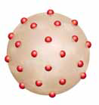
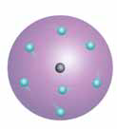
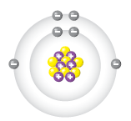
1.3 Atomic Theory

Slide 2
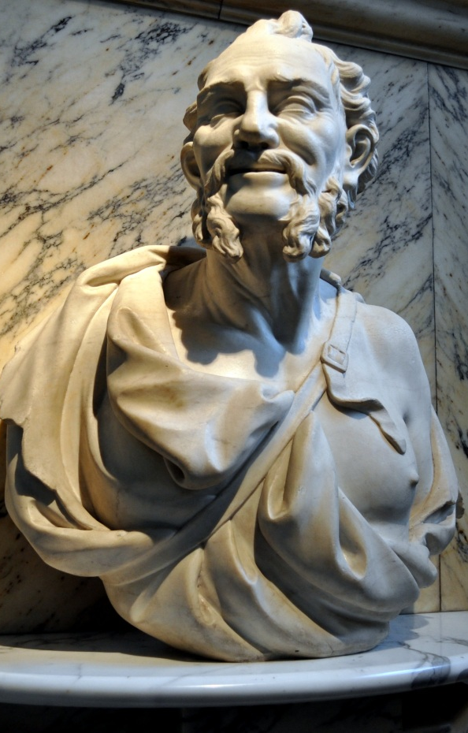
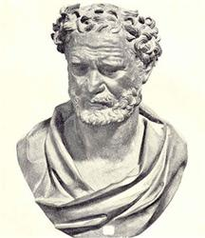
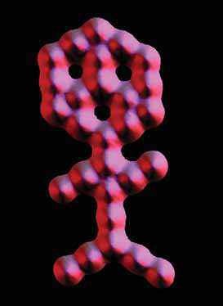
Early Ideas about Matter
  Greek philosophers believed that matter was made of atomos that were the smallest pieces of matter.

Slide 3
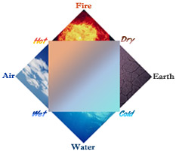
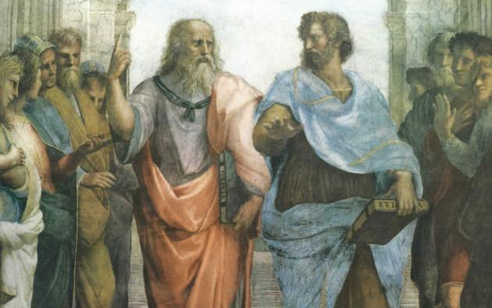
Early Ideas about Matter
  Aristotle believed matter was made of different combinations of earth, air, fire, and water.

Slide 4
The Behaviour of Gases Activity

Slide 5
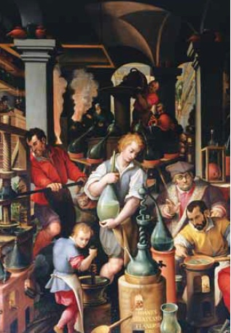
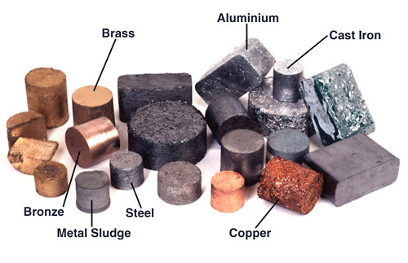
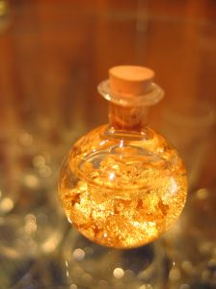
Early Ideas about Matter
  Alchemists experimented with matter and tried to turn common metals into gold.

Slide 6
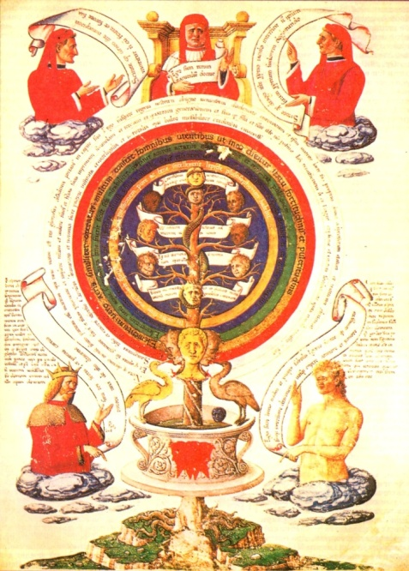
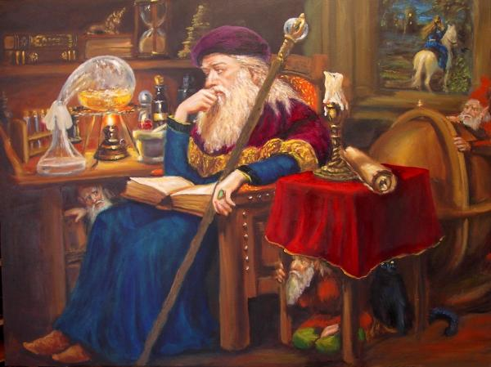
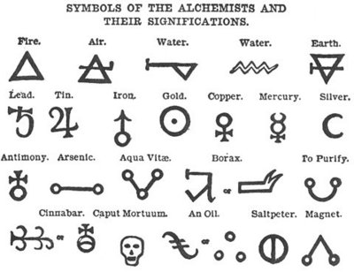
Early Ideas about Matter
  Their activities marked the beginning of our understanding of matter.

Slide 7
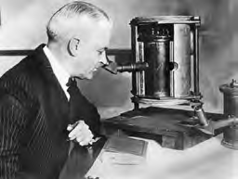
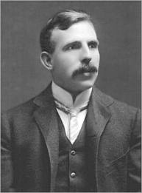
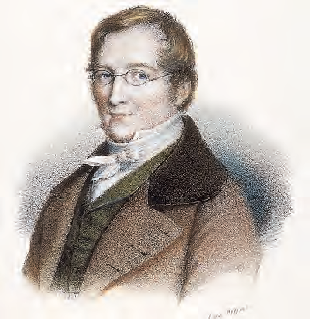
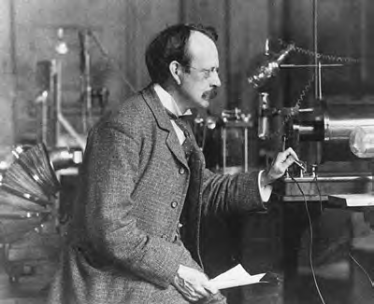
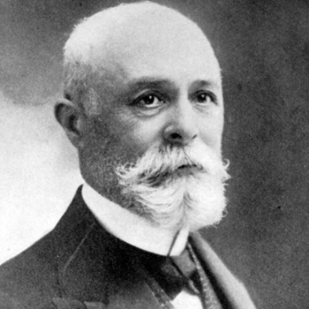
Development of the Atomic Theory
Many scientists in different countries have contributed to the understanding of matter - atoms

Slide 8
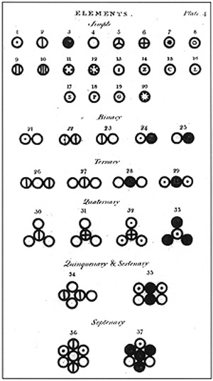
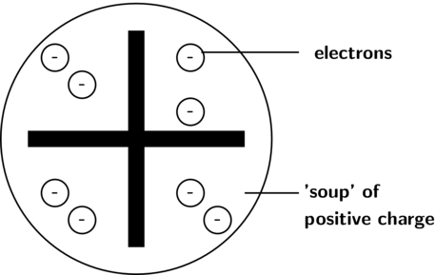
John Dalton
  Credited with developing a theory that was a
  new way of explaining matter.

Slide 9
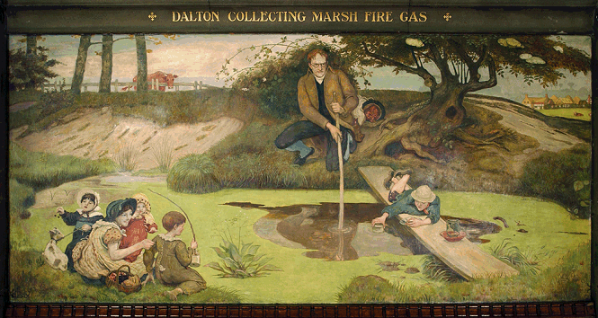
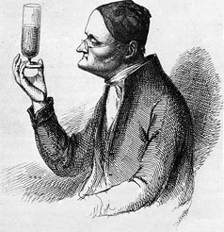
John Dalton
  He studied gases that make up Earth’s atmosphere.

Slide 10

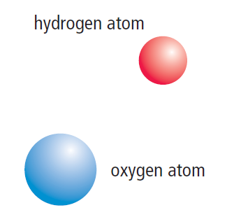
John Dalton
  Based on his studies, he suggested that:
  matter is made of small, hard spheres that are different for different elements
  the smallest particle of an element is called an atom
  This is the basis for Dalton’s Atomic Theory.

Slide 11
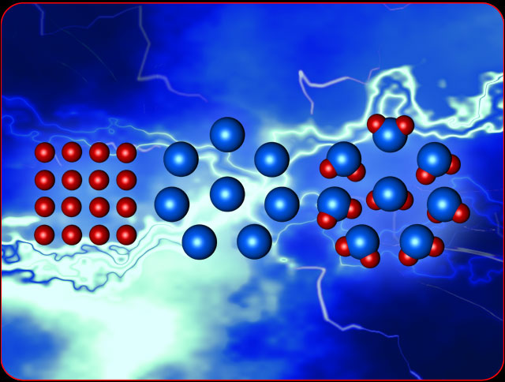
Dalton’s Atomic Theory

Slide 12
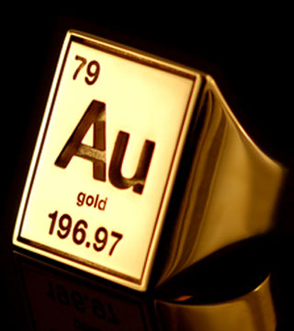
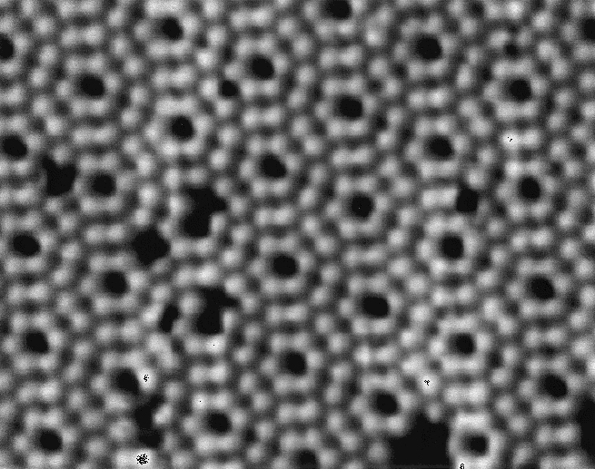

ATOMIC THEORY by DALTON
1. All matter is composed of extremely small particles called atoms.

Slide 13
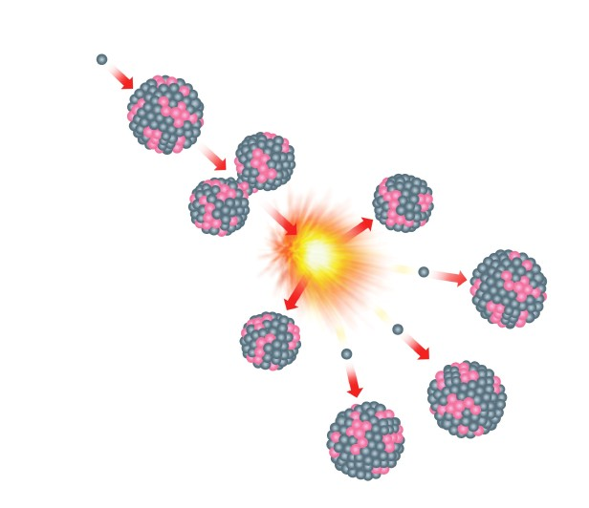
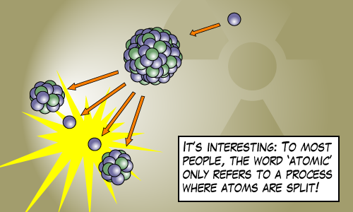
ATOMIC THEORY by DALTON
2. Atoms are indivisible (cannot be divided into smaller
particles) AND

Slide 14
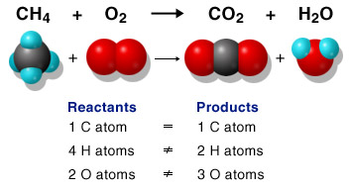
ATOMIC THEORY by DALTON
2. Atoms are indivisible (cannot be divided into smaller particles) AND atoms can neither be created nor destroyed in chemical reactions.

Slide 15
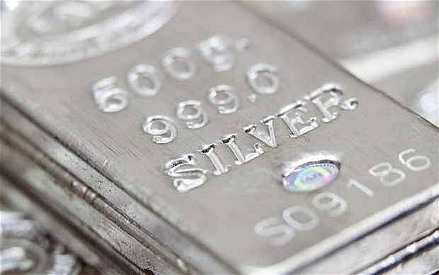

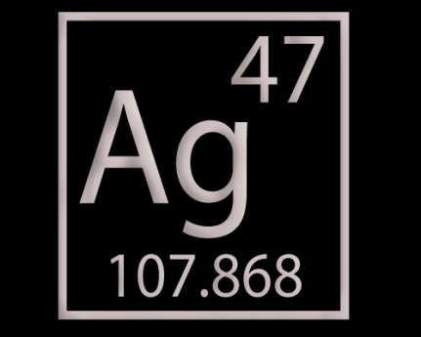
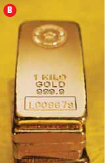
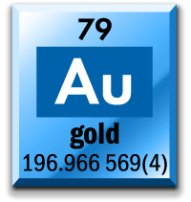
ATOMIC THEORY by DALTON
3. All atoms of a given element are identical in mass and size, AND

Slide 16
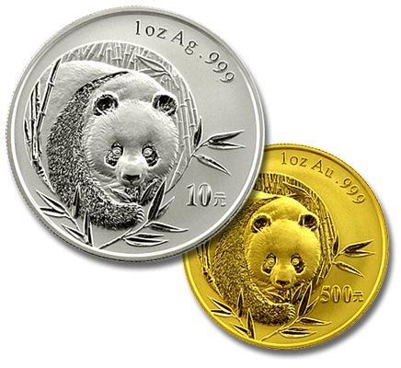
ATOMIC THEORY by DALTON
3. All atoms of a given element are identical in mass and size, AND
the atoms of one element (e.g. GOLD) are different from the atoms of all other elements (SILVER)

Slide 17
ATOMIC THEORY by DALTON
4. Compounds are formed when 2 or more atoms combine together

Slide 18
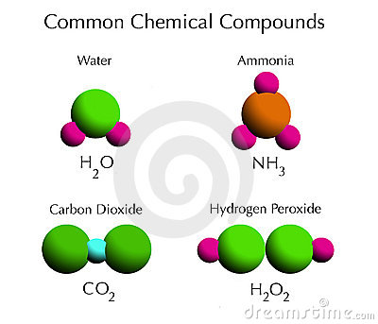
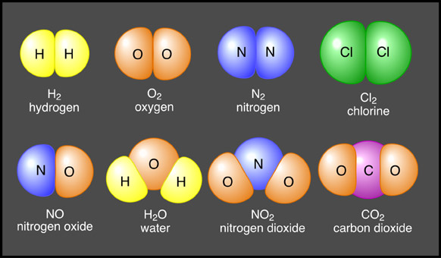
ATOMIC THEORY by DALTON
A given compound always has the same relative number and kind of atoms/elements

Slide 19
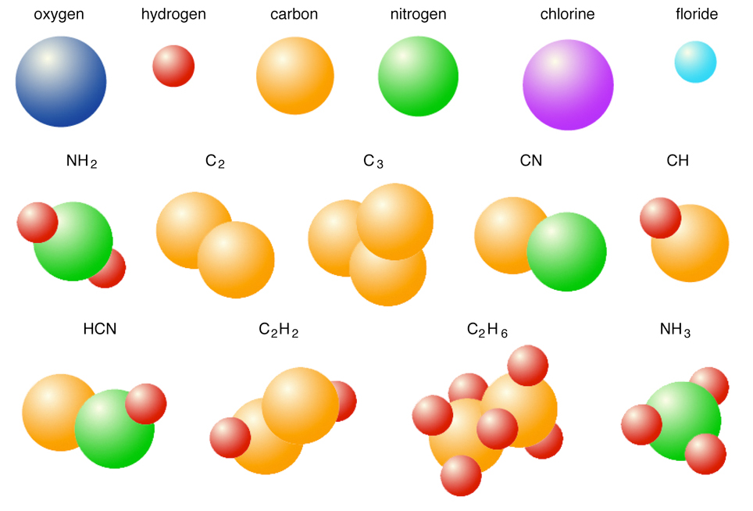
ATOMIC THEORY by DALTON
5. Atoms combine with each other in small whole numbers ratios

Slide 20
Dalton’s Atomic Theory
Which of the Proposition
of the Dalton’s Theory are true?

Slide 21
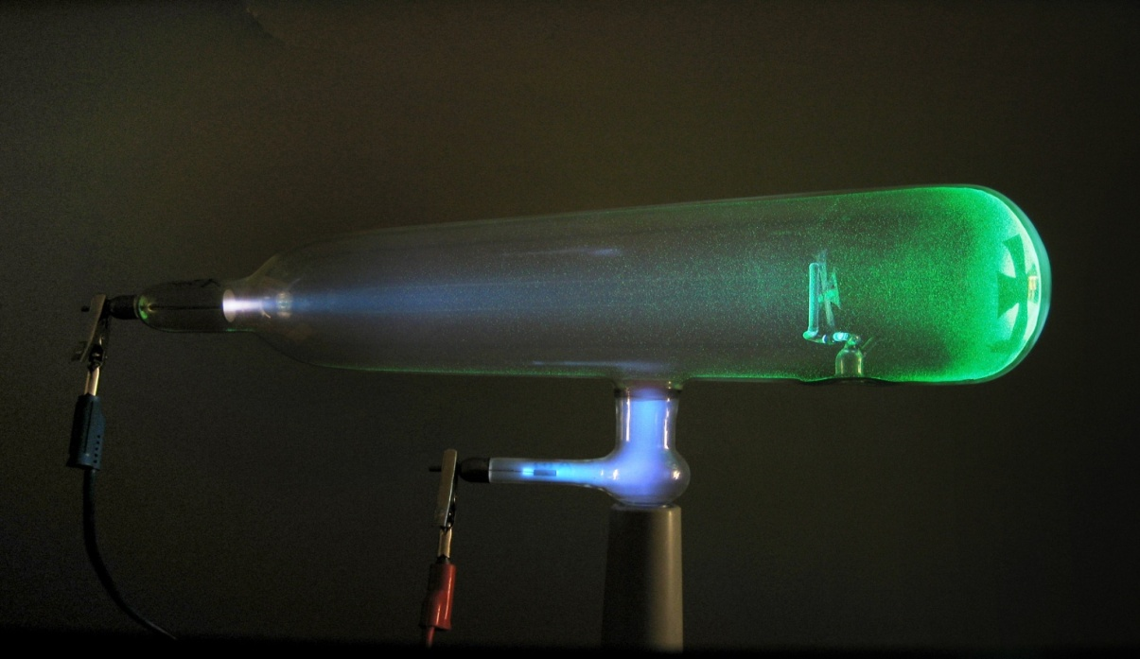
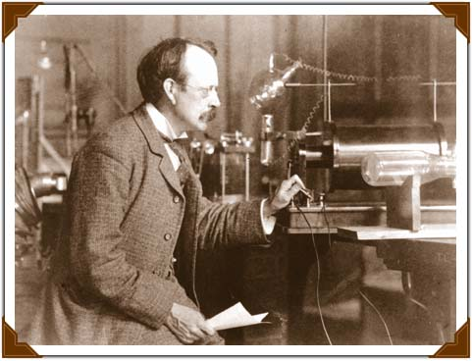
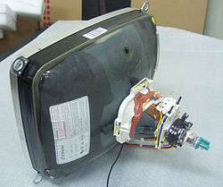
J.J. Thompson
He studied electric currents in gas discharged tubes (Cathode Ray tubes)

Slide 22
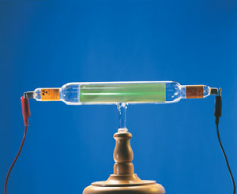
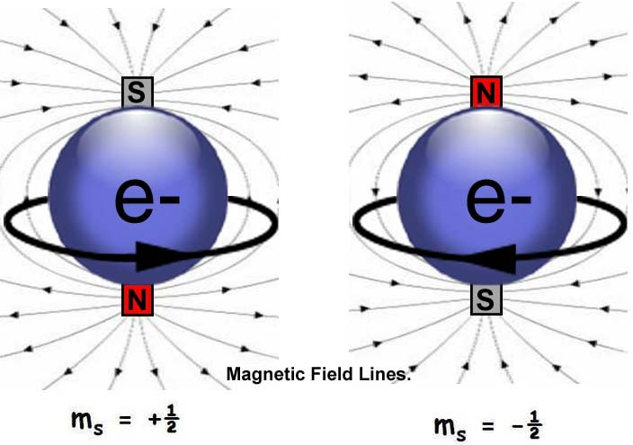
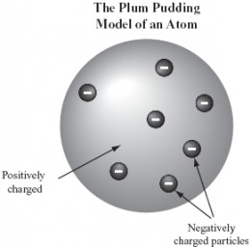
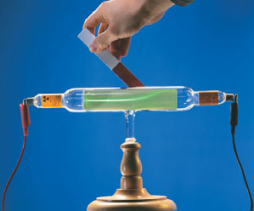
THE ELECTRON
J.J. Thomson discovered the existence of the first subatomic particle – the electron
But since the atoms were known to be neutral, he suggested that atom is made up of a cloud of positive charge with the negative electrons embedded randomly in it

Slide 23
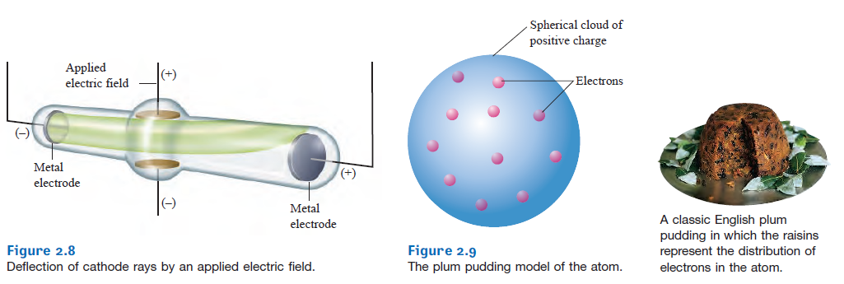
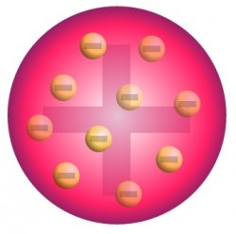
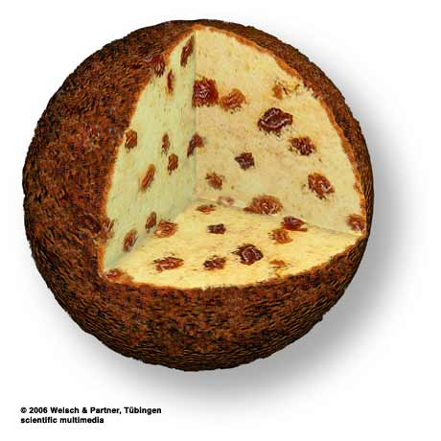
THE PLUM PUDDING MODEL OF THE ATOM
He called his model of the atom:

Slide 24
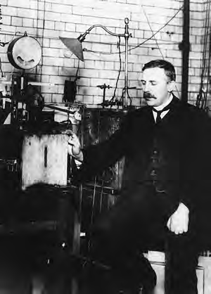
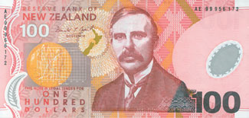

Ernest Rutherford
Ernest Rutherford tested PLUM PUDDING MODEL OF THE ATOM

Slide 25
The Gold Foil Experiment

Slide 26

He expected this:
Based on the Plum Pudding Model

Slide 27
He got this:
He found that some particles were deflected in directions not originally predicted.

Slide 28

This didn’t agree with the Plum Pudding Model!
He suggested that inside of the atom, there is a very dense center of a positive charge – a NUCLEUS
It was the nucleus that deflected the stream of alpha particles

Slide 29


The Nuclear Atom (nucleus)
He proposed a different model for the atom:
Most of the volume of an atom is empty space in which negatively charged electrons move around the dense, positively charged nucleus.

Slide 30



Niels Bohr
He studied gaseous samples of atoms, which were made to glow by passing an electric current through them.

Slide 31


Based on his observations, Bohr proposed that
electrons surround the nucleus ONLY in specific “energy levels” or “shells.”
Each “energy levels” or “shells” have certain amount of energy!

Slide 32


Think of these electron shells as stairs
The electrons can only move from shell to shell (stair to stairs)

Slide 33
Think of these electron shells as stairs
The electrons can only move from shell to shell (stair to stairs)

Slide 34
Think of these electron shells as stairs
The electrons can only move from shell to shell (stair to stairs)

Slide 35
Think of these electron shells as stairs
The electrons can only move from shell to shell (stair to stairs)

Slide 36
Think of these electron shells as stairs
The electrons can only move from shell to shell (stair to stairs) = you can never find them between the shells (between the stairs)

Slide 37
Think of these electron shells as stairs
The electron in the closest shell to the nucleus have the LOWEST energy =
It is on the lowest step of the stairwell

Slide 38
Think of these electron shells as stairs
The electrons in the furtermost shell to the nucleus have the HIGHEST energy =
It is on the highest step of the stairwell

Slide 39
So the electrons closer to the nucleus have less energy than the electrons further from the nucleus

Slide 40




Slide 41
Which electron has higher energy?
If the blue electron wanted to reach the shell in which the red electron is, would the light be given off or not?
YES because the blue electron
falls into a lower energy level

Slide 42
Which electron has higher energy?
If the blue electron wanted to reach the shell in which the red electron is, would the light be given off or not?
NO because the blue electron
jumps to a higher energy level

Slide 43
Which electron has higher energy?
If the blue electron wanted to reach the shell in which the red electron is, would the light be given off or not?
They are in the same electron shell
=
energy level

Slide 44
Make the Models of an Atom using Play-Doh
Build all the three models of the atom that we talked about
Label the appropriate parts of each model using toothpicks/stir sticks
Have fun!

Slide 45


Inside the Atom
An atom is the smallest particle of a particular element
It is made up of three particles:

Slide 46

THE MODERN VIEW OF THE ATOM
It is composed of electrons, protons and neutrons
ELECTRONS:
Orbit (move around) the nucleus
Charge of -1 (negative)
Symbol is e
They can be shared or transferred between the atoms

Slide 47
THE MODERN VIEW OF THE ATOM
It is composed of electrons, protons and neutrons
Protons:
In the nucleus
Charge of +1 (positive)
Symbol is p
They CAN’T be shared or transferred between the atoms = they are locked in the nucleus

Slide 48
THE MODERN VIEW OF THE ATOM
It is composed of electrons, protons and neutrons
Neutrons:
In the nucleus
Charge of 0 (no charge)
Symbol is n
They CAN’T be shared or transferred between the atoms = they are locked in the nucleus

Slide 49



THE MODERN VIEW OF THE ATOM
The relative size of the nucleus and atom!

Slide 50

Inside the Atom

Slide 51
NOW
Worksheets
1. Parts of the Atom Concept map
2. Subatomic Particles

Slide 52
NOW
Computer lab
Atomic Theory

Slide 53
SAS Curriculum Pathway
Google: SAS Curriculum Pathways
Log in name: row57itself
Select: Science – Atomic Theory

Slide 54
HOMEWORK
WORKBOOK:
Page: 16 – 17
Problems: all

Slide 55
Chapter 1 TEST preparation
WORKBOOK:
Check Your
Understanding
Page: 18 – 19
Problems: all

