Slide 1
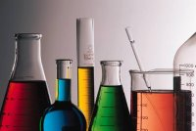
Lab Equipment

Slide 2
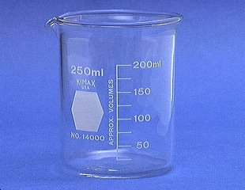
Beaker
Holding liquids
• may be graduated (sometimes in two directions)
• has a white spot for labeling
• various sizes including 50, 150, 250, 450, 650, and 1000 mL

Slide 3
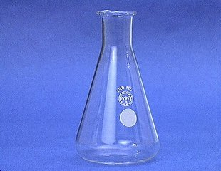
Erlenmeyer Flask
Holding liquids
• shape avoids loss due to splashing
• used for titration
• common sizes include 125, 250, and
500 mL

Slide 4
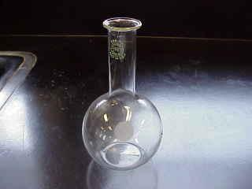
Florence Flask
Heating liquids
• shape allows even distribution of heat while boiling
• never graduated
•common sizes include 250 and 500 mL

Slide 5
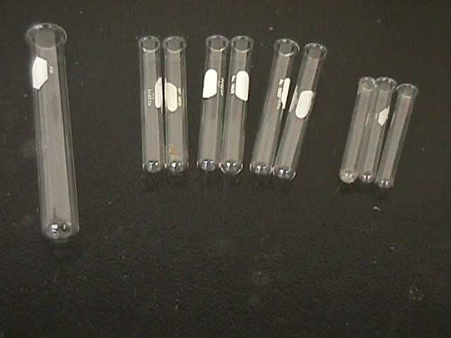
Test Tubes
Holding liquids or solids
• can be heated directly or in a water bath
• may be used to mix small quantities of
chemicals
• large variety of sizes

Slide 6
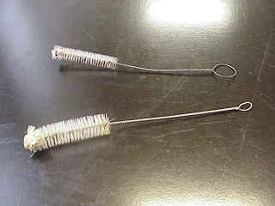
Test Tube Brushes
Test tube brushes are used to clean test tubes and graduated cylinders.
Forcing a large brush into a small test tube will often break the tube.

Slide 7
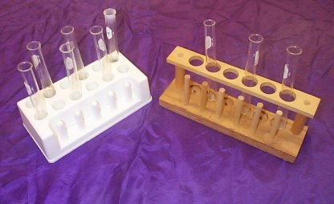
Test Tube Racks
Test tube racks are for holding and organizing test tubes on the laboratory counter. Plastic racks may melt in contact with very hot test tubes.

Slide 8
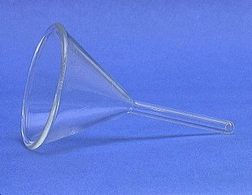
Funnel
Funneling liquids
• useful for pouring liquids through small
openings
• can contain filter paper for separating
solids from suspensions by filtration

Slide 9
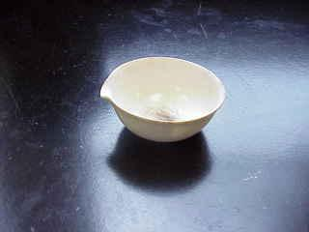
Evaporating Dish
Evaporating solvent
• evaporation from a solution
• can be used to dry a damp product
• ceramic material allows direct heat to high
temperatures

Slide 10
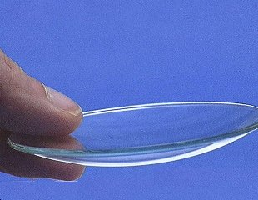
Watch Glass
Holding or covering
• useful for holding a sample of chemical
• may cover a beaker or flask to prevent
evaporation
• holds chemicals while drying

Slide 11
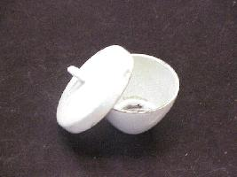
Crucible
Heating to high temperatures
• heating covered or partially covered samples
• ceramic material may be directly heated
until red hot

Slide 12
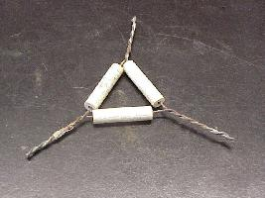
Pipe Stem Triangle
Providing a base to hold a crucible
• sits atop a wrought-iron ring
• stems are made of ceramic material

Slide 13
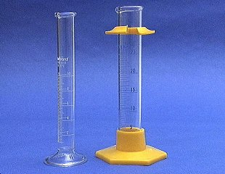
Graduated Cylinder
Measuring volumes of liquids
• sizes vary
• commonly 10, 25, 50, 100, and 250 mL

Slide 14
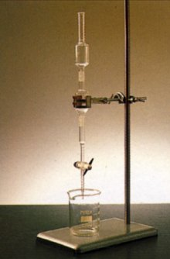
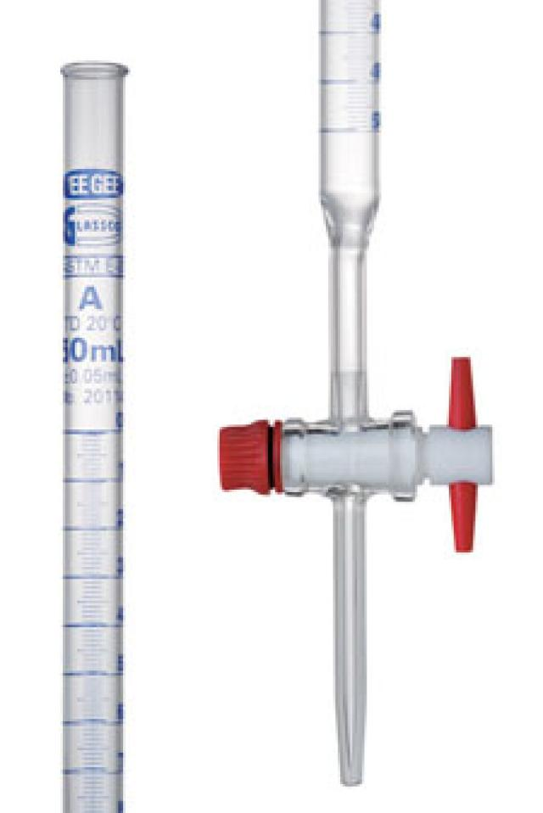
Burette
Measuring volumes of liquids
• delivers various volumes through a valve
called a stop cock
• more precise (exact) than the graduated
cylinder

Slide 15
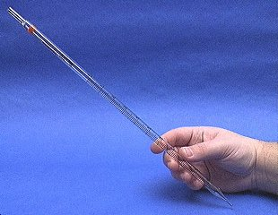
Mohr Pipet
A Mohr pipet measures and delivers exact volumes of liquids.

Slide 16
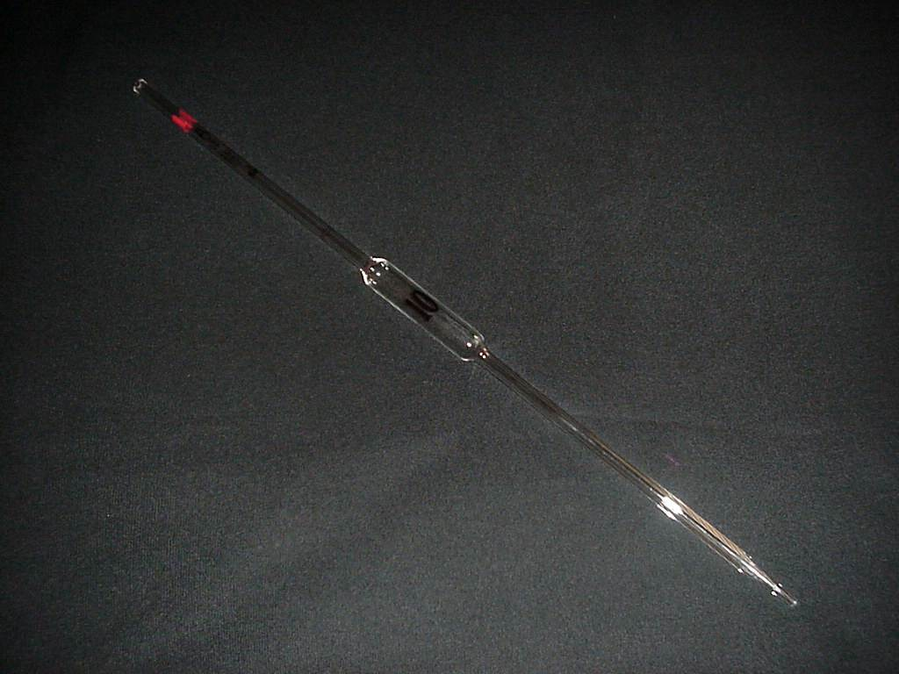
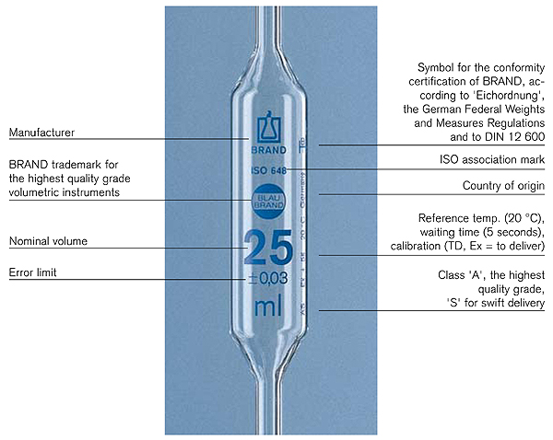
Volumetric Pipette
Measuring volumes of liquids
• may be graduated
• may be volumetric (designed to deliver one
specific volume)
• liquid is drawn

Slide 17
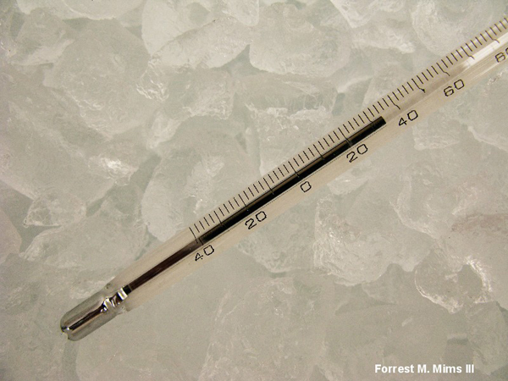
Thermometer
Measuring temperatures
• bulb should be submerged in the fluid being measured
• temperature ranges vary
• most contain dyed alcohol
• more precise thermometers contain mercury
• commonly measure temperature in degrees Celsius

Slide 18
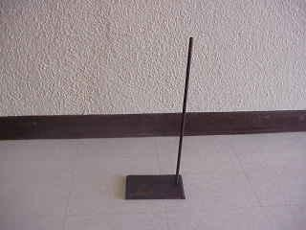
Ring stands and their Components
Ring stands are a safe and convenient way to perform reactions that require heating using a Bunsen burner.

Slide 19
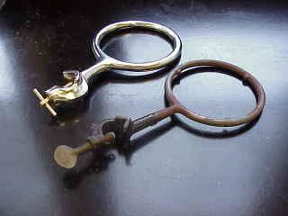
Ring stands and their Components Iron Rings
Iron rings connect to a ring stand and provide a stable, elevated platform for the reaction.

Slide 20
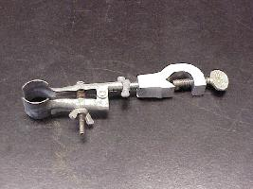
Ring stands and their Components Utility Clamps
Utility clamps are used to secure test tubes, distillation columns, and burets to the ring stand.

Slide 21
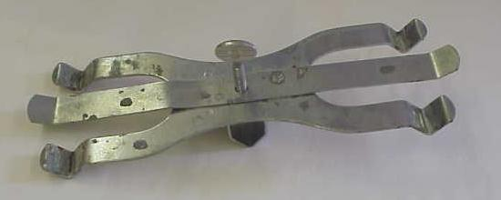
Ringstands and their Components Double Burret Clamps
Double Buret clamps are used to burets – long graduated tubes used in titration.

Slide 22
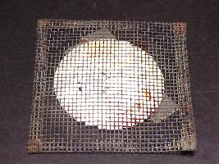
Ring stands and their Components Wire Gauze
Wire gauze sits on the iron ring to provide a place to stand a beaker.
On older wire gauze, the white material is asbestos!

Slide 23
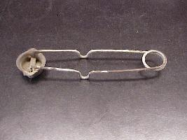
Strikers
Strikers are used to light Bunsen burners.
The flints on strikers are expensive. Do not operate the striker repeatedly just to see the sparks!

Slide 24
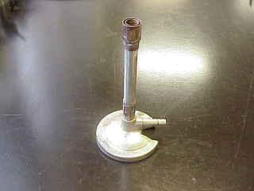
Bunsen Burner
Bunsen burners are used for the heating of nonvolatile liquids and solids.

Slide 25
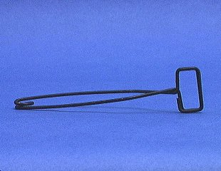
Test Tube Holder
A test tube holder is useful for holding a test tube which is too hot to handle.

Slide 26
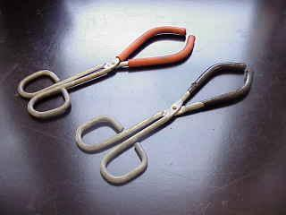
Beaker Tongs
Beaker tongs are used to move beakers containing hot liquids

Slide 27
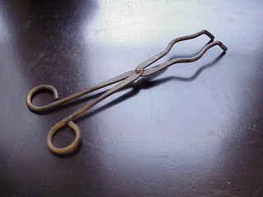
Crucible Tongs
For handling hot crucibles; also used to pick up other hot objects. NOT to be used for picking up beakers!

Slide 28
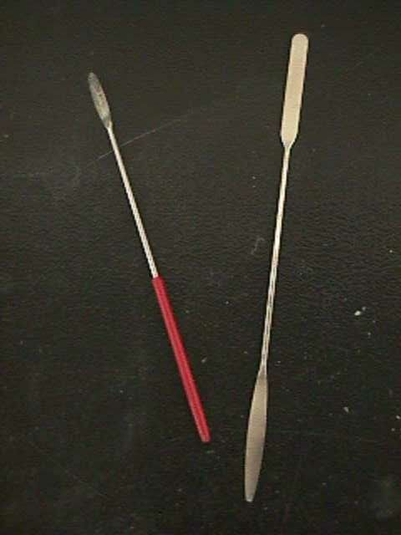
Spatulas
Spatulas are used to dispense solid chemicals from their containers.
Chemicals should never be transferred with your bare hands!!!!!

Slide 29
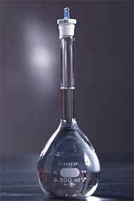
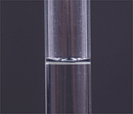
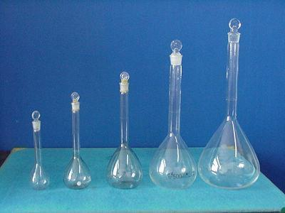
Volumetric Flask
A volumetric flask is used to make up a solution of fixed volume very accurately

Slide 30
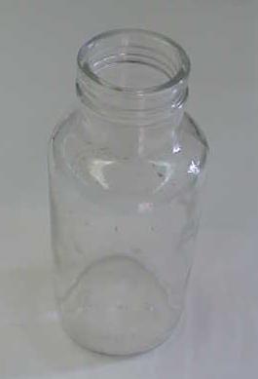
Gas Collecting Bottle
We use gas collecting bottles when large volumes of gases are produced, and must be collected by the displacement of water.

Slide 31
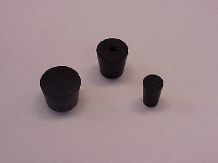
Rubber Stoppers
Rubber stoppers are used to close containers to avoid spillage or contamination.
Containers should never be heated when there is a stopper in place.

Slide 32
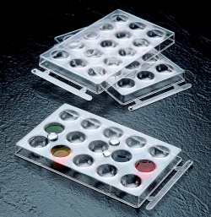
Spot Plates
Spot plates are used when we want to perform many small scale reactions at one time. We will use these many times during the year.

Slide 33
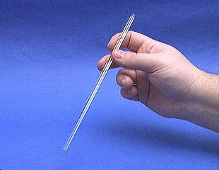
Glass Stir Rod
A glass rod is used to manually stir solutions. It can also be used to transfer a single drop of a solution.

Slide 34
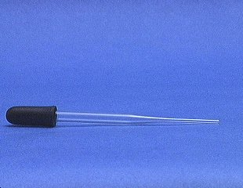
Medicine Dropper
A medicine dropper is used to transfer a small volume of liquid (less than one mL).
On top of each medicine dropper is a “rubber bulb”

Slide 35
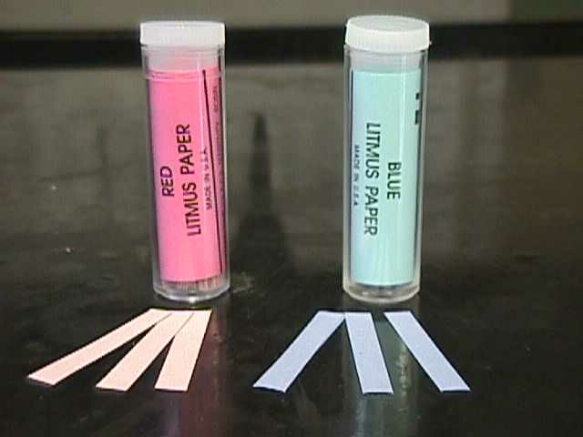
Litmus Paper
Red litmus paper is used to identify bases.
Blue litmus paper is used to identify acids.

Slide 36
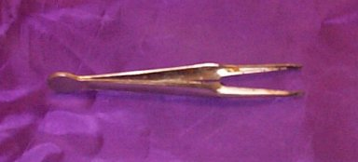
Forceps/Tweezers
Forceps (or tweezers) are used to pick up small objects.

Slide 37
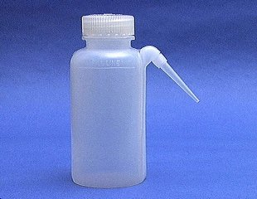
Wash Bottle
A wash bottle has a spout that delivers a wash solution to a specific area. Distilled water is the only liquid that should be used in a wash bottle.

Slide 38
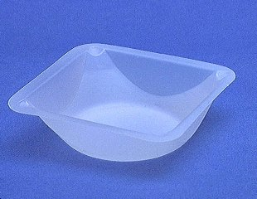
Weighing Boat
Weighing boats are used to weigh solids that will be transferred to another vessel.

Slide 39
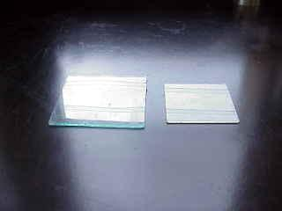
Glass Plates
Glass plates provide a surface for semi-micro scale experiments, such as drop reactions and testing of acids and bases.

Slide 40
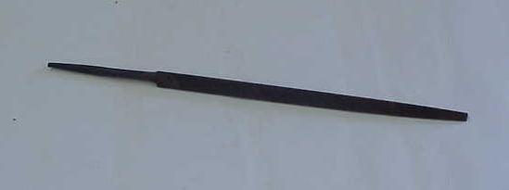
Triangular File
Triangular files are used primarily to cut glass rod, a skill that your instructor will share with you when it becomes useful.

Slide 41
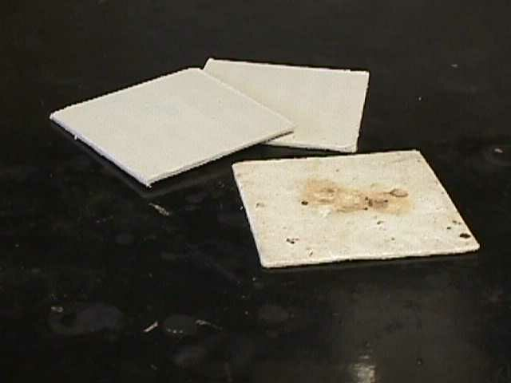
Pressed Fiber Pad
A 4” x 4” square of ceramic fiber, it provides a surface for hot beakers so that the beaker does not come in contact with a cold countertop and shatter.

Slide 42
HOMEWORK
1.1 Review Questions
(4, 5, 15)

