Slide 1
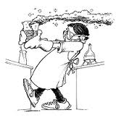
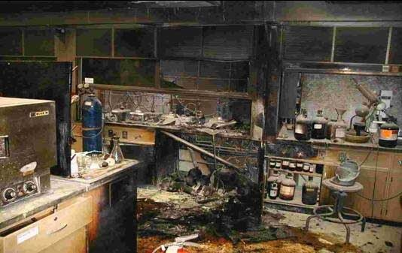
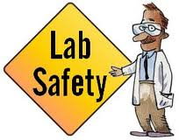
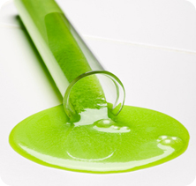
Laboratory safety

Slide 2
Page 6 - 13

Slide 3
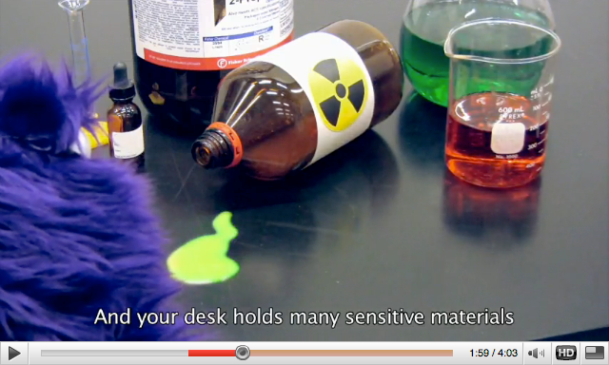
- We need laboratory experiments to learn about chemistry
But we need correct procedures to minimize hazards in laboratory
REMEMBER we are dealing with dangerous chemicals
All chemicals and instruments may be DANGEROUS to you or to your classmates

Slide 4
YOU ALWAYS MUST:
Follow teacher’s instructions (no running, fighting, backpacks on the floor/chair, )
Wear a protective equipment (lab. coat, shoes, and goggles, tie your hair into pony tail)
Know the location of the protective equipment in your classroom (fire blanket, eye washing station, emergency shower, fire extinguisher)
Have your working area free of spilled chemicals and waste.
NEVER work with broken glassware! Throw it into designated container.
No eating or Drinking in Laboratory!

Slide 5
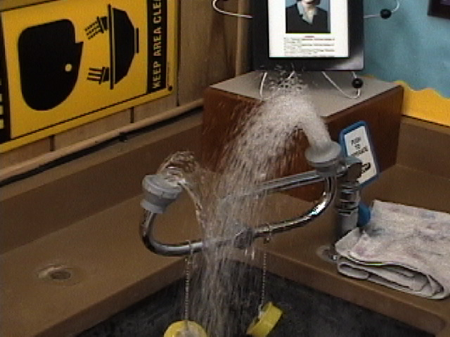
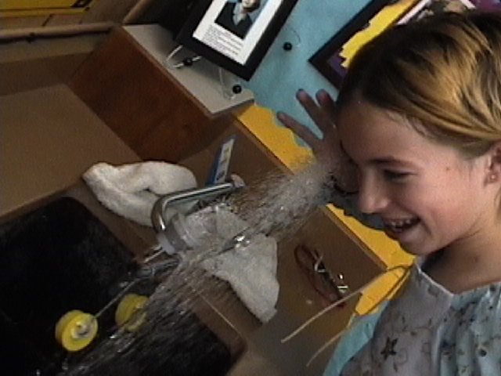
PROTECTIVE EQUIPMENT in LAB
Eye Rinsing Station

Slide 6
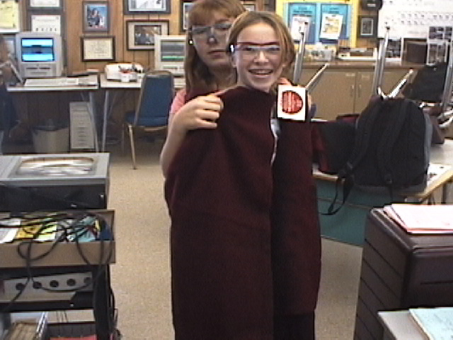
PROTECTIVE EQUIPMENT in LAB
Fire Blanket

Slide 7
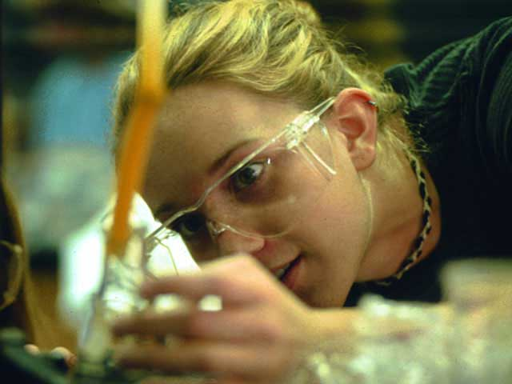
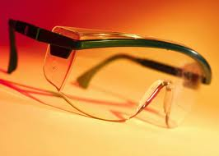
PROTECTIVE EQUIPMENT in LAB
Goggles

Slide 8
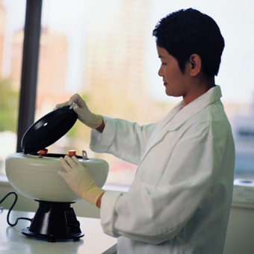
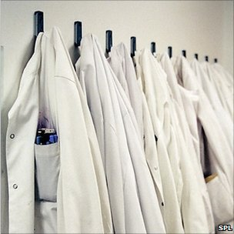
PROTECTIVE EQUIPMENT in LAB
Laboratory Coat

Slide 9
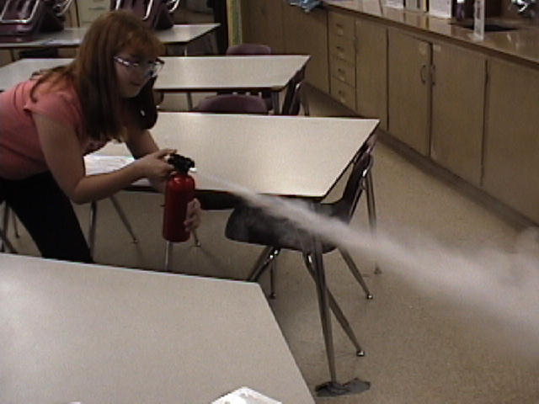
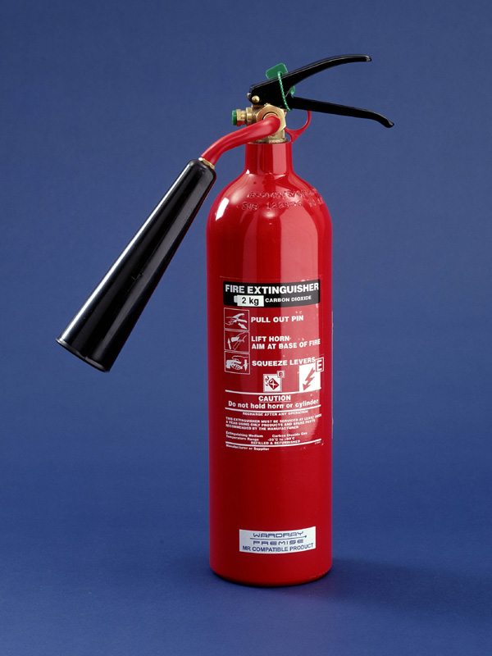
PROTECTIVE EQUIPMENT in LAB
Fire Extinguisher

Slide 10
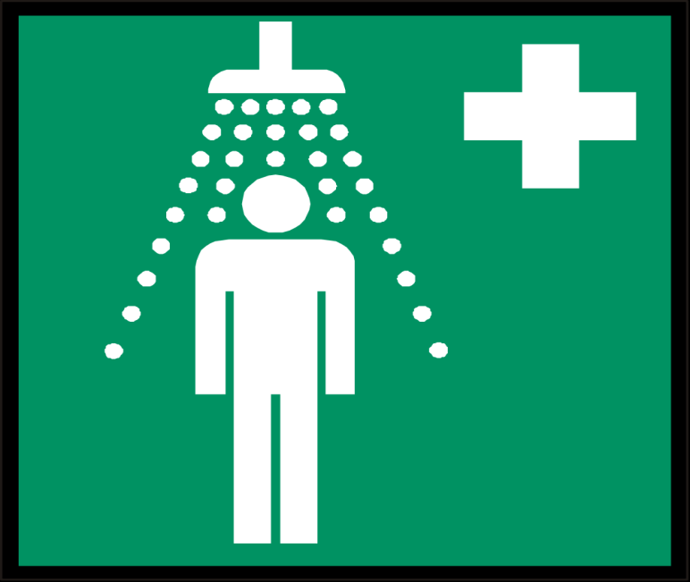
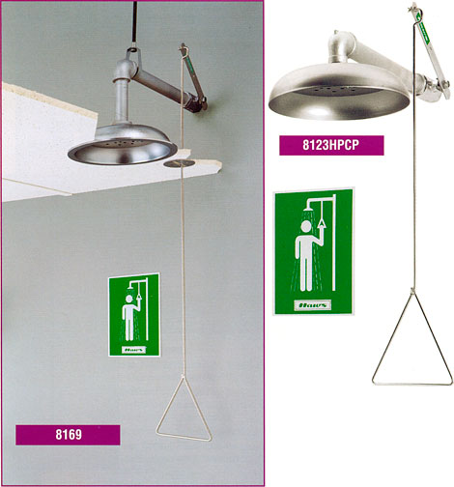
PROTECTIVE EQUIPMENT in LAB
Emergency Shower

Slide 11
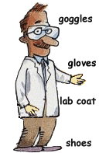
Laboratory Safety Quiz
DANGEROUS or NOT??

Slide 12
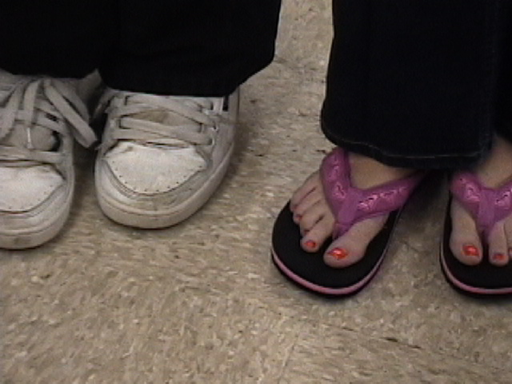
YES

Slide 13
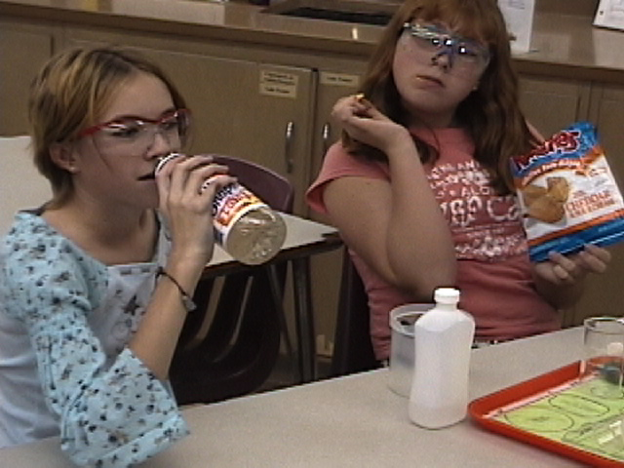
YES

Slide 14
Laboratory safety
YES
picture

Slide 15
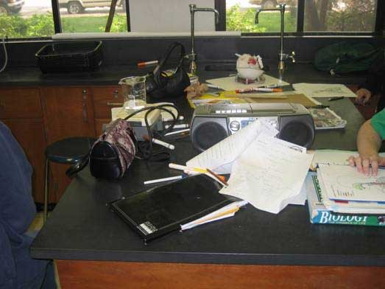
YES

Slide 16
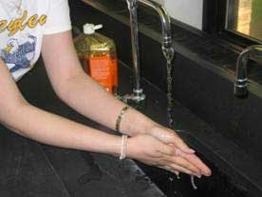
NO

Slide 17
YES and NO

Slide 18
YES

Slide 19
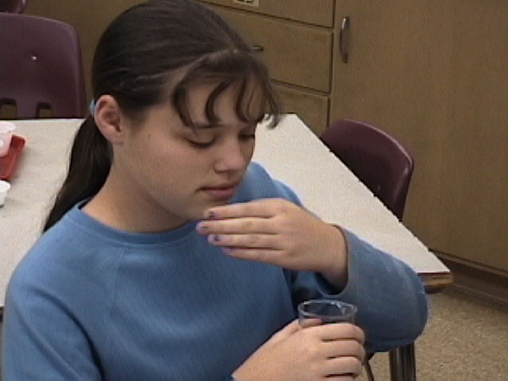
NO

Slide 20
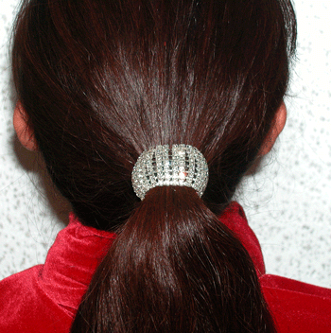
NO

Slide 21
WHAT YOU SHOULD NOT DO IN A LABORATORY?? CAN YOU SPOT 16 THINGS?
The pair who finds the most things wins a PRIZE!!!

Slide 24
CAN YOU SEE 16 THINGS YOU SHOULD NOT DO IN A LABORATORY??
Talking on a cell phone
Chemicals spilled on the ground
A backpack on a chair
No goggles
No lab.coats
Teacher is just sitting
Splashing
Running
Playing with fire extinguisher

Slide 25
CAN YOU SEE 15 THINGS YOU SHOULD NOT DO IN A LABORATORY??
Kissing
Fire on a table
Spilled chemicals on a table
Smelling
Listening to Music
Drinking
Pouring chemicals down the sink

Slide 26
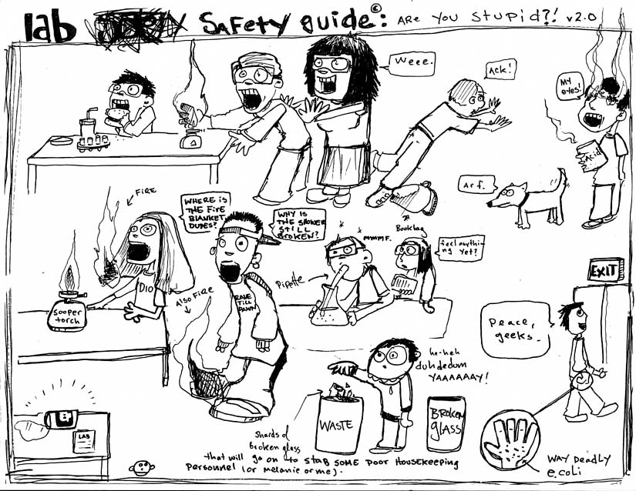
Laboratory safety
picture

Slide 27
Cover the beaker with a ceramic pad
Put it in ice, cold water
Notify Mr. V and labmates working next to you
Use baking soda, wipe out with paper towel, clean the glass pieces, dispose into a glass container
Heat it on a hot plate
Be careful when heating glass
Keep test tubes in a test tube holder or a beaker,

Slide 28
MSDS
Material Safety Data Sheet
Data Sheets which describe risks, precautions and first aid etc..

Slide 29
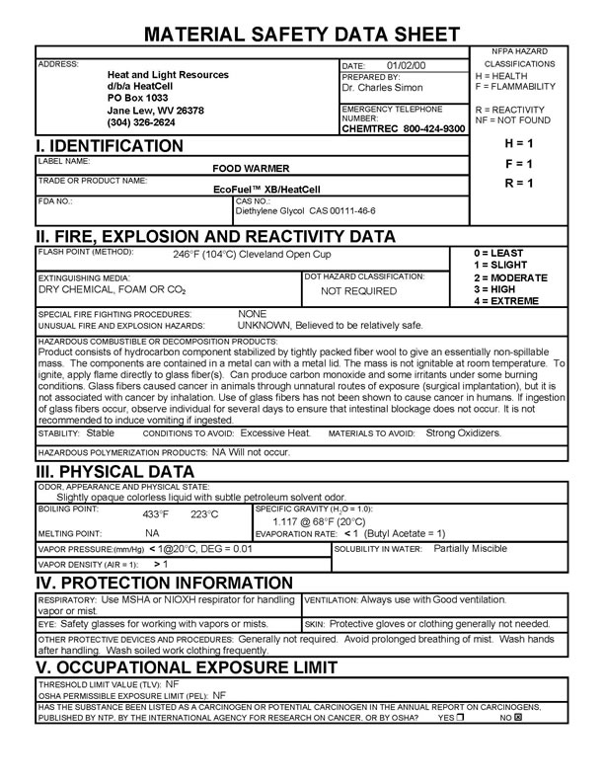

Slide 30
MSDS
Material Safety Data Sheet
Videos
Scavenger Hunt

Slide 31
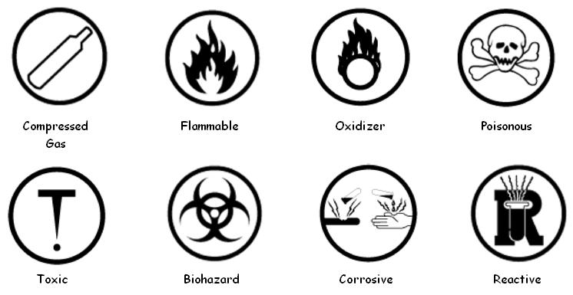
WHMIS
The Workplace Hazardous Materials Information System
8 labels/pictures which you can find on a bottle of any chemical
Gives information about hazards of the specific chemical

Slide 32
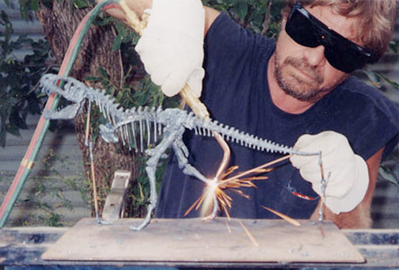
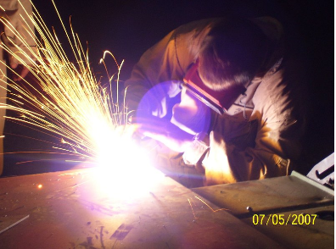
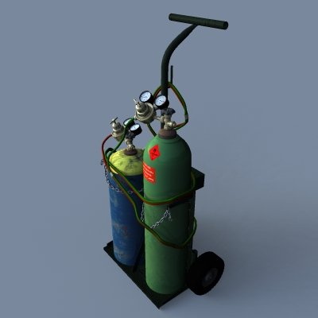
Class A: Compressed gas
Example: gas cylinders for oxyacetylene welding

Slide 33
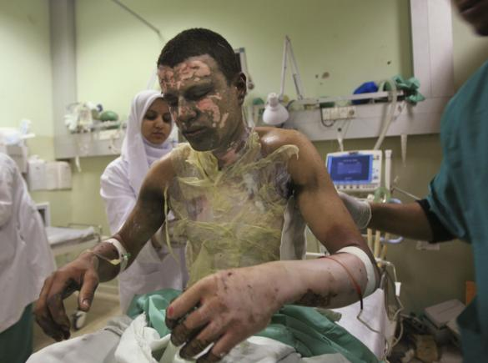
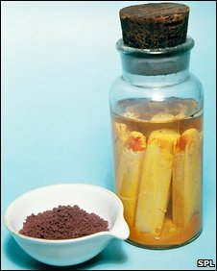
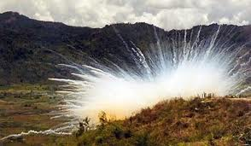
Class B: Flammable and combustible material
Example: white phosphorus, acetone and butane

Slide 34
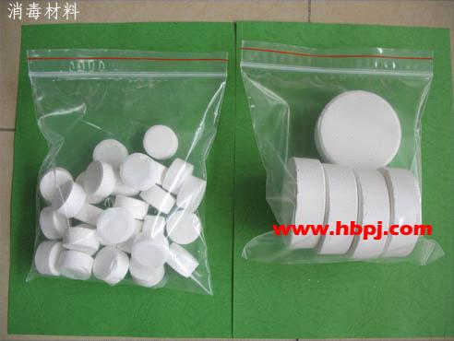
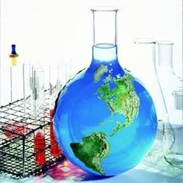
Class C: Oxidizing material
Example: sodium hypochlorite (bleach and cleaning), perchloric acid, inorganic peroxides

Slide 35
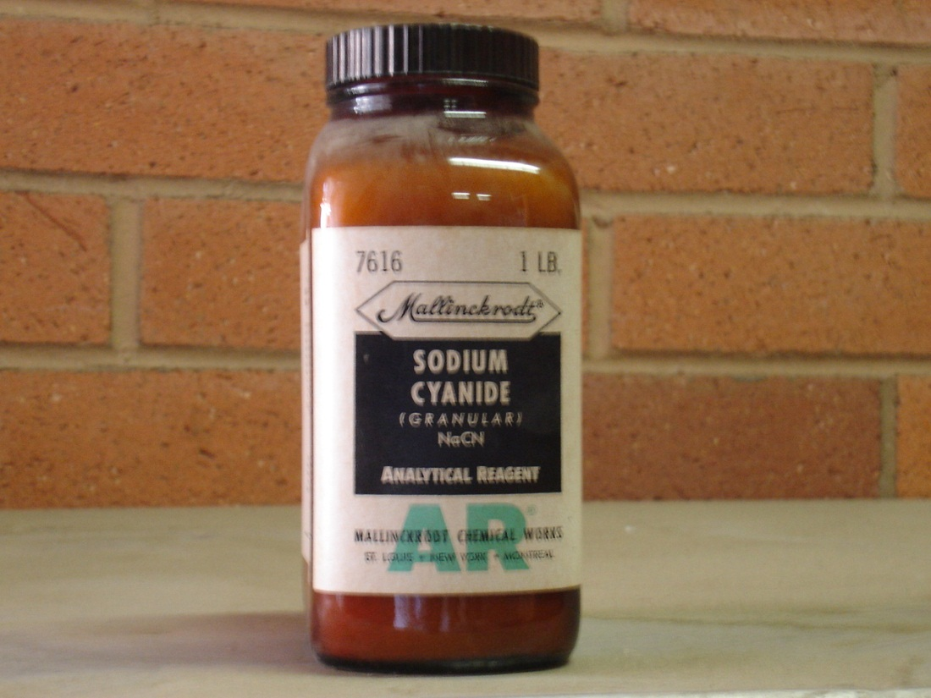
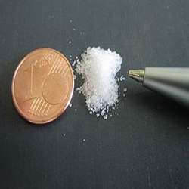
Class D: 1. Materials causing immediate and serious and toxic effects
Example: sodium cyanide, hydrogen sulphide

Slide 36
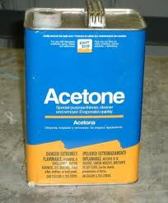
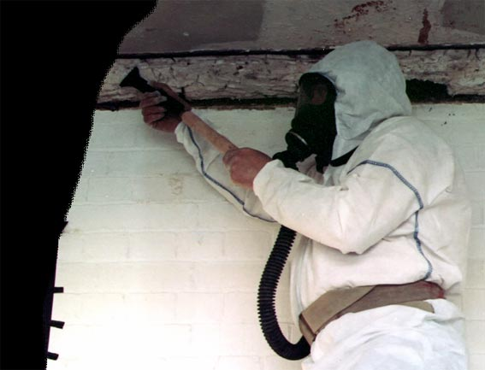
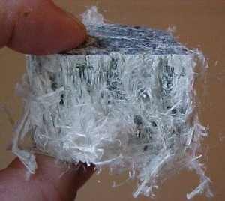
Class D: 2. Materials causing other toxic effects
Example: acetone (irritant), asbestos (carcinogen), toluene diisocyanate (senzitizer).

Slide 37
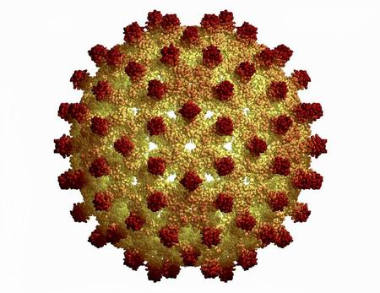
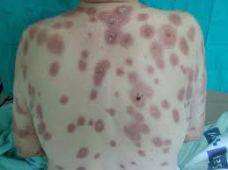
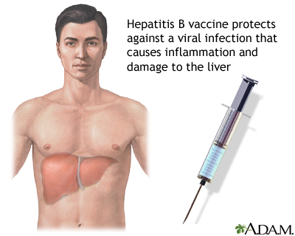
Class D: 3. Biohazardous infectious materials
Example: cultures or diagnostic specimens containing salmonella bacteria or the hepatitis B virus.

Slide 38
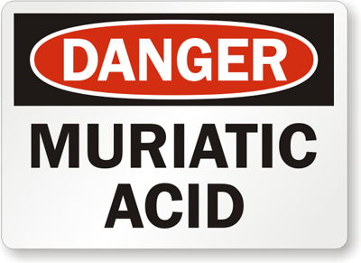
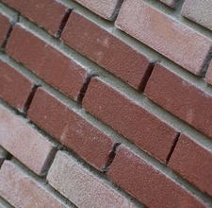
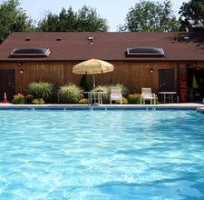
Class E: Corrosive materials
Example: muriatic acid, lye

Slide 39
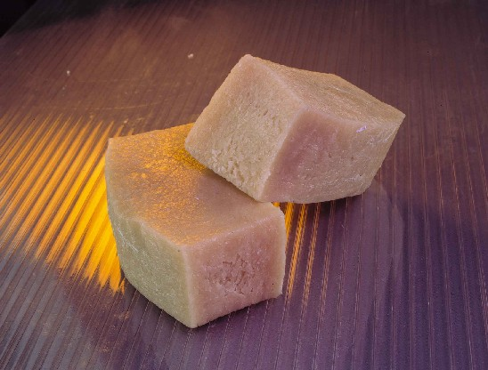
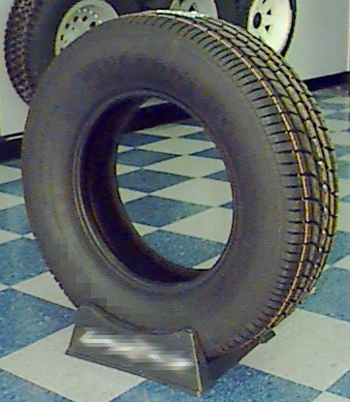
Class F: Dangerously reactive material
Example: butadiene and some cyanides

Slide 40
HOMEWORK
Read 1.1
1.1 Activity: Safety in the Laboratory (page 13)
1.1 Review Questions
(all except 4, 5, 15)

Slide 41
1.1 QUIZ
Laboratory safety and Labelling – Based on reading 1.1 and 1.1 Review Questions
15 minutes
Thursday, Feb 6

