Slide 1
Chemistry11
TODAY:
The Imperial vs. Metric System

Slide 2
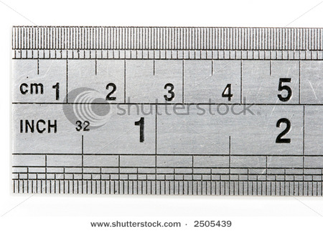
1.4 Analysis of Units and Conversions in Chemistry
Pages: 45 - 58

Slide 3
There are two types of measurements we use
Pages: 10 - 20

Slide 4

The units on the following pictures are the IMPERIAL units
Copyright © 2010 Ryan P. Murphy

Slide 5
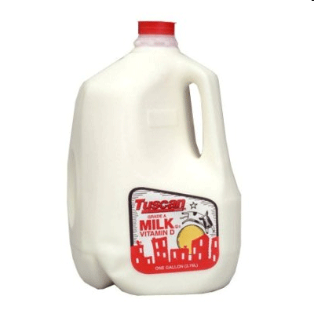
What unit of measurement is this?
Copyright © 2010 Ryan P. Murphy

Slide 6
Gallon

Slide 7
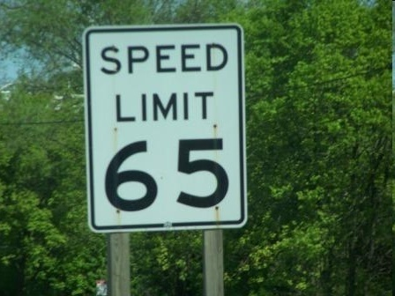
What unit of measurement is this?
Copyright © 2010 Ryan P. Murphy

Slide 8
Mph (Miles per hour)
Gallon

Slide 9
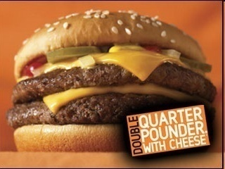
What unit of measurement is this?
Copyright © 2010 Ryan P. Murphy
Copyright © 2010 Ryan P. Murphy

Slide 10
Mph (Miles per hour)
Gallon
Pounds

Slide 11
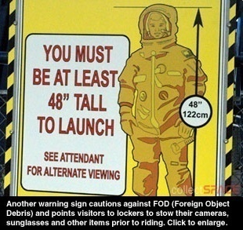
What unit of measurement is this?
Copyright © 2010 Ryan P. Murphy

Slide 12
Mph (Miles per hour)
Gallon
Pounds
Inches

Slide 13
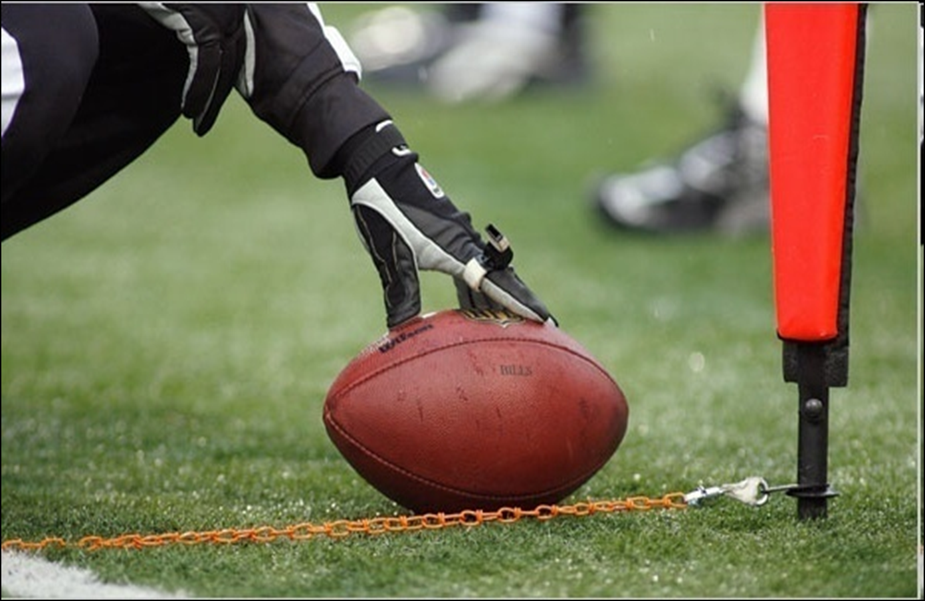
What unit of measurement is this?
Copyright © 2010 Ryan P. Murphy

Slide 14

Mph (Miles per hour)
Gallon
Pounds
Inches
Yards

Slide 15
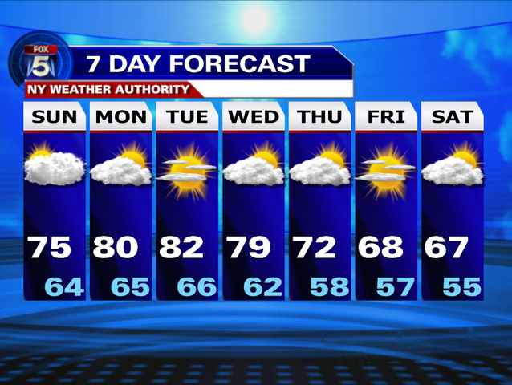
What unit of measurement is this?
Copyright © 2010 Ryan P. Murphy

Slide 16
Mph (Miles per hour)
Gallon
Pounds
Inches
Yards
Fahrenheit

Slide 17
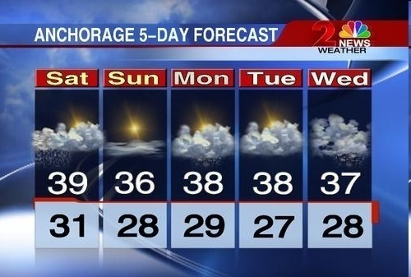
More than likely, we said the following things
  Gallon of milk.
  65 miles per hour
  Quarter Pounder
  48 inches
  Temperature in Fahrenheit
Copyright © 2010 Ryan P. Murphy

Slide 18
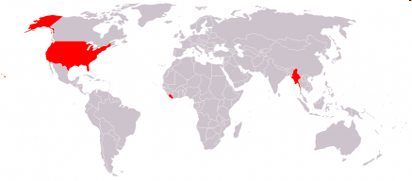
The countries colored in red are the ones that use the Imperial System
Canada (sometimes)
The United States
Burma
Liberia
Copyright © 2010 Ryan P. Murphy

Slide 19
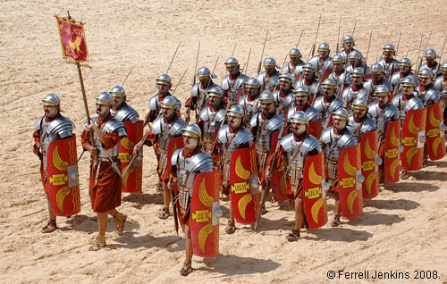

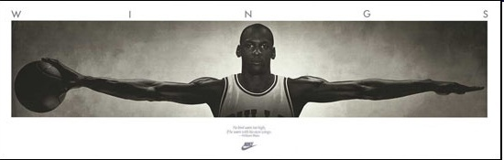
The Imperial System Example
LENGTH

Slide 20
The IMPERIAL system is based on the following.
  An inch represents the width of a thumb

Slide 21
Yard
the distance from the tip of the nose to the end of the middle finger of the outstretched hand

Slide 22
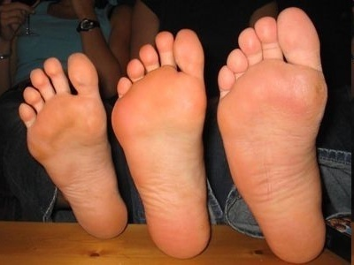
Foot (12 inches)
originally the length of a human foot, although it has evolved to be longer than most peoples feet.
Copyright © 2010 Ryan P. Murphy

Slide 23
Mile
A Roman unit, originally defined to be the length of 2000 steps of a Roman legion.

Slide 24
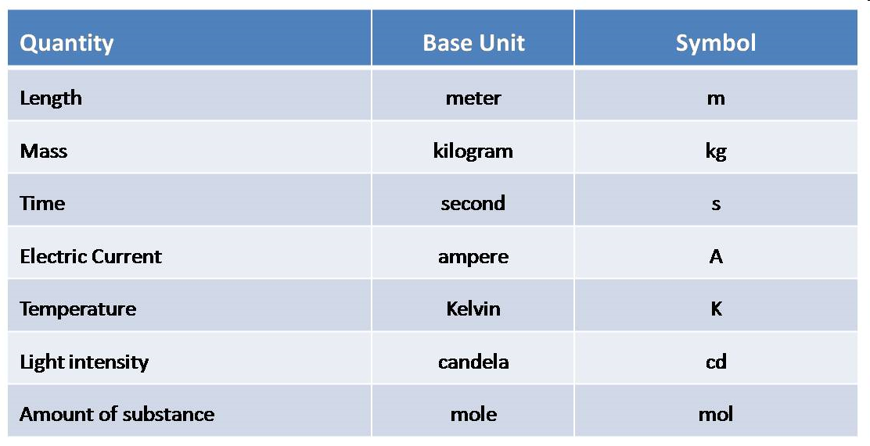
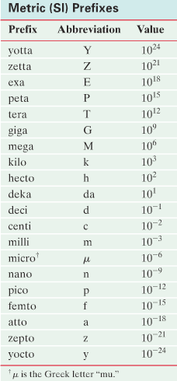
The Metric System and SI UNITS
Copyright © 2010 Ryan P. Murphy

Slide 25

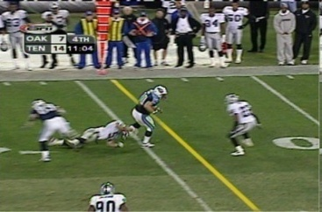
I will show you these 6 pictures showing you their metric values.
Mph (Miles per hour)
Gallon
Pounds
Inches
Yards
Fahrenheit

Slide 26
One gallon of milk = 3.78 liters of milk

Slide 27
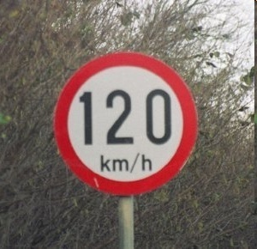
65 mph = 104 km/h
Copyright © 2010 Ryan P. Murphy
Copyright © 2010 Ryan P. Murphy

Slide 28
Double Quarter Pounder(0.5 pound) = 0.226 kg

Slide 29
48 inches tall = 1.22 meters tall
Copyright © 2010 Ryan P. Murphy
Copyright © 2010 Ryan P. Murphy

Slide 30

1 Yards = 0.914 meters
Copyright © 2010 Ryan P. Murphy

Slide 31
80 degrees Fahrenheit = 26.7 degrees Celsius
Copyright © 2010 Ryan P. Murphy

Slide 32
The International System (System Internationale ‘unites) of Units (SI) also known as THE METRIC SYSTEM.

Slide 33
It is used by scientists all over the world

Slide 34
DIFFICULTY OF THE IMPERIAL UNITS
One inch is usually divided into 8, 10 or 16 parts:
This particular ruler has 16 divisions

Slide 35
DIFFICULTY OF THE IMPERIAL UNITS
One inch is usually divided into 8, 10 or 16 parts:
So, the smallest division = 1/16th of an inch

Slide 36
What is the length of the pencil?
One inch is usually divided into 8, 10 or 16 parts:
So, the smallest division = 1/16th of an inch

Slide 37

What is the length of the pencil?
One inch is usually divided into 8, 10 or 16 parts:

Slide 38
The simplicity of the Metric System?
For example:
LENGTH: meter
MASS: gram
VOLUME: liter
Only one unit of measurement for each quantity
Copyright © 2010 Ryan P. Murphy

Slide 39
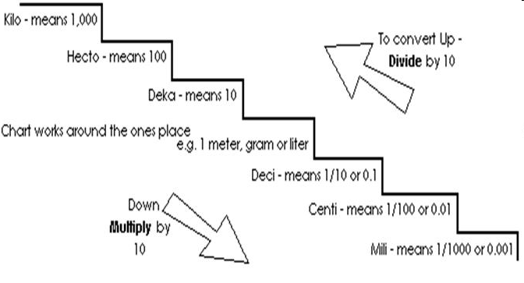
You can measure the very small and the very large with the same unit
meter
Copyright © 2010 Ryan P. Murphy

Slide 40

The measurements below are all the same.
“I am 1828.80 mm tall.”
“I am 182.80 cm tall.”
“I am 1.8280 meters tall.”
“I am .001828 km tall.”
Compare it with Imperial System
Copyright © 2010 Ryan P. Murphy

Slide 41
The simplicity of the Metric System?
SI
For example:
LENGTH: meter
MASS: gram
VOLUME: liter
Only one unit of measurement for each quantity
Imperial
For example:
LENGTH: mile, yard, foot/feet, inch…
MASS: grain (≈0.65g), drachm (1.77 g), pound (453 g)…
VOLUME: ounce (0.028 L), gill (0.142 L), gallon (4.55 L)…
Copyright © 2010 Ryan P. Murphy

Slide 42
Must know!
Copyright © 2010 Ryan P. Murphy

Slide 43
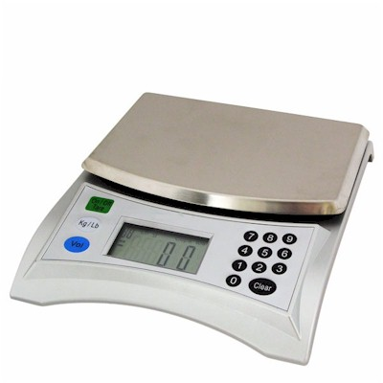
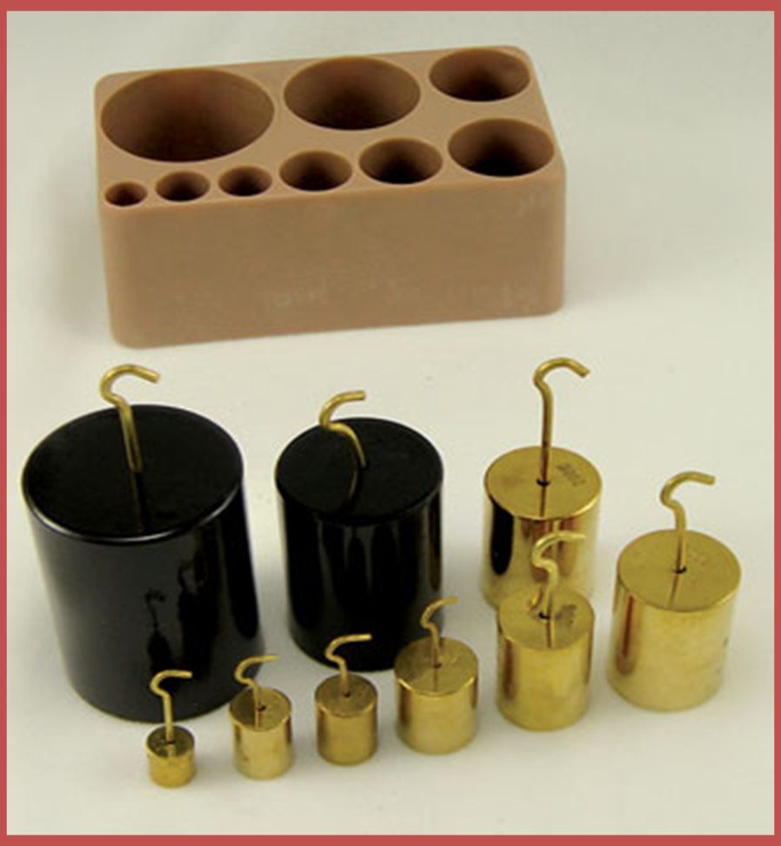
MASS

Slide 44
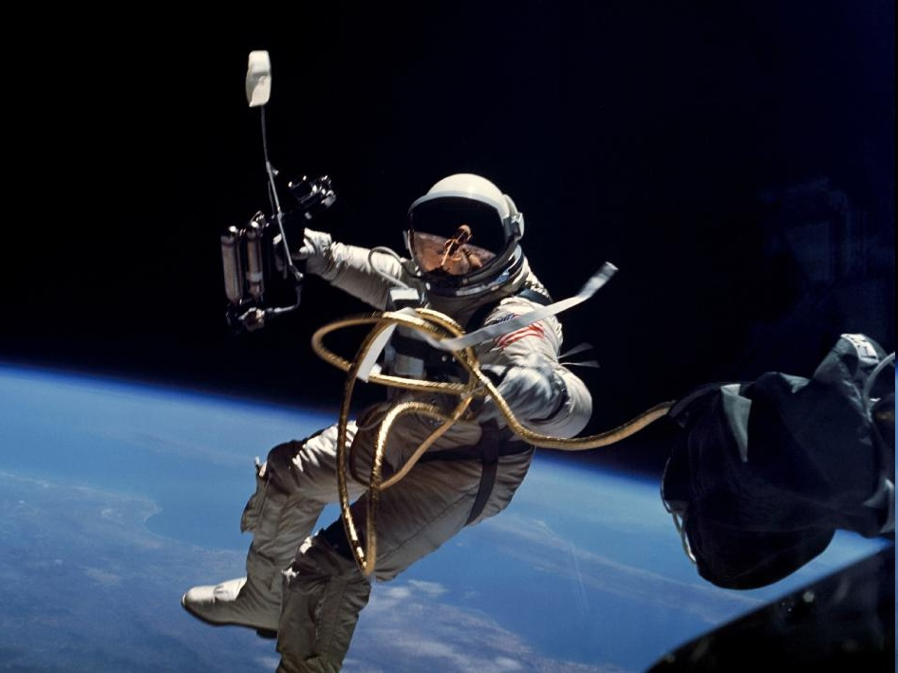
The amount of matter in an object.
Copyright © 2010 Ryan P. Murphy

Slide 45
THE BASE UNIT = kilogram
SYMBOL = kg

Slide 46
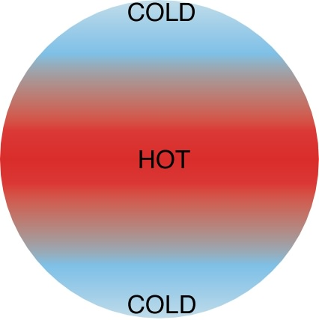
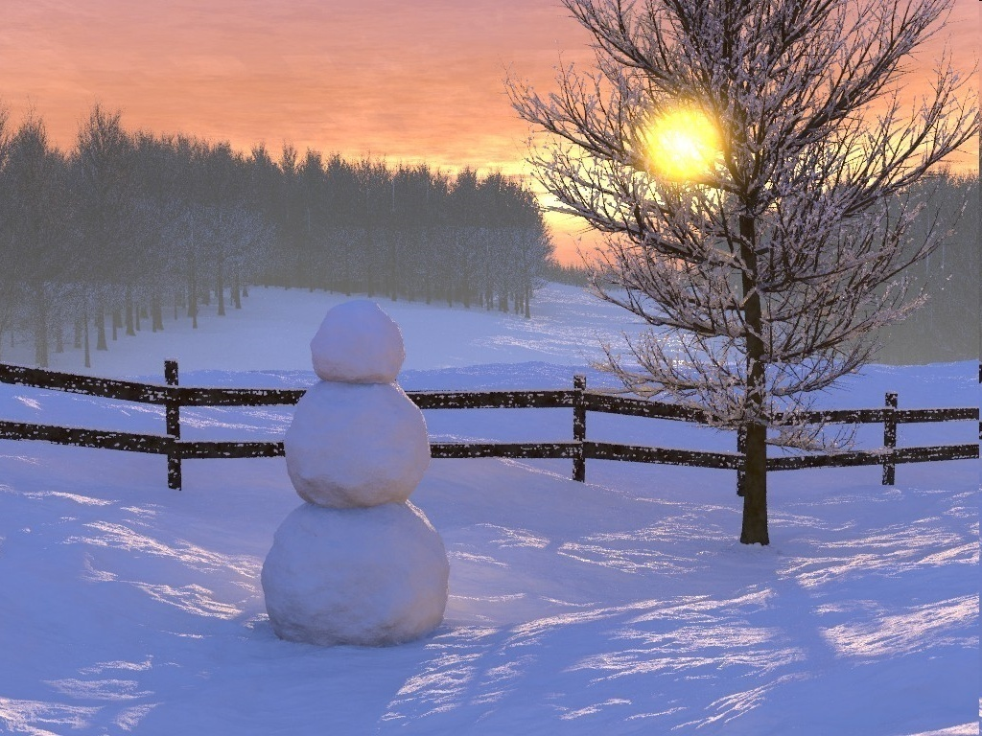
TEMPERATURE

Slide 47
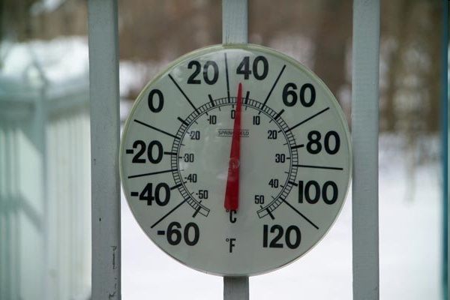
The degree of hotness or coldness of an object
Copyright © 2010 Ryan P. Murphy

Slide 48
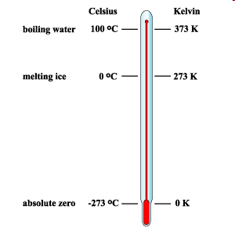
THE BASE UNIT = kelvin
SYMBOL = K
Copyright © 2010 Ryan P. Murphy

Slide 49

TIME
Copyright © 2010 Ryan P. Murphy

Slide 50
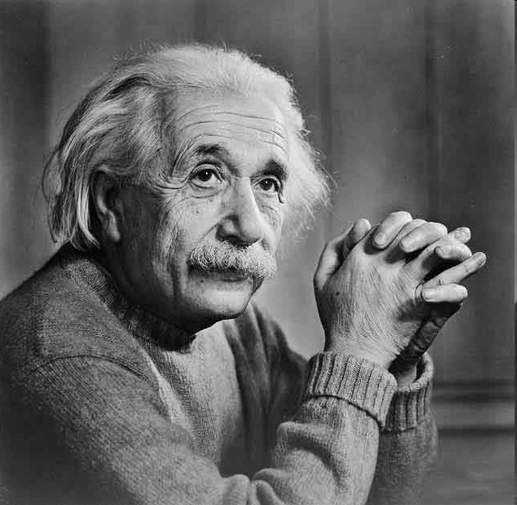
Time is not the same everywhere. Time speeds up and slows down. The faster you are going, the slower time travels.

Slide 51
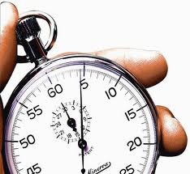
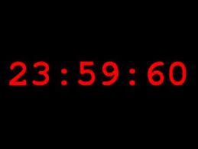
THE BASE UNIT = second
SYMBOL = s

Slide 52

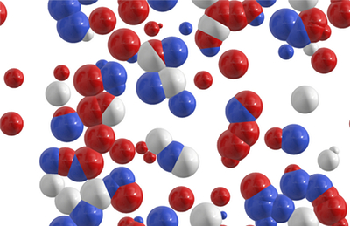
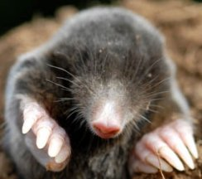
Amount of Substance
Copyright © 2010 Ryan P. Murphy

Slide 53
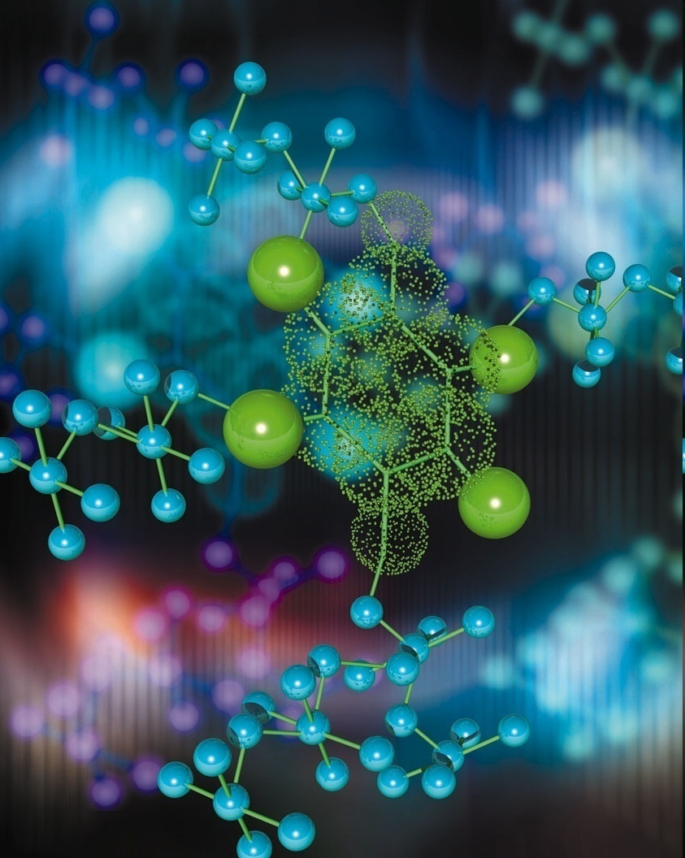
The mole: The molecular weight of a substance expressed in grams
Copyright © 2010 Ryan P. Murphy

Slide 54
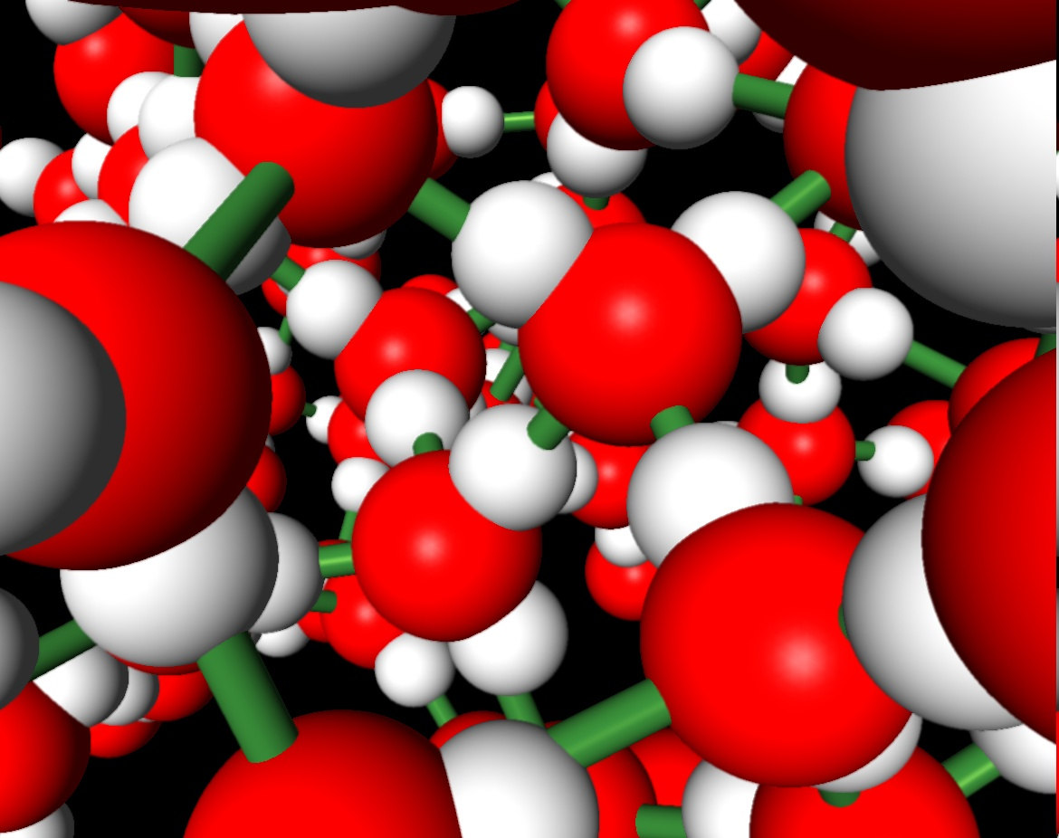
THE BASE UNIT = mole
SYMBOL = mol

Slide 55
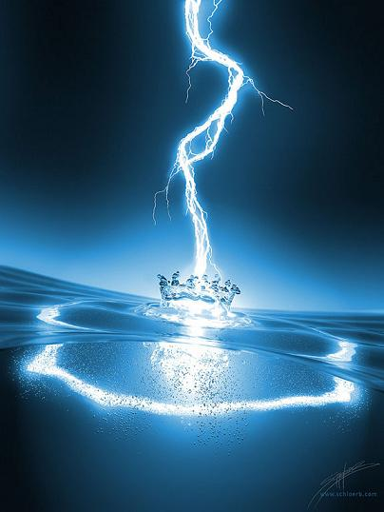
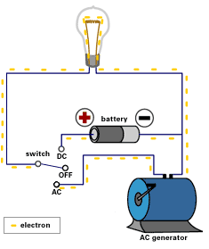
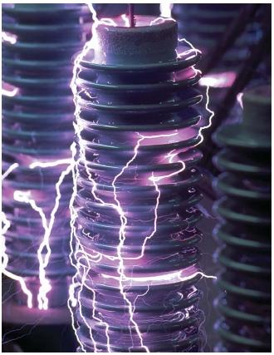
Electric Current
Copyright © 2010 Ryan P. Murphy

Slide 56
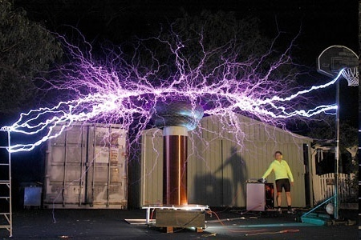
THE BASE UNIT = ampere
SYMBOL = A
Copyright © 2010 Ryan P. Murphy

Slide 57

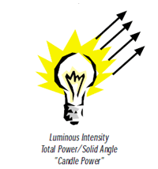
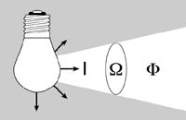
Luminous Intensity
Copyright © 2010 Ryan P. Murphy

Slide 58
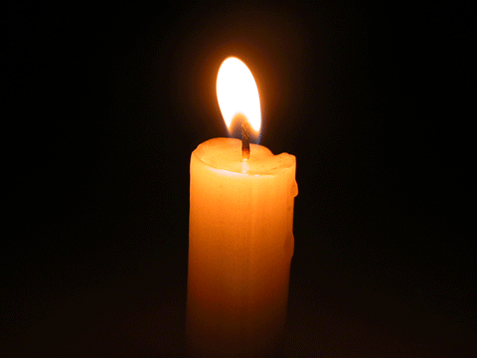
THE BASE UNIT = candela
SYMBOL = cd
Copyright © 2010 Ryan P. Murphy

Slide 59
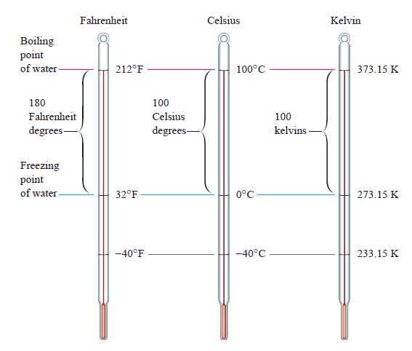
CONVERTING TEMPERATURE
The size of the temperature unit (the degree) is the same for KELVIN and CELSIUS scales but different for FEHRENHEIT
Copyright © 2010 Ryan P. Murphy
Copyright © 2010 Ryan P. Murphy

Slide 60
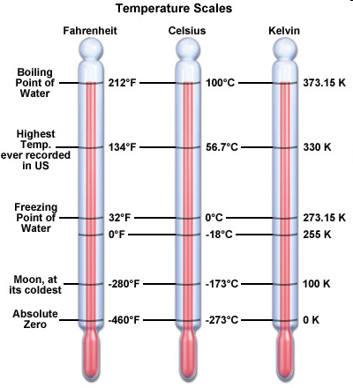
CONVERTING TEMPERATURE
However, KELVIN, CELSIUS and FEHRENHEIT scales have different zero points
Copyright © 2010 Ryan P. Murphy
Copyright © 2010 Ryan P. Murphy

Slide 61

KELVIN vs. CELSIUS
Copyright © 2010 Ryan P. Murphy
Copyright © 2010 Ryan P. Murphy

Slide 62

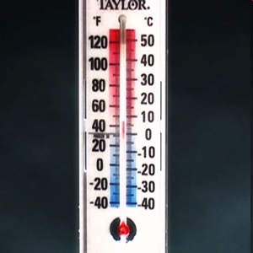
CELSIUS vs. Fahrenheit
Copyright © 2010 Ryan P. Murphy
Copyright © 2010 Ryan P. Murphy

Slide 63
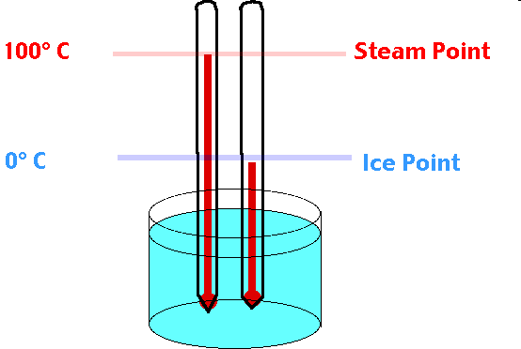
Zero Degrees Celsius is a freezing point of water, 100 degrees Celsius is a boiling point of water
Copyright © 2010 Ryan P. Murphy

Slide 64
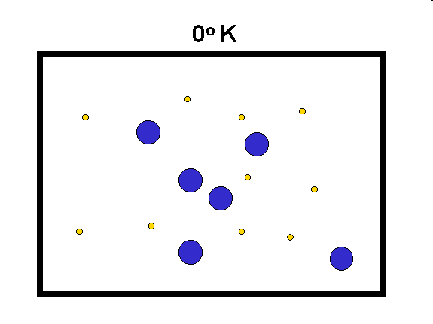
Molecular motion stops at zero degrees K ( -273.15˚C)
Copyright © 2010 Ryan P. Murphy

Slide 65
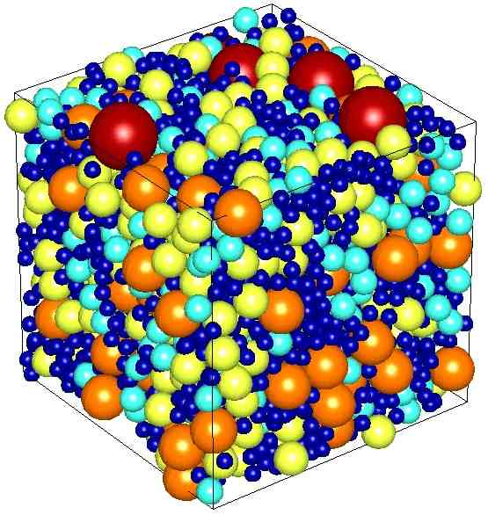
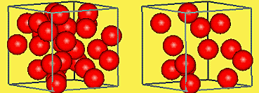
DENSITY

Slide 66
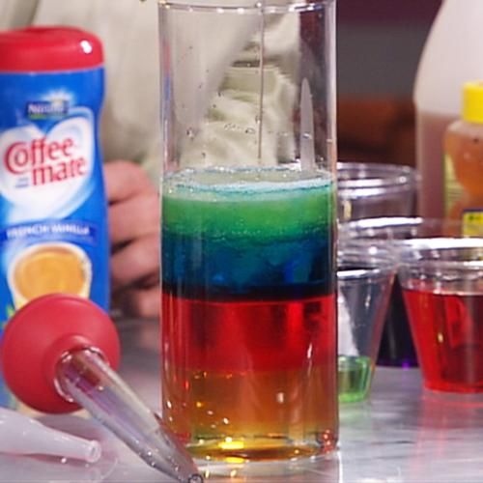

UNITS
gram/cm³
gram/ml
Amount of substance per unit volume of a substance
Copyright © 2010 Ryan P. Murphy
Copyright © 2010 Ryan P. Murphy

Slide 67
Density = $\frac{\text{Mass} }{\text{Volume}}$
Which colored substance will have the lowest density?
The more dense, the more heavier something is…
Copyright © 2010 Ryan P. Murphy
Copyright © 2010 Ryan P. Murphy

Slide 68
Density = $\frac{\text{Mass} }{\text{Volume}}$
GREEN SUBSTANCE!
The more dense, the more heavier something is…
Copyright © 2010 Ryan P. Murphy
Copyright © 2010 Ryan P. Murphy

Slide 69
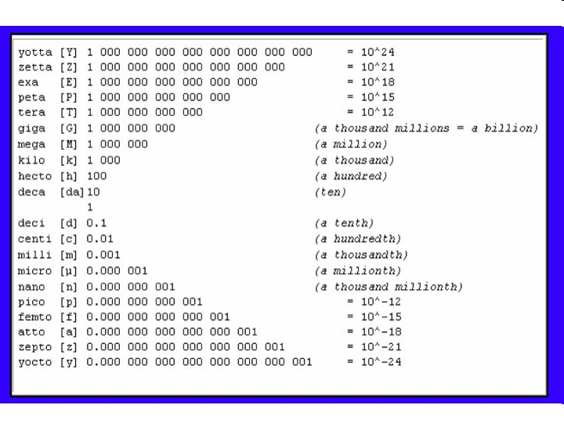
The Metric System: A measurement system based on the powers of ten.
Copyright © 2010 Ryan P. Murphy

Slide 70
POWERS OF TEN HAVE PREFIXES
Copyright © 2010 Ryan P. Murphy

Slide 71
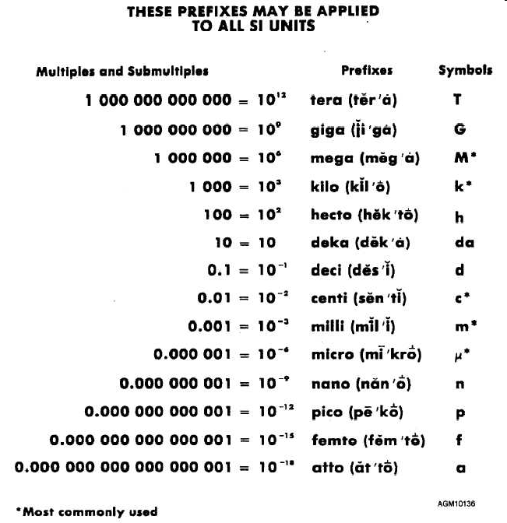
YOU MUST KNOW THEM!!!
Copyright © 2010 Ryan P. Murphy

