Slide 1
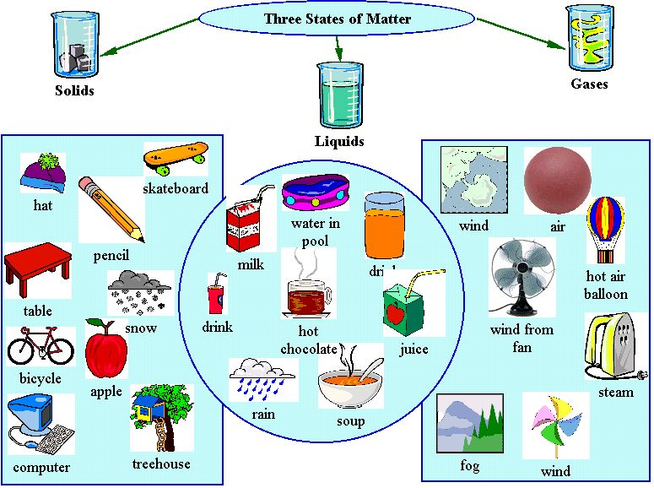
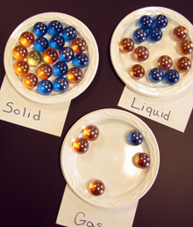
CHARACTERISTICS OF MATTER

Slide 2
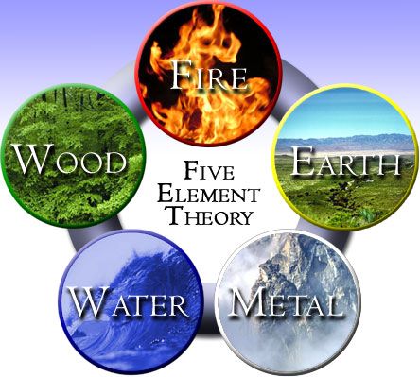
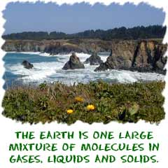
What is the Matter?
Stuff of which all materials are made out of
Anything that has mass and takes up space.

Slide 3
WHY ARE WE CONCERNED WITH MATTER??
CHEMISTRY IS ALL ABOUT MATTER!!!
Chemistry is the science concerned with the properties, composition, and behaviour of matter!

Slide 4
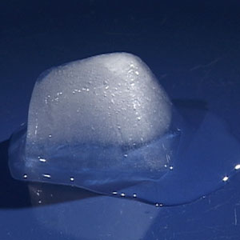
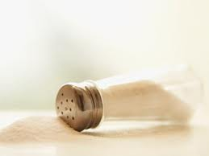
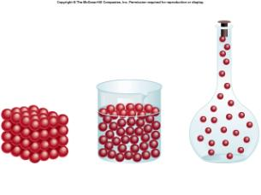
Classification of Matter

Slide 5
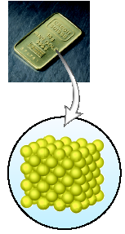
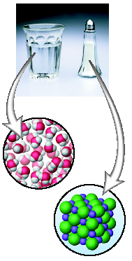
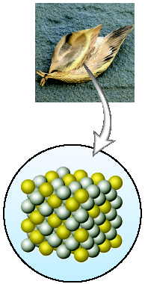
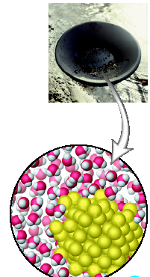
Classifying Matter

Slide 6
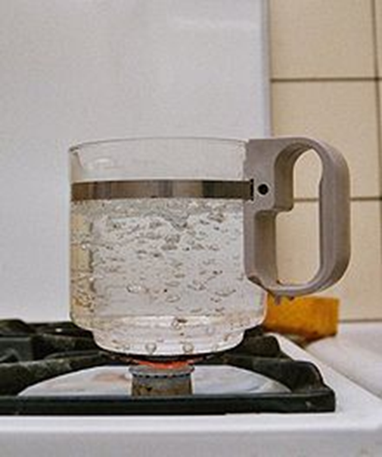
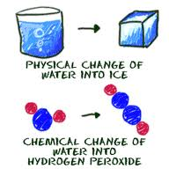
Properties of Matter
Properties are characteristics that can be used to describe a substance.

Slide 7
Properties of Matter
We will deal with PHYSICAL and CHEMICAL properties

Slide 8
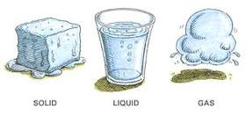
Physical Properties of Matter
Describe physical changes
Describe the physical characteristics of a substance

Slide 9
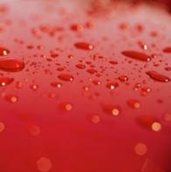
Physical Properties of Matter
State at room temperature (Solid/ Liquid/Gas)
Melting point

Slide 10
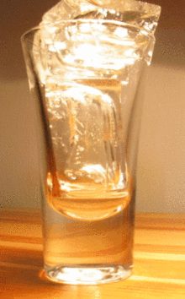
MELTING POINT
Each substance have different temperature at which it melts
(at different P)
What temperature does water melt?

Slide 11
MELTING POINT
> 0 °C
What temperature does water melt?

Slide 12
Physical Properties of Matter
State at room temperature (Solid/ Liquid/Gas)
Melting point
Boiling point

Slide 13
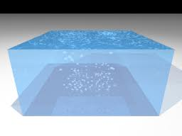
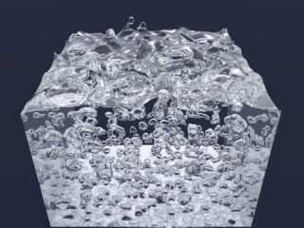
BOILING POINT
Each substance have different temperature at which it boils
(at different P)
What temperature does water boil?

Slide 14
BOILING POINT
100 °C
What temperature does water boil?

Slide 15
Physical Properties of Matter
State at room temperature (Solid/ Liquid/Gas)
Melting point
Boiling point
Hardness ( ability to resist applied force)

Slide 16
Physical Properties of Matter
State at room temperature (Solid/ Liquid/Gas)
Melting point
Boiling point
Hardness ( ability to be scratched)
Malleability ( can it be rolled into sheets or pounded flat?)

Slide 17
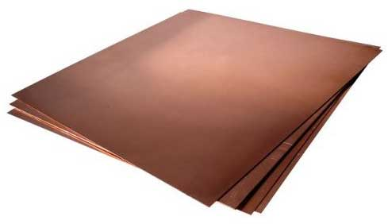
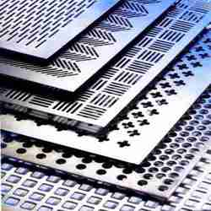
MALLEABILITY
Shiny
Malleability (can it be rolled into sheets or pounded flat?)

Slide 18
Physical Properties of Matter
State at room temperature (Solid/ Liquid/Gas)
Melting point
Boiling point
Hardness ( ability to be scratched)
Malleability ( can it be rolled into sheets or pounded flat?)
Ductility (can it be stretched into a wire ?)

Slide 19
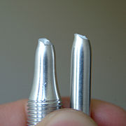
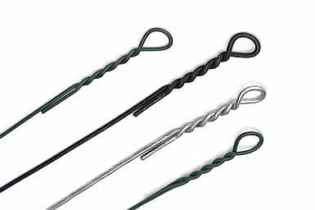
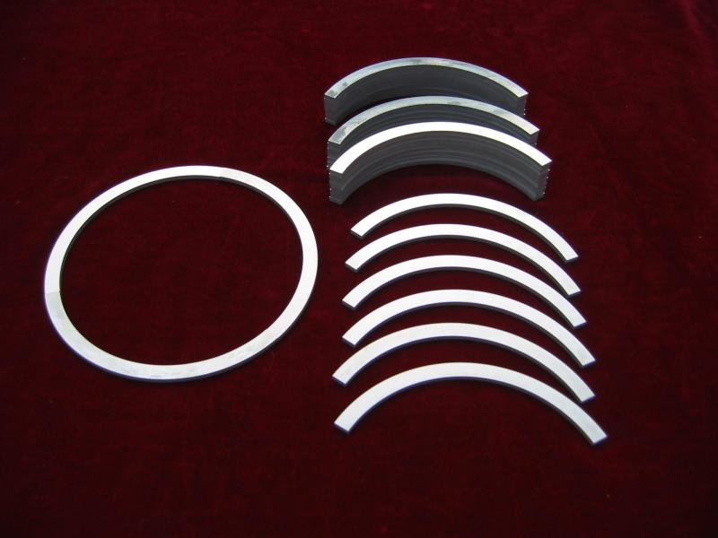
DUCTILITY
Ductility (can it be stretched into a wire ?)

Slide 20
Physical Properties of Matter
State at room temperature (Solid/ Liquid/Gas)
Melting point
Boiling point
Hardness ( ability to be scratched)
Malleability ( can it be rolled into sheets or pounded flat?)
Ductility (can it be stretched into a wire ?)
Solubility ( can it be dissolved into another?)

Slide 21
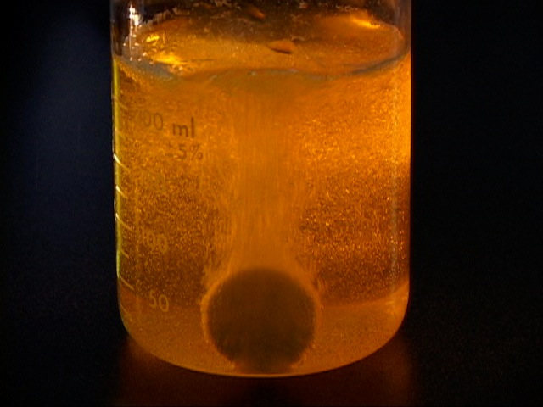
SOLUBILITY
Solubility ( can it be dissolved in another substance?)

Slide 22
Physical Properties of Matter
The mass of an unknown chemical is 50 g and its length is 15 cm
Find the identity of these
Chemicals!
The density of an unknown chemical is 1 g/ml and its boiling point is 100 ˚C at 1 atm

Slide 23
Physical Properties of Matter
The mass of an unknown chemical is 50 g and its length is 15 cm
Extensive properties of a substance
Depend on the amount of substance present
For example: Mass, volume, length…
You CAN NOT identify an unknown substance based on extensive properties!

Slide 24
Physical Properties of Matter
Intensive properties of a substance
Depend on the characteristics of a substance present and not on how much of that substance is present
For example: Density, boiling point, melting point
You CAN identify an unknown substance based on intensive properties!
The density of an unknown chemical is 1 g/ml and its boiling point is 100 ˚C at 1 atm

Slide 25
Physical Properties of Matter
Intensive properties of a substance
The density of an unknown chemical is 1 g/ml and its boiling point is 100 ˚C at 1 atm

Slide 26
Chemical Properties of Matter
Describe chemical changes
Describe the tendency of a chemical to react (its stability, reactivity, toxicity and/or flammability)

Slide 27
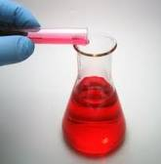
Chemical Properties of Matter
Reaction with an acid(s)

Slide 28
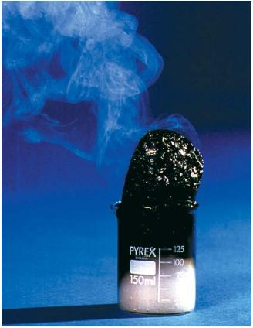
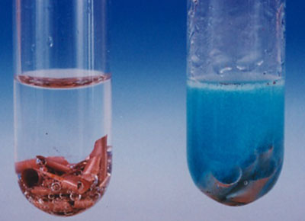
REACTION WITH ACID

Slide 29
Chemical Properties of Matter
Reaction with an acid(s)
Ability to burn

Slide 30
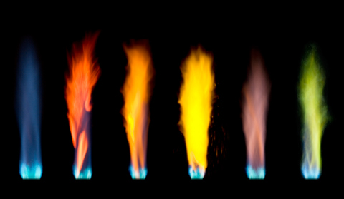
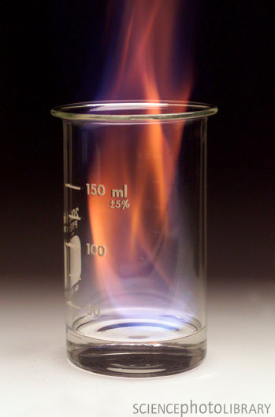
ABILITY TO BURN

Slide 31
Chemical Properties of Matter
Reaction with an acid(s)
Ability to burn
Behaviour in air

Slide 32
BEHAVIOUR IN AIR

Slide 33
Chemical Properties of Matter
Reaction with an acid(s)
Ability to burn
Behaviour in air
Reactions to heat
Poisonous
Toxic
Explosive

Slide 34
Other Physical Properties?
• shape/texture
• colour
• odor
• magnetism
• density
• conductivity
Chemical Property?
• change in odor
• colour change
• temperature change

Slide 35
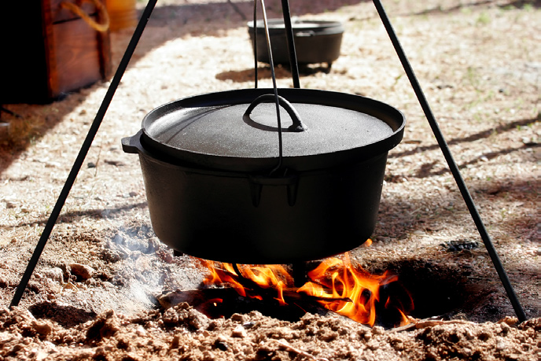
What Physical and Chemical Changes Are Occurring Here?
Wood burning
Liquid boiling

Slide 36
 | Identify the property | Physical or Chemical? | Extensive or Intensive?
Water boils at 100ºC | Boiling Point | Physical | Intensive
Gasoline burns in air | Combustion reaction (burning in air) | Chemical
Gasoline is a clear pink solution | Color | Physical | Intensive
Cooling down brown, NO2 gas causes it to turn colorless. | Change of color | Chemical
Magnesium reacts with HCl to produce magnesium chloride and hydrogen gas. | Ability to react with acids | Chemical
Sulphur is a foul smelling, yellow solid at room temperature | Odor and color | Physical | Intensive

Slide 37
Now, on your own…
Kinetic energy (pg. 62)
Thermal energy, Temperature, Heat = energy of motion energy (pg. 62 – 63)
The average mechanical energy of the particles that compose a material
The total mechanical energy of an object’s or a material’s particles
The energy transferred from one body to another because of a difference in temperature

Slide 38
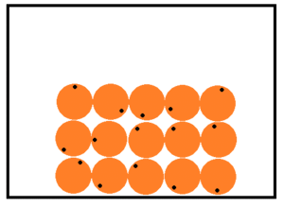
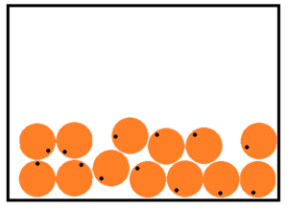
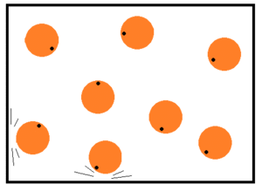
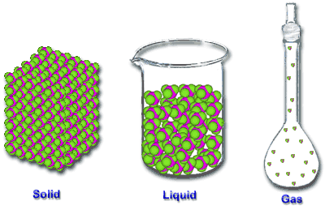
States of Matter

Slide 39
The Particle Model of Matter
Describes the behavior of matter
All matter is made of small particles – there are spaces between particles
Solid
Almost no spaces
Liquids
More spaces
Gases
Lot of spaces

Slide 40
The Particle Model of Matter
Particles are always moving
Particles are attracted to each other – the strength of the attraction depends on a specific particle
Scientists used this model to come up with THEORY

Slide 41
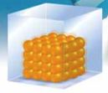
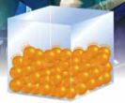
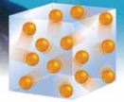
The Kinetic Molecular Theory (KMT)
Kinetic energy = energy of motion
Describes what happens to matter when the kinetic energy of particles changes

Slide 42
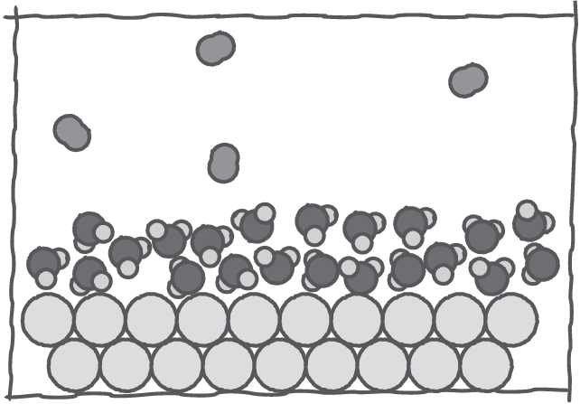
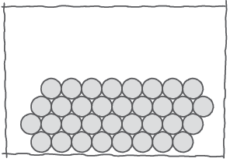
The Kinetic Molecular Theory (KMT)
1. All matter is made of very small particles

Slide 43
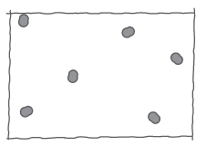
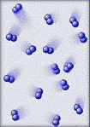
The Kinetic Molecular Theory (KMT)
2. There is empty space between particles

Slide 44
The Kinetic Molecular Theory (KMT)
3. Particles are constantly moving!
Particles of SOLIDS
Particles of LIQUIDS
Particles of GASES

Slide 45
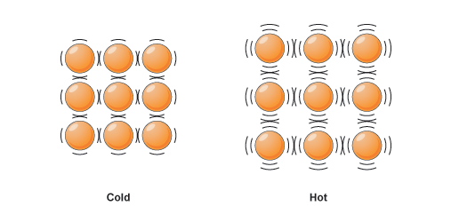
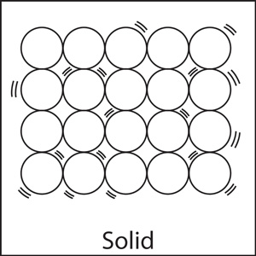
SOLID
The particles are packed so closely together that they only vibrate in place
Fixed shape
Fixed volume

Slide 46
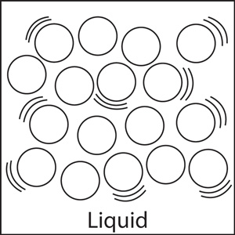
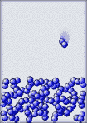
LIQUID
the particles are touching but can flow past each other
It takes the shape of its container
Fixed volume

Slide 47
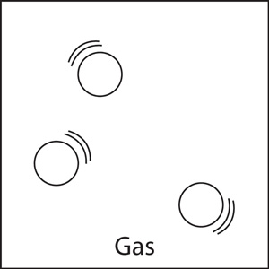
GAS
the particles are separated by large spaces and move quickly
It takes the shape of its container
It takes the volume of its container

Slide 48
The Kinetic Molecular Theory (KMT)
4. The particles move because of energy.
The amount of energy the particles have determine how fast and far they move

Slide 49
CHANGES OF STATES OF MATTER

Slide 50
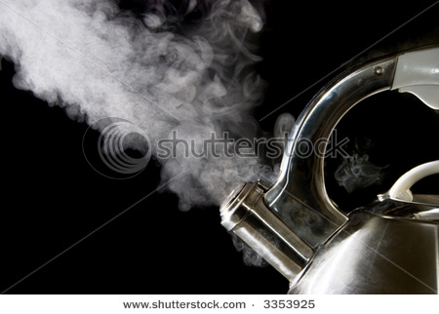
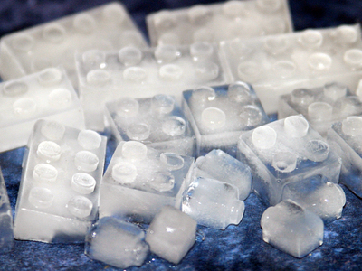
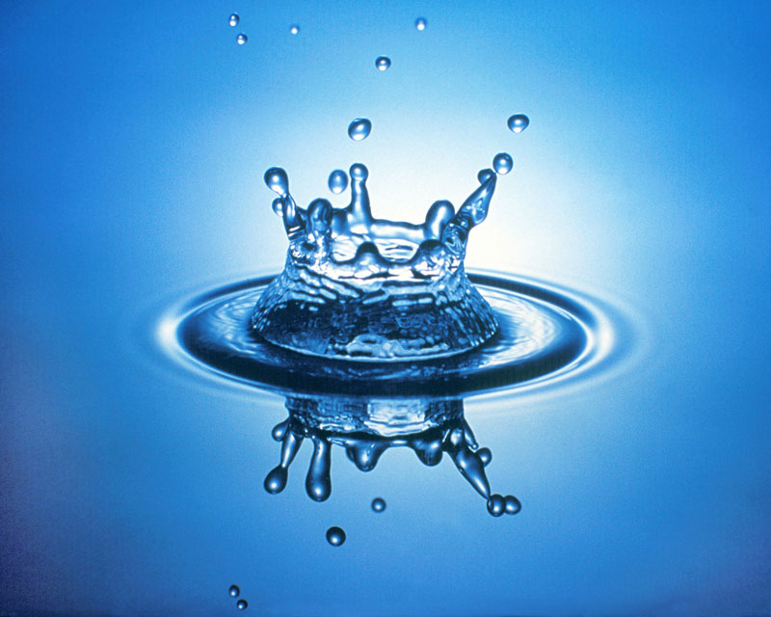
GAS
sublimation
evaporation
condensation
deposition
solidification
SOLID
LIQUID
melting

Slide 51
CHANGES OF STATES OF MATTER
CHANGE OF STATE | GOES FROM…. | TO….
Condensation | GAS | LIQUID
Sublimation | SOLID | GAS
Deposition | GAS | SOLID
Evaporation | LIQUID | GAS
Solidification | LIQUID | SOLID
Melting | SOLID | LIQUID

Slide 52
Now, on your own…
Some Physical Properties (pg. 65 - 67)
Thermal energy, Temperature, Heat = energy of motion energy (pg. 62 – 63)
The process of changing from a solid to a liquid
The vigorous bubbling that occurs within the body of a liquid as it vaporizes internally
The amount of heat energy required to melt a specified amount of a substance at its
melting point

Slide 53
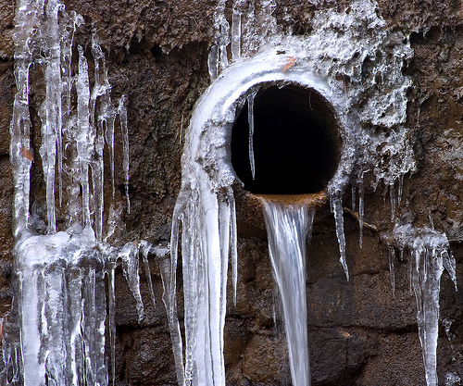
The KMT and Changes of State
Changes of state occur when matter changes from one state to another

Slide 54
Solid GOLD
Particles are close together, fixed in position and vibrating.

Slide 55
Melting GOLD
As temperature increases, particles’ kinetic energy increases.

Slide 56
Liquid GOLD
Particles are still close, but slide past one another.

Slide 57
Boiling GOLD
As temperature increases, particles’ kinetic energy continues to increase, creating more space.

Slide 58
Gaseous GOLD
Particles are highly energetic and moving freely.

Slide 59
How does a graph of Temperature vs. heat added look like for a pure substance (GOLD)?
A Heating Curve
Temperature →
Increase in heat over time →

Slide 60
If you heat a pure substance…
Temperature →
Increase in heat over time →

Slide 61
The graph looks like this
Boiling
G
L
G
Temperature →
Melting
L
Condensing
S
L
G = gas
S = Solid
L = liquid
S
Freezing
Increase in heat over time →

Slide 62
On the slopes of the graph:
Boiling
G
L
G
Temperature →
Melting
L
Condensing
S
L
G = gas
S = Solid
L = liquid
S
Freezing
Increase in heat over time →

Slide 63
The heat is added and is used to warm the substance– temperature is rising
Boiling
G
L
G
Temperature →
Melting
L
Condensing
S
L
G = gas
S = Solid
L = liquid
S
Freezing
Increase in heat over time →

Slide 64
On the levelled portions of the graph:
Boiling
G
L
G
Temperature →
Melting
L
Condensing
S
L
G = gas
S = Solid
L = liquid
S
Freezing
Increase in heat over time →

Slide 65
The substance had too much heat energy, it can’t stay in the same phase
Boiling
G
L
G
Temperature →
Melting
L
Condensing
S
L
G = gas
S = Solid
L = liquid
S
Freezing
Increase in heat over time →

Slide 66
All this heat energy is used to form liquid from solid or the gas from liquid – temperature does not change at this point
Boiling
G
L
G
Temperature →
Melting
L
Condensing
S
L
G = gas
S = Solid
L = liquid
S
Freezing
Increase in heat over time →

Slide 67
This temperature is BOILING/CONDENSING POINT
This temperature is FREEZING or MELTING POINT
Boiling
G
L
G
Temperature →
Melting
L
Condensing
S
L
G = gas
S = Solid
L = liquid
S
Freezing
Increase in heat over time →

Slide 68
This temperature is BOILING/CONDENSING POINT
This temperature is FREEZING or MELTING POINT
G
L
G
Temperature →
L
S
L
S
Increase in heat over time →

Slide 69
CLASSWORK/HOMEWORK
Worksheets
Practice Problems: all even
The Thickness of Aluminum Foil activity

Slide 70
QUIZ
Two days from now

