Slide 1
2.4 Names and Formulas of Inorganic Compounds

Slide 2
Naming and Writing Formulae of Ionic Compounds
What is an Ionic Compound?
A compound made up of ions of a metal AND
a non-metal or a polyatomic ion
A compound in which a metal and a non-metal/polyatomic ion donate and accept electrons
The net (overall) charge of the ionic compound is 0
i.e. the compound is NEUTRAL

Slide 3
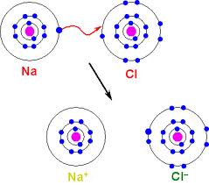
IONIC COMPOUNDS
Formed by an attraction of positively charged ion and negatively charged ion
Chemical formula
NaCl

Slide 4
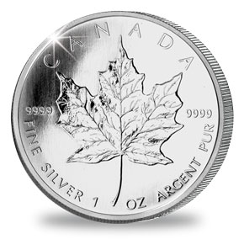
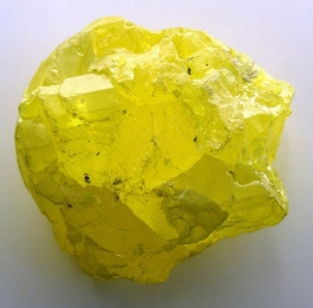
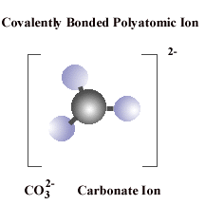
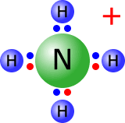
Naming of IONIC COMPOUNDS
metal
nonmetal
metal
polyatomic
ion
UNIVALENT
MULTIVALENT
polyatomic
ion
polyatomic
ion
Al³⁺
Fe³⁺
Fe²⁺

Slide 5
Naming of IONIC COMPOUNDS
metal
nonmetal
UNIVALENT
MULTIVALENT
Al³⁺
Fe³⁺
Fe²⁺

Slide 6
Chemical names of Ionic Compounds
Have always two parts: one for a metal ion (Ca²⁺) and one for non metal ion (Cl⁻)
CaCl₂
Name the metal ion (a positive ion)
Name the non-metal ion (a negative ion)
Put 1 + 2 together
Let’s learn how to name the metal ions first!

Slide 7
There Are Two Types Of Metal Ions
metal
More than one charge
UNIVALENT
MULTIVALENT
Al³⁺
Fe³⁺
only one charge
Fe²⁺

Slide 8
There Are Two Types Of Metal Ions
If a metal has only one charge
METAL NAME | METAL SYMBOL | METAL ION NAME | METAL ION SYMBOL

Slide 9
UNIVALENT METAL ION (cation)
If a metal has only one charge
METAL NAME | METAL SYMBOL | METAL ION NAME | METAL ION SYMBOL

Slide 10
To name an ion...
Use only the name of a metal
METAL SYMBOL | METAL NAME | METAL ION SYMBOL | METAL ION NAME
Ca | calcium | Ca²⁺ | calcium
K | potassium | K⁺ | potassium
Mg | magnesium | Mg²⁺ | magnesium
Ag | silver | Ag⁺ | silver
Li | lithium | Li⁺ | lithium
Al | aluminum | Al³⁺ | aluminum
Ba | barium | Ba²⁺ | barium
Cs | cesium | Cs⁺ | cesium

Slide 11
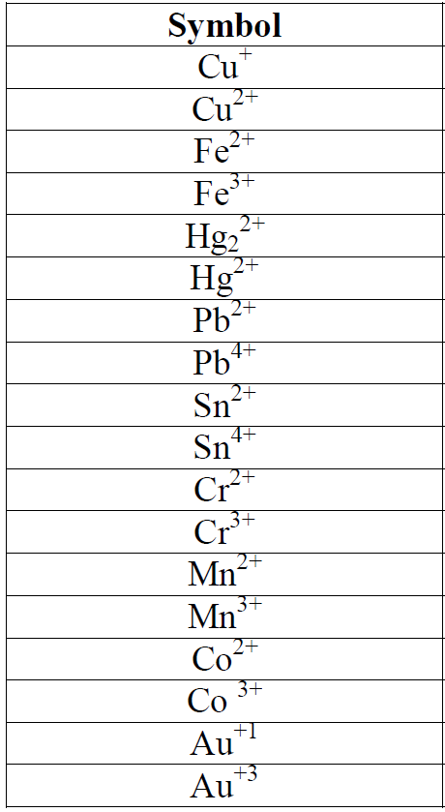
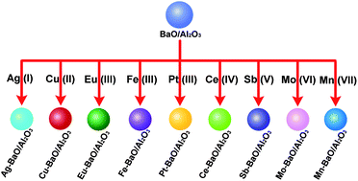
MULTIVALENT METAL ION (cations)
If a metal has more than one charge…

Slide 12
To name a MULTIVALENT ION
Name exactly like an Univalent Metal Ion, but...
You MUST indicated the charge by a Roman numeral, in parentheses, immediately following the name of the metal ion
Fe²⁺ = iron (II) (“iron two”)
Fe³⁺ = iron (III) (“iron three”)

Slide 13
MULTIVALENT METALS (cations)
METAL ION SYMBOL | METAL ION NAME USING THE STOCK NAMING SYSTEM | A NAME USING THE CLASSICAL SYSTEM
Cu²⁺ | copper (ll) | cupric
Au⁺ | gold (l) | aurous
Fe²⁺ | iron (ll) | ferrous
Pb²⁺ | lead (ll) | plumbous
Sn²⁺ | tin (ll) | stannous
Au³⁺ | gold (lll) | auric
Co²⁺ | cobalt (ll) | cobaltous
Hg²⁺ | mercury (ll) | mercuric

Slide 14
Chemical names of Ionic Compounds
Have always two parts: one for a metal ion (Ca₂⁺) and one for non metal ion (Cl⁻)
CaCl₂
Name the metal ion (a positive ion)
Name the non-metal ion (a negative ion)
Put 1 + 2 together
Let’s learn how to name the non - metal ions now!

Slide 15
NON – METAL IONS (anions)
Omit the original ending of the element’s name and add an “ide” ending
“ide” ending means that the ion has a negative charge
For example:
Cl
Cl⁻
chlorine
chloride

Slide 16
NON – METAL IONS (anions)
ELEMENT SYMBOL | ELEMENT NAME | ION SYMBOL | ION NAME
F | fluorine | F⁻ | fluoride
Cl | chlorine | Cl⁻ | chloride
Br | bromine | Br⁻ | bromide
I | iodine | I⁻ | iodide
O | oxygen | O²⁻ | oxide
S | sulphur | S²⁻ | sulphide
N | nitrogen | N³⁻ | nitride
P | phosphorus | P³⁻ | phosphide

Slide 17
Chemical names of Ionic Compounds
Have always two parts: one for a metal ion (Ca₂⁺) and one for non metal ion (Cl⁻)
CaCl₂
Name the metal ion (a positive ion)
Name the non-metal ion (a negative ion)
Put 1 + 2 together
Let’s put #1 and #2 together!!

Slide 18
Rules For Naming Ionic Compounds
Example 1:
Zn
Cl₂
zinc
chloride
Simply name the ions one after the another!
(Remember that the first ion has a positive charge (metal) and the second ion has a negative charge (non - metal)

Slide 19
Rules For Naming Ionic Compounds
Example 2:
Ca
O
calcium
oxide

Slide 20
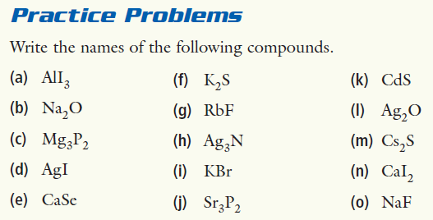
Naming Ionic Compounds

Slide 21
Writing Formulas of Ionic Compounds
potassium oxide
2 methods to do this!
The positive charge MUST ALWAYS balance the negative charge in the ionic compound

Slide 22
Method #1
potassium oxide
K⁺ and O²⁻
Write the formulas + charges for the metal ion (cation) and the nonmetal ion (anion)(or a polyatomic ion)

Slide 23
2. Balance the charges, so the overall charge of the compound = 0
What is the overall charge right now?
potassium oxide
K⁺ and O²⁻
+1
-2
=
-1
We need it to be 0!

Slide 24
2. Balance the charges, so the overall charge of the compound = 0
ADD ONE MORE POTASSIUM
potassium oxide
K⁺ and O²⁻
+1
-2
=
-1
We need it to be 0!

Slide 25
2. Balance the charges, so the overall charge of the compound = 0
ADD ONE MORE POTASSIUM
potassium oxide
K⁺ and K⁺ and O²⁻
+1
+1
-2
=
-1
We need it to be 0!

Slide 26
2. Balance the charges, so the overall charge of the compound = 0
ADD ONE MORE POTASSIUM
potassium oxide
K⁺ and K⁺ and O²⁻
+1
+1
-2
=
0
We need it to be 0!

Slide 27
2. Balance the charges, so the overall charge of the compound = 0
ADD ONE MORE POTASSIUM
potassium oxide
K⁺ and K⁺ and O²⁻
K₂O
+1
+1
-2
=
0
Now, it is ZERO!

Slide 28
Method #2 = CROSSOVER METHOD
potassium oxide

Slide 29
Method #2 = CROSSOVER METHOD
potassium oxide
K¹⁺ and O²⁻

Slide 30
Method #2 = CROSSOVER METHOD
potassium oxide
K¹⁺ and O²⁻
K₂O₁

Slide 31
Method #2 = CROSSOVER METHOD
potassium oxide
K¹⁺ and O²⁻
K₂O

Slide 32
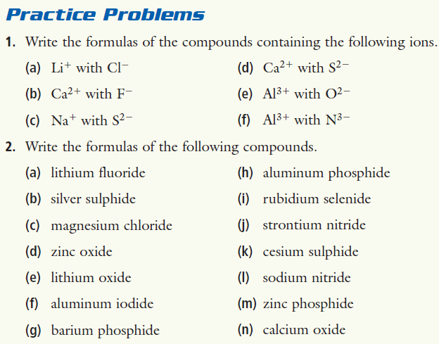
Writing Formulas of Ionic Compounds

Slide 33
Writing the Formulas of Ionic Compounds containing Multivalent Metals
If you have a name of an ionic compound containing a multivalent metal,
Fe²⁺ = iron (II) (“iron two”)
Fe³⁺ = iron (III) (“iron three”)

Slide 34
To name a MULTIVALENT ION
Name it exactly like you do with Univalent Metal Ions, but...
You MUST indicated the charge by a Roman numeral, in parentheses, immediately following the name of the metal ion
Fe²⁺ = iron (II) (“iron two”)
Fe³⁺ = iron (III) (“iron three”)

Slide 35
Writing the Formulas of Ionic Compounds containing Multivalent Metals
Identify each ion and its charge
Use A CROSSOVER METHOD (or Method #1) to balance the charges on each ion so you have ZERO (0) overall charge!!
iron(III)sulphide
Fe³⁺ and S²⁻
Fe₂S₃

Slide 36
Rules For Naming Ionic Compounds containing Multivalent Metals
If the first ion (metal) is a multivalent metal ion, use the second ion’s charge to determine the first ion’s name
Fe²⁺ = iron (II) (“iron two”)
Fe³⁺ = iron (III) (“iron three”)

Slide 37
Rules For Naming Ionic Compounds containing Multivalent Metals
Example 2:
Pb
O₂
Which lead is it?
lead (II)
OR
lead (IV)
How will you find out?

Slide 38
Rules For Naming Ionic Compounds containing Multivalent Metals
Example 2:
Pb
O₂
Which lead is it?
lead (II)
OR
lead (IV)
Look at the charge on the second ion!

Slide 39
Rules For Naming Ionic Compounds containing Multivalent Metals
Example 2:
Pb
O₂
Which lead is it?
lead (II)
OR
lead (IV)
You know:
1. The compound is neutral (overall 0 charge), so the charge of the first ion (lead) equals the charge on the second ion (oxide)

Slide 40
Rules For Naming Ionic Compounds containing Multivalent Metals
Example 2:
Pb
O₂
Which lead is it?
lead (II)
OR
lead (IV)
-2
So, the charge of the two oxides is twice as much:
One oxide’s (O²⁻) charge is:
O₂
-4
We have two oxides:

Slide 41
Rules For Naming Ionic Compounds containing Multivalent Metals
Example 2:
Pb
O₂
Which lead is it?
lead (II)
OR
lead (IV)
The charge on the positive ion then MUST be +4
to balance the negative charge of -4

Slide 42
Rules For Naming Ionic Compounds containing Multivalent Metals
Example 2:
Pb
O₂
Which lead is it?
lead (II)
OR
lead (IV)
The correct ion is then:

Slide 43
Rules For Naming Ionic Compounds containing Multivalent Metals
Example 2:
Pb
O₂
Which lead is it?
lead (II)
OR
lead (IV)
And the name for this compound is:
lead (IV)
oxide

Slide 45
Naming of IONIC COMPOUNDS
metal
nonmetal
metal
polyatomic
ion
UNIVALENT
MULTIVALENT
polyatomic
ion
polyatomic
ion
Al³⁺
Fe³⁺
Fe²⁺

Slide 46
Naming of IONIC COMPOUNDS
metal
nonmetal
metal
polyatomic
ion
UNIVALENT
MULTIVALENT
polyatomic
ion
polyatomic
ion
Al³⁺
Fe³⁺
Fe²⁺

Slide 47
Polyatomic Ions
A polyatomic ion contains more than one atom
OH⁻, CN⁻, NH₄⁺, NO₃⁻

Slide 48
Polyatomic Ions
You have to memorize the names, formulae, and charges of these polyatomic ions + other ones (see the worksheet):
Name | Formula and charge
carbonate | CO₃²⁻
chromate | CrO₄²⁻
dichromate | Cr₂O₇²⁻
sulphate | SO₄²⁻
sulphite | SO₃²⁻
nitrate | NO₃⁻
nitrite | NO₂⁻
ammonium | NH₄⁺
Name | Formula and charge
acetate | H₃C₂O₂⁻
permanganate | MnO₄⁻
perchlorate | ClO₄⁻
oxalate | C₂O₄²⁻
cyanide | CN⁻
chlorite | ClO₂⁻
phosphate | PO₄³⁻
hydroxide | OH⁻

Slide 49
Writing the Formulas of Ionic Compounds containing Polyatomic Ions
Identify each ion and its charge
Use A CROSSOVER METHOD (or Method #1) to balance the charges on each ion so you have ZERO (0) overall charge!!
iron(III)sulphate
Fe³⁺ and SO₄²⁻
Fe₂(SO₄)₃

Slide 50
Naming the Formulas of Ionic Compounds containing Polyatomic Ions
Pb
(OH)₂
Which lead is it?
lead (II)
OR
lead (IV)
How will you find out?

Slide 51
Rules For Naming Ionic Compounds containing Multivalent Metals
Pb
(OH)₂
Which lead is it?
lead (II)
OR
lead (IV)
Look at the charge on the hydroxide ion!

Slide 52
The compound is neutral (overall charge = 0), so...
The charge of the metal ion (lead) = the charge on the polyatomic ion(s) (hydroxide)
Pb
(OH)₂
Which lead is it?
lead (II)
OR
lead (IV)

Slide 53
OH⁻
1-
hydroxide’s charge is:
OH⁻
OH⁻
1-
1-
We have two hydroxides :
Pb
(OH)₂
Which lead is it?
lead (II)
OR
lead (IV)

Slide 54
OH⁻
1-
hydroxide’s charge is:
OH⁻
OH⁻
1-
2-
1-
We have two hydroxides :
Pb
(OH)₂
Which lead is it?
lead (II)
OR
lead (IV)

Slide 55
OH⁻
1-
hydroxide’s charge is:
OH⁻
OH⁻
2-
We have two hydroxides :
Pb
(OH)₂
Which lead is it?
lead (II)
OR
lead (IV)
The charge on lead ion then MUST be 2+
to balance the hydroxide ions’ charge of 2-

Slide 56
OH⁻
1-
hydroxide’s charge is:
OH⁻
OH⁻
2-
We have two hydroxides :
Pb
(OH)₂
Which lead is it?
lead (II)
OR
lead (IV)
The charge on lead ion then MUST be 2+
to balance the hydroxide ions’ charge of 2-

Slide 57
OH⁻
1-
hydroxide’s charge is:
OH⁻
OH⁻
2-
We have two hydroxides :
Pb
(OH)₂
Which lead is it?
lead (II)
OR
lead (IV)
lead(II)hydroxide

Slide 58
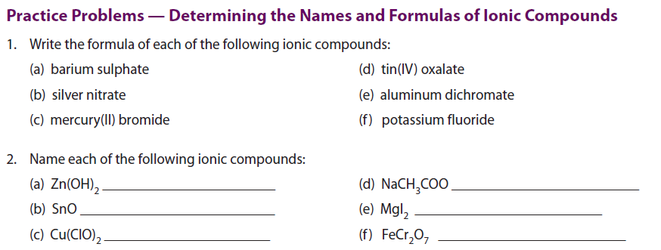

Slide 59
Naming Hydrates
They are salts which include a water molecule in their crystal structure
- This usually happens when an ionic compound is grown as a crystal by evaporation. This crystal structure will often include water molecules
WHAT
ARE HYDRATES?

Slide 60
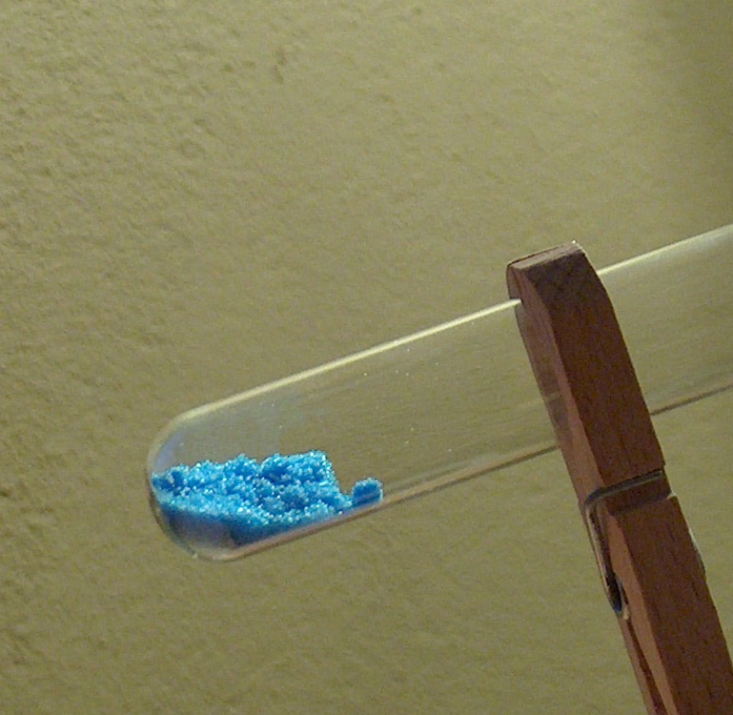
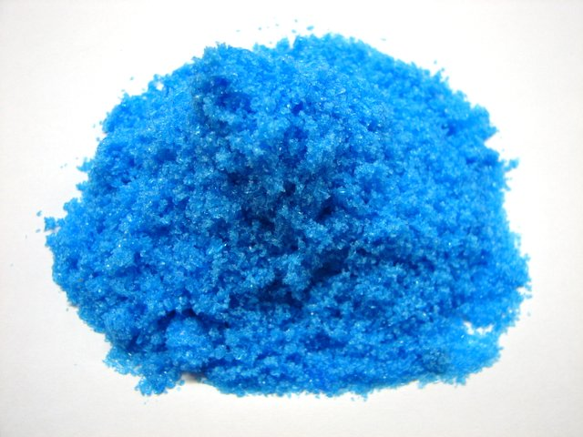
WHAT ARE HYDRATES?
Example:
When copper(II)sulphate is crystalized from water,
the resulting crystals have the formula:
CuSO₄ • 5H₂O

Slide 61
WHAT ARE HYDRATES?
Example:
When copper(II)sulphate is crystalized from water,
the resulting crystals have the formula:
CuSO₄ • 5H₂O
This means that 5 water molecules are attached to each copper(II)sulphate
The naming of hydrates is pretty easy!
All you need is to memorize prefixes and the numbers they represent.

Slide 62
PREFIX | Number of water molecules
mono | 1
di | 2
tri | 3
tetra | 4
penta | 5
hexa | 6
hepta | 7
octa | 8
nona | 9
deca | 10

Slide 63
Naming Hydrates
PREFIX | Number of water molecules
mono | 1
di | 2
tri | 3
tetra | 4
penta | 5
hexa | 6
hepta | 7
octa | 8
nona | 9
deca | 10
CuSO₄ • 5H₂O
Name salt as usual
Use a prefix to name the number associated with water molecule
Add a word “hydrate” to step 2 (hydrate = water)
Put steps 1 + 3 together
copper(II)sulphate pentahydrate

Slide 64
Naming Hydrates
PREFIX | Number of water molecules
mono | 1
di | 2
tri | 3
tetra | 4
penta | 5
hexa | 6
hepta | 7
octa | 8
nona | 9
deca | 10
Zn(CH₃COO)₂ • 2H₂O
Name salt as usual
Use a prefix to name the number associated with water molecule
Add a word “hydrate” to step 2 (hydrate = water)
Put steps 1 + 3 together
zinc acetate dihydrate

Slide 65
Writing the Chemical Formula of a Hydrate
PREFIX | Number of water molecules
mono | 1
di | 2
tri | 3
tetra | 4
penta | 5
hexa | 6
hepta | 7
octa | 8
nona | 9
deca | 10
calcium nitrate tetrahydrate
Ca(NO₃)₂ • 4H₂O

Slide 66
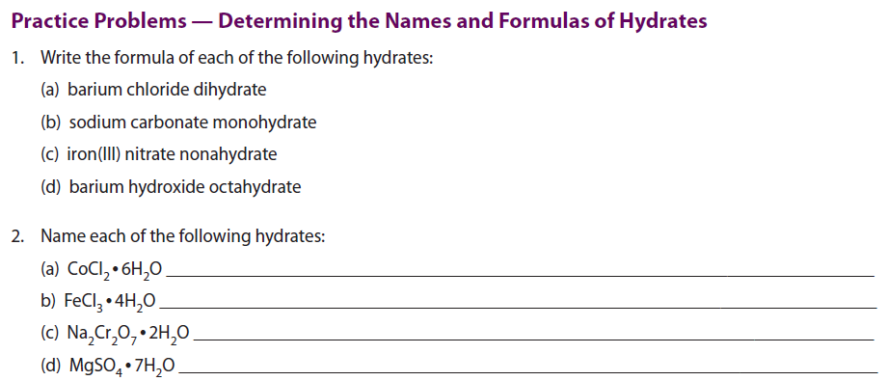

Slide 67
Naming and Writing Formulas of Acids
A SIMPLE DESCRIPTION:
An acid is a compound which has its formula starting with “H”
The formula of an acid is one or more hydrogens bonded to a monatomic or polyatomic anion.
The way that the acid is named is determined by the suffix of the anion.
HCl, HF, H₂SO₄, HNO₃
WHAT IS AN ACID?

Slide 68
Naming and Writing Formulas of Acids
A SIMPLE DESCRIPTION:
An acid is a compound which has its formula starting with “H”
The formula of an acid is one or more hydrogens bonded to a monatomic or polyatomic anion.
The way that the acid is named is determined by the suffix of the anion.
HCl, HF, H₂SO₄, HNO₃
WHAT IS AN ACID?

Slide 69
Naming and Writing Formulas of Acids
The way that the acid is named is determined by the suffix of the anion.
NO₃⁻
N³⁻
NO₂⁻
nitrate
nitride
nitrite

Slide 70
Naming and Writing Formulas of Acids
Name this compound
HNO₃
hydrogen nitrate

Slide 71
Naming and Writing Formulas of Acids
Name this compound
H₃N
hydrogen nitride

Slide 72
Naming and Writing Formulas of Acids
Name this compound
HNO₂
hydrogen nitrite

Slide 73
Naming and Writing Formulas of Acids
The way that the acid is named is determined by the suffix of the anion.
HNO₃
H₃N
HNO₂
hydrogen nitrate
hydrogen nitride
hydrogen nitrite
The naming is different though:
hydrogen nitrate
nitric acid
hydrogen nitride
hydronitric acid
hydrogen nitrite
nitrous acid

Slide 74
Naming and Writing Formulas of Acids
In general
hydrogen ___ide
hydro ___ic acid
hydrogen ___ate
______ic acid
hydrogen ___ite
_____ous acid

Slide 75
Naming and Writing Formulas of Acids
Examples:
HCl
H₂SO₄
HClO₂
HF

Slide 76
Naming and Writing Formulas of Acids
What is the suffix?
HCl
- ide
hydrochloric acid
H₂SO₄
- ate
sulphuric acid
HClO₂
- ite
chlorous acid
HF
- ide
hydrofluoric acid

Slide 77
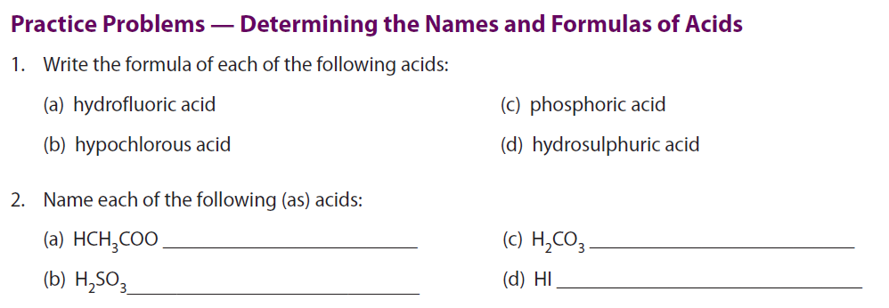

Slide 78
Naming and Writing Formulas of Covalent Compounds (molecules)
COVALENT COMPOUNDS (molecules):
contain a non metal(s) bonding to a non metal(s)
because non-metals combine in more than one ratio, we must use prefixes to indicate the number of atoms of each element in the formula.
if the prefix is followed by a vowel, the final "a" or "o" is dropped (not for DI- or TRI-)
EXCEPTION: the prefix mono is omitted for the first element only

Slide 79
The prefixes used are the same as for naming hydrates:
PREFIX | Number of atoms
mono | 1
di | 2
tri | 3
tetra | 4
penta | 5
hexa | 6
hepta | 7
octa | 8
nona | 9
deca | 10

Slide 80
Naming and Writing Formulas of Covalent Compounds (molecules)
PREFIX | Number of atoms
mono | 1
di | 2
tri | 3
tetra | 4
penta | 5
hexa | 6
hepta | 7
octa | 8
nona | 9
deca | 10
EXAMPLES:
N₂O
dinitrogen monoxide
N₂O₅
dinitrogen pentoxide
CO
monocarbon monoxide
carbon monoxide
CO₂
carbon dioxide

Slide 81
HOMEWORK
2.4 Review Problems: 105 - 106
Problems: all

Slide 82
QUIZ
Tuesday, March 11

