Slide 1
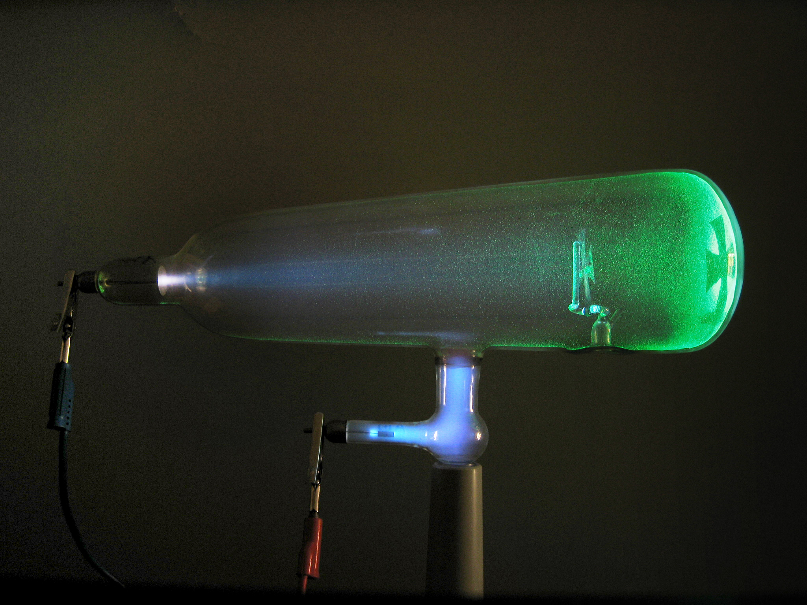
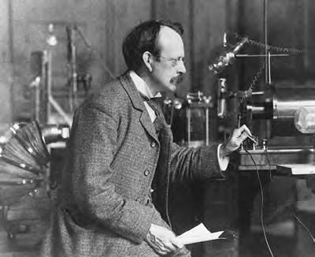
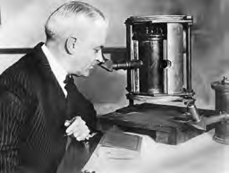
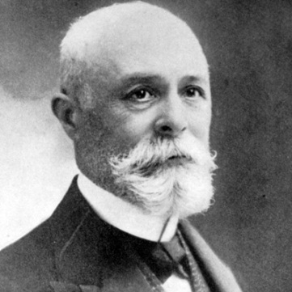
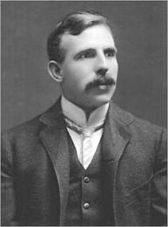
The Early Experiments To Characterize the Atom

Slide 2
TODAY’S OBJECTIVE??
To learn and familiarize yourself with scientists and experiments that led to development of the model of the atom which we use today

Slide 3
The Early Experiments To Characterize the Atom
Read the instructions on the worksheet
Work in pairs, BUT complete your own worksheet
Search the course website for additional clues (PPTs, videos, animations, pdf files of textbooks) to help you with the questions
ASK me questions if you are unsure
ENJOY!

Slide 4
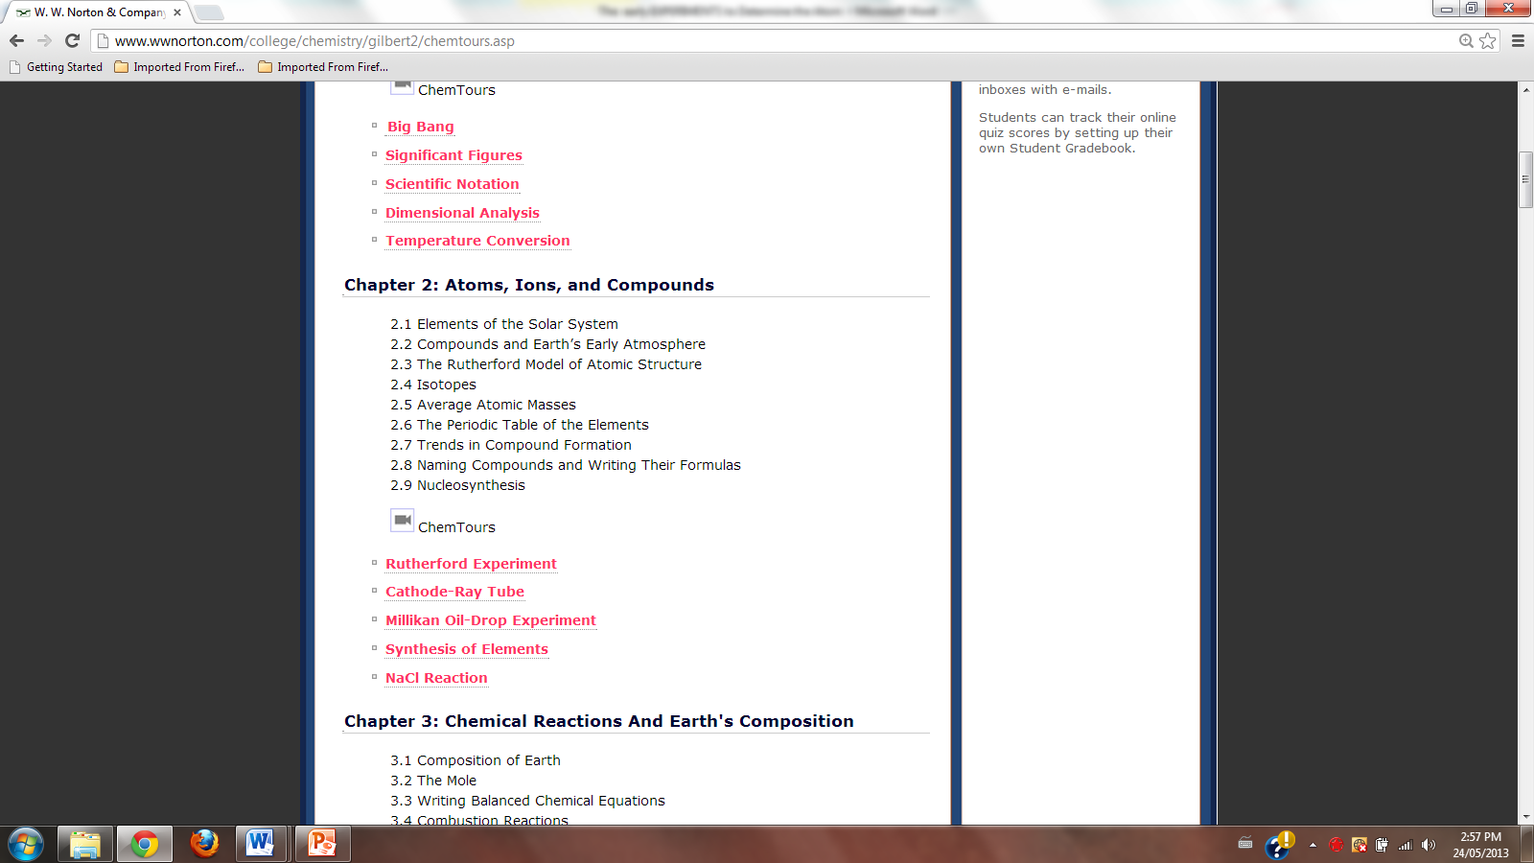
The website

Slide 5
The website

Slide 6
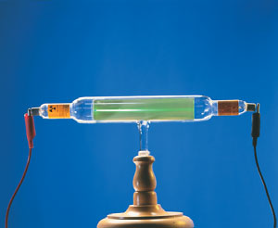
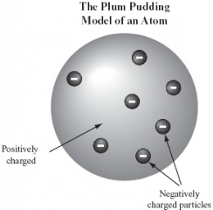
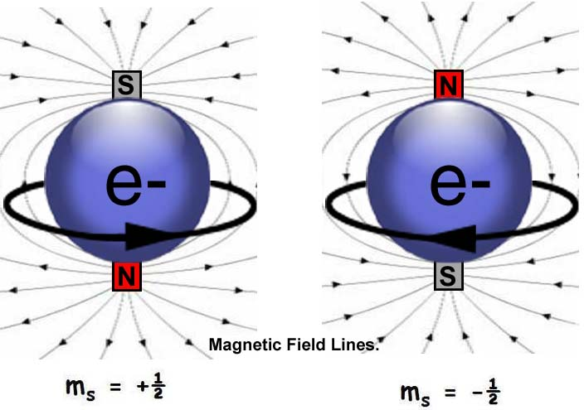
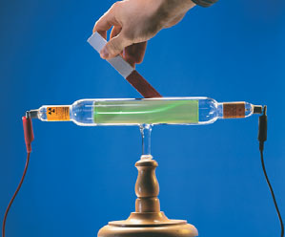
THE ELECTRON
J.J. Thomson discovered the existence of the first subatomic particle – the electron and its charge - mass ratio
$\frac{\text{e}}{\text{m}}$ = -1.76 x 10⁸ C/g
But since the atoms were known to be neutral, he suggested that atom is made up of a cloud of positive charge with the negative electrons embedded randomly in it

Slide 7
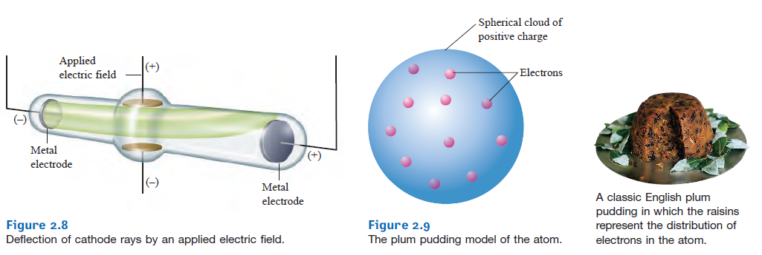
THE PLUM PUDDING MODEL OF THE ATOM
He called his model of the atom:
But since the atoms were known to be neutral, he suggested that atom is made up of a cloud of positive charge with the negative electrons embedded randomly in it

Slide 8
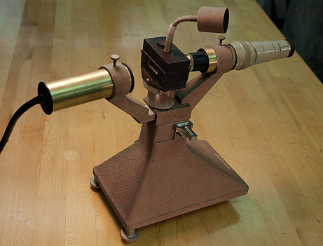
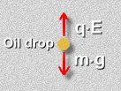
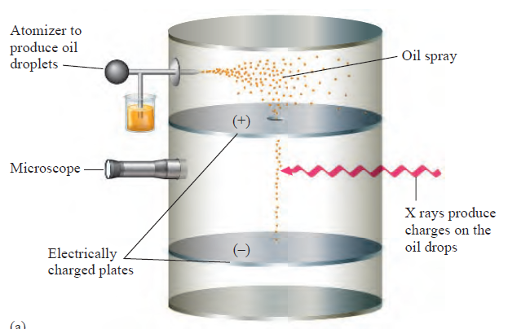
THE ELECTRON
In 1909, Robert Millikan determined the mass and the charge of the electron
e = 9.11 x 10⁻³¹ kg
e = 1 .602 x 10⁻¹⁹ C

Slide 9
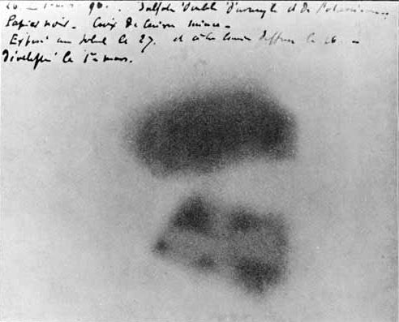
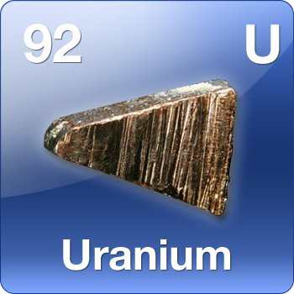
RADIOACTIVITY
The French scientist Henri Becquerel discovered that uranium spontaneously emits high-energy radiation. It was called radioactivity.
This discovery allowed for testing J.J. Thomson’s
PLUM PUDDING MODEL OF THE ATOM

Slide 10
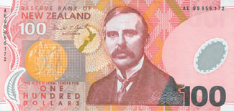
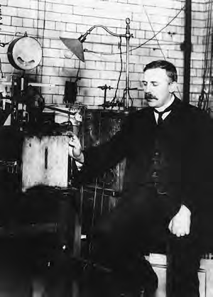
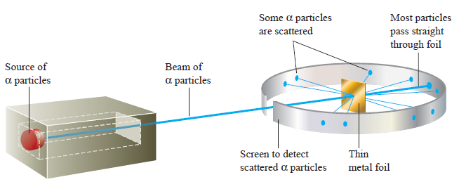
The Nuclear Atom (nucleus)
Ernest Rutherford tested PLUM PUDDING MODEL OF THE ATOM

Slide 11
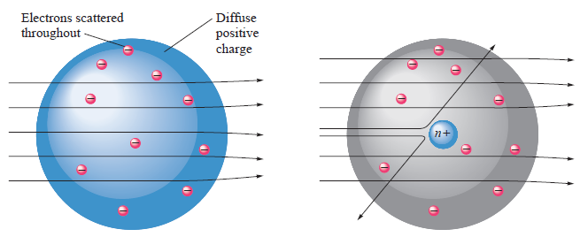
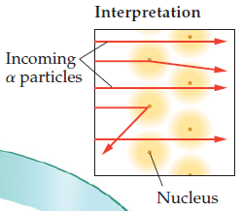
The Nuclear Atom (nucleus)
He found out that inside of the atom, there is a dense center of a positive charge – a NUCLEUS
This didn’t agree with the Thomson’s model!

Slide 12
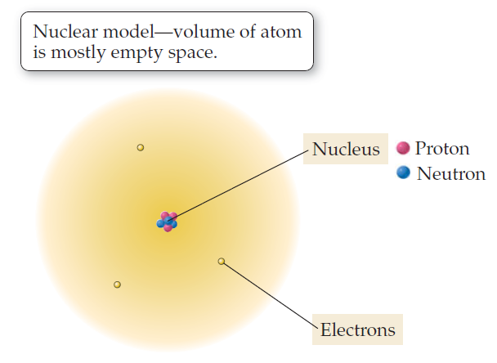
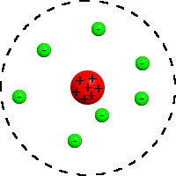
The Nuclear Atom (nucleus)
He proposed a different model for the atom:
Most of the volume of an atom is empty space in which negatively charged electrons move around the dense, positively charged nucleus.

Slide 13
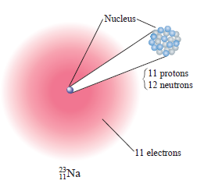
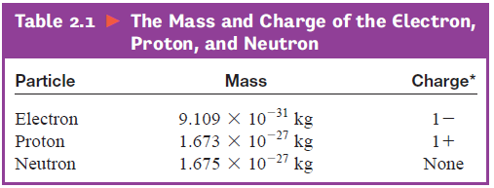
THE MODERN VIEW OF THE ATOM
It is composed of electrons, protons and neutrons
ELECTRONS:
Orbit the nucleus
Charge of -1
Very low mass

Slide 14
THE MODERN VIEW OF THE ATOM
It is composed of electrons, protons and neutrons
Protons:
In the nucleus
Charge of +1
Much higher mass then electrons

Slide 15
THE MODERN VIEW OF THE ATOM
It is composed of electrons, protons and neutrons
Neutrons:
In the nucleus
Charge of 0
Almost identical mass as protons

