Slide 1
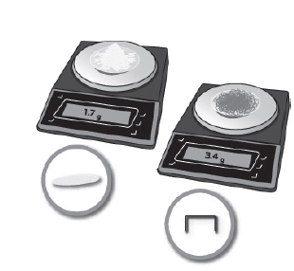
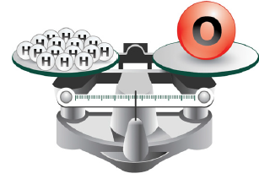
3.1 Relative Atomic Mass

Slide 2
dozen
litre
kg
volume
mass

Slide 3
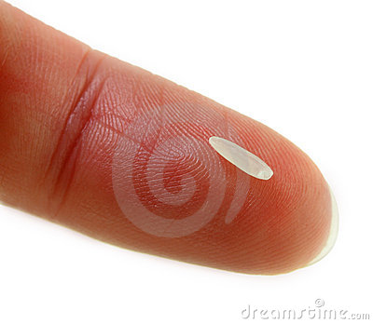
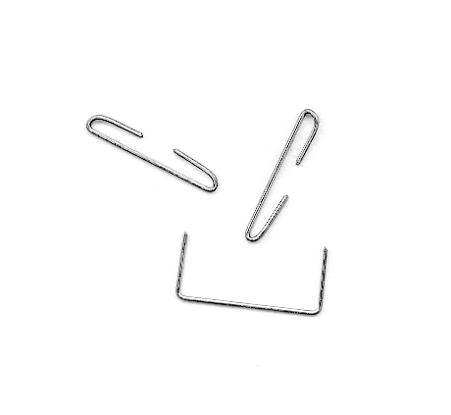
Relative Mass
What does Relative Mass mean?
Comparing one object’s mass to the other’s

Slide 4
Relative Mass
What does Relative Mass mean?
How can you compare the relative masses of a grain of rice and a staple…?

Slide 5
Relative Mass
If you do not have a scale precise enough to register a mass of each…
How can you compare the relative masses of a grain of rice and a staple…?

Slide 6
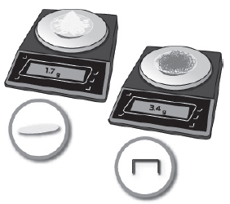
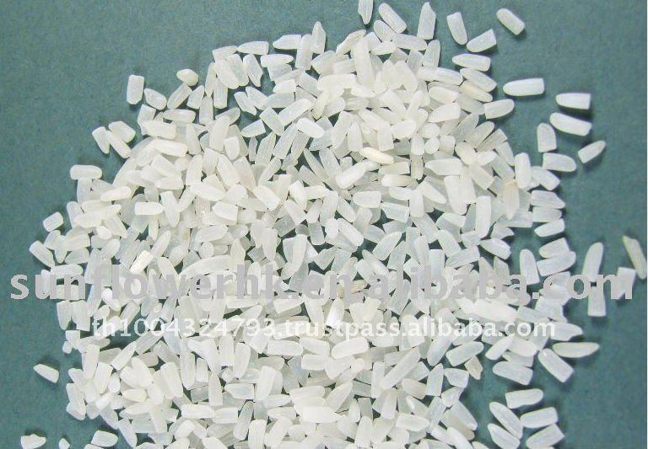
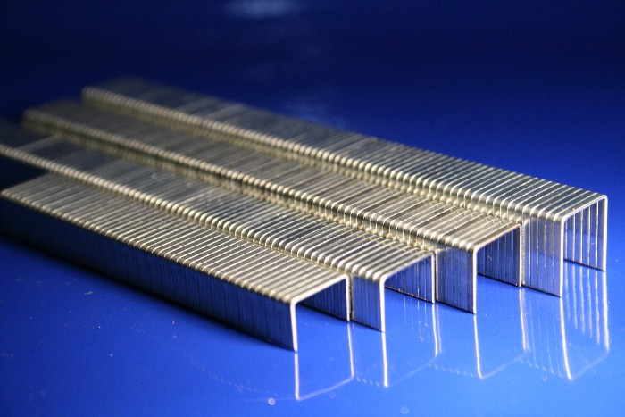
Relative Mass
Weight 100 grains and 100 staples and compare

Slide 7
Relative Mass
Can this method work even if the grains and staples are not identical?

Slide 8
Relative Mass

Slide 9
One object’s mass relative to another’s
You must have the same number of candies in each bag

Slide 10
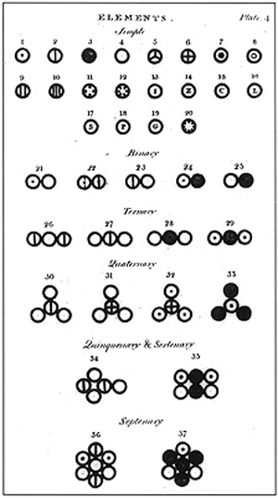
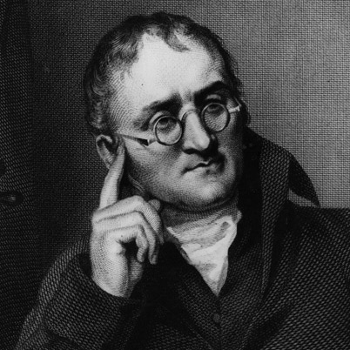
The Law of Constant Composition
Chemists in the past apply this simple method to figure out relative masses of different types of atoms…

Slide 11
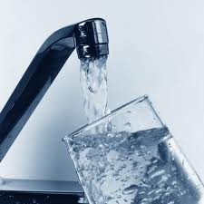
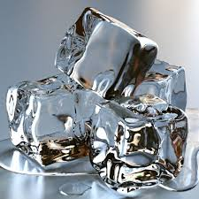
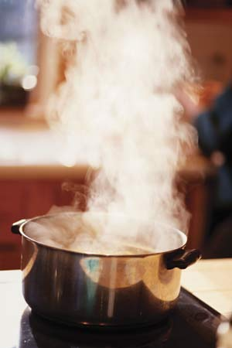
The Law of Constant Composition
They discovered that all samples of a given compound (e.g. water) have the same mass ratio of their constituents elements

Slide 12
The Law of Constant Composition
For every 1g of H, there are always 8g of oxygen in every sample of water

Slide 13
The Law of Constant Composition
For every 1g of H, there are always 8g of oxygen in every sample of water
Dalton argued that the mass ratios in which different elements combine (8g O : 1g H in water) = the mass ratios of their individual atoms (or a multiple thereof)

Slide 14
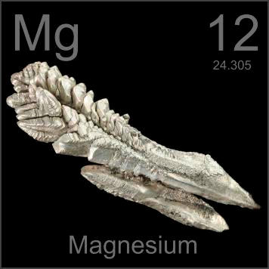
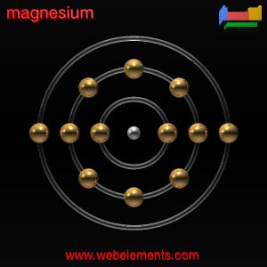
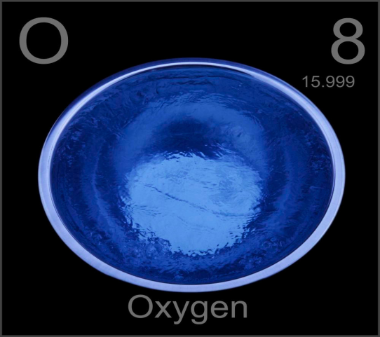
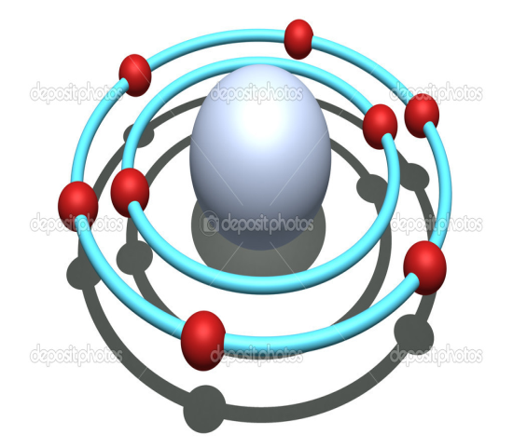
The Law of Constant Composition
If one atom of Mg weighs 1.5 times as much as one atom of O, then ANY NUMBER of Mg atoms would weigh 1.5 times as much as the same number of oxygen atoms
Dalton argued that the mass ratios in which different elements combine (8g O : 1g H in water) = the mass ratios of their individual atoms (or a multiple thereof)

Slide 15
If one atom of Mg weighs 1.5 times as much as one atom of O, then ANY NUMBER of Mg atoms would weigh 1.5 times as much as the same number of oxygen atoms

Slide 16
10.5
5.48
6.94 amu
lithium

Slide 17
Relative Masses of Atoms
If one atom of Mg weighs 1.5 times as much as one atom of O, then ANY NUMBER of Mg atoms would weigh 1.5 times as much as the same number of oxygen atoms

Slide 18
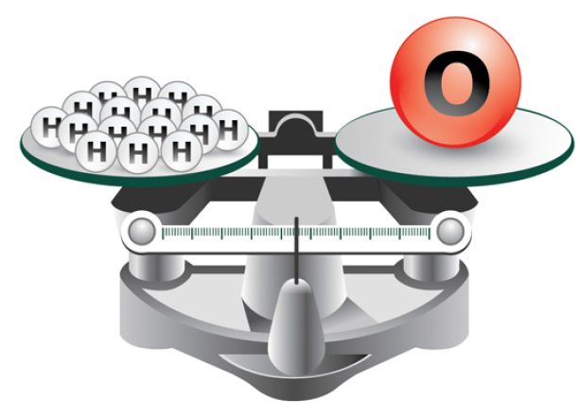
Relative Masses of Atoms
Hydrogen was found out to be the lightest atom, so its atom was assigned atomic mass 1 u (1 amu), all other atoms were expressed as relative to it…

Slide 19
Relative Masses of Atoms
Oxygen mass is 16u (16 amu)
What Does This Mean?

Slide 20
2(1.934) x 35.5 u = 137.3 u

Slide 21
Number of Atoms Ratio of Al : I
in a compound
Mass Ratio of Al : I
in a compound
Atomic Masses of Al : I
1 Al : 3I
1 Al : 14I
X u Al : 126.9 u I
Make it 1:1 ratio
Divide I by 3
Make it 1:1 ratio
Divide I by 3
1 Al : 1I
1 Al : 4.7I
What number did you multiply 4.7 I to get 126.9u I?

Slide 22
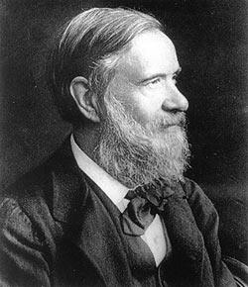
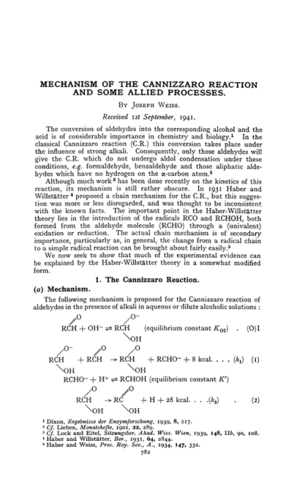
Cannizzaro’s Paper
Read on your own
Page 111
Testable on QUIZ/TEST

Slide 23
CLASSWORK
3.1 Activity: page 112
3.1 Review Problems: 113 – 114
all of them
Case Study: (due after Chapter 3 TEST)

Slide 24
QUIZ
Tuesday, March 11

