Slide 1
What
do the next few
pictures
have in common?

Slide 2

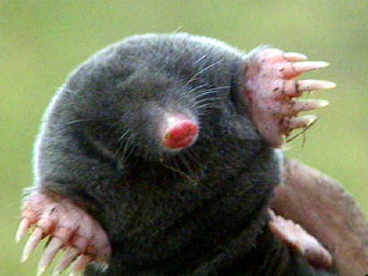

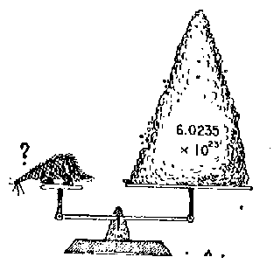

Slide 3
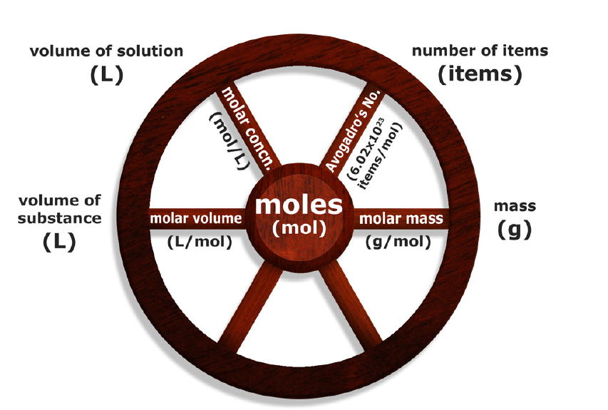
3.2 The Mole - Central Unit of Chemistry
Pages 115 - 123

Slide 4


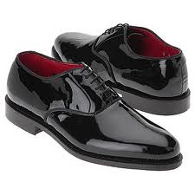
Introduction to the Mole
A pair of socks/shoes
2 socks/shoes

Slide 5

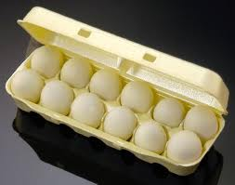
Introduction to the Mole
A dozen of roses/eggs
12 roses/eggs

Slide 6


Introduction to the Mole
A ream of paper
500 sheets

Slide 7
Introduction to the Mole
Why is it useful to use units like a dozen or a ream?
The calculation of the items becomes easier especially when the number of items is large

Slide 8
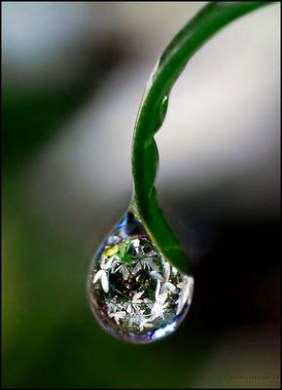

How many molecules of water are in a one drop!

Slide 9
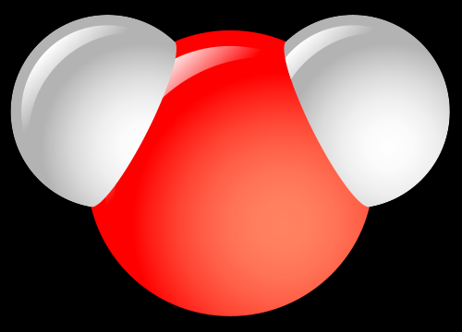
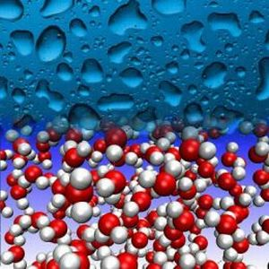
How many molecules of water are in a one drop!
They are too small to count

Slide 10
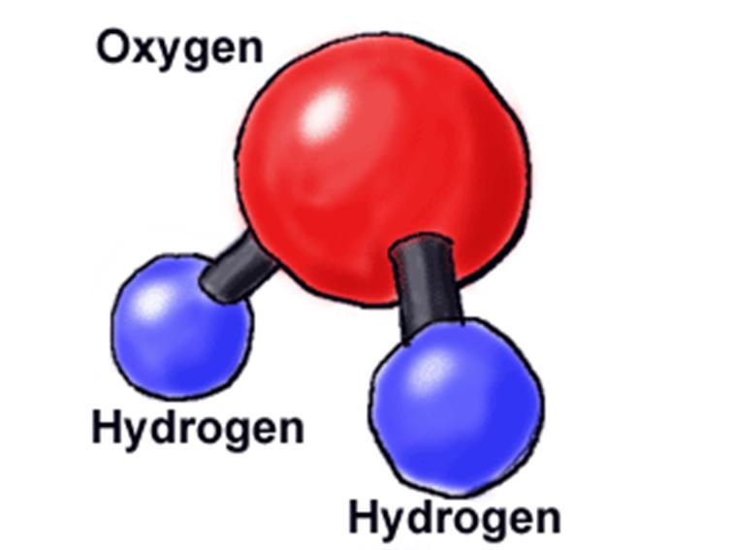
How many molecules of water are in a one drop!
We need to find a way how to count things which are very, very tiny!

Slide 11
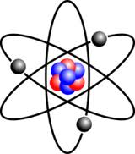
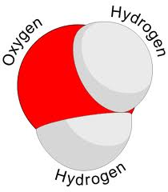
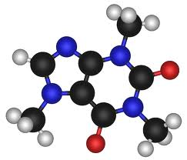
That is why scientists came up
with a special unit
This unit lets us COUNT anything very, very small.
Things that you can not see easily such as
IT IS CALLED

Slide 12
MOLE

Slide 13
1 MOLE of anything is
=
6.022 x 10²³
602,200,000,000,000,000,000,000
AVOGADRO’S NUMBER

Slide 14
=
2
12
=
=
6.022 x 10²³
602,200,000,000,000,000,000,000
AVOGADRO’S NUMBER

Slide 15
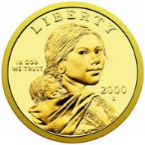
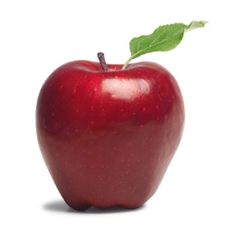
1 MOLE of
602,200,000,000,000,000,000,000
1 MOLE of
602,200,000,000,000,000,000,000
6.022 x 10²³
1 MOLE of
602,200,000,000,000,000,000,000
1 MOLE of
602,200,000,000,000,000,000,000

Slide 16
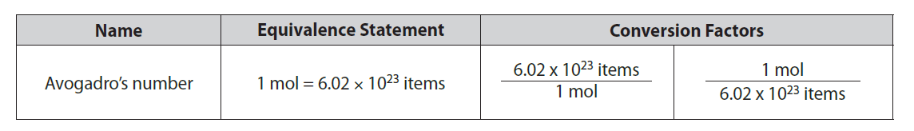
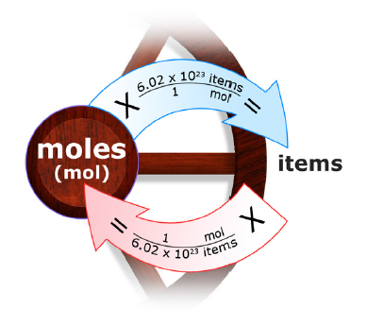
Conversion Factors Involving Moles

Slide 17

Conversion Factors Involving Moles

Slide 18
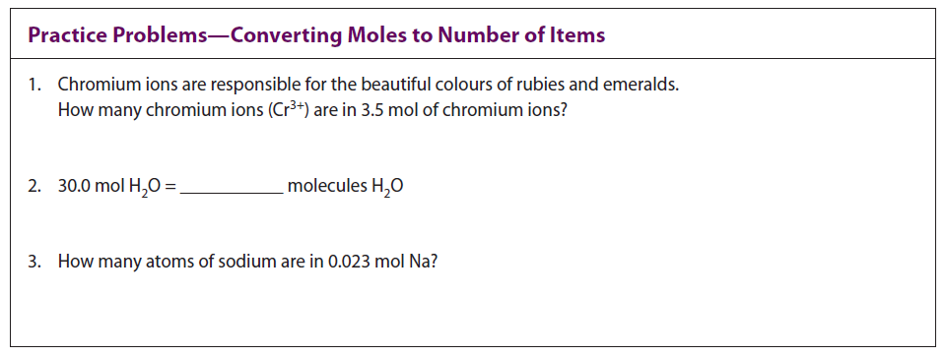
Conversion Factors Involving Moles

Slide 19

Conversion Factors Involving Moles

Slide 20
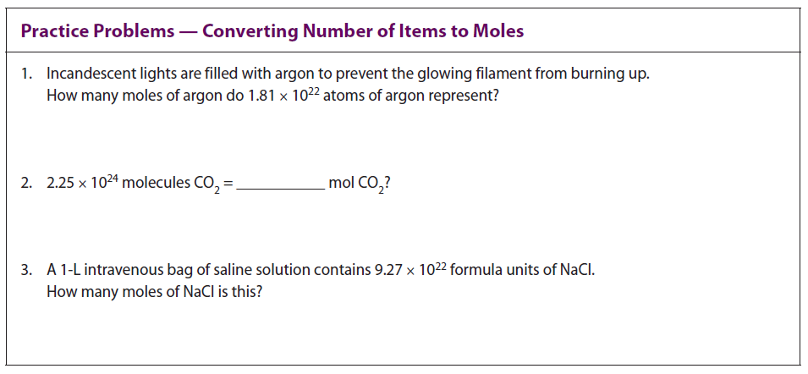
Conversion Factors Involving Moles

Slide 21
Mollionaire
How long would it take to spend a mole of $1 coins, if they were being spent at a rate of 1 billion per second
19 million years

Slide 22


Atomic Mass vs. Formula (Molecular) Mass
What is the mass of 1 atom of sulphur?
32.1 amu
Atomic Mass
What is the mass of 1 molecule of water?
(1 oxygen atom + 2 hydrogen atoms)
(Atomic mass of O) + 2(Atomic Mass of Hydrogen)
16.0 + 2(1.0) = 18.0 amu
Molecular Mass or Formula Mass

Slide 23
Calculate the Molecular Mass of C₆H₁₂O₆
How to do it?

Slide 24
Calculate the Molecular Mass of C₆H₁₂O₆
List all the different atoms
in the molecule!
We have CARBON, HYDROGEN, and OXYGEN.

Slide 25
Calculate the Molecular Mass of C₆H₁₂O₆ :
What is the atomic mass of one CARBON atom?
12.0 amu
HOW MANY CARBON ATOMS ARE THERE?
6
=
72.0 amu
12.0 amu
x
6

Slide 26
Calculate the Molecular Mass of C₆H₁₂O₆ :
What is the atomic mass of one hydrogen atom?
1.0 amu
HOW MANY HYDROGEN ATOMS ARE THERE?
12
=
12.0 amu
1.0 amu
x
12

Slide 27
Calculate the Molecular Mass of C₆H₁₂O₆ :
What is the atomic mass of one OXYGEN atom?
16.0 amu
HOW MANY OXYGEN ATOMS ARE THERE?
6
=
96.0 amu
16.0 amu
x
6

Slide 28
Calculate the Molecular Mass of C₆H₁₂O₆ :
Put all Atomic Masses for all atoms together:
6 CARBON ATOMS:
72.0 amu
+
12 HYDROGEN ATOMS:
12.0 amu
+
6 OXYGEN ATOMS:
96.0 amu
Molecular Mass of C₆H₁₂O₆ = 180.0 amu
WATCH OUT FOR SIG.FIGS!

Slide 29
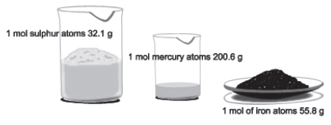
Molar Mass
The mass of 1 mole of an element is
equal to its atomic mass units expressed in grams.

Slide 30
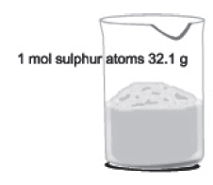
Molar Mass (for an element)
What is the mass of 1 atom of sulphur?
32.1 amu
Atomic Mass
What is the mass of 1 mol of sulphur atoms?
(6.02 x 10²³ S atoms)
32.1 grams
32.1 g S /mol
Molar Mass

Slide 31
Basically, take an ATOMIC MASS, switch units from amu to g and the atomic mass becomes MOLAR MASS
What is the mass of 1 atom of sulphur?
32.1 amu
Atomic Mass
What is the mass of 1 mol of sulphur atoms?
(6.02 x 10²³ S atoms)
32.1 grams
32.1 g S /mol
Molar Mass

Slide 32
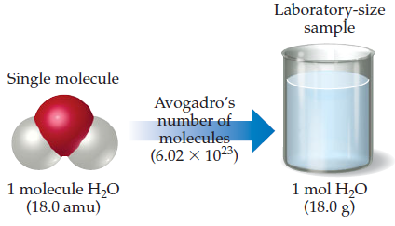
Molar Mass (for a compound)
The mass of 1 mole of a compound is
equal to its Molecular (formula) mass expressed in grams.

Slide 33


Molar Mass (for a compound)
What is the mass of 1 molecule of water?
(1 oxygen atom + 2 hydrogen atoms)
(Atomic mass of O) + 2(Atomic Mass of Hydrogen)
16.0 + 2(1.0) = 18.0 amu
Molecular Mass or Formula Mass
What is the mass of 1 mol of WATER MOLECULES?
(6.02 x 10²³ H₂O molecules)
18.0 grams
18.0 g H₂O/mol
Molar Mass

Slide 34
Basically, take MOLECULAR (FORMULA) MASS, switch units from amu to g and the molecular (formula)mass becomes MOLAR MASS

Slide 35
Calculate the Molecular Mass of C₆H₁₂O₆
180.0 amu
Calculate the Molar Mass of C₆H₁₂O₆
180.0 g

Slide 36
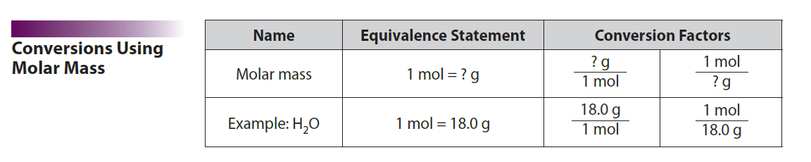
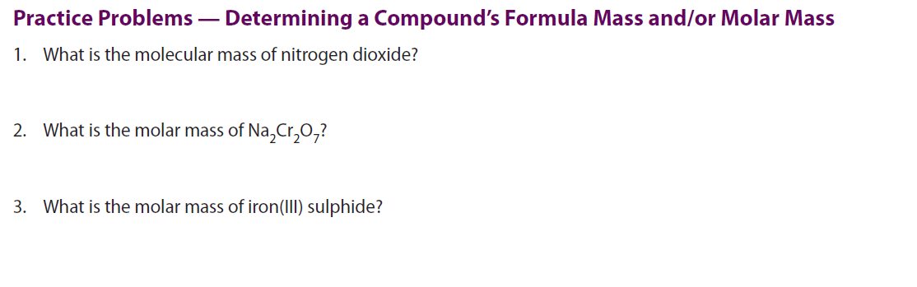
Molar Mass

Slide 37
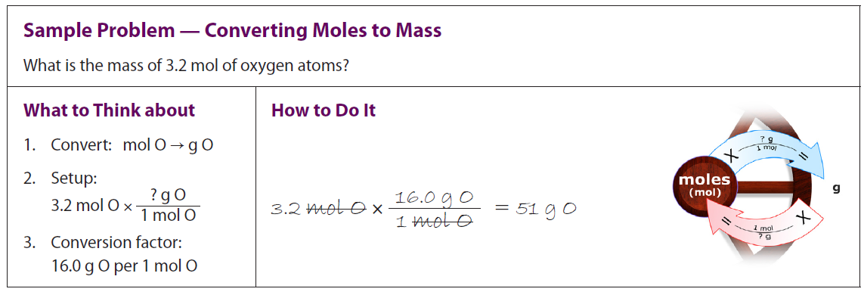

Slide 38
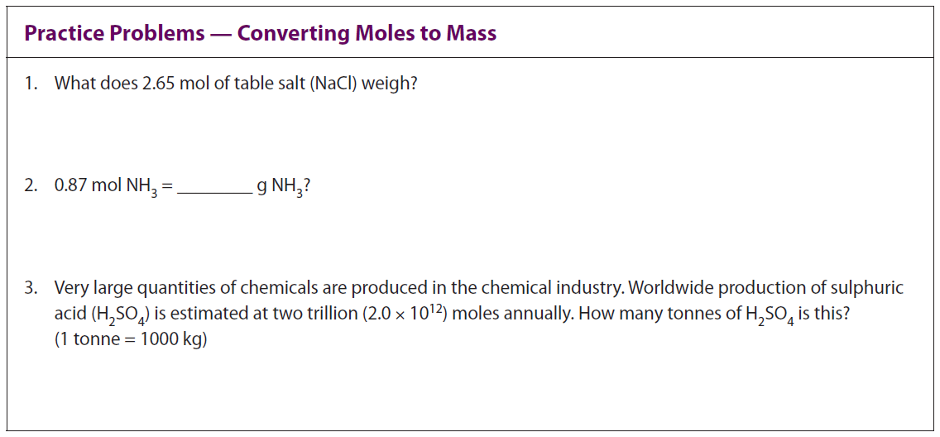

Slide 39
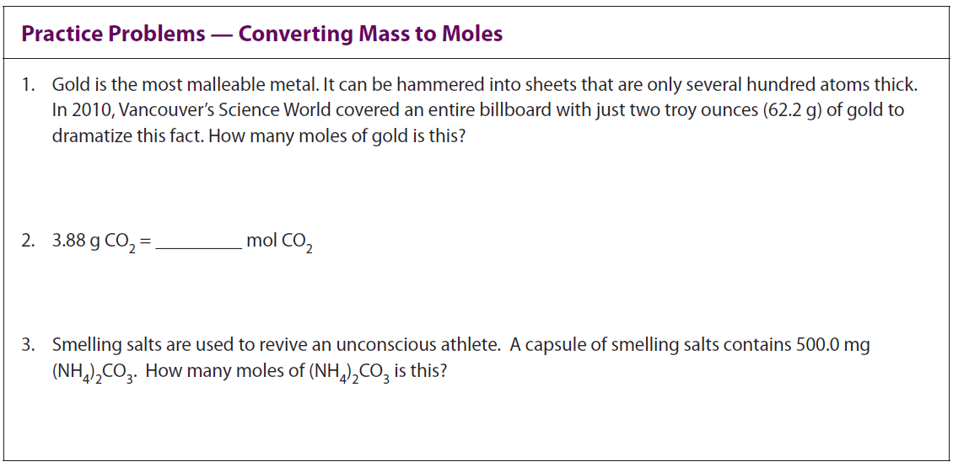

Slide 40
Classwork/Homework
3.2 Review Problems (page 122 – 123): all even

