Slide 1
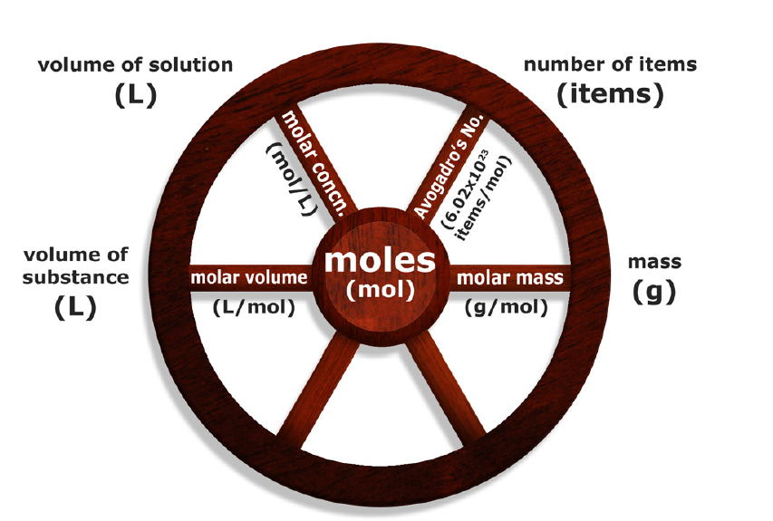
3.3 The Wheel Model of Mole Conversion
Pages 124 - 131

Slide 2

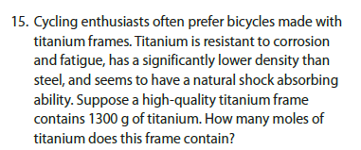
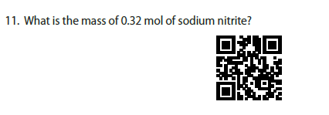
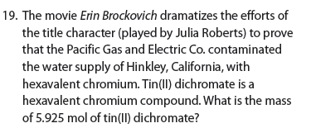


Slide 3
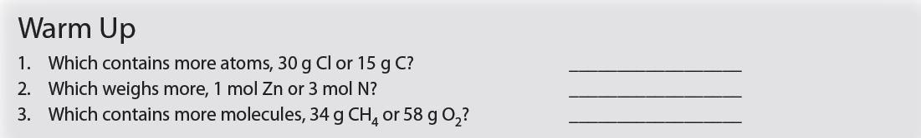

Slide 4
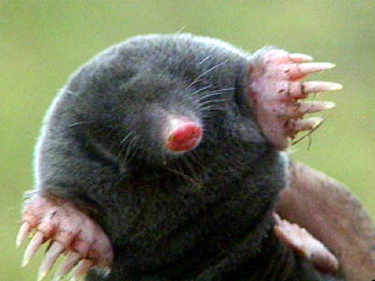
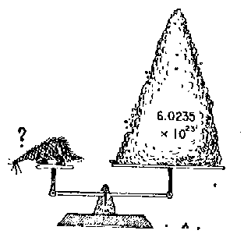
The mole is the link between the
world of atoms/molecules and
observable quantities
(mass, volume, number of particles)

Slide 5
The mole is the link between the
world of atoms/molecules and
observable quantities
(mass, volume, number of particles)

Slide 6
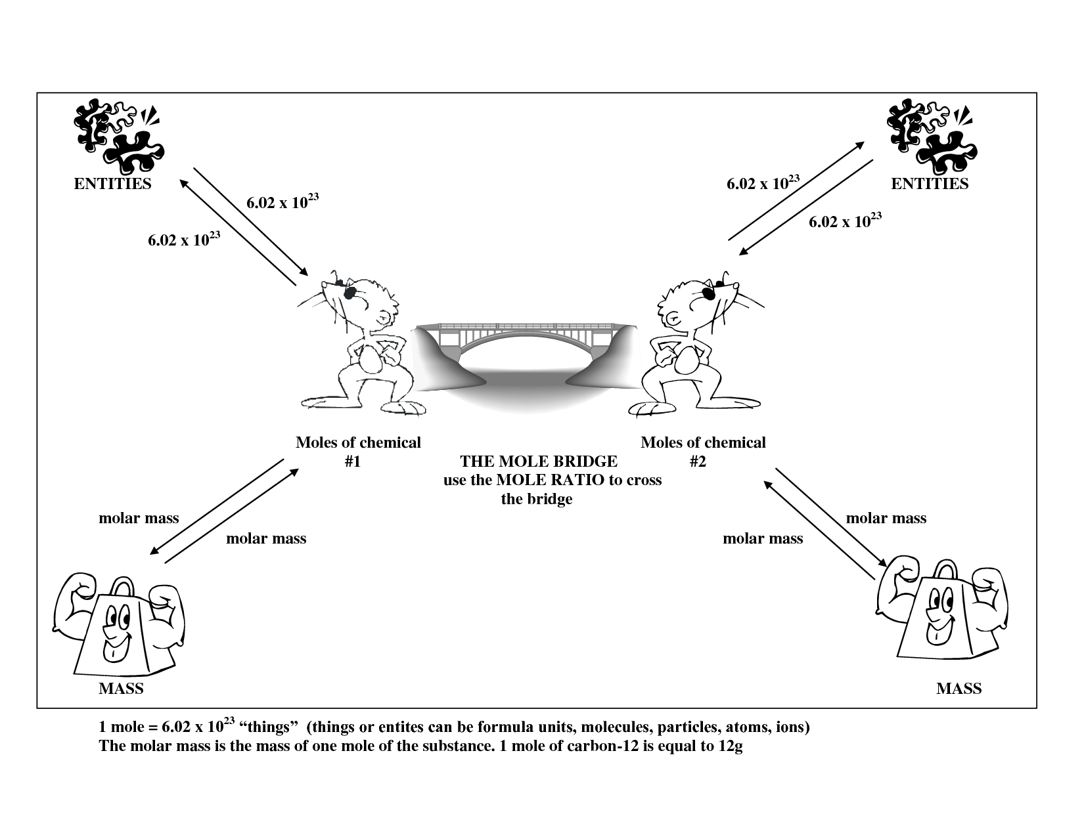

Slide 7
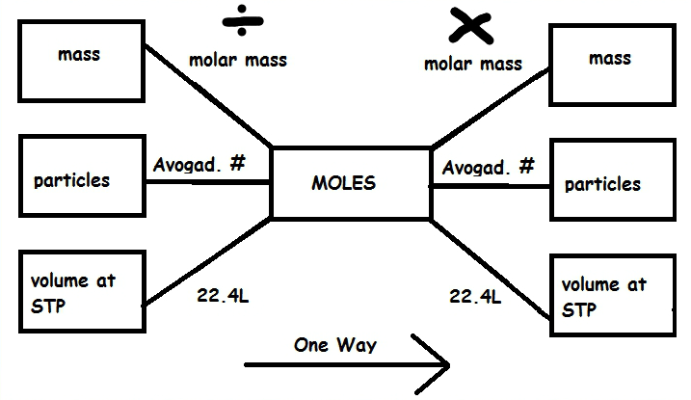

Slide 8
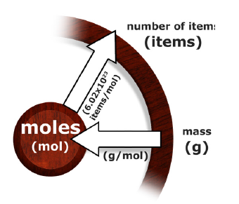
How Many Atoms are in 5.0g of Copper
Two – step conversion:
2
Mass of Cu to mol of Cu
Mol of Cu to Number of atoms of Cu
1

Slide 9
How Many Atoms are in 5.0g of Copper
Two – step conversion:

Slide 10
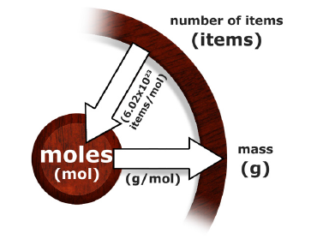
What is the mass of an oxygen atom in grams?
Two – step conversion:
1
Number of atoms of O to mol of O
Mol of O to Mass of O
2

Slide 11
What is the mass of an oxygen atom in grams?
Two – step conversion:

Slide 12
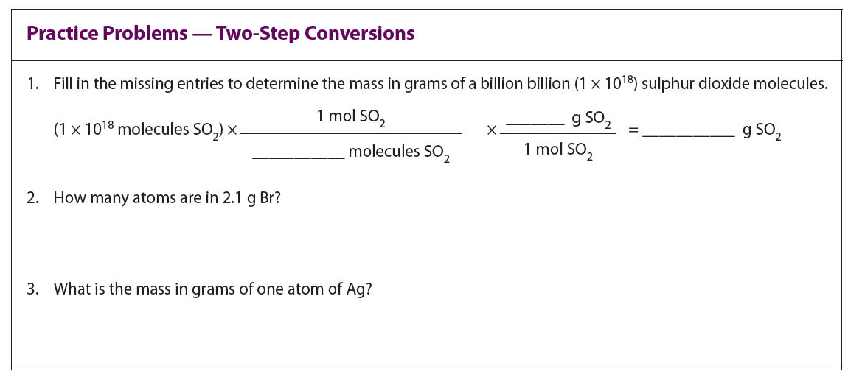
the case study time…!

Slide 13
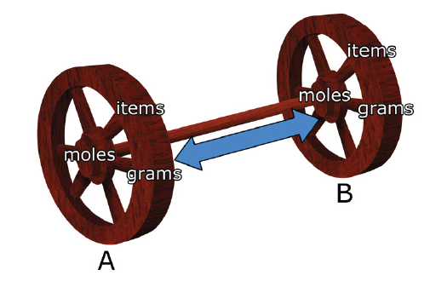
The Wheel Conversions
Relating a quantity of one
chemical to a quantity of another chemical

Slide 14
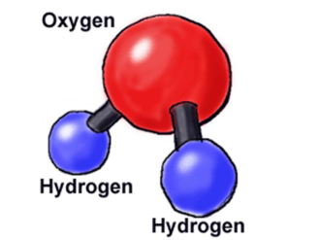

Imaging having 1 molecule of water...
How many Hydrogen atoms?
How many Oxygen atoms?
H₂O
Imaging having 10 molecule of water...
How many Hydrogen atoms?
How many Oxygen atoms?
10 H₂O

Slide 15
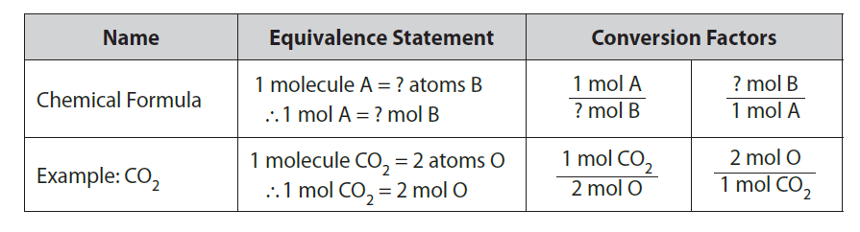
Imaging having 1 mol of water...
How many Hydrogen atoms?
How many Oxygen atoms?
H₂O
To convert between two different species...

Slide 16
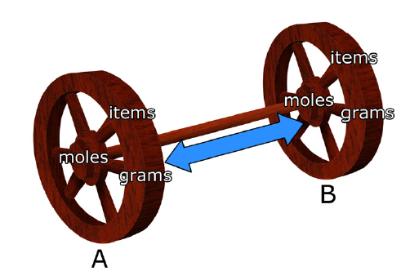
CO₂
O
To convert between two different species...

Slide 17
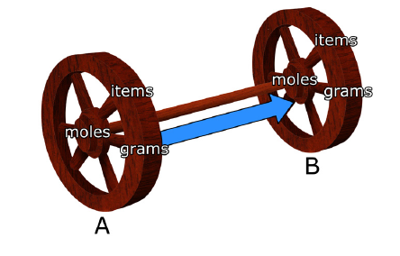
How many moles of hydrogen are in 6.0 mol of water?
One – step conversion:
Moles of H₂O to mol of H
1
H
H₂O

Slide 18
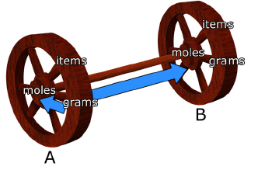
Two – step conversion:
Grams of H to mol of H
Mol of H to mol of CH₄
2
CH₄
1
H

Slide 19
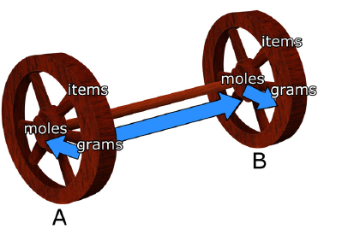
How many grams of oxygen are in 14.6 g of CO₂?
1
3
Three – step conversion:
Grams of CO₂ to mol of CO₂
Mol of CO₂ to mol of O
Mol of O to grams of O
2
o
CO₂

Slide 20
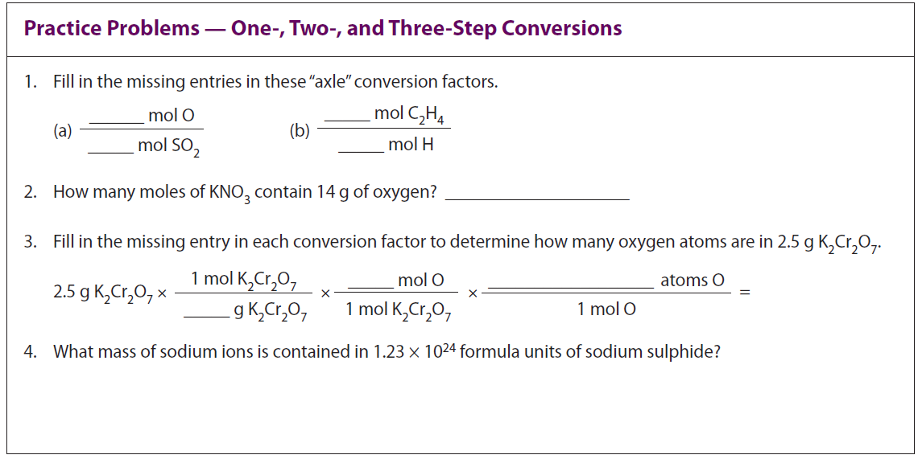
Page: 128

Slide 21
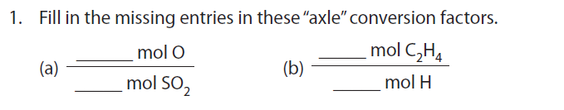

Slide 22
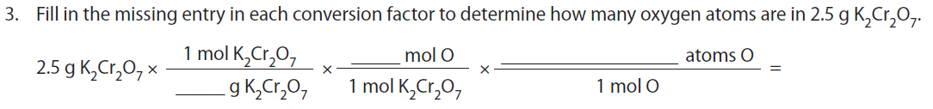

Slide 23
Classwork/Homework
3.3 Activity: The Evaporation of Water (page 129)
3.3 Review Problems (page 130 – 131): all even
3.3 QUIZ, Friday April 11

Slide 24
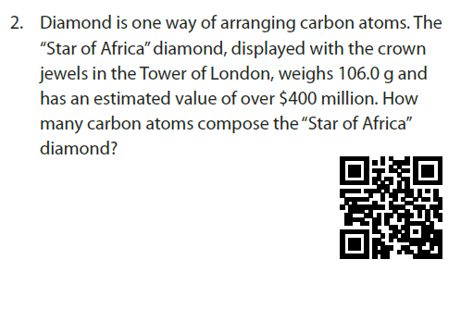


Slide 25
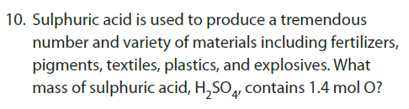


Slide 26
EXAMPLE 1
If you will distribute 1 mole of dollars evenly to each of the 4.5 x 10⁹ people on Earth and each person spend one thousand dollars each second, day and night. What percentage of each person’s wealth will have been spent after one year?
0.2357%

Slide 27
EXAMPLE 2
The total land area of the earth is 1.49 x 10⁸ km². The cross – sectional area of a penny is 3.61 cm² (1 km² = 1x10¹⁰ cm) and the thickness of a penny is 1.50 mm. If a mole of pennies is distributed evenly over the total land area of the earth, how thick a layer will be formed?

