Slide 1
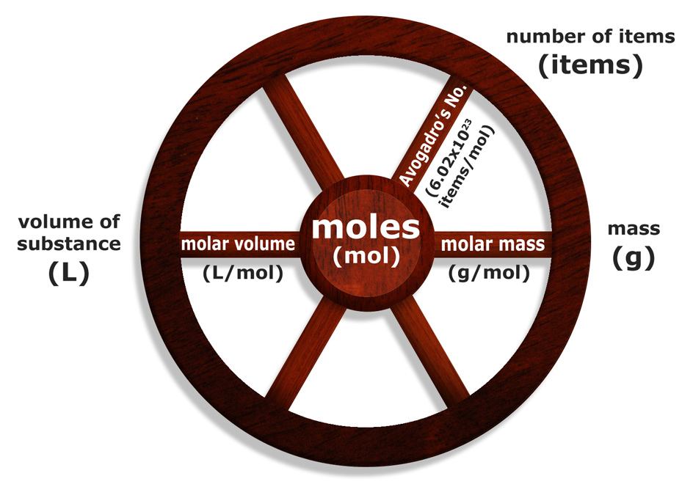
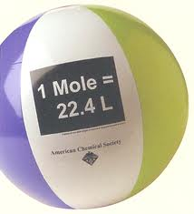
3.3 The Molar Volume
Pages 132- 141

Slide 2
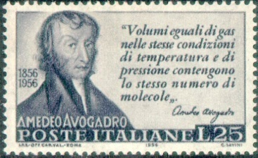
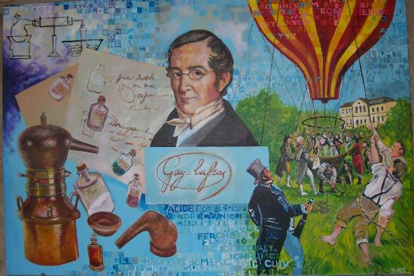
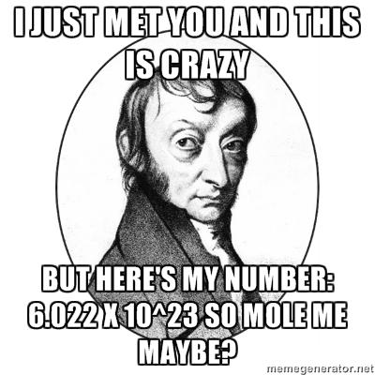
MOLAR VOLUME
Gay Lussas and Amadeo Avogadro found out that
equal volumes of different gases , measured at the same temperature and pressure have equal number of particles

Slide 3
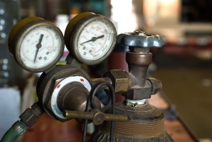
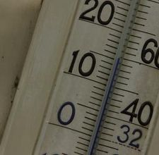
Standard Temperature and Pressure
(STP)
Temperature: 273.15K or 0ºC
Pressure: 101.3kPa or 1 atm

Slide 4
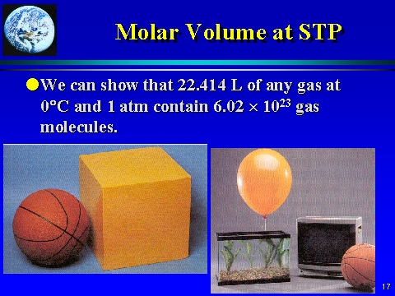
MOLAR VOLUME
Volume occupied by one mole of the gas at STP

Slide 5
MOLAR VOLUME
Volume occupied by one mole of any gas at STP
Volume occupied by 6.02 x 10²³ particles of any gas at STP

Slide 6
1 mol of any gas at STP has a volume of 22.4 L
OR in other words,
The volume of 1 mol of any gas at STP is 22.4 L

Slide 7
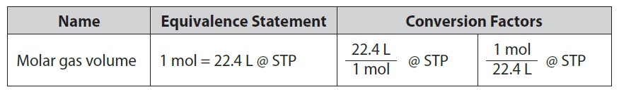
MOLAR VOLUME
Volume occupied by one mole of any gas at STP
It only applies to:
Gases
Only at STP

Slide 8
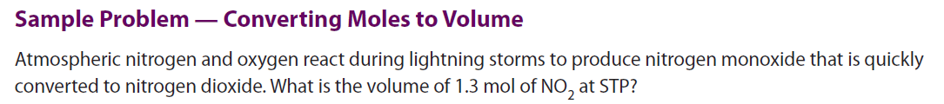
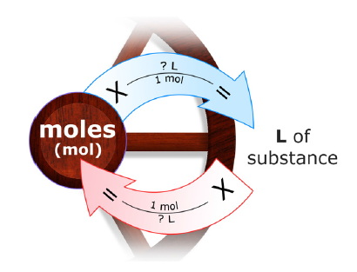

Slide 11
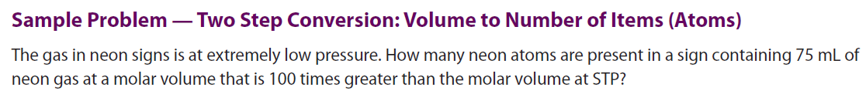
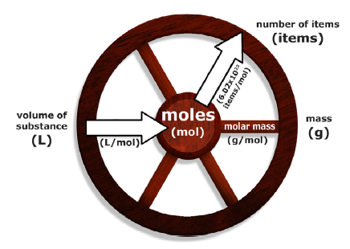
Two – step conversion:
2
1
Volume of Ne to mol of Ne
Mol of Ne to Number of atoms of Ne

Slide 12
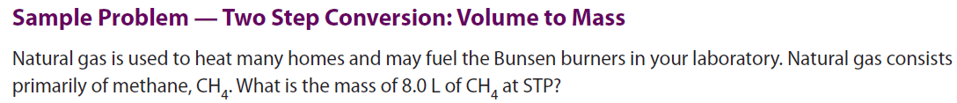
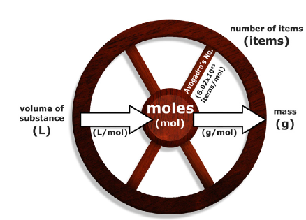
Two – step conversion:
1
Volume of CH₄ to mol of CH₄
Mol of CH₄ to grams of CH₄
2

Slide 13
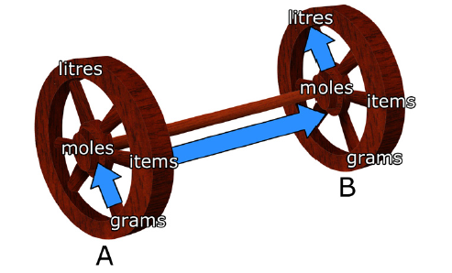
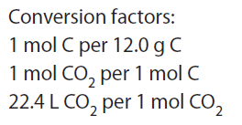
What volume of CO₂ at STP contains 0.20g of C?
Grams of C to mol of C
Mol of C to mol of CO₂
Mol of CO₂ to litres of CO₂
CO₂
C

Slide 14
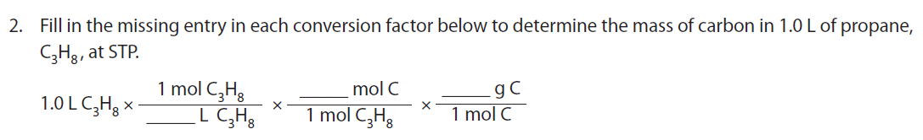

Slide 16
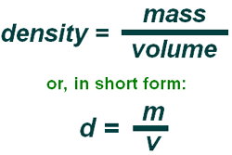
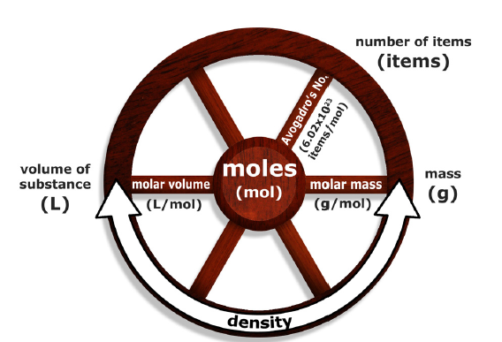
MOLAR VOLUME and DENSITY
Density = amount of matter in a given volume
Using units for molar volume and molar mass,
Try to come up with a formula that relates them to density

Slide 17

MOLAR VOLUME and DENSITY
Density = amount of matter in a given volume
Using units for molar volume and molar mass,
Try to come up with a formula that relates them to density

Slide 18
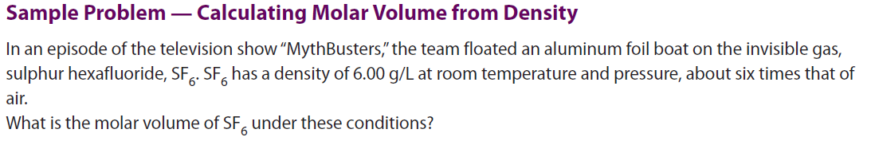

Slide 21
Classwork/Homework
3.4 Review Problems (page 140 – 141): all even
3.4 QUIZ, Wednesday, April 16

Slide 22
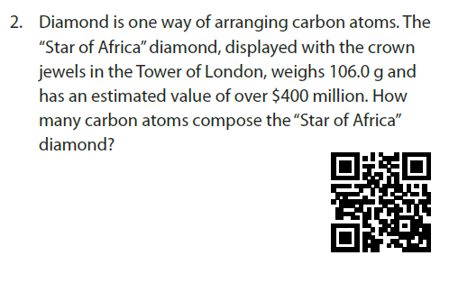


Slide 23
