Slide 1
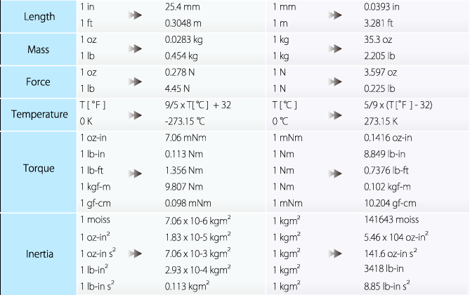
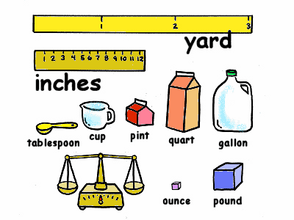
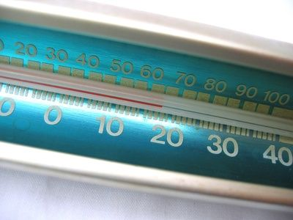
Dimensional Analysis and Conversion factors

Slide 2
Any quantity we measure,(length, mass, volume…) consists of a number and unit
22.2 g
If we are given a quantity in one type of unit, and we want another type of unit :
22.2 g = ? lb
We must convert the units
We can do this by using
CONVERSION FACTORS

Slide 6
A relationships between any quantities can be expressed by CONVERSION FACTORS

Slide 7
A relationships between any quantities can be expressed by CONVERSION FACTORS

Slide 8
Now, write down CONVERSION FACTORS for:
1.) yard and inch (1 yard = 36 inches)
2.) feet and meters (1 foot = 0.3048 metre)
3.) mile and kilometers (1 mile = 1.609 km)
4.) pounds and kilograms (2.2 lb = 1kg)

Slide 9
EXAMPLE #1
Convert 21.5 inches to cm!
Step 1: Write conversion factors for inches and cm
Step 2: Choose a conversion factor which will allow you to cancel units of a given quantity (inches in our case)
Step 3: Multiply, cancel and check the units

Slide 10
Convert 21.5 inches to cm!
Step 1: Write conversion factors for inches and cm

Slide 11
Convert 21.5 inches to cm!
Step 1: Write conversion factors for inches and cm
Step 2: Choose a conversion factor which will allow you to cancel units of a given quantity (inches in our case)

Slide 12
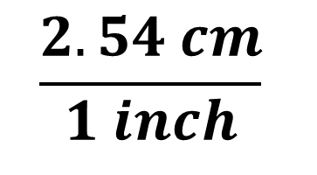
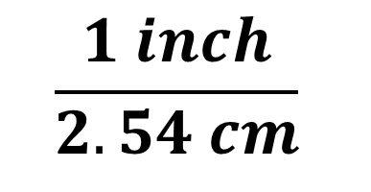
Convert 21.5 inches to cm!
Step 2: Choose a conversion factor which will allow you to cancel units of a given quantity (inches in our case)
$$\frac{1 inch}{2.54 cm}$$
NO!
21.5 inches x
$$\frac{2.54 cm}{1 inch}$$
YES!
21.5 inches x
$\frac{1 inch}{2.54 cm}$ $\frac{2.54 cm}{1 inch}$

Slide 13
EXAMPLE #1
Convert 21.5 inches to cm!
1 step metric conversion

