Slide 1
2 step metric conversion
Requires the use of two conversion factors because there are 2 prefixes in the question:
micro(µ) and kilo(k)
Convert 6.32 µm to km

Slide 2
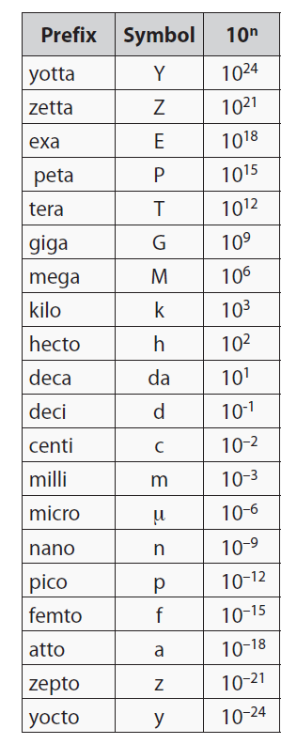
Convert 6.32 µm to km
Convert to a base unit (need 2 conversion factors) and from the base unit
Set up the units so the known unit cancels (in denominator) and the desired unit is in numerator
Insert the values for 1 µm and 1 km
Cancel the units and do the math

Slide 3
Convert 6.32 µm to km
Convert to a base unit (need 2 conversion factors) and from the base unit

Slide 4
Convert 6.32 µm to km
Set up the units so the known unit cancels (in denominator) and the desired unit is in numerator

Slide 5
Convert 6.32 µm to km
Insert the values for 1 µm and 1 km

Slide 6
Convert 6.32 µm to km
Cancel the units and do the math

Slide 7
Derived Units
Convert 55.0 km/h to m/s

Slide 9
Conversion Involving Exponents
Convert 0.35 m³ to mL(1mL = 1cm³)

Slide 11
HOMEWORK (optional)
Do any Review Questions that you need and want
We will have a QUIZ next week
The answer key to this section will be on the web today
Come and get help if you need

