Slide 1
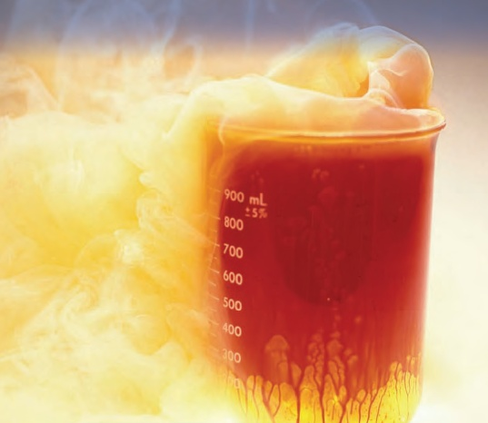
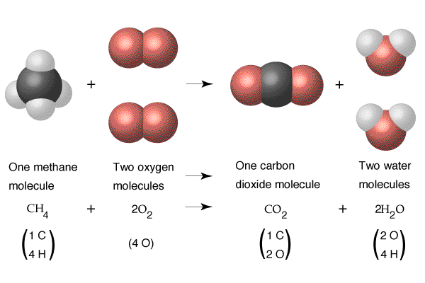
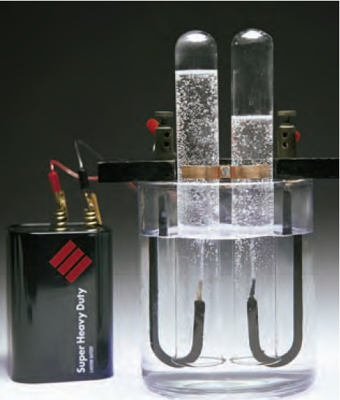
4.1 Writing and Balancing Chemical Reactions

Slide 2
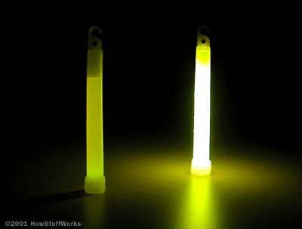
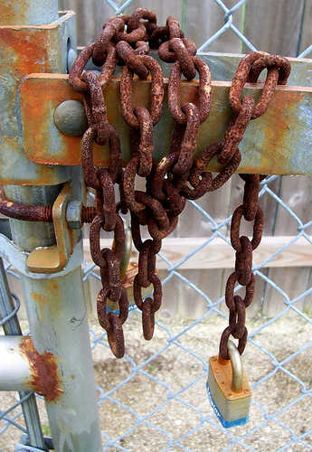
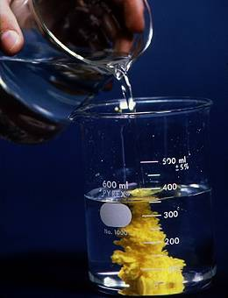
Introduction to Chemical Equations
How do you know whether a chemical reaction occurred?
2

Slide 3
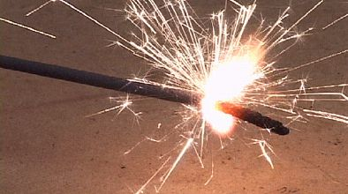
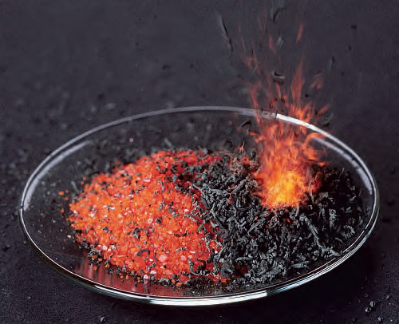
Introduction to Chemical Equations
Energy (temperature) CHANGE
Energy, in the form of heat, light, sound or electricity, is produced
3

Slide 4
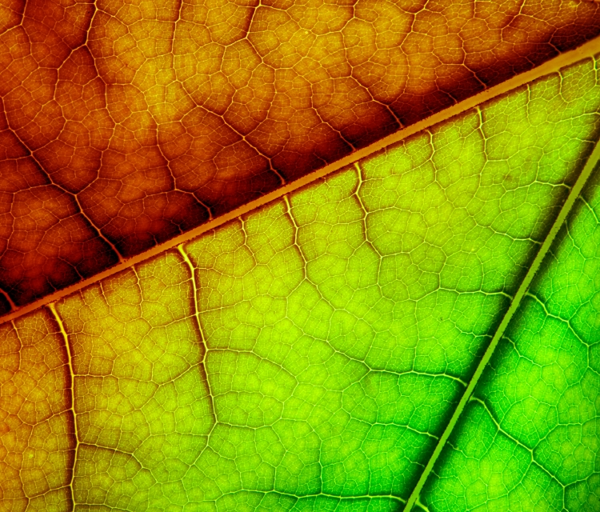
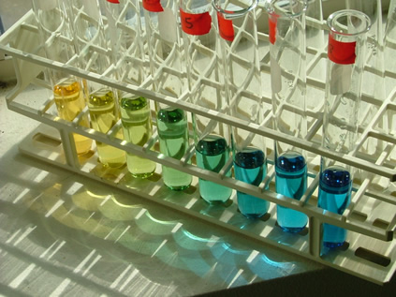
Introduction to Chemical Equations
COLOR CHANGE
The final product(s) may have a different color than the colors of the starting materials.
4

Slide 5
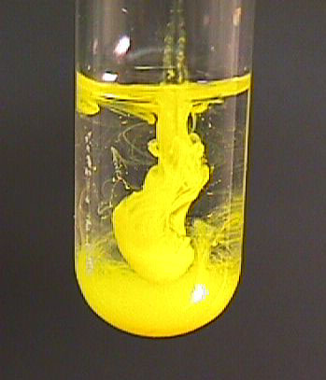
Introduction to Chemical Equations
STATE CHANGE
The final materials may include a substance in a state that is different from the starting materials
5

Slide 6
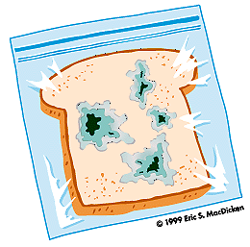
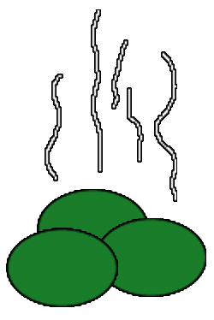
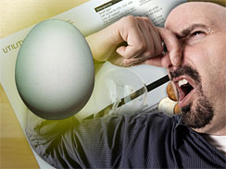
Introduction to Chemical Equations
ODOR (smell) CHANGE
The final materials may have different odours than those of the starting materials
6

Slide 7
In general…
In general...
A chemical reaction occurs when the starting species form different chemicals
7

Slide 8
The chemical equation for a reaction gives two important types of information:
The Meaning a Chemical Equation
The Nature Of The Reactants
And Products
The Relative Number Of
Reactants And Products

Slide 9
1. The Nature Of The Reactants And Products

Slide 10
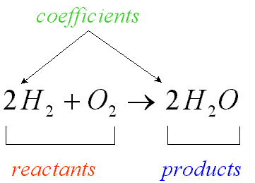
2. The Relative Number Of Reactants and Products

Slide 11
2. The Relative Number Of Reactants and Products
REACTANTS → PRODUCTS
Sodium and chlorine react to form sodium chloride
2 Na + Cl₂ → 2 NaCl
COEFFICIENTS =
Number of atoms/molecules (number of moles)

Slide 12
2. The Relative Number Of Reactants and Products
REACTANTS → PRODUCTS
Sodium and chlorine react to form sodium chloride
2 Na + Cl₂ → 2 NaCl
Atoms have been only reorganized!
THERE WERE NO NEW ATOMS CREATED OR DESTROYED

Slide 13
2. The Relative Number Of Reactants
CH₄(g) + 2O₂(g) → CO₂(g) + 2H₂O(g)
1 molecule + 2 molecules → 1 molecule + 2 molecules
80.0 g of REACTANTS → 80.0 g of PRODUCTS

Slide 14
There must be the same number of each type of atom on the product side and on the reactant side of the arrow
CH₄
O₂
CO₂
H₂O
Look at the equation…
Is there the same number of each type of atom on either side?

Slide 15
There must be the same number of each type of atom on the product side and on the reactant side of the arrow
CH₄
O₂
CO₂
H₂O
C = 1
C = 1
Look at the equation…
Is there the same number of each type of atom on either side?
H = 4
H = 2
O = 2
O = 3

Slide 16
There must be the same number of each type of atom on the product side and on the reactant side of the arrow
CH₄
O₂
CO₂
H₂O
C = 1
C = 1
NO!
H = 4
H = 2
O = 2
O = 3

Slide 17
There must be the same number of each type of atom on the product side and on the reactant side of the arrow
CH₄
O₂
CO₂
H₂O
C = 1
C = 1
We must even this difference out!
H = 4
H = 2
We call this BALANCING THE EQUATION
O = 2
O = 3

Slide 18
Balancing a Chemical Equation
Based on The Conservation Laws,
we have to make sure that each side of the chemical equation has the same number of each type of atom

Slide 19
Balancing a Chemical Equation
(NH₄)₃PO₄ +
NaOH
Na₃PO₄ +
H₂O +
NH₃

Slide 20
Balancing a Chemical Equation
(NH₄)₃PO₄ +
NaOH
Na₃PO₄+
H₂O +
NH₃
Easy Way To Balance an Equation?
Practice,
Practice,
Practice!

Slide 21
Balancing a Chemical Equation
3
3
3
(NH₄)₃PO₄ +
NaOH
Na₃PO₄+
H₂O +
NH₃

Slide 22
Using Chemical Word Equations
You have to be able to translate a “word equation” into “formula equation”:
Liquid water reacts with powdered sodium oxide to produce aqueous sodium hydroxide

Slide 23
Using Chemical Word Equations
You have to be able to translate a “word equation” into “formula equation”:
Aqueous hydrochloric acid reacts with calcium carbonate crystals, producing aqueous calcium chloride, gaseous carbon dioxide, and liquid water

Slide 24
Liquid water reacts with powdered sodium oxide to produce aqueous sodium hydroxide
Words like:
“powder,”
“crystals,”
“precipitate”

Slide 25
Liquid water reacts with powdered sodium oxide to produce aqueous sodium hydroxide
mean
that particular species is a solid

Slide 26
Liquid water reacts with powdered sodium oxide to produce aqueous sodium hydroxide

Slide 27
Liquid water reacts with powdered sodium oxide to produce aqueous sodium hydroxide
2
H₂O(l) +
Na₂O(s)
NaOH(aq)
BALANCE THE EQUATION!

Slide 28
Aqueous hydrochloric acid reacts with calcium carbonate crystals, producing aqueous calcium chloride, gaseous carbon dioxide, and liquid water

Slide 29
Aqueous hydrochloric acid reacts with calcium carbonate crystals, producing aqueous calcium chloride, gaseous carbon dioxide, and liquid water
2
CaCl₂(aq) +
CaCO₃(s) +
HCl(aq)
H₂O(l) +
CO₂(g)
BALANCE THE EQUATION!

Slide 30
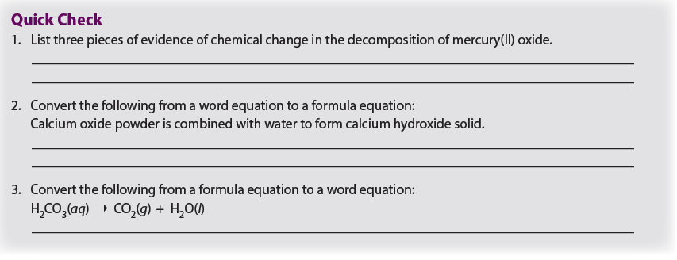

Slide 31
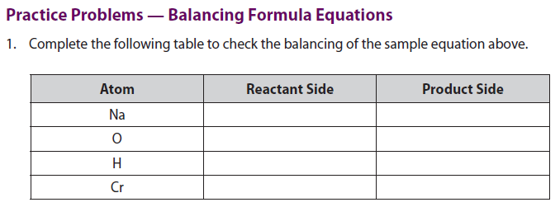

Slide 35
Classwork/Homework
4.1 Review Problems: all even

Slide 36
4.2 Classifying Chemical Changes and Predicting Products

Slide 37
4.2 Classifying Chemical Changes and Predicting Products
There are many patterns in the way substances react and we classify the chemical reactions into 6 important types
1. Synthesis
2. Decomposition
3. Single Replacement
4. Double Replacement
5. Neutralization
6. Combustion

Slide 38
1. Synthesis
Combination of 2 or more substances to form (synthesize) a compound
General Formula
A + B → AB
C(s) +
O₂(g)
CO₂(g)
Look for two ELEMENTS reacting!

Slide 39
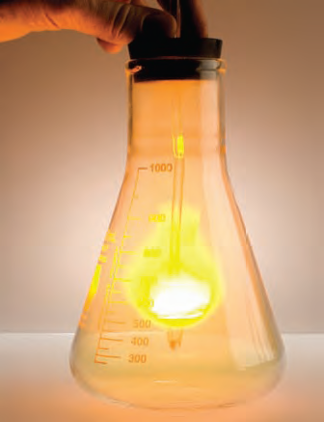
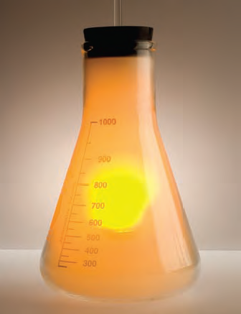
1. Synthesis
Combination of 2 or more substances to form (synthesize) a compound
2Na(s) +
Cl₂(g)
2NaCl(g)
Look for two ELEMENTS reacting!
39

Slide 40
1. Synthesis

Slide 41
2. Decomposition
Breaking down a compound into simpler substances
General Formula
AB → A + B
2Ag₂O(s)+
heat
4 Ag(s) +
O₂(g)
It is a reverse of the Synthesis reaction
41

Slide 42
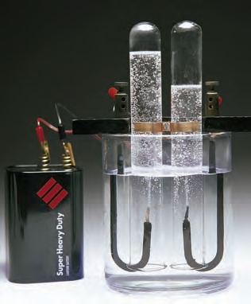
2. Decomposition
2H₂O → 2H₂ + O₂
It is a reverse of the Synthesis reaction
42

Slide 43
2. Decomposition

Slide 44
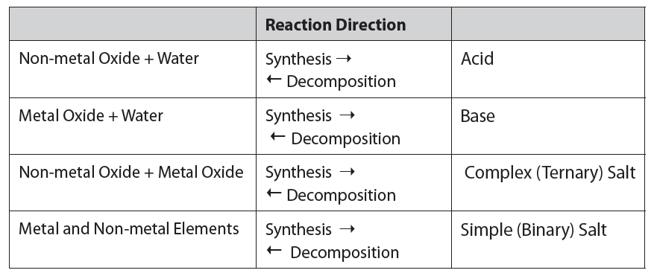
Relationship between SR and DR

Slide 45
3. Combustion of Hydrocarbons
A reaction of a hydrocarbon (compound made out of C and H and/or oxygen) with oxygen. The products are ALWAYS H₂O and CO₂
General Formula
C_{x}H_{y} + O₂→ CO₂ + H₂O
C_{x}H_{y}O_{z} + O₂→ CO₂ + H₂O

Slide 46
3. Combustion of Hydrocarbons
2C₂H₂ + 5O₂→ 4CO₂ + 2H₂O

Slide 49
4. Single Replacement
Replacement of one atom in a compound by another atom
General Formula
A + BX → AX +B
Fe(s)+
CuCl₂(aq)
FeCl₂(aq)+
Cu(s)
An ELEMENT reacts with a COMPOUND

Slide 50
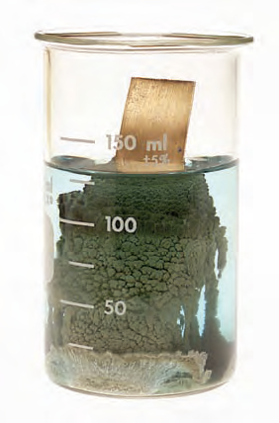
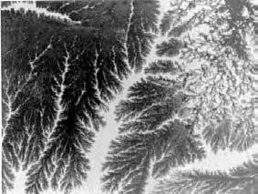
4. Single Replacement
Cu + 2AgNO₃ → 2Ag + Cu(NO₃)₂
An ELEMENT reacts with a COMPOUND

Slide 51
4. Single Replacement
The Compound (BX) contains a METAL and NON-METAL
If an element (A) is a non - metal: A exchanges places with a non - metal in the compound
If an element (A) is a metal: A exchanges places with a metal in the compound
A + BX → AX + B

Slide 52
4. Single Replacement
If an element (A) is a non - metal: A exchanges places with a non - metal in the compound
CuI₂(aq)+
Br₂(g)
CuBr₂(aq)+
I₂(g)
If an element (A) is a metal: A exchanges places with a metal in the compound
CuI₂(aq)+
Fe(s)
FeI₂(aq)+
Cu(g)
A + BX → AX + B

Slide 53
4. Single Replacement
Hydrogen Replacement: metals can replace hydrogen (in water) to produce hydrogen gas
M + H₂O→ MOH + H₂
M + HOH→ MOH + H₂
2Na(s) +
2HOH(l)
2NaOH(aq)+
H₂(g)

Slide 54
Activity Series
Not all SRR will proceed as written
We must compare their Chemical Reactivity to see if a SRR will occur
A metal (in a compound) can be displaced by another element ONLY when it is BELOW that element in the activity series

Slide 55
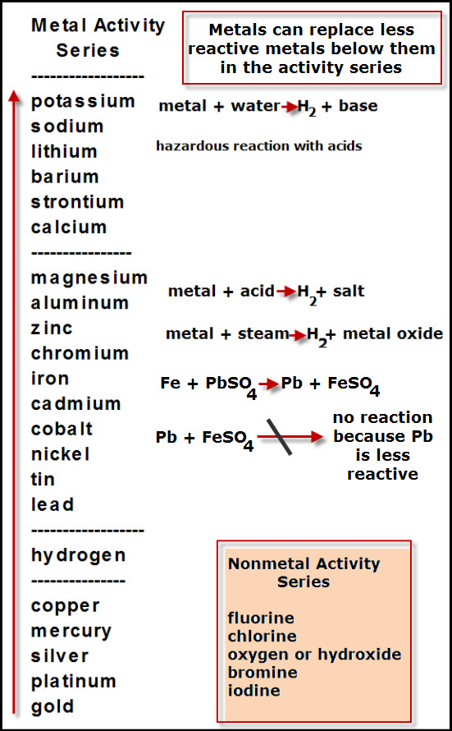

Slide 56
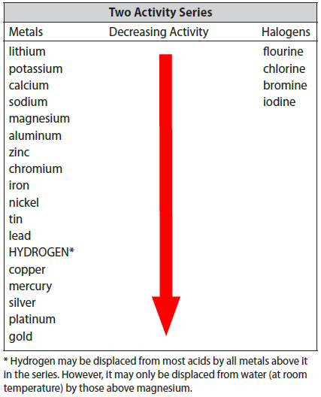
A metal (in a compound) can be displaced by another element ONLY when it is BELOW that element in the activity series

Slide 57
4. Single Replacement

Slide 58
5. Double Replacement
Exchange of atoms or groups between two different compounds
General Formula
AB + CD → AD + CB
AgNO₃(aq)+
NaCl(s)
AgCl(s)+
NaNO₃(s)
A COMPOUND reacts with another COMPOUND
58

Slide 59
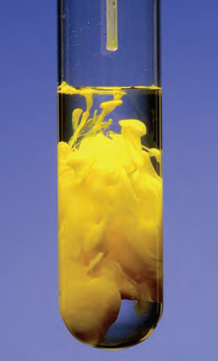
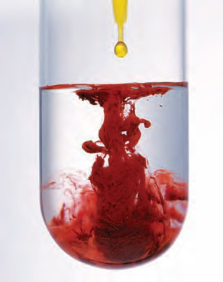
5. Double Replacement
Exchange of atoms or groups between two different compounds
K₂CrO₄ + 2AgNO₃ → 2Ag₂CrO4 + 2K(NO₃)
A COMPOUND reacts with another COMPOUND
59

Slide 60
5. Double Replacement

Slide 61
6. Neutralization (Acid-Base)Reactions
An acid and a base react to produce salt and water
General Formula
HX + MOH→ MX + H₂O
H₂SO₄ +
Ca(OH)₂
CaSO₄ +
2H₂O
Acid and base are neutralized by each other
61

Slide 62
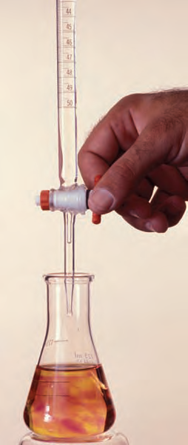
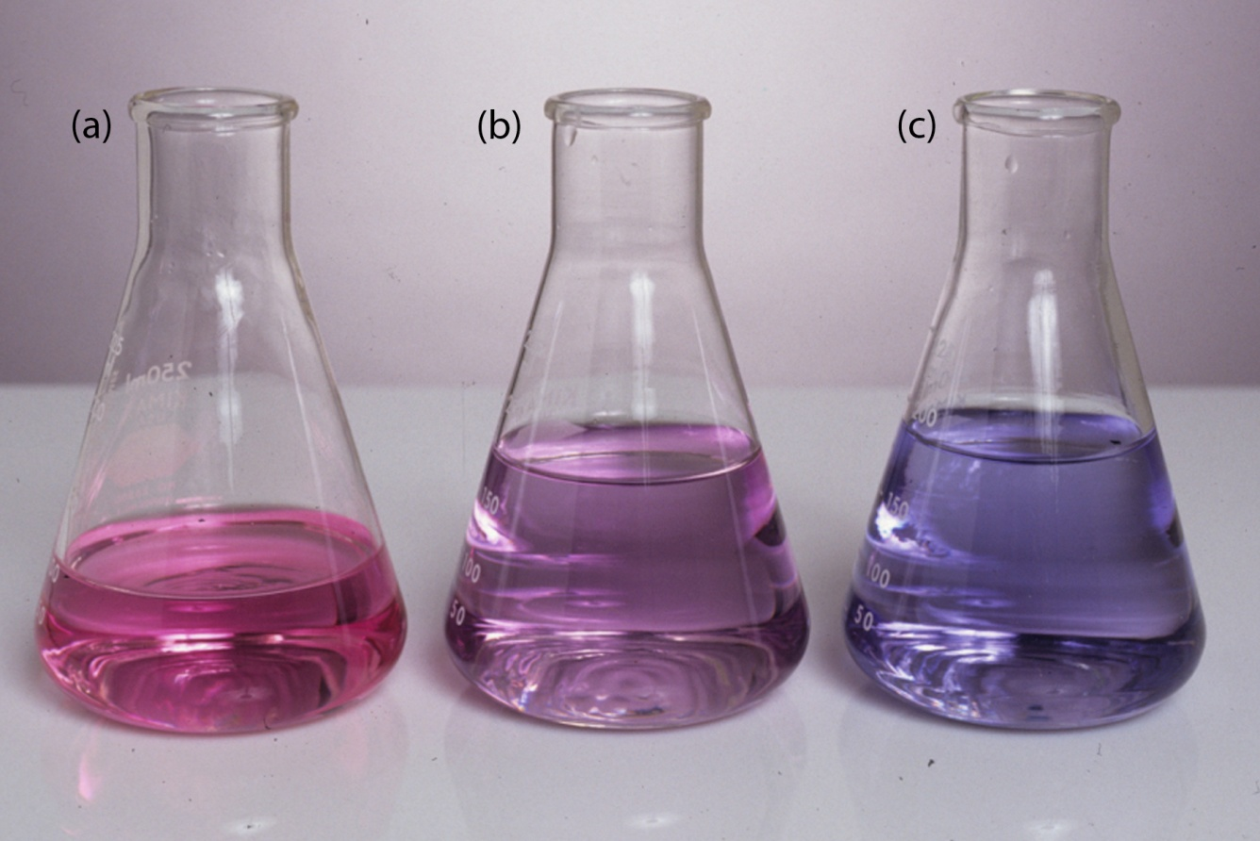
6. Neutralization (Acid-Base)Reactions
HCl + NaOH → NaCl + H₂O
Acid and base are neutralized by each other
62

Slide 63
6. Neutralization (Acid-Base)Reactions

Slide 65
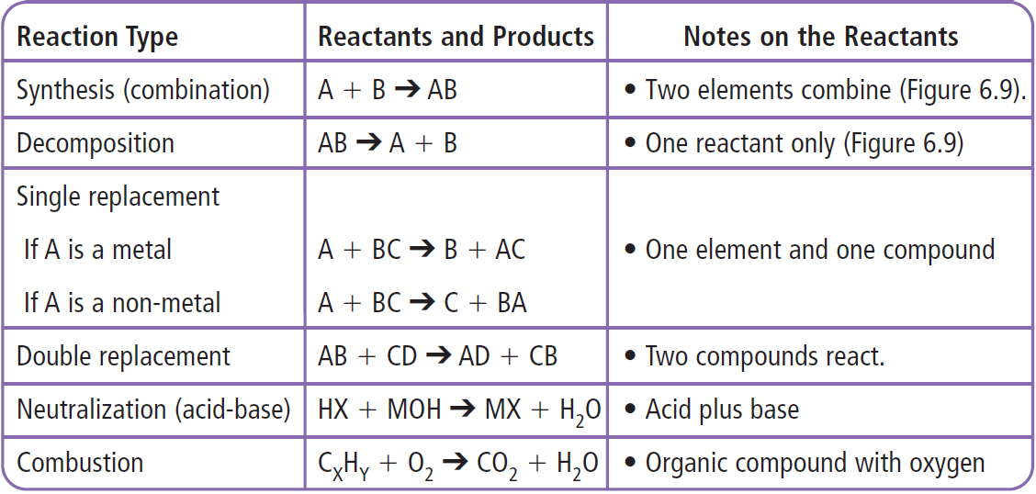
SUMMARY of Chemical Reaction Types

Slide 66
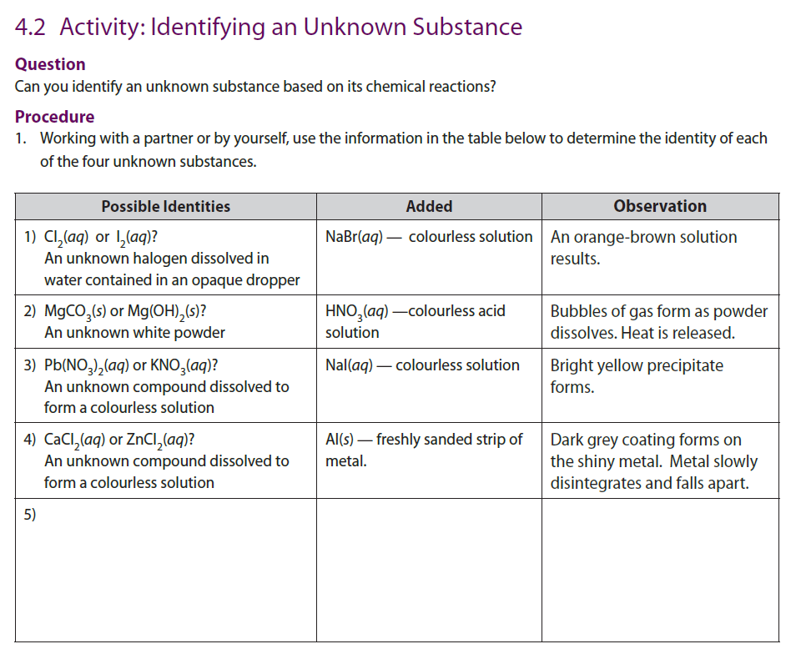

Slide 67
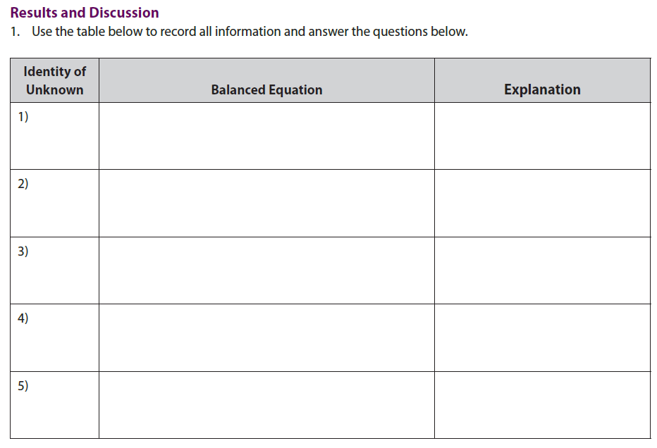

Slide 68
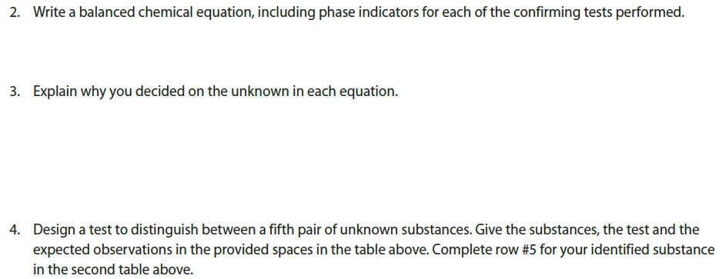

Slide 71
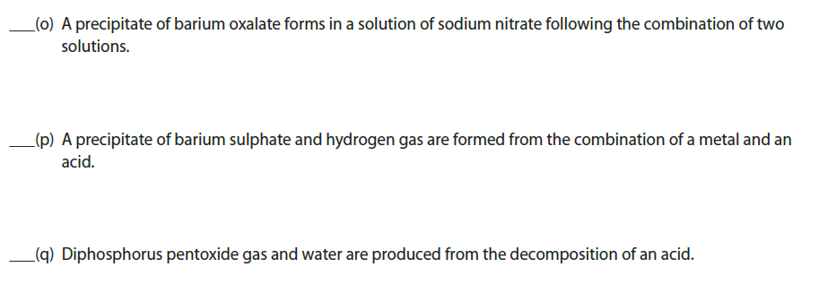

Slide 72
SUMMARY of Chemical Reaction Types

Slide 73
4.2 Review Problems
PAGE: 184
PROBLEMS: 1, all even

