Slide 1
4.5 Calculating Chemical Change - STOICHIOMETRY

Slide 2
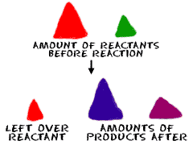
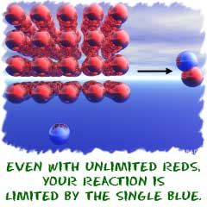
STOICHIOMETRY
It is the relationship between the amount of reactants and the amount of products produced by the reaction
2

Slide 3
STOICHIOMETRY
CONSIDER A REACTION:
C₃H₈(s) +
5O₂(g)
3CO₂(g)+
4H₂O(g)
What mass of oxygen will react with 96.1 grams of propane (C₃H₈)?
What mass of propane will you need to get 22.6 mL of water?
STOICHIOMETRY is the method which we will use to answer these questions
3

Slide 4
Remember!!
A coefficients is just a “relative” number/amount of the chemical!
REACTANTS → PRODUCTS
Sodium and chlorine react to form sodium chloride
2 Na + Cl₂ → 2 NaCl
COEFFICIENTS =
Number of atoms/molecules (number of moles)

Slide 5
REACTANTS → PRODUCTS
Sodium and chlorine react to form sodium chloride
2 Na + Cl₂ → 2 NaCl
COEFFICIENTS =
Number of atoms/molecules (number of moles)

Slide 6
The Meaning of Coefficients in a Reaction Equation
C₃H₈(s) +
5O₂(g)
3CO₂(g) +
4H₂O(g)
The coefficients tell us that:
1 PROPANE molecule reacts with 5 OXYGEN molecules
to produce 3 CARBON DIOXIDE molecules
and 4 WATER molecules
However, the equation is also balanced when numbers are multiplied by 100:
100C₃H₈(s)+
500O₂(g)
300CO₂(g)+
400H₂O(g)

Slide 7
The Meaning of Coefficients in a Reaction Equation
C₃H₈(s) +
5O₂(g)
3CO₂(g) +
4H₂O(g)
The coefficients tell us that:
1 PROPANE molecule reacts with 5 OXYGEN molecules
to produce 3 CARBON DIOXIDE molecules
and 4 WATER molecules
Or by 10000:
10000C₃H₈(s)+
50000O₂(g)
30000CO₂(g) +
40000H₂O(g)

Slide 8
The Meaning of Coefficients in a Reaction Equation
C₃H₈(s) +
5O₂(g)
3CO₂(g) +
4H₂O(g)
The coefficients tell us that:
1 PROPANE molecule reacts with 5 OXYGEN molecules
to produce 3 CARBON DIOXIDE molecules
and 4 WATER molecules
Or by 602000000000000000000000:
(6.02 x 10²³) C₃H₈(s) +
5 •(6.02 x 10²³ )O₂(g)
3 •(6.02 x 10²³ ) CO₂(g) +
4 •(6.02 x 10²³ ) H₂O(g)

Slide 9
The Meaning of Coefficients in a Reaction Equation
Or 6.02 x 10²³:
(6.02 x 10²³) C₃H₈(s) +
5 •(6.02 x 10²³ )O₂(g)
3 •(6.02 x 10²³ )CO₂(g) +
4 •(6.02 x 10²³ )H₂O(g)
This equation is equivalent to writing:
(mole) C₃H₈(s) +
5 •(mole)O₂(g)
3 •(mole)CO₂(g) +
4 •(mole)H₂O(g)

Slide 10
The Meaning of Coefficients in a Reaction Equation
Or 6.02 x 10²³:
(6.02 x 10²³) C₃H₈(s) +
5 •(6.02 x 10²³ )O₂(g)
3 •(6.02 x 10²³ )CO₂(g) +
4 •(6.02 x 10²³ )H₂O(g)
or simply:
C₃H₈(s) +
5O₂(g)
3CO₂(g) +
4H₂O(g)

Slide 11
The Meaning of Coefficients in a Reaction Equation
Or 6.02 x 10²³:
(6.02 x 10²³) C₃H₈(s) +
5 •(6.02 x 10²³ )O₂(g)
3 •(6.02 x 10²³ )CO₂(g) +
4 •(6.02 x 10²³ )H₂O(g)
The coefficients now mean:
MOLES
C₃H₈(s) +
5O₂(g)
3CO₂(g) +
4H₂O(g)

Slide 12
The Meaning of Coefficients in a Reaction Equation
C₃H₈(s) +
5O₂(g)
3CO₂(g) +
4H₂O(g)
The ratio $\frac{\text{C}\text{3}\text{H}\text{8}}{\text{O}\text{2}}=\frac{\text{1}}{\text{5}}$ is correct for:
$$\frac{\text{1 }\text{molecule} \text{C}\text{3}\text{H}\text{8}}{\text{5} \text{molecule} \text{O}\text{2}}or\frac{\text{1 }\text{mol} \text{C}\text{3}\text{H}\text{8}}{\text{5} \text{mol} \text{O}\text{2}}$$

Slide 13
STOICHIOMETRY – BASIC CALCULATIONS
2C₂H₆(s) +
7O₂(g)
4CO₂(g) +
6H₂O(g)
a) How many molecules of oxygen react with 6 molecules of C₂H₆?
b) How many water molecules are produced when 12 molecules of C₂H₆ react?
c) How many moles of oxygen molecules are needed to produce 18 mol of CO₂?
d) How many moles of CO₂ molecules are produced when 13 mol of C₂H₆ are used?

Slide 14
STOICHIOMETRY – BASIC CALCULATIONS
2C₂H₆(s) +
7O₂(g)
4CO₂(g) +
6H₂O(g)
a) How many molecules of oxygen react with
6 molecules of C₂H₆?
CONVERSION FACTORS??

Slide 15
STOICHIOMETRY – BASIC CALCULATIONS
2C₂H₆(s) +
7O₂(g)
4CO₂(g) +
6H₂O(g)
a) How many molecules of oxygen react with
6 molecules of C₂H₆?

Slide 16
STOICHIOMETRY – BASIC CALCULATIONS
2C₂H₆(s) +
7O₂(g)
4CO₂(g) +
6H₂O(g)
b) How many water molecules are produced when 12 molecules of C₂H₆ react?

Slide 17
STOICHIOMETRY – BASIC CALCULATIONS
2C₂H₆(s) +
7O₂(g)
4CO₂(g) +
6H₂O(g)
c) How many moles of oxygen molecules are needed to produce 18 mol of CO₂?
31.5 mol O₂
17
17

Slide 18
STOICHIOMETRY – BASIC CALCULATIONS
2C₂H₆(s) +
7O₂(g)
4CO₂(g) +
6H₂O(g)
d) How many moles of CO₂ molecules are produced when 13 mol of C₂H₆ are used?
26 mol CO₂

Slide 19
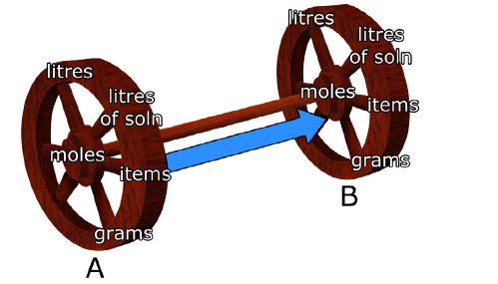
When 1.57 mol oxygen reacts with hydrogen gas to form dihydrogen monoxide, how many moles of hydrogen are consumed in the process?
MOLES A → MOLES B
conversions

Slide 20
When 1.57 mol oxygen reacts with hydrogen gas to form dihydrogen monoxide, how many moles of hydrogen are consumed in the process?
2H₂ (g) +
O₂(g)
2H₂ O(g)
1.57 mol g of O₂ x$\frac{2 mol of \text{H}\text{2}}{1 mol of \text{O}\text{2}}$
# moles of H₂ =
# moles of H₂ = 3.14 mol

Slide 23
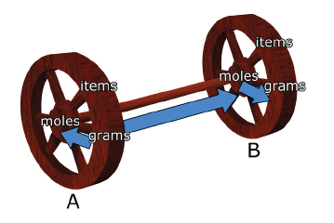
What is the mass of CO₂ produced when 1.00 g of C₄H₁₀ (the fuel in disposable lighters) is burned?
Mass A → Mass B
conversions

Slide 24
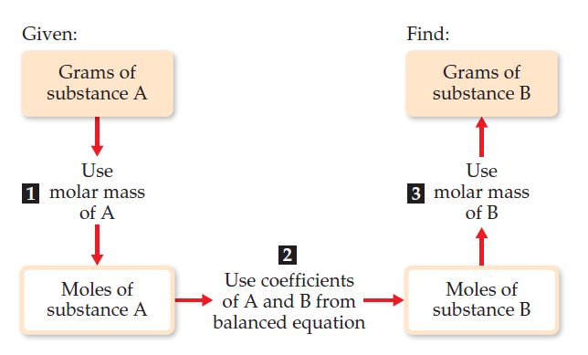
What is the mass of CO₂ produced when 1.00 g of C₄H₁₀ (the fuel in disposable lighters) is burned?
2C₄H₁₀(l) +
13O₂(g)
10H₂O(g)
+ 8CO₂(g)

Slide 25
What is the mass of CO₂ produced when 1.00 g of C₄H₁₀ (the fuel in disposable lighters) is burned?
2C₄H₁₀(l) +
13O₂(g)
8H₂O(g)
+ 10CO₂(g)
# mass of CO₂ = ??
1.00 g C₄H₁₀ x$\frac{1 mol \text{C}\text{4}\text{H}\text{10}}{58.0 g \text{C}\text{4}\text{H}\text{10}}$ =
0.0172 mol C₄H₁₀
x$\frac{8 mol \text{C}\text{O}\text{2}}{2 mol \text{C}\text{4}\text{H}\text{10}}$ =
0.0172 mol C₄H₁₀
0.0688 mol $\text{CO}\text{2}$
0.0688g mol $\text{CO}\text{2}$x$\frac{44.0 g \text{CO}\text{2}}{1 mol \text{CO}\text{2}}$ =
3.03 g $\text{CO}\text{2}$

Slide 26
What is the mass of CO₂ produced when 1.00 g of C₄H₁₀ (the fuel in disposable lighters) is burned?
2C₄H₁₀(l) +
13O₂(g)
8H₂O(g)
+ 10CO₂(g)
# mass of CO₂ = ??
1.00 g C₄H₁₀ x$\frac{1 mol \text{C}\text{4}\text{H}\text{10}}{58.0 g \text{C}\text{4}\text{H}\text{10}}$
x$\frac{8 mol \text{C}\text{O}\text{2}}{2 mol \text{C}\text{4}\text{H}\text{10}}$
x$\frac{44.0 g \text{CO}\text{2}}{1 mol \text{CO}\text{2}}$ =
3.03 g $\text{CO}\text{2}$

Slide 31
In how many litres of CO₂ would form from the combustion of 10.0 L of propane (C₃H₈) gas?
Volume A → Volume B
Mass A → Volume B
Volume A → Mass B
conversions

Slide 36
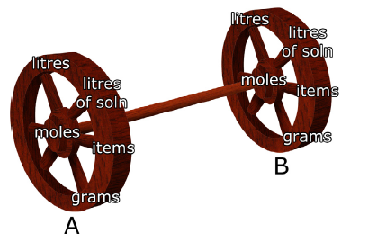
What mass of nickel wire reacts with all the silver nitrate in 1.25 L of 0.15 M solution
Molarity A → Volume B
conversions

Slide 37
What mass of nickel wire reacts with all the silver nitrate in 1.25 L of 0.15 M solution

Slide 41
4.5 Review Problems
PAGE: 217 - 219
PROBLEMS: 1, 2, 6, 8,10, 14

Slide 43
