Slide 1
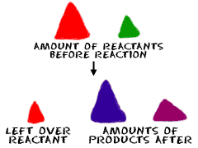
4.6 Excess, Limiting Amounts, Percentage Yield, and Impurities
1

Slide 2
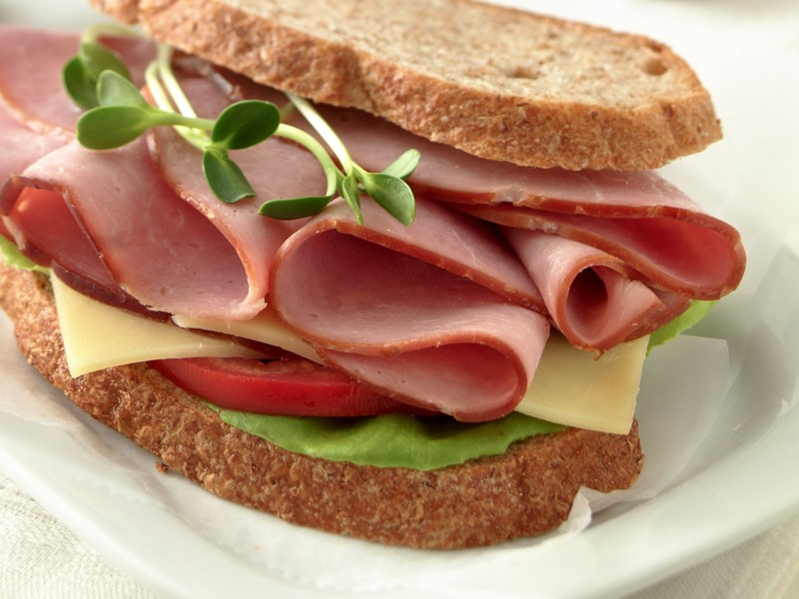

LIMITING and EXCESS REACTANTS
Suppose you have a job in a sandwich shop
One very popular sandwich has ingredients as follows:
2 slices of bread + 3 slices of meat + 1 slice of cheese

Slide 3


LIMITING and EXCESS REACTANTS
2 slices of bread
3 slices of meat
1 sandwich
1 slice of cheese

Slide 4
LIMITING and EXCESS REACTANTS
2 slices of bread
3 slices of meat
1 sandwich
1 slice of cheese
You come to work one day and find the following ingredients:

Slide 5
LIMITING and EXCESS REACTANTS
8 slices of bread
9 slices of meat
1 slice of cheese

Slide 6
NOW, ANSWER THE QUESTIONS ON THE WORKSHEET!
8 slices of bread
9 slices of meat
5 slice of cheese

Slide 7
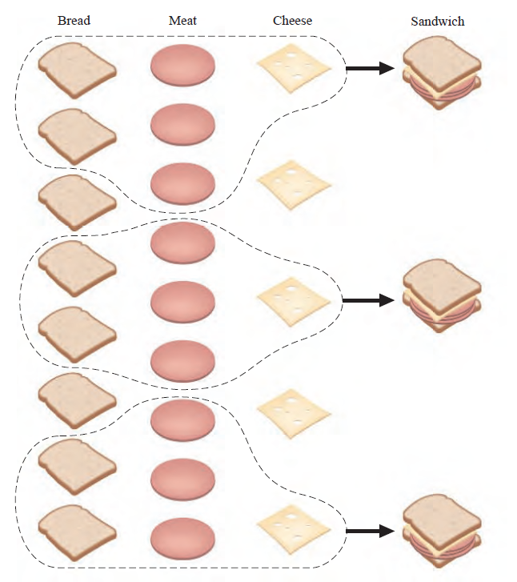
Most probably you found out:
The meat was a limiting ingredient!
When you run out of meat,
you couldn’t make any more sandwiches even though
you had bread and cheese in excess (too much or extra)

Slide 8
Most probably you found out:
Molecules react with each other in very similar way!

Slide 9
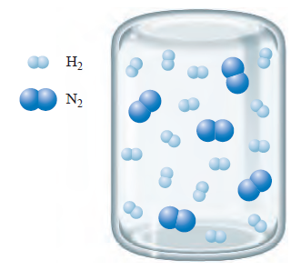
N₂(g) + 3H₂(g) 2NH₃(g)
Consider the following container of N₂ and H₂ :
How many N₂ are there?
5
How many H₂ are there?
15
What will this container look like if the reaction between N₂ and H₂ proceeds to completion?
REMEMBER:
Each N₂ needs 3 H₂ molecules to form 2 NH₃

Slide 10
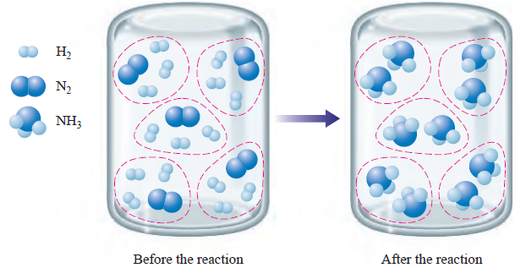
N₂(g) + 3H₂(g) 2NH₃(g)
This ratio EXACTLY matches the numbers in the balanced equation

Slide 11
N₂(g) + 3H₂(g) 2NH₃(g)
NOTHING is limiting (too little) and NOTHING is in excess (too much or extra)

Slide 12
N₂(g) + 3H₂(g) 2NH₃(g)
Now, consider a different container of N₂ and H₂:
How many N₂ are there?
5
How many H₂ are there?
9
What will this container look like if the reaction between N₂ and H₂ proceeds to completion?
REMEMBER:
Each N₂ needs 3 H₂ molecules to form 2 NH₃

Slide 13
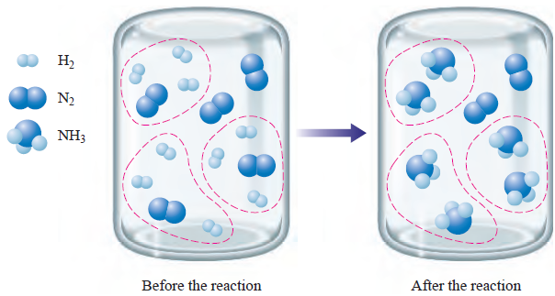
N₂(g) + 3H₂(g) 2NH₃(g)
HYDROGEN is limiting (too little) because it is used up BEFORE all NITROGEN molecules are used.

Slide 14
N₂(g) + 3H₂(g) 2NH₃(g)
HYDROGEN limits the amount of AMMONIA (NH3) that can be produced = H₂ is a LIMITING REACTANT

Slide 15
N₂(g) + 3H₂(g) 2NH₃(g)
NITROGEN is in excess (too much or extra) because the reaction runs out of HYDROGEN molecules first

Slide 16
N₂(g) + 3H₂(g) 2NH₃(g)
NITROGEN is called the EXCESS REACTANT

Slide 17
N₂(g) + 3H₂(g) 2NH₃(g)
In real life problems, we MUST know how much PRODUCT is produced.
And because this is limited by the LIMITING REACTANT, we must look for a reactant that is LIMITING.

Slide 18
N₂(g) + 3H₂(g) 2NH₃(g)
In real life, we don’t count the molecules to find out what are LIMITING and what are EXCESS REACTANTS!

Slide 19
N₂(g) + 3H₂(g) 2NH₃(g)
We MUST count by weighing or by calculating the number of moles!

Slide 20
SAS Curriculum Pathways
Username: alexanderacademy
Pick “Vlab: Limiting Reactants”

Slide 21
SAS Curriculum Pathways
Answers for Data & Observations:
On a separate piece of paper
You will have a data table handout as well
Answers for Analysis & Conclusions:
On a separate piece of paper

Slide 22
Calculating Limiting Reactant!
If a sample containing 18.1 g of NH₃ is reacted with 90.4 g of CuO, which is the limiting reactant? Which is the excess reactant? How many grams of N₂ will be produced?
2NH₃(g) + 3CuO(s) N₂(g) + 3Cu(s) + 3H₂O(g)

Slide 23
If a sample containing 18.1 g of NH₃ is reacted with 90.4 g of CuO, which is the limiting reactant? Which is the excess reactant? How many grams of N₂ will be produced?
2NH₃(g) + 3CuO(s) N₂(g) + 3Cu(s) + 3H₂O(g)
1. USING EACH REACTANT, CALCULATE THE MASS OF N₂!
2. WHICHEVER REACTANT PRODUCES THE SMALLEST AMOUNT OF N_{2,} THAT IS THE LIMITING REACTANT!
3. USE THE NUMBER OF MOLES OF THE LIMITING REACTANT TO CALCULATE THE MASS OF N₂.

Slide 24
If a sample containing 18.1 g of NH₃ is reacted with 90.4 g of CuO, which is the limiting reactant? Which is the excess reactant? How many grams of N₂ will be produced?
2NH₃(g) + 3CuO(s) N₂(g) + 3Cu(s) + 3H₂O(g)
1. USING EACH REACTANT, CALCULATE THE MASS OF N₂!

Slide 25
If a sample containing 18.1 g of NH₃ is reacted with 90.4 g of CuO, which is the limiting reactant? Which is the excess reactant? How many grams of N₂ will be produced?
2NH₃(g) + 3CuO(s) N₂(g) + 3Cu(s) + 3H₂O(g)
2. WHICHEVER REACTANT PRODUCES THE SMALLEST AMOUNT OF N_{2,} THAT IS THE LIMITING REACTANT!

Slide 26
If a sample containing 18.1 g of NH₃ is reacted with 90.4 g of CuO, which is the limiting reactant? Which is the excess reactant? How many grams of N₂ will be produced?
2NH₃(g) + 3CuO(s) N₂(g) + 3Cu(s) + 3H₂O(g)
3. USE THE NUMBER OF MOLES OF THE LIMITING REACTANT TO CALCULATE THE MASS OF N₂.

Slide 27
CuO is the Limiting Reactant
If a sample containing 18.1 g of NH₃ is reacted with 90.4 g of CuO, which is the limiting reactant? Which is the excess reactant? How many grams of N₂ will be produced?
2NH₃(g) + 3CuO(s) N₂(g) + 3Cu(s) + 3H₂O(g)
3. USE THE NUMBER OF MOLES OF THE LIMITING REACTANT TO CALCULATE THE MASS OF N₂.

Slide 28
If a sample containing 18.1 g of NH₃ is reacted with 90.4g of CuO, which is the limiting reactant? Which is the excess reactant?
By how many grams is the NH₃ in excess?
2NH₃(g) + 3CuO(s) N₂(g) + 3Cu(s) + 3H₂O(g)
1. Use the mass/moles of THE LIMITING REACTANT to find out the mass of the excess reactant which reacted
2. Take the mass of the excess reactant from the step 1 and subtract it from the original mass of the excess reactant

Slide 29
If a sample containing 18.1 g of NH₃ is reacted with 90.4g of CuO, which is the limiting reactant? Which is the excess reactant?
By how many grams is the NH₃ in excess?
2NH₃(g) + 3CuO(s) N₂(g) + 3Cu(s) + 3H₂O(g)
1. Use the mass/moles of THE LIMITING REACTANT to find out the mass of the excess reactant which reacted

Slide 30
If a sample containing 18.1 g of NH₃ is reacted with 90.4g of CuO, which is the limiting reactant? Which is the excess reactant?
By how many grams is the NH₃ in excess?
2NH₃(g) + 3CuO(s) N₂(g) + 3Cu(s) + 3H₂O(g)
2. Take the mass of the excess reactant from the step 1 and subtract it from the original mass of the excess reactant
Mass of the excess reactant which reacted =
The original mass of the excess reactant =

Slide 31
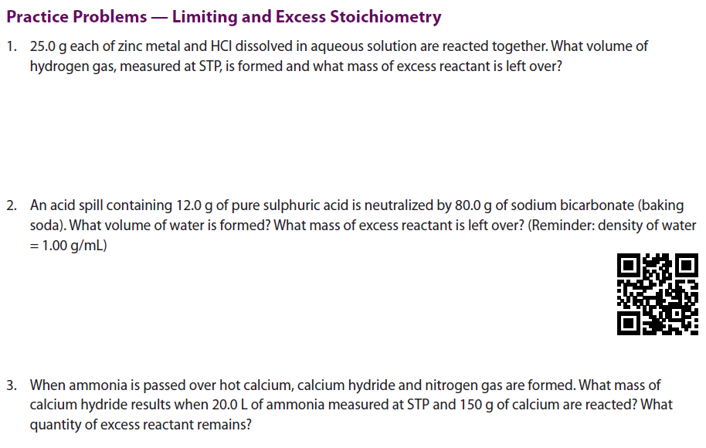


Slide 32
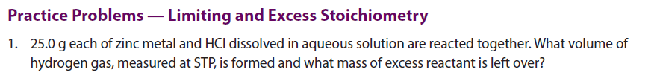

Slide 35
Classwork/Homework

Slide 36
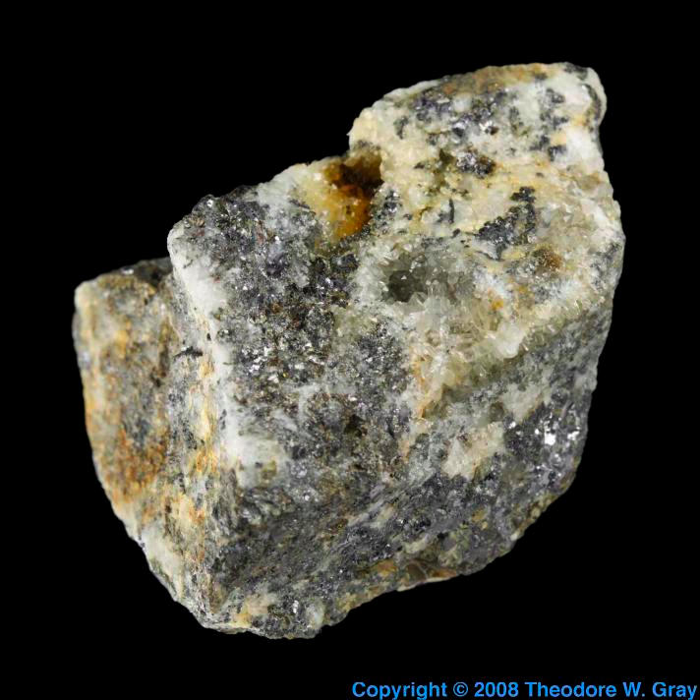
PERCENTAGE PURITY
36

Slide 37
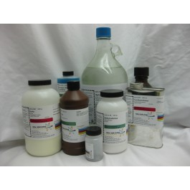
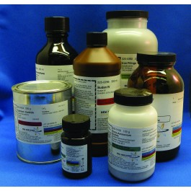
PERCENTAGE PURITY
It is virtually impossible to obtain a 100% chemical
Even chemicals from chemical supply companies include impurities

Slide 38

PERCENTAGE PURITY

Slide 39
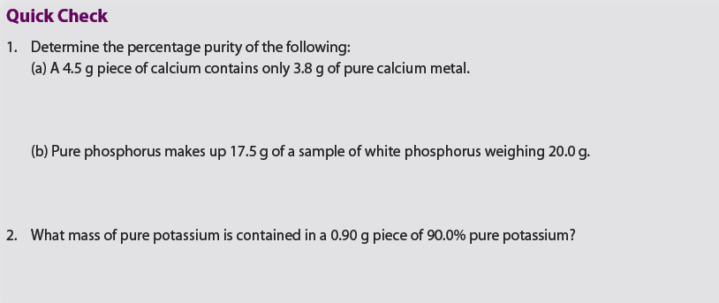

Slide 40
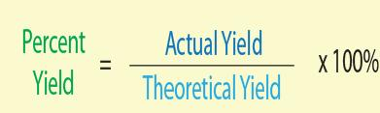
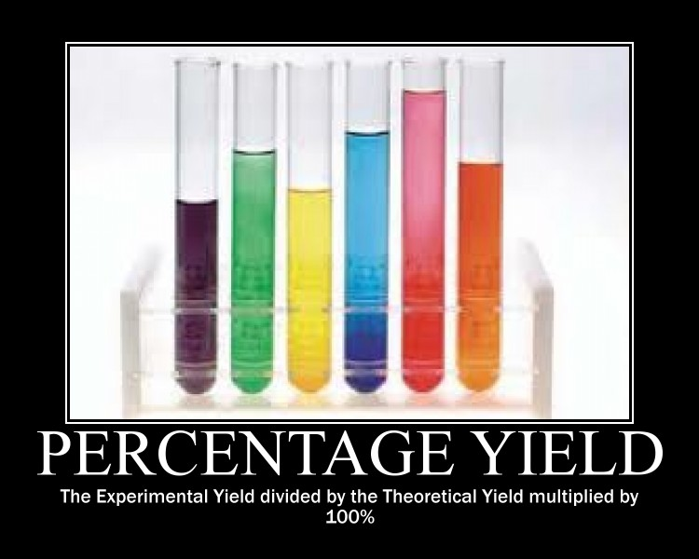
PERCENTAGE YIELD
40

Slide 41
PERCENTAGE YIELD
Most of the times, the amount of products that we receive from the reaction is less than what we expected based on our calculations and the balanced equation
WHY DO YOU THINK
THIS HAPPENS?
Different reactions happening at the same time (side reactions)
Not all of the pure material (product) reacts
The products might not be 100% pure
Some of the product is lost during the laboratory procedures

Slide 42
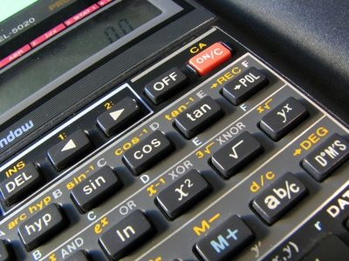

THEORETICAL YIELD
So, the balanced equation and the stoichiometric calculations will give you ONLY THE EXPECTED (THEORETICAL) YIELD of a product

Slide 43
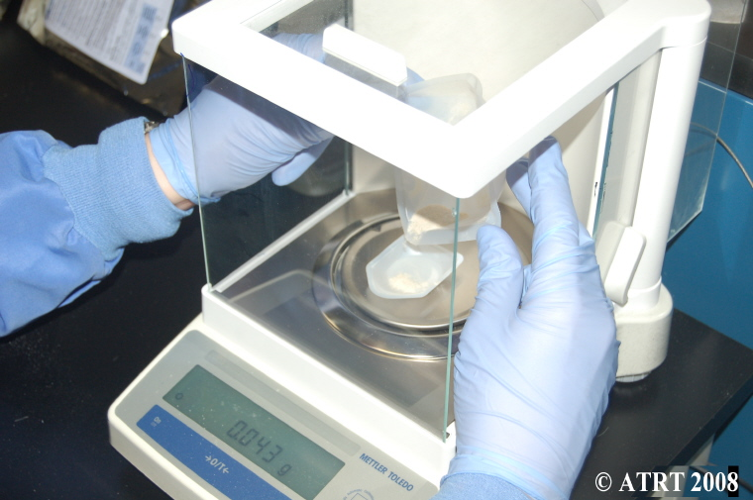
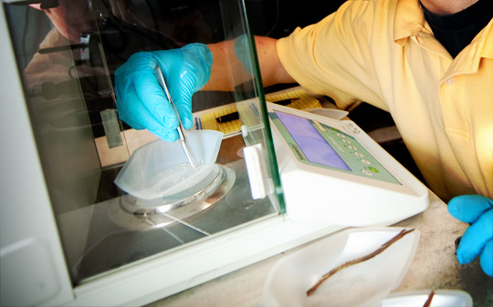
ACTUAL YIELD
When you actually measure (weigh) how much product is produced, this is called:
THE ACTUAL YIELD

Slide 44
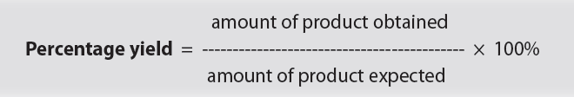
PERCENTAGE YIELD

Slide 45
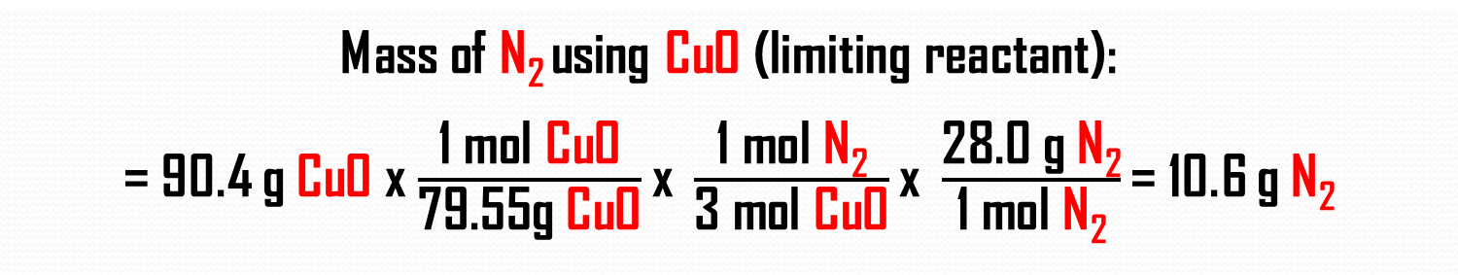
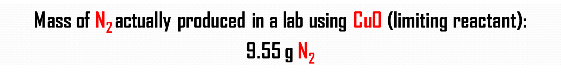
If a sample containing 18.1 g of NH₃ is reacted with 90.4 g of CuO. How many grams of N₂ will be produced?
Crisanta did this experiment in a lab, and obtained 9.55 g of N₂.
What was the percentage yield of the reaction?
2NH₃(g) + 3CuO(s) N₂(g) + 3Cu(s) + 3H₂O(g)
Mass of N₂ using $\text{CuO}\text{ (}\text{limiting} \text{reactant}\text{)}$:
= 90.4 g $\text{CuO}$x $\frac{\text{1 }\text{mol} \text{CuO}}{\text{79.55}\text{g} \text{CuO}}\text{x} \frac{\text{1 }\text{mol} \text{N}\text{2}}{\text{3} \text{mol} \text{CuO}}\text{x} \frac{\text{28.0 }\text{g} \text{N}\text{2}}{\text{1 }\text{mol} \text{N}\text{2}}\text{=}$ 10.6 g$\text{N}\text{2}$
Theoretical Yield
Mass of N₂ actually produced in a lab using $\text{CuO}\text{ (}\text{limiting} \text{reactant}\text{)}$:
9.55 g$\text{N}\text{2}$
Actual Yield

Slide 46
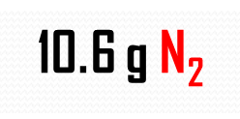
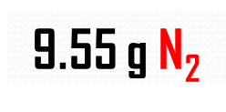
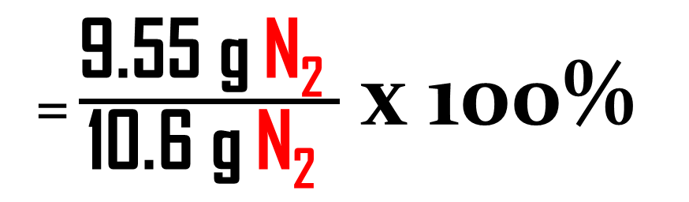
PERCENTAGE YIELD
Theoretical Yield
Actual Yield
10.6 g$\text{N}\text{2}$
9.55 g$\text{N}\text{2}$
= 90.1%
= $\frac{\text{9.55 }\text{g} \text{N}\text{2} }{\text{10.6 }\text{g} \text{N}\text{2} }$ x 100%

Slide 47

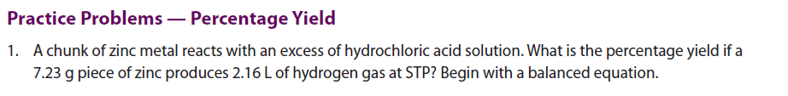
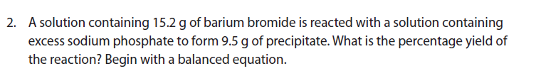

Slide 49
HOMEWORK
PAGE: 228
PROBLEMS:
4.6 Activity: Charting and Graphing Stoichiometry
Practice Problems (do as many as you want/need)
The answer key will be given on Monday, after I see 4.6 Activity completed

Slide 50
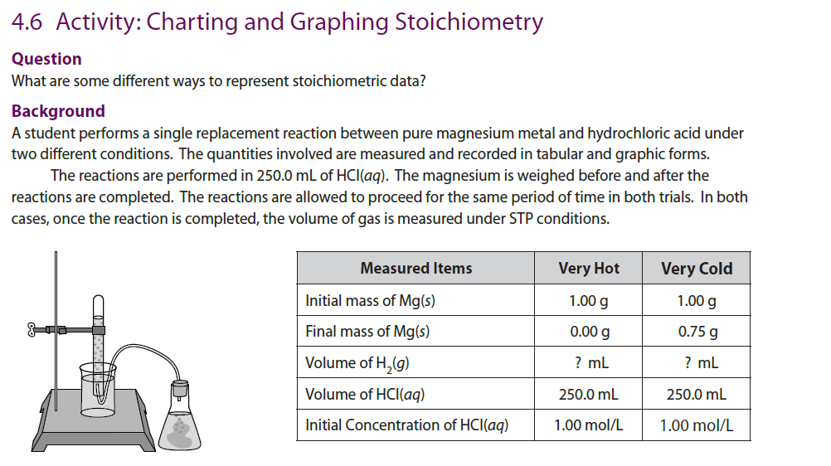

Slide 51
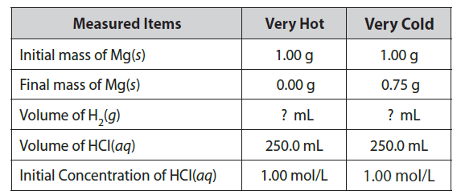
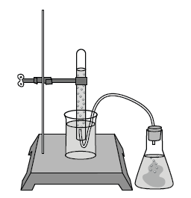
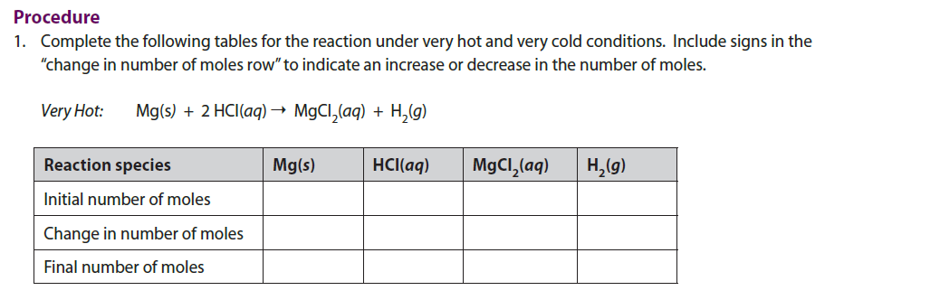
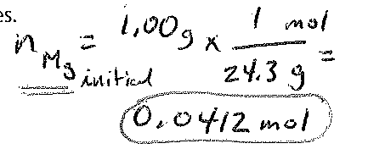



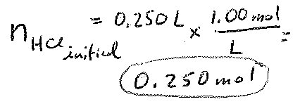





Slide 52
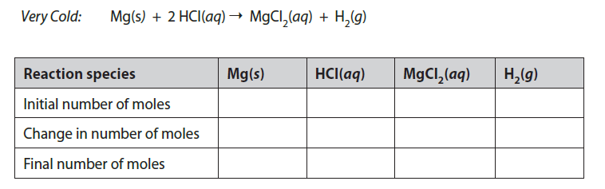






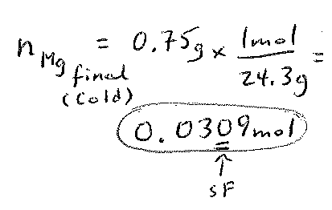

Slide 53
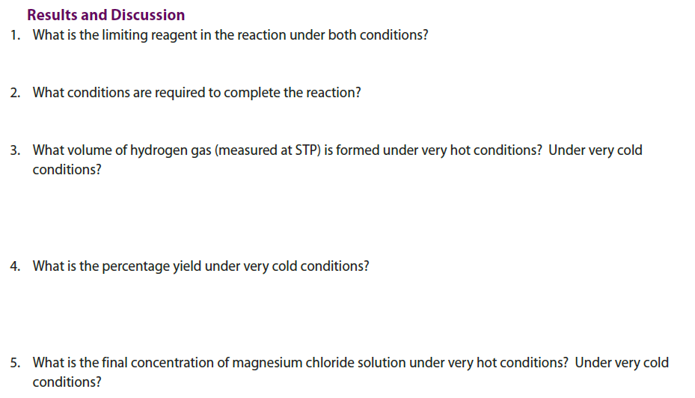

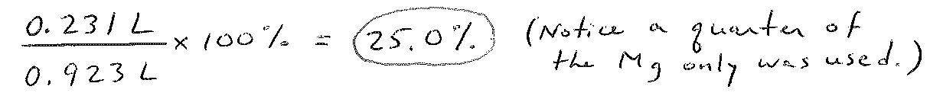


Slide 54
Chapter 4 TEST
Tuesday, May 13th
5 questions – one from each section

