Slide 1
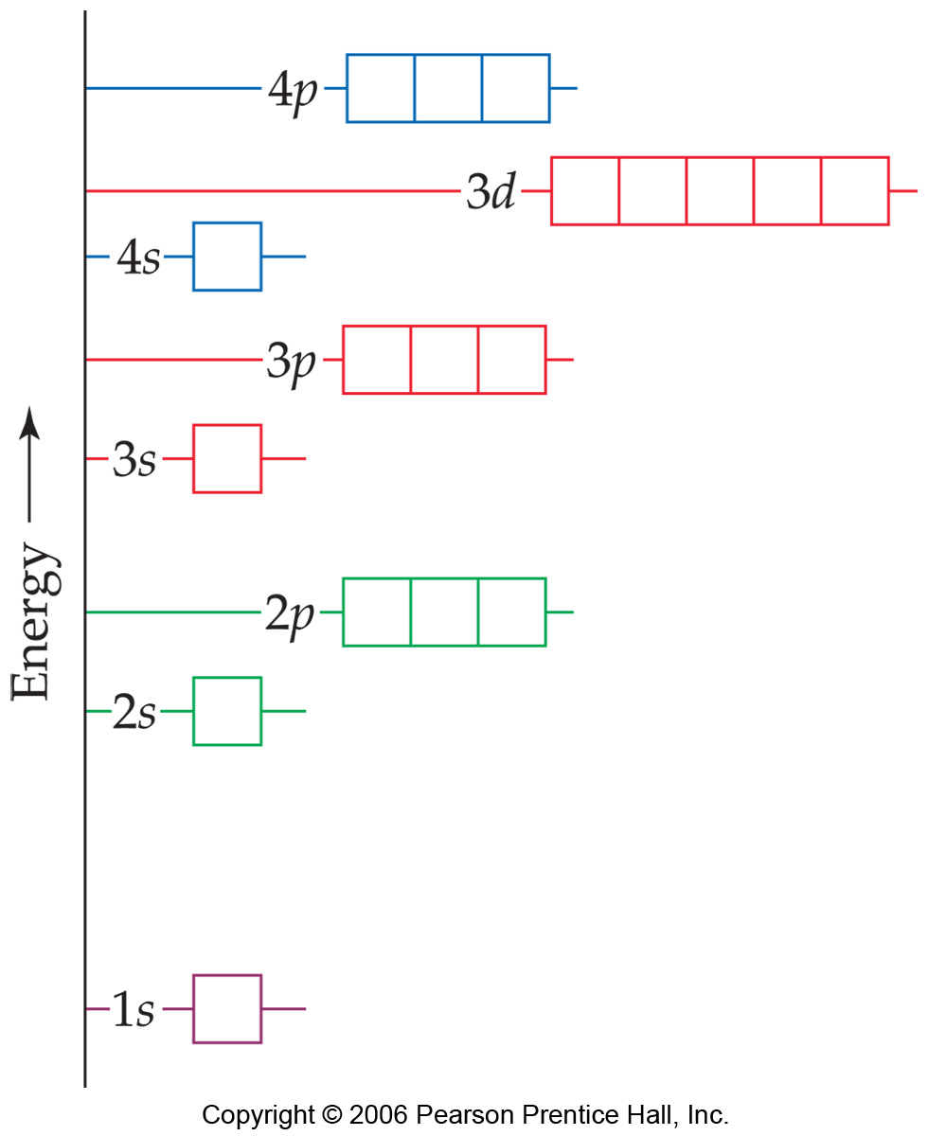
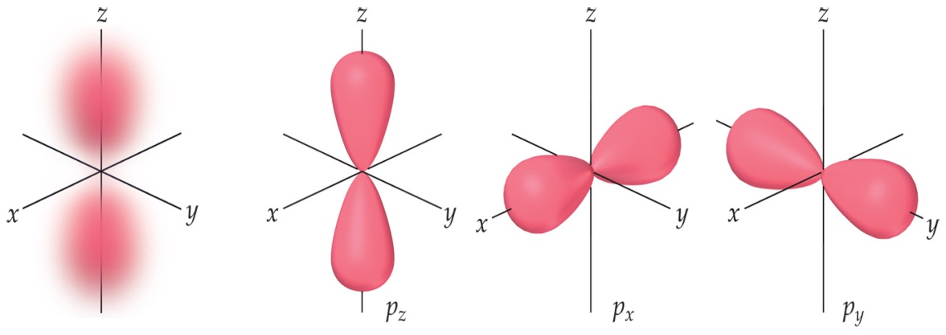
5.2 Quantum Theory and the Bohr Model of the Atom
Pages:
250 - 260

Slide 2
The Wave Nature of Light
The analysis of light helped us understand the electronic structure of atoms

Slide 3
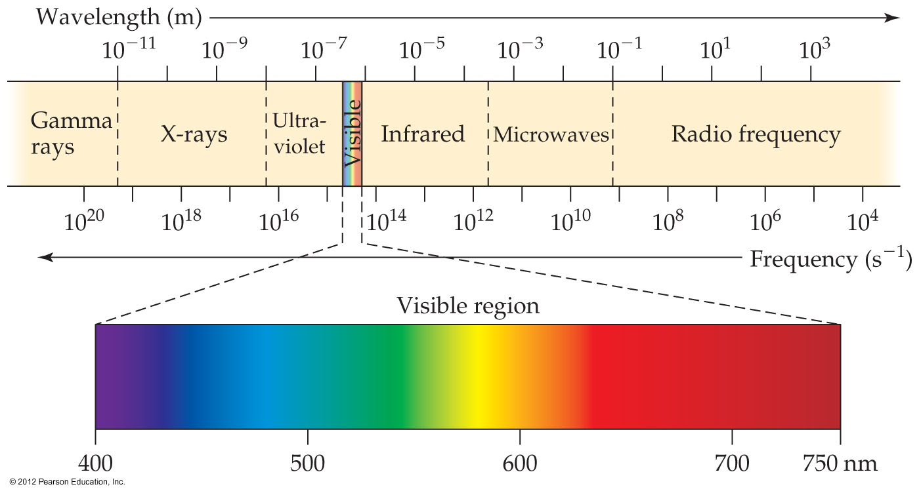
Electromagnetic radiation
The light we see with our own eyes is called
Visible light
It is one type of electromagnetic radiation
(radiant energy)

Slide 4
Many Types of Electromagnetic Radiation

Slide 5
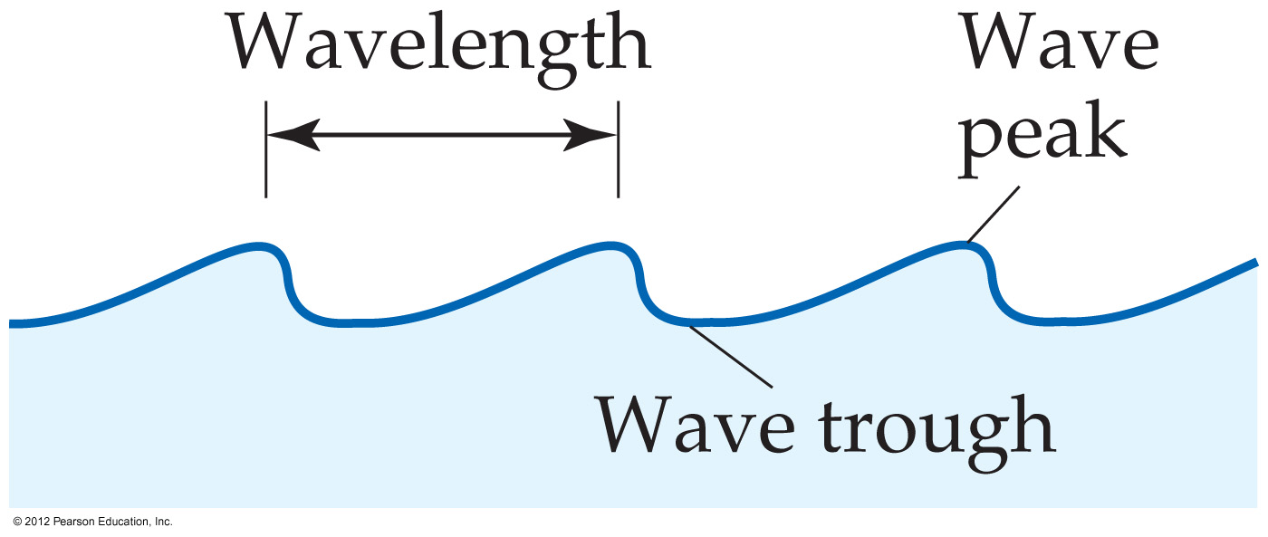
Many Types of Electromagnetic Radiation
All of them have
wave like properties

Slide 6
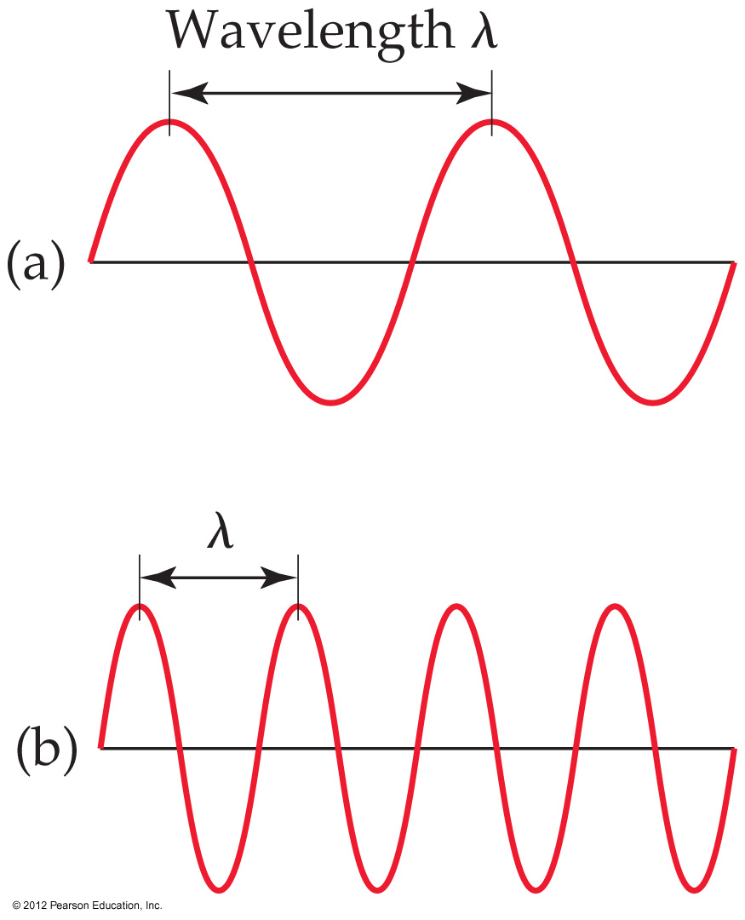
Many Types of Electromagnetic Radiation
The distance between corresponding points on adjacent waves is the wavelength (λ).
The number of waves passing a given point per unit of time is the frequency (v).

Slide 7
Quantized Energy and Photons
The wave model of light could not explain three phenomena

Slide 8
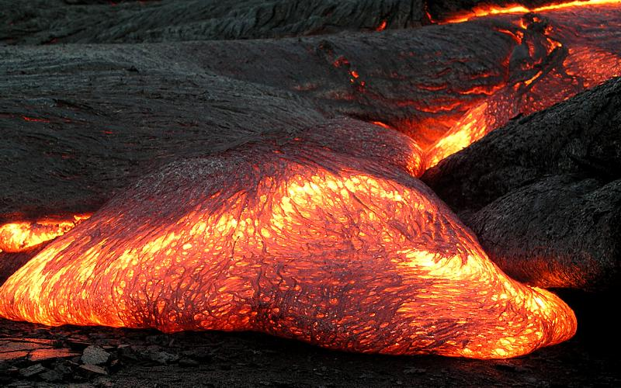
Unexplained Phenomena
Black Body Radiation
Photoelectric effect
An object that absorbs all radiation falling on it, at all wavelengths, is called a black body
The emission of electrons from metal surfaces on which light shines

Slide 9
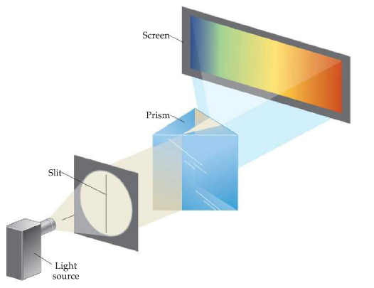
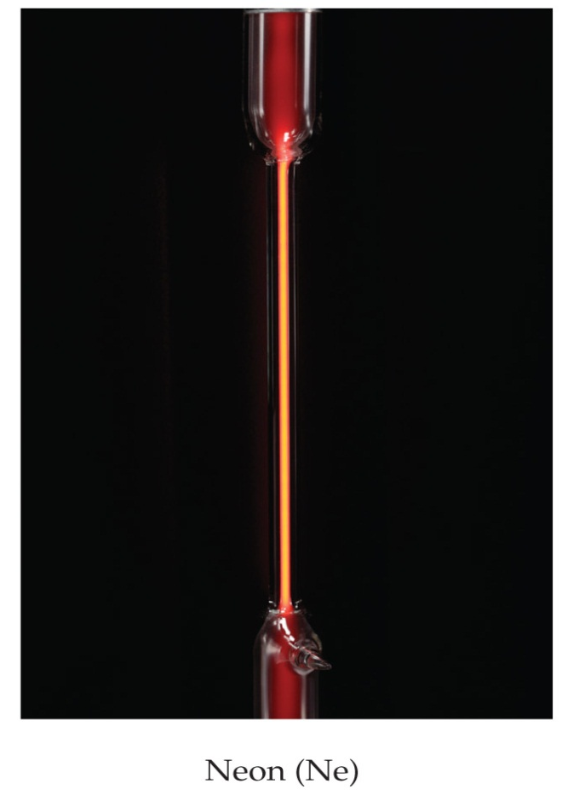
Unexplained Phenomena
Emission Spectra
The emission of light from electronically excited gas atoms

Slide 10
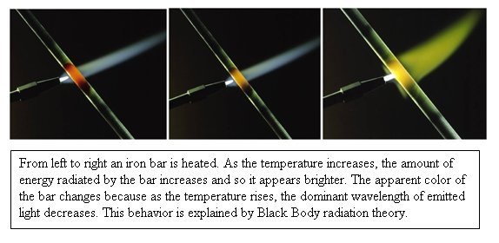
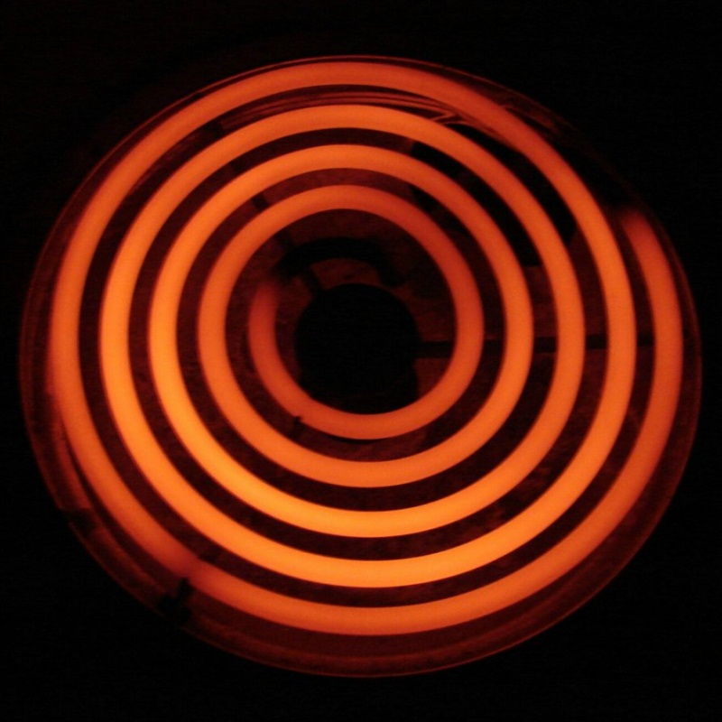
1. Black Body Radiation
When solids are heated, they emit radiation and get hot
However, they have different temperature:
a yellowish/white – hot
object is hotter than
a red – hot object
Explained by
Max Planck

Slide 11
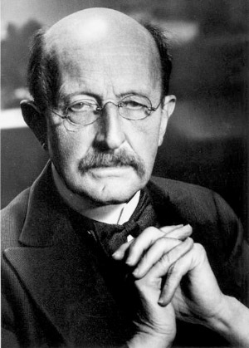
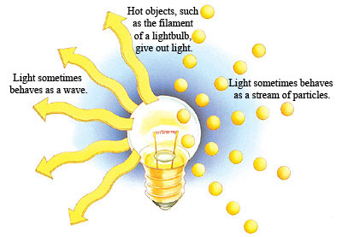
Hot Objects and Quantization of Energy
He assumed the energy can be released or absorbed by packets of quanta
Proposed that the energy of a single quantum:
E = h ∙ v
v = frequency
h = Plank’s constant = 6.626 x 10⁻³⁴ joule-second (J-s)

Slide 12
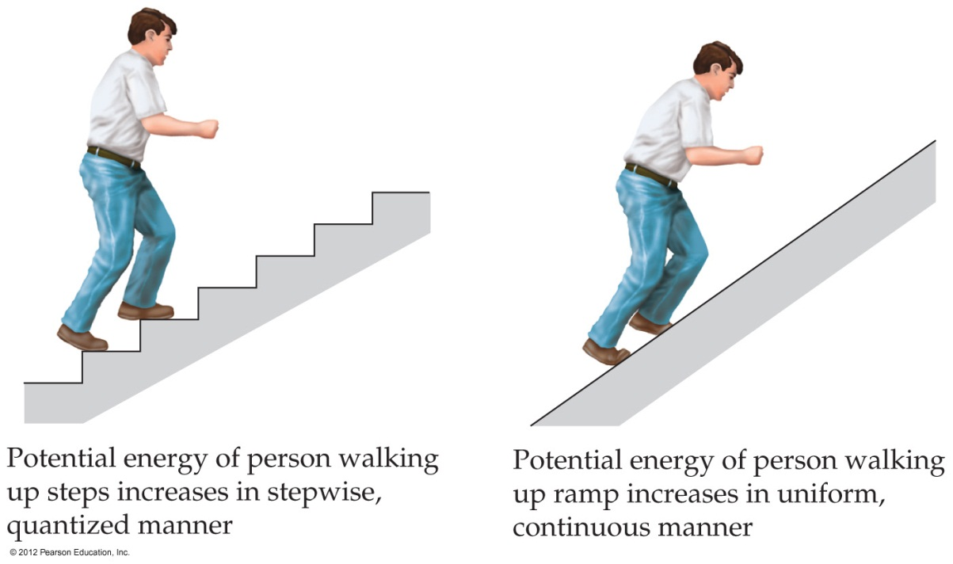
Hot Objects and Quantization of Energy
E = h ∙ v
A matter can emit or absorb energy in whole number multiple of h ∙ v
2hv
3hv
4hv

Slide 13
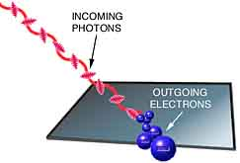
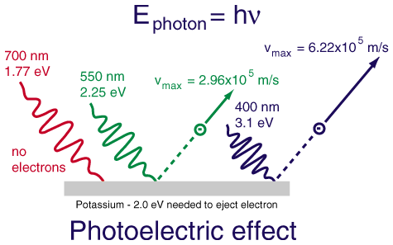
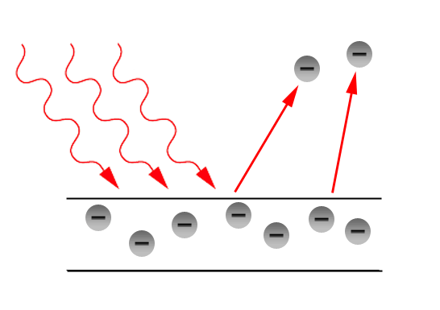
2. The Photoelectric Effect
The emission of electrons from metal surfaces on which light shines
Explained by
A. Einstein

Slide 14
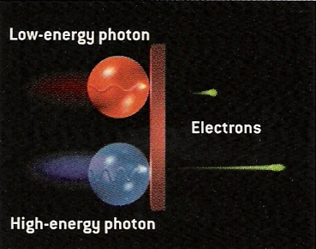
2. The Photoelectric Effect
He called the “Plank’s packets of energy” photons
E_{photon} = h ∙ v

Slide 15
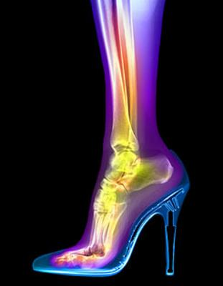
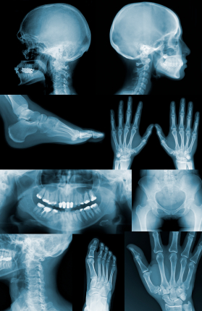
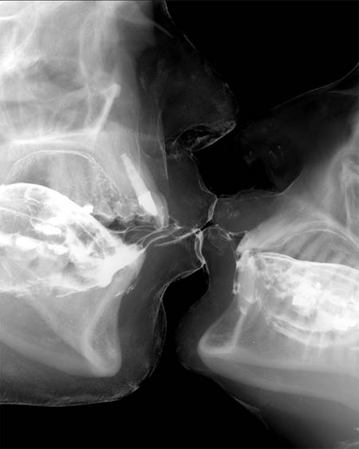
Summary of the photoelectric effect:
the energy of light (photon) depends on its frequency
Short wavelength radiation = high frequency radiation (X – ray)
=
High energy (damage to our cells and tissues)

Slide 16
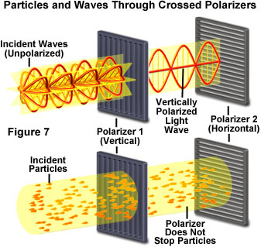
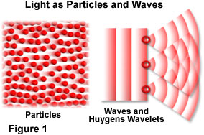
Summary of light so far…
Light can be:
a wave
a particle – like

Slide 17
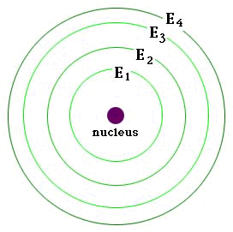
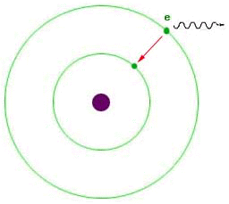
2. The Photoelectric Effect
What does this have to do with structure of an atom?
When an electron moves from a higher energy level to a lower energy level, a photon (particle of light) is emitted.

Slide 18
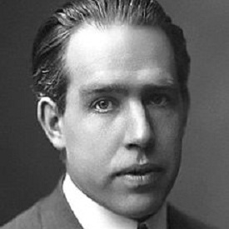
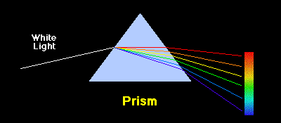
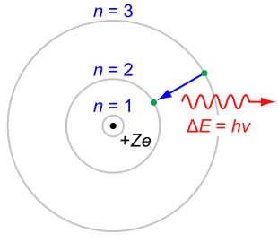
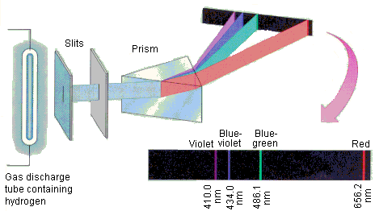
3. Emission Spectra
Energy (light) emitted by excited atoms or molecules
Explained by
Niels Bohr

Slide 19
Line Spectra and the Bohr Model
Spectrum –
range of colors produced when radiation (from sun, light bulbs etc…) is separated into its components

Slide 20
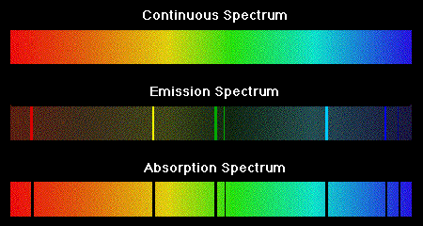
Continuous Spectrum – all wavelengths are present
Emission (Line) Spectrum – only few wavelengths are present

Slide 21
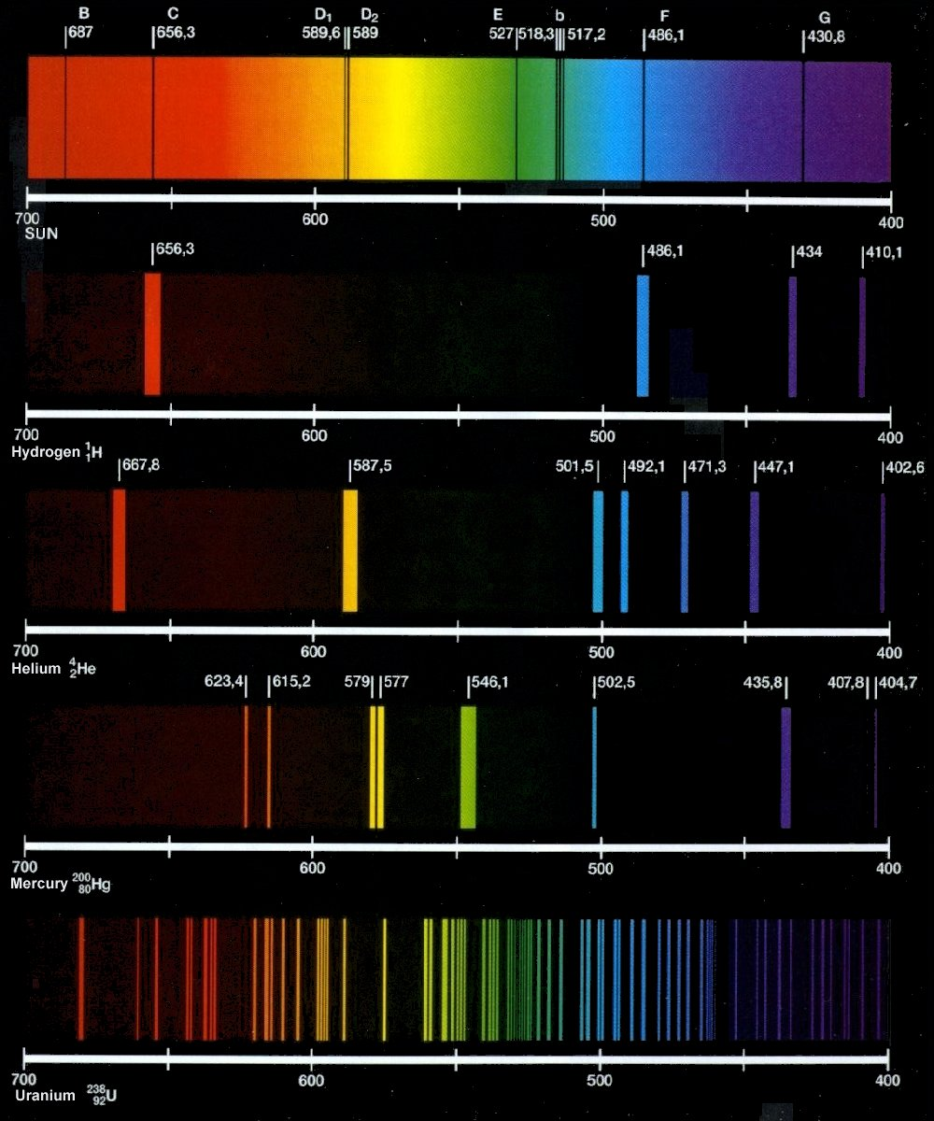
Emission (Line) Spectrum – only few wavelengths are present

Slide 22
Emission (Line) Spectrum – only few wavelengths are present
To explain the line spectrum of hydrogen, Niels Bohr came up with a model of an atom

Slide 23
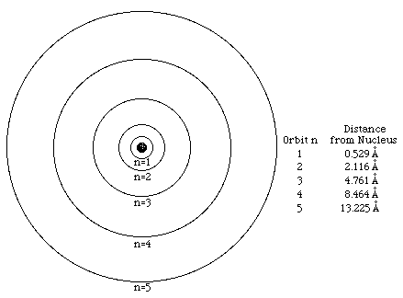
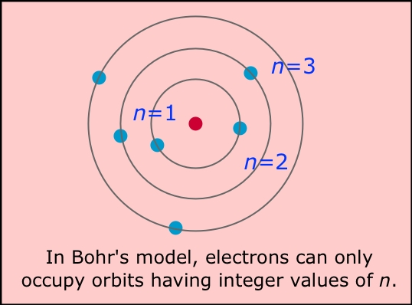
The Bohr Model Of A Hydrogen Atom
1. Electrons in an atom can only occupy certain orbits (corresponding to certain energies).

Slide 24
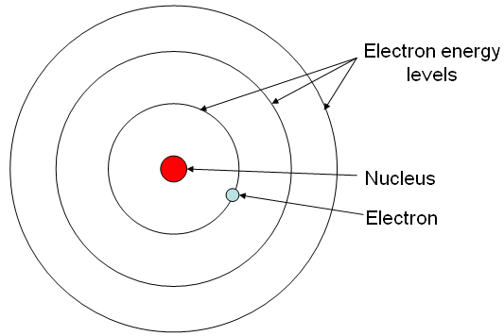
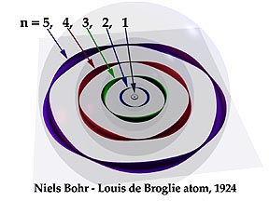
The Bohr Model Of A Hydrogen Atom
2. Electrons in permitted orbits have specific, “allowed” energies which will not be radiated and lost

Slide 25
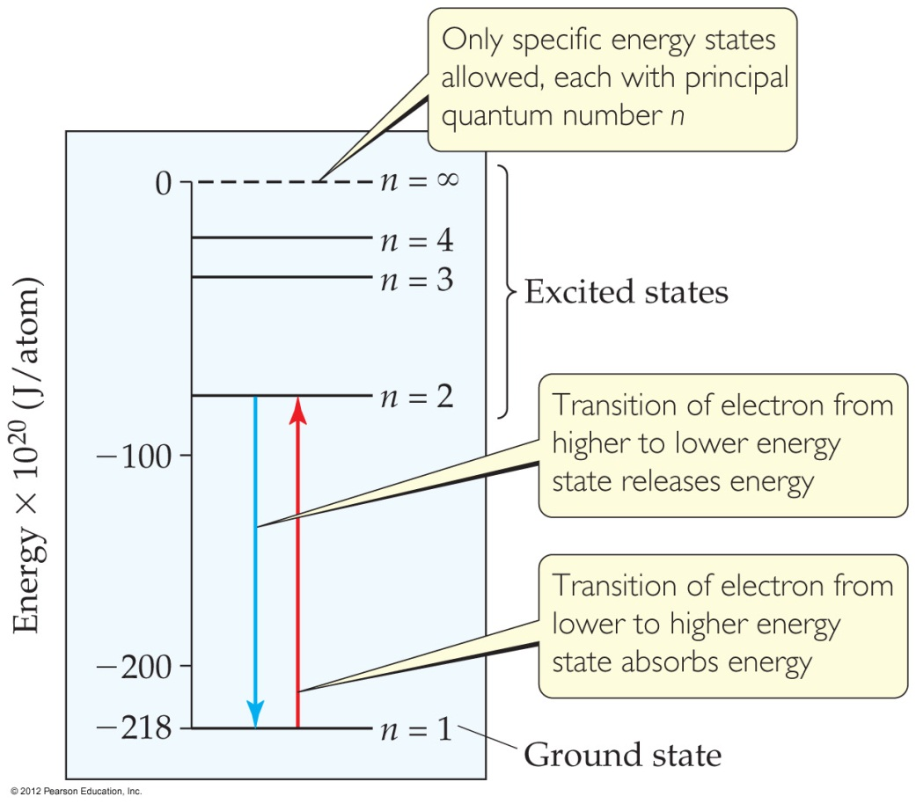
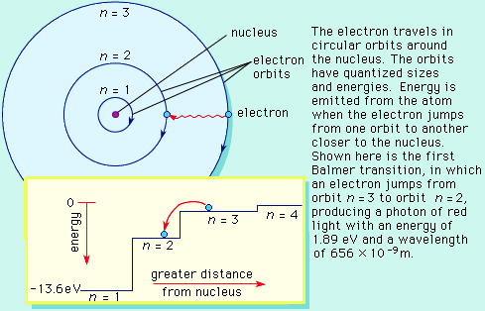
The Bohr Model Of A Hydrogen Atom
3. Energy is only absorbed or emitted in such a way as to move an electron from one “allowed” energy state to another
The energy is defined by E = h$ν$

Slide 26
The Bohr Model Of A Hydrogen Atom
The energy absorbed or emitted from the process of electron promotion or demotion between the orbitals can be calculated by the equation:
ΔE = -hcR_{h} ($\frac{\text{1}}{\text{n}\text{f}\text{2}}$ - $\frac{\text{1}}{\text{n}\text{i}\text{2}}$)
h = Planck’s constant
c = the speed of light
R_{h} = Rydberg’s constant

Slide 27
The Bohr Model Of A Hydrogen Atom
The energy absorbed or emitted from the process of electron promotion or demotion between the orbitals can be calculated by the equation:
ΔE = -2.18 x 10⁻¹⁸ ($\frac{\text{1}}{\text{n}\text{f}\text{2}}$ - $\frac{\text{1}}{\text{n}\text{i}\text{2}}$)
h = Planck’s constant
c = the speed of light
R_{h} = Rydberg’s constant

Slide 28
The Bohr Model Of A Hydrogen Atom
n = integer = principal quantum number
ΔE = -2.18 x 10⁻¹⁸ ($\frac{\text{1}}{\text{n}\text{f}\text{2}}$ - $\frac{\text{1}}{\text{n}\text{i}\text{2}}$)
Each orbit in an atom corresponds to different value of n
The lower the energy is (based on the formula), the more stable the atom is

Slide 29
The Bohr Model Of A Hydrogen Atom
n = integer = principal quantum number
ΔE = -2.18 x 10⁻¹⁸ ($\frac{\text{1}}{\text{n}\text{f}\text{2}}$ - $\frac{\text{1}}{\text{n}\text{i}\text{2}}$)
n = 1
has the
LOWEST ENERGY

Slide 30
The Bohr Model Of A Hydrogen Atom
When atom is in
n = 1
it is in a
Ground state
When atom is in
n = 2, 3, 4,…
it is in an
Excited state

Slide 31
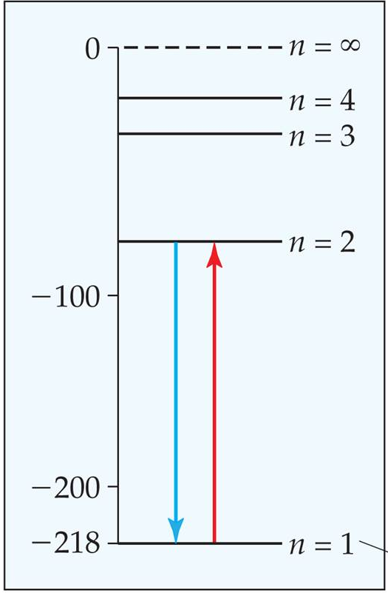
Using the picture below, predict which of these electronic transitions produces the spectral line having the longest wavelength:
n = 2 to n = 1; n = 3 to n = 2, n = 4 to n = 3
If wavelength increases, then frequency decreases. So…
The longest wavelength = the lowest frequency!
Because E = hv, the lower the frequency,
the lower the energy
the longest wavelength = the lowest frequency = the smallest energy change

Slide 32
Limitations of The Bohr Model
The explanation of the line spectrum works ONLY for hydrogen
Electron is not only a small particle circling the nucleus (it has wave – like properties)

Slide 33
The Summary of The Bohr Model
Electrons exist only in certain discrete energy levels, which are described by quantum numbers
Energy is involved in the transition of an electron from one level to another.

Slide 34
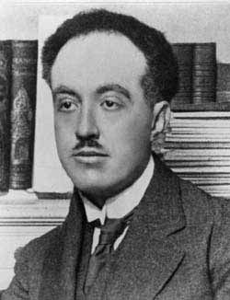
6.4 The Wave Nature of Matter
If energy (radiation) can behave as wave or particle
Could matter behave like a wave?
He showed:
Explained by
Louis de Broglie

Slide 35
6.4 The Wave Nature of Matter
An electron (matter) moving around the nucleus behaves like a wave and has a wavelength
h
mv
λ =
The relationship between mass and wavelength

Slide 36
6.4 The Wave Nature of Matter
An electron (matter) moving around the nucleus behaves like a wave and has a wavelength
h
mv
λ =
mv = momentum

Slide 37
What is the wavelength of an electron with a speed of 5.97 x 10⁶ m/s? The mass of electron is 9.11 x 10⁻³¹ kg
h = Plank’s constant = 6.626 x 10⁻³⁴ J-s
h
mv
λ =
λ = 1.22 x 10⁻¹⁰ m

Slide 38
Worksheet Example 0
Calculate the velocity of a neutron whose de Broglie wavelength is 500 pm. The mass of a neutron is given in the table inside the back cover of the text.

Slide 39
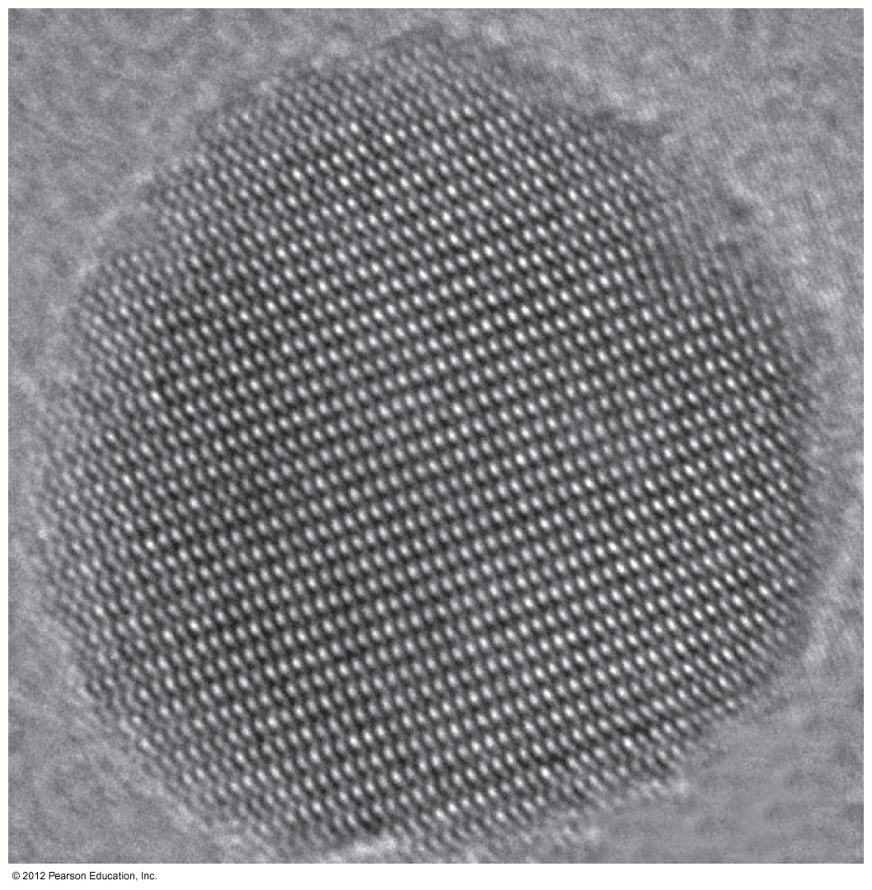
The demonstration of the wave properties of electrons
X – ray diffraction
When electrons pass through a crystal, their diffraction pattern is SAME
=
The wave behavior is the same as x-ray radiation (or other type)

Slide 40
HOMEWORK
PAGE: 240 - 243
PROBLEMS: 13, 17, 23, 31, 33, 35, 39, 43, 47

Slide 41
AP Chemistry
TODAY’S OBJECTIVES:
Knowing what Quantum Mechanics is and how we can use it to describe the structure of an atom
The similarities and differences between the Bohr Model and Quantum Mechanics model of an atom
What are the quantum numbers and what do they represent?

Slide 42
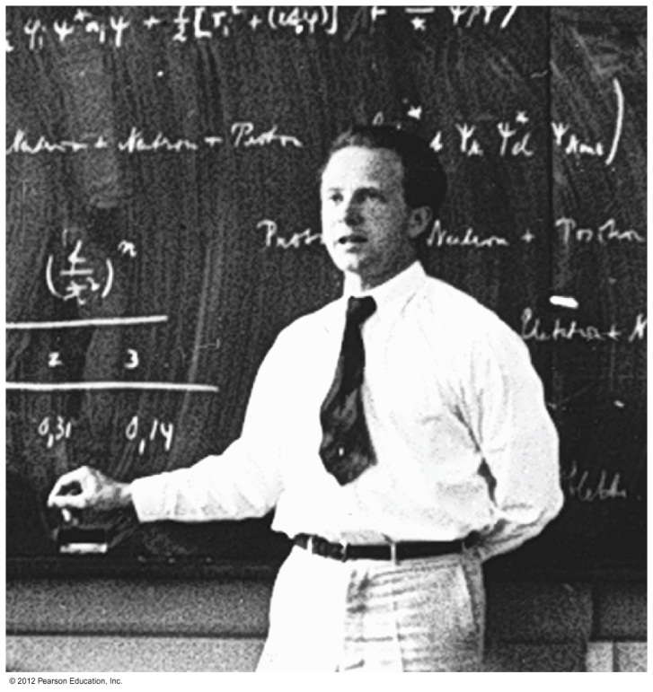
The Uncertainty Principle
Due to electrons’ wave characteristics, we can not precisely know the exact LOCATION and the MOMENTUM (m ∙ v) of the electrons at an instant of the time
Calculated that the uncertainty of the whereabouts of an electron is greater than the atom itself!
Explained by
Werner Heisenberg

Slide 43
The Uncertainty Principle
That’s why scientists needed another way how to describe an electron’s energy
Explained by
Werner Heisenberg

Slide 44
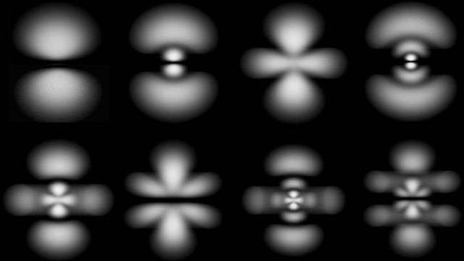
The Uncertainty Principle
They decided to use probable (NOT PRECISE) location and momentum of an electron to describe the electron's energy
Quantum Mechanics

Slide 45
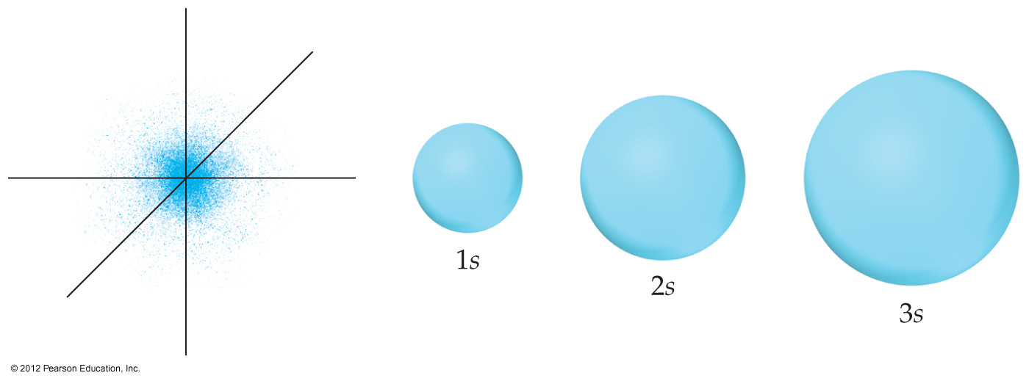
5.3 Beyond Bohr – The Quantum Mechanical Model of the Atom
Pages: 219 - 222

Slide 46
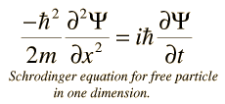
6.5 Quantum Mechanics
Introduced by Erwin Schrödinger (Wave Equation)
He treated the electron in H as a guitar string =
standing wave
Wave equation
ψ

Slide 47
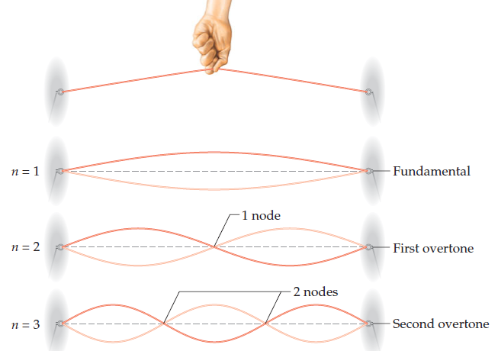
6.5 Quantum Mechanics
Introduced by Erwin Schrödinger (Wave Equation)
He treated the electron in H as a guitar string =
standing wave
Wave equation
ψ

Slide 48
6.5 Quantum Mechanics
Introduced by Erwin Schrödinger (Wave Equation)
He treated the electron in H as a guitar string =
standing wave
The square of the wave equation
ψ²
Probability of where an electron can be at any instant in time

Slide 49
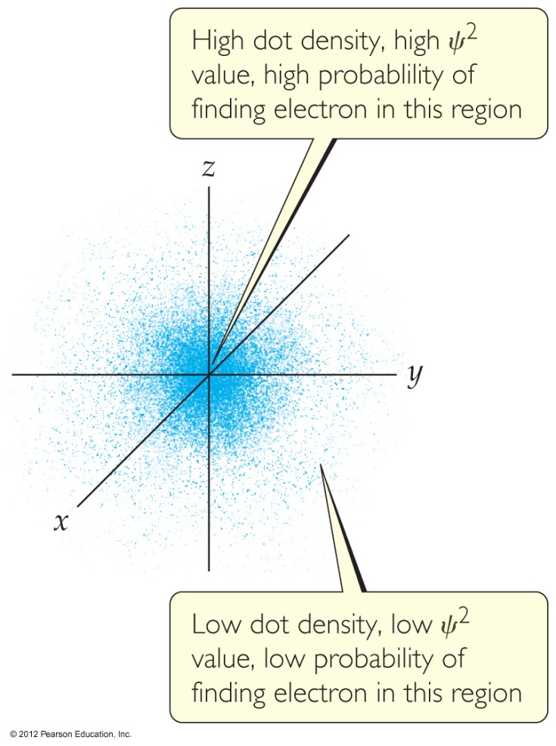
6.5 Quantum Mechanics
For hydrogen model, the energies of electrons are the same as for the Bohr Model
What is the difference between Bohr model and the QM model #1?
Electrons’ location can not be known precisely
They are in an “electron cloud” (electron density area)
Electrons are in a circular orbit of some particular radius

Slide 50
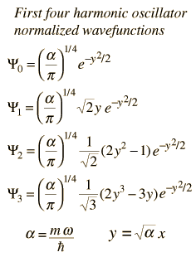
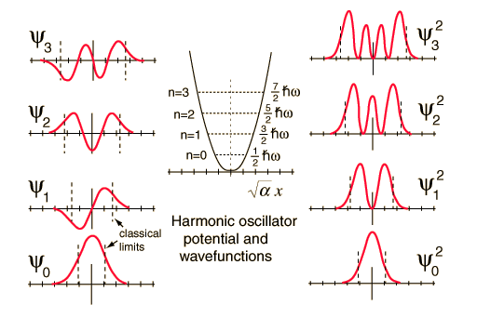
Orbitals and Quantum Numbers
Solving the wave equation gives a set of wave functions called ORBITALS and their energies

Slide 51
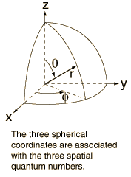
Orbitals and Quantum Numbers
An ORBITAL is described by a set of three Quantum Numbers

Slide 52
6.5 Quantum Mechanics
what is the difference between Bohr model and the QM model #2?
The Quantum Mechanical Model uses ORBITALS and 3 QUANTUM NUMBERS
Bohr model uses
ORBITS and only 1
QUANTUM NUMBER

Slide 53
The Principal Quantum Number
Describes the energy level on which the orbital resides
n = 1, 2, 3, ….
As n increases, the orbital becomes larger
and an electron has higher energy (farther from nucleus)

Slide 54
The Angular Momentum Quantum Number
Describes the SHAPE of the orbital
l = 0 up to(n-1)
Three different values of l =
Three different shapes of orbitals
Value of l | 0 | 1 | 2 | 3
Type of orbital | s | p | d | f

Slide 55
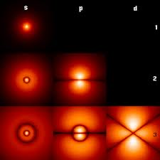
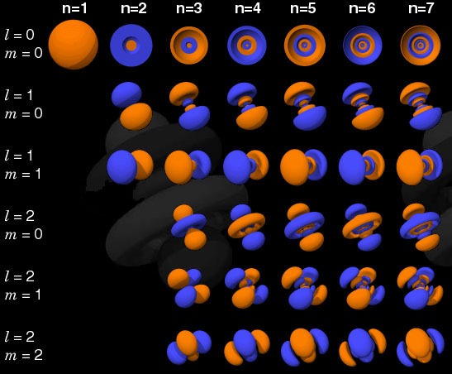
The Magnetic Quantum Number
Describes the ORIENTATION of the orbital in space
$\text{−}\text{l}≤$ m_{l} $≤$ l

Slide 56
Example 1
If your principal quantum number is 3, what are the possible values for other two quantum numbers?
n = 3
l = 0 up to (n-1)
l = 0 up to (3-1)
l = 0 up to 2
l = 0, 1, 2

Slide 57
Example 1
If your principal quantum number is 3, what are the possible values for other two quantum numbers?
n = 3
l = 0, 1, 2
s
d
p

Slide 58
Example 1
If your principal quantum number is 3, what are the possible values for other two quantum numbers?
n = 3
l = 0, 1, 2
$\text{−}\text{l}≤$ m_{l} $≤$ l

Slide 59
Example 1
If your principal quantum number is 3, what are the possible values for other two quantum numbers?
n = 3
l = 0, 1, 2
$\text{−}\text{2}≤$ m_{l} $≤$ 2

Slide 60
Example 1
If your principal quantum number is 3, what are the possible values for other two quantum numbers?
n = 3
l = 0, 1, 2
m_{l} $=$ -2, -1, 0, 1, 2

Slide 61
Worksheet Example 1
1. If your principal quantum number is 5, what are the possible values for other two quantum numbers?

Slide 62
Electron Shell and subshells
Orbitals with the same value of n =
an ELECTRON SHELL
Different orbital types within a shell (with the same n value)
=
SUBSHELL
Each subshell has a number which corresponds to the value of n

Slide 63
l : The secondary quantum number
If n can be thought of as shells, l can be thought of as “subshells” dividing each shell into subsections … (l = 0 → n - 1)
n = 1
l = 0 (s)
n = 3
l = 0 (s)
l = 1 (p)
l = 2 (d)
n = 2
l = 0 (s)
l = 1 (p)

Slide 64
For example…
The orbitals that have:
Value of l | 0 | 1 | 2 | 3
Type of orbital | s | p | d | f
n = 4
l = 2
are called 4d orbitals and are said to be in the 4d subshell

Slide 65
The first shell (n = 1) has only one subshell (l = 0): 1s
The second shell (n = 2) has two subshells (l = 0 and l = 1)
(l = 0): 2s
(l = 1): 2p

Slide 66
The second shell (n = 2) has two subshells (l = 0 and l = 1)
(l = 0): 2s (subshell)
(l = 1): 2p (subshell)
Each subshell has a specific number of orbitals which corresponds to the value of m_{l}
s subshells (1s, 2s, 3s, …) have l = 0 → value m = 0
1 orbital
$\text{−}\text{l}≤$ m_{l} $≤$ l

Slide 67
Each subshell has a specific number of orbitals which corresponds to the value of m_{l}
s subshells (1s, 2s, 3s, …) have l = 0 → value m = 0
p subshells (2p, 3p, 4p, …) have l = 1 → value m = -1, 0, 1
3 orbitals
$\text{−}\text{l}≤$ m_{l} $≤$ l

Slide 68
Each subshell has a specific number of orbitals which corresponds to the value of m_{l}
s subshells (1s, 2s, 3s, …) have l = 0 → value m = 0
p subshells (2p, 3p, 3p, …) have l = 1 → value m = -1, 0, 1
# orbitals = n²

Slide 69
Example
1. Predict the number of subshells in the fourth shell, that is, for n = 4.
2. Give the label for each of these subshells.
3. How many orbitals are in each of these subshells?

Slide 70
Example
1. Predict the number of subshells in the fourth shell, that is, for n = 4.
n = 4
l = 0,1,2,3

Slide 71
Example
1. Predict the number of subshells in the fourth shell, that is, for n = 4.
2. Give the label for each of these subshells.
n = 4
l = 0,1,2,3
4f
4s
4d
4p

Slide 72
Example
1. Predict the number of subshells in the fourth shell, that is, for n = 4.
2. Give the label for each of these subshells.
3. How many orbitals are in each of these subshells?
4s
1
4d
5
4p
3
4f
7

Slide 73
Worksheet Example 2
1. What is the designation for the subshell with n = 5 and l = 1?
2. How many orbitals are in this subshell?
3. Indicate the values of m_{l} for each of these orbitals

Slide 74
HOMEWORK
PAGE: 243
PROBLEMS: 49, 51, 55

Slide 75
6.6 REPRESENTATION OF ORBITALS

Slide 76
s ORBITALS
The value of l is 0
They are spherical in shape
The radius of the sphere increases with the value of n

Slide 77
p ORBITALS
The value of l for p orbitals is 1.

Slide 78
p ORBITALS
The value of l for p orbitals is 1.
Same size and shape, but their orientation is different

Slide 79
d ORBITALS
The value of l for d orbitals is 2. (-2,-1,0,1,2)

Slide 80
d ORBITALS
The value of l for d orbitals is 2. (-2,-1,0,1,2)
Four of the five have 4 lobes; the other resembles a p orbital with a doughnut around the center.

Slide 81
Worksheet Example 3
1. Draw all possible s and p orbitals if n = 2

Slide 82
HOMEWORK
PAGE: 243
PROBLEMS: 49, 51, 55, 59

Slide 83
6.7 MANY – ELECTRONS ATOMS

Slide 84
One – Electron atom (HYDROGEN)
For a one-electron hydrogen atom, orbitals on the same energy level have the same energy
That is, they are degenerate.

Slide 85
Many – Electron atoms
As the number of electrons increases, though, so does the repulsion between them.
This causes various subshells in a given shell to be at different energies
In a given shell, the energy of an orbital increases as l increases

Slide 86
Many – Electron atoms
As the number of electrons increases, though, so does the repulsion between them.
This causes various subshells in a given shell to be at different energies
In a given shell, the energy of an orbital increases as l increases

Slide 87
Think about it…
How may orbitals have the principal quantum number n = 3?
In a many-electron atom, what are the relative energies of these orbitals?
One 3s orbital, three 3p orbitals, five 3d orbitals
2. 3s < 3p < 3d

Slide 88
Electron Spin and the Pauli Exclusion Principle
Which orbitals do the electrons occupy?
How many electrons are in each orbital?

Slide 89
Electron Spin and the Pauli Exclusion Principle
In the 1920s, it was discovered that two electrons in the same orbital do not have exactly the same energy.
The “spin” of an electron describes its magnetic field, which affects its energy.

Slide 90
Spin Quantum Number - m_{s}
This led to a 4th quantum number
Only two allowed values:
+1/2 and – 1/2

Slide 91
Pauli Exclusion Principle
no two electrons in an atom can have the same set of four quantum numbers: n, l, m_{l}, and m_{s}.
For a given orbital : n, l, and m_{l}, are FIXED
So if we want to put more than one electron into the same orbital, only m_{s} must be different
Only 2 electrons are allowed for each orbital!!

Slide 92
6.8 ELECTRON CONFIGURATIONS

Slide 93
6.8 ELECTRON CONFIGURATIONS
This term shows the distribution of all electrons in an atom.
Each component consists of:
4p⁵

Slide 94
6.8 ELECTRON CONFIGURATIONS
This term shows the distribution of all electrons in an atom.
Each component consists of
A number denoting the energy level
4p⁵

Slide 95
6.8 ELECTRON CONFIGURATIONS
This term shows the distribution of all electrons in an atom.
Each component consists of
A letter denoting the type of orbital
4p⁵

Slide 96
6.8 ELECTRON CONFIGURATIONS
This term shows the distribution of all electrons in an atom.
Each component consists of
A superscript denoting the number of electrons in those orbitals.
4p⁵

Slide 97
6.8 ELECTRON CONFIGURATIONS
The way electrons are distributed within various orbitals
the orbitals are filled in order of increasing energy, with no more than two electrons per orbital
Orbital Diagram
:1s²2s¹
electron
configuration

Slide 98
6.8 ELECTRON CONFIGURATIONS
The way electrons are distributed within various orbitals
the orbitals are filled in order of increasing energy, with no more than two electrons per orbital
Orbital Diagram
:1s²2s¹
Paired
electrons
Unpaired
electron

Slide 99
6.8 ELECTRON CONFIGURATIONS
The way electrons are distributed within various orbitals
the orbitals are filled in order of increasing energy, with no more than two electrons per orbital
Orbital Diagram
:1s²2s¹
How many unpaired electrons
does a Li atom posses?

Slide 100
WHITE BOARD EXAMPLE
Fill the boxes below with the arrow notation for electrons showing the correct ground state electron configuration for the element B.
What is the electron
configuration of a B atom?
How many unpaired electrons
does a B atom posses?

Slide 101
Hund’s Rule
Show the correct ground state electron configuration for the element C.
How many unpaired electrons
does a C atom posses?
“For degenerate orbitals, the lowest energy is attained when the number of electrons with the same spin is maximized.”

Slide 102
Hund’s Rule
Show the correct ground state electron configuration for the element C.
How many unpaired electrons
does a C atom posses?
“When an electron is added to a subshell, it will always occupy an empty orbital if there is a one available.

Slide 103
WORSHEET QUESTION
Draw the orbital diagram for the electron configuration of N.
What is the electron
configuration of a N atom?
How many unpaired electrons
does a N atom posses?

Slide 104
Some other atoms…

Slide 105
Shorthand Notation

Slide 106
Valence Electrons
The electrons in the outermost principal quantum level of an atom

Slide 107
Outer Shell Electrons OR Valence Electrons
The electrons in the outermost principal quantum level of an atom

Slide 108
Inner Shell Electrons OR Core Electrons

Slide 109
WORSHEET QUESTION
What is the shorthand (condensed) electron
configuration of a Ca atom?
How many valence electrons
does a Ca atom posses?
How many core electrons
does a Ca atom posses?

Slide 110
EXAMPLE
What is the electron
configuration of a potassium atom?
1s²2s²2p⁶3s²3p⁶4s¹
1s²2s²2p⁶3s²3p⁶3d¹

Slide 111
Transition Metals
An electron with the highest energy went to the 4s instead of 3d orbital!
WHY?

Slide 112
WORKSHEET EXAMPLE
What is the electron
configuration of a rubidium atom?

Slide 113
WORKSHEET EXAMPLE
Based on the structure of the periodic table, which becomes occupied first, the 6s orbital or the 5d orbitals?

Slide 114
HOW TO REMOVE ELECTRONS FROM ATOMS TO FORM IONS
For Cations:
First, remove the electron (s) from the occupied orbitals with the largest principal quantum number

Slide 115
HOW TO REMOVE ELECTRONS FROM ATOMS TO FORM IONS
For Cations:
2. If there is more than one occupied subshell for a given value of n (e.g 3s, 3p..), the electrons are removed from the orbital with the highest value of l

Slide 116
HOW TO ADD ELECTRONS FROM ATOMS TO FORM IONS
For ANIONS:
1. The electrons are added to the empty or partially filled orbital having the lowest value of n

Slide 117
EXAMPLE
Write the electron configuration for Ca²⁺, Co³⁺, and S²⁻.
[Ar]4s²
[Ar]4s²3d⁷
[Ne]3s²3p⁴
[Ar]
[Ar]3d⁶
[Ne]3s²3p⁶
[Ar]

Slide 118
WORKSHEET EXAMPLE
Write the electron configuration for Cr³⁺, Ga³⁺, and Br⁻.

Slide 119
ACTIVITY
Using the given squares, poster paper, glue sticks and scissors:
DESIGN A GRAPHICAL WAY OR STEP BY TO FOLLOW FOR ELECTRONIC CONFIGURATION OF ANY ELEMENT
Originality
Correctness
Speed
Clarity

Slide 121
HOMEWORK
PAGE: 243
PROBLEMS: 61, 65, 67, 69

Slide 122
6.9 Electron Configurations and Periodic Table

Slide 123
Periodic Table
Is divided into different blocks
s - block and p – block elements =
the main group elements

Slide 124
Periodic Table
Is divided into different blocks
d - block elements =
the transition metals

Slide 125
Periodic Table
Is divided into different blocks
f - block elements =
the f-block metals

Slide 126
REMEMBER!!!
The number of columns in each block corresponds to the maximum number of electrons that can occupy each kind of subshell

Slide 127
Some Anomalies
Cr, cu
Some irregularities occur when there are enough electrons to half-fill s and d orbitals on a given row.

Slide 128
Some Anomalies
For instance,
the electron configuration
for cromium is
[Ar] 4s¹ 3d⁵
rather than
the expected
[Ar] 4s² 3d⁴.

Slide 129
Some Anomalies
This occurs because
the 4s and 3d orbitals are
very close in energy.
These
anomalies
occur in f-block atoms, as well

Slide 130
EXAMPLE
1. Based on its position in the periodic table, write the condensed electron configuration for bismuth, element 83.
2. How many unpaired electrons does a bismuth atom have?

Slide 131
ACTIVITY!!!
Remember the Elements that you were assigned for building of the Periodic Table??
1. Take two of those elements and write their full ground-state electron configuration and the shorthand electron configuration

Slide 132
ACTIVITY!!!
2. Prepare a chart similar to the one shown in the example below, giving the values of each of the four quantum numbers for each electron in the atom.

Slide 133
ACTIVITY!!!
3. Create an energy level diagram for your elements. Use a line to represent an orbital, and use up and down arrows to represent electrons in each orbital.

Slide 134
ACTIVITY!!!
4. Many substances exhibit no magnetic properties except in the presence of a magnetic field. Substances with all paired electrons are weakly repelled by a magnetic field. These substances are called diamagnetic. Other substances are attracted to a magnetic field and are called paramagnetic. This property is the result of unpaired electrons.
Which of the following do you expect to be paramagnetic? Explain how you reached your conclusions?
K
Ba²⁺
Fe³⁺
F
Fe²⁺
F⁻
Ni²⁺

Slide 135
HOMEWORK
PAGE: 246
PROBLEMS: 71, 74, 94

Slide 136
ANSWERS TO WORKSHEET EXAMPLES

Slide 137
Worksheet Example 0
Calculate the velocity of a neutron whose de Broglie wavelength is 500 pm. The mass of a neutron is given in the table inside the back cover of the text.
7.92 × 10² m/s

Slide 138
Worksheet Example 1
1. If your principal quantum number is 5, what are the possible values for other two quantum numbers?
l = 4, 3, 2, 1, 0
m = -4, -3, -2, -1, 0, 1, 2, 3, 4

Slide 139
Worksheet Example 2
1. What is the designation for the subshell with n = 5 and l = 1?
2. How many orbitals are in this subshell?
3. Indicate the values of m_{l} for each of these orbitals
5p
3
-1, 0, 1

Slide 140
Worksheet Example 3
1. Draw all possible s and p orbitals if n = 2

Slide 141
WORSHEET QUESTION
What is the shorthand (condensed) electron
configuration of a Ca atom?
[ar]4s²
2
How many valence electrons
does a Ca atom posses?
18
How many core electrons
does a Ca atom posses?

Slide 142
WORKSHEET EXAMPLE
EXAMPLE
What is the electron
configuration of a rubidium atom?
1s²2s²2p⁶3s²3p⁶3d¹⁰4s²4p⁶5s¹

Slide 143
WORKSHEET EXAMPLE
Based on the structure of the periodic table, which becomes occupied first, the 6s orbital or the 5d orbitals?

