Slide 1
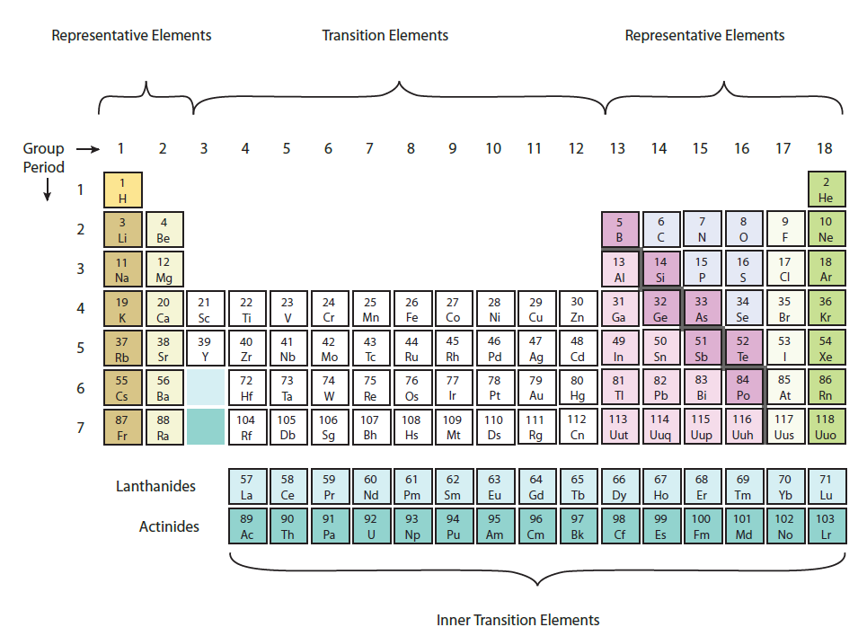
6.1 The Development of the Periodic Table
Pages:
286 – 298

Slide 2
You already know this material…
Read the textbook
Do all QUICK CHECKS
Review Problems (all)

Slide 5
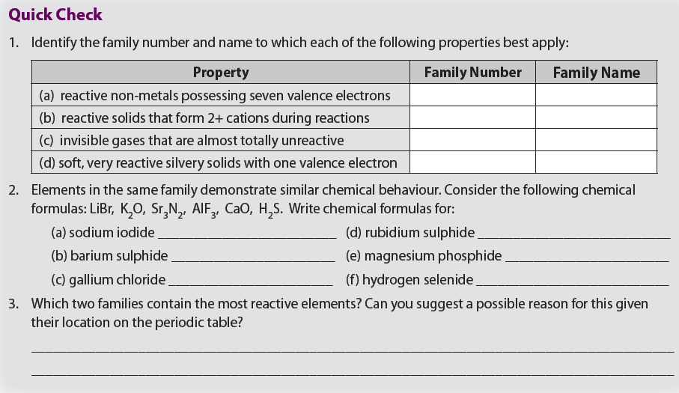

Slide 7
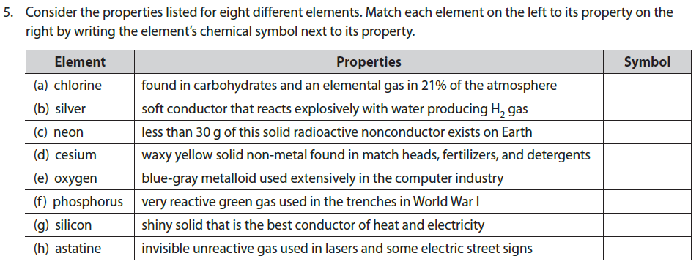

Slide 8
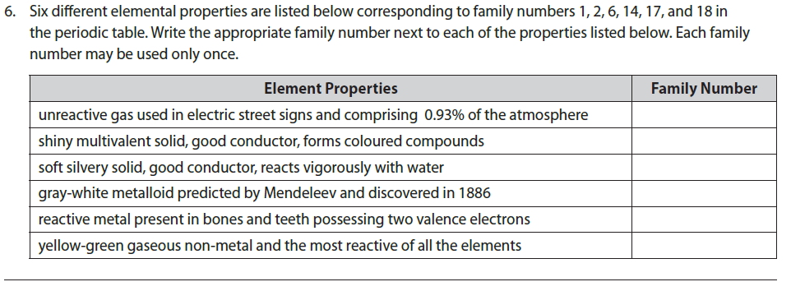

Slide 9
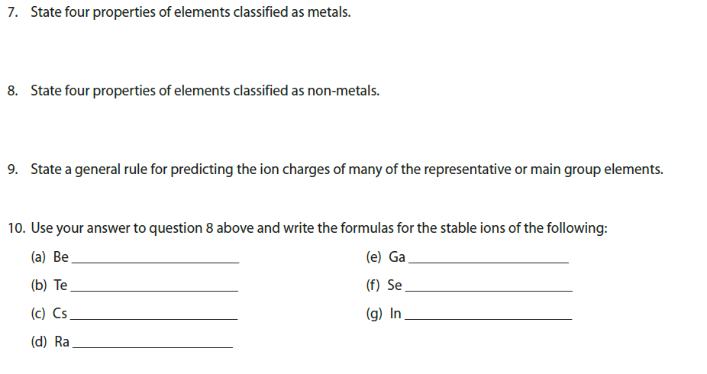

Slide 15
HOMEWORK
PAGE: 283 - 284
PROBLEMS: all

