Slide 1
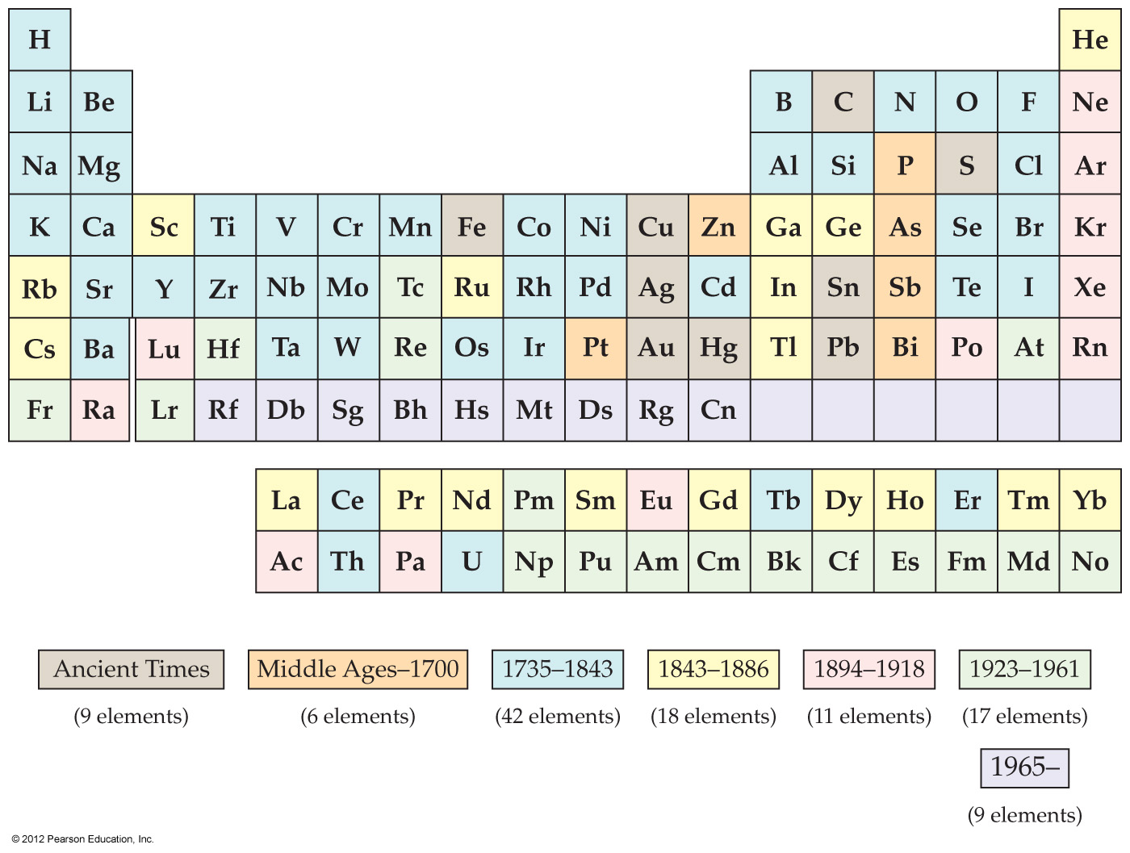
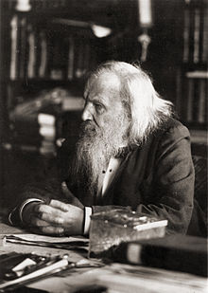
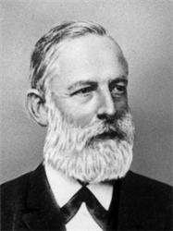
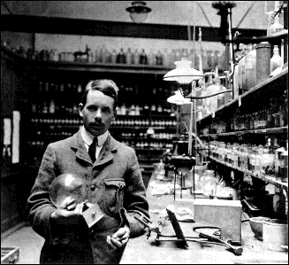
7.1 Development of The Periodic Table
Developed by Mendeleev and Meyer
Moseley developed the concept of atomic number

Slide 2
6.2 Periodic Trends - Regular Changes in Elemental Properties
We will find out trends in :
Sizes of Atoms and Ions
Ionization Energy
Electronegativity

Slide 3
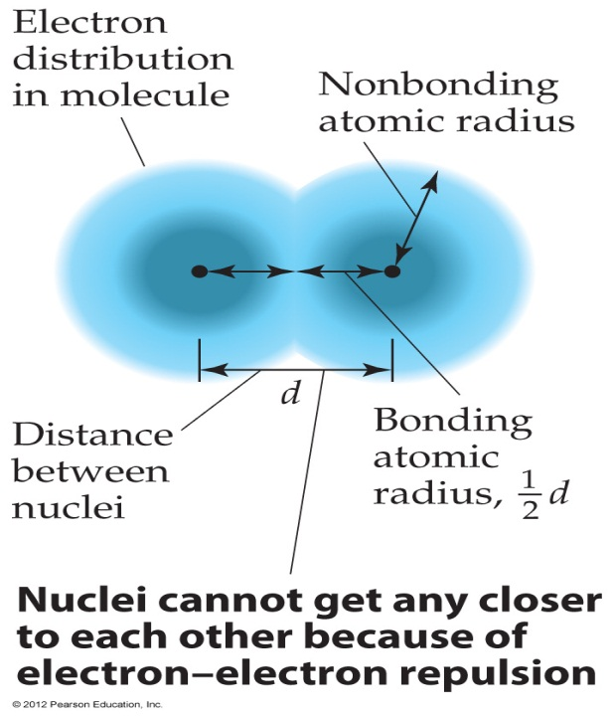
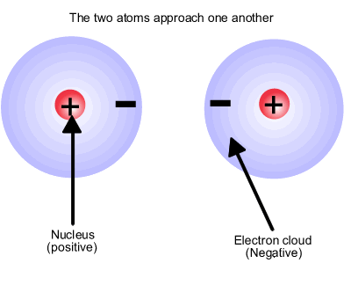
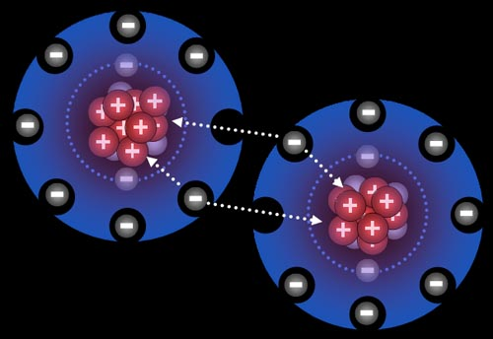
Three Basic Rules You Should Keep In Mind
1. Electrons are attracted to protons in the nucleus of an atom:
The closer the electron is to the nucleus, the stronger the force of attraction
The more protons in a nucleus, the more strongly an electron is attracted to the nucleus

Slide 4
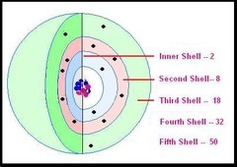
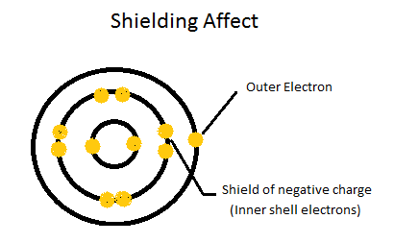
Three Basic Rules You Should Keep In Mind
2. Electrons are repelled by other electrons within an atom
If there are other electrons between a valence (outer) electron and the nucleus, the valence electron will be less attracted to the nucleus
This is called SHIELDING

Slide 5
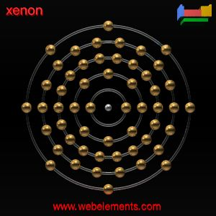
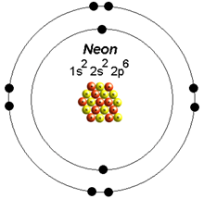
Three Basic Rules You Should Keep In Mind
3. Complete shells are very stable
Atoms prefer to add or subtract valence electrons to create the filled (complete) shells

Slide 6
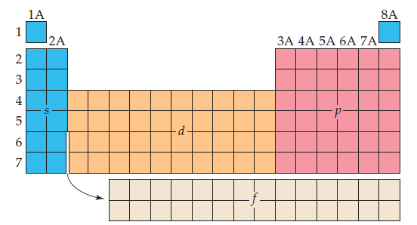
Effective Nuclear Charge
Elements in the same column contain the same number of valence electrons
RECALL

Slide 7
Valence Electrons
The electrons in the outermost principal quantum level of an atom

Slide 8
Review EXAMPLE
How many core electrons and how many valence electrons does Lithium and Beryllium have?
Lithium
Beryllium
1s²2s¹
1s²2s²
2 core electrons
1 valence electron
2 core electrons
2 valence electrons

Slide 9
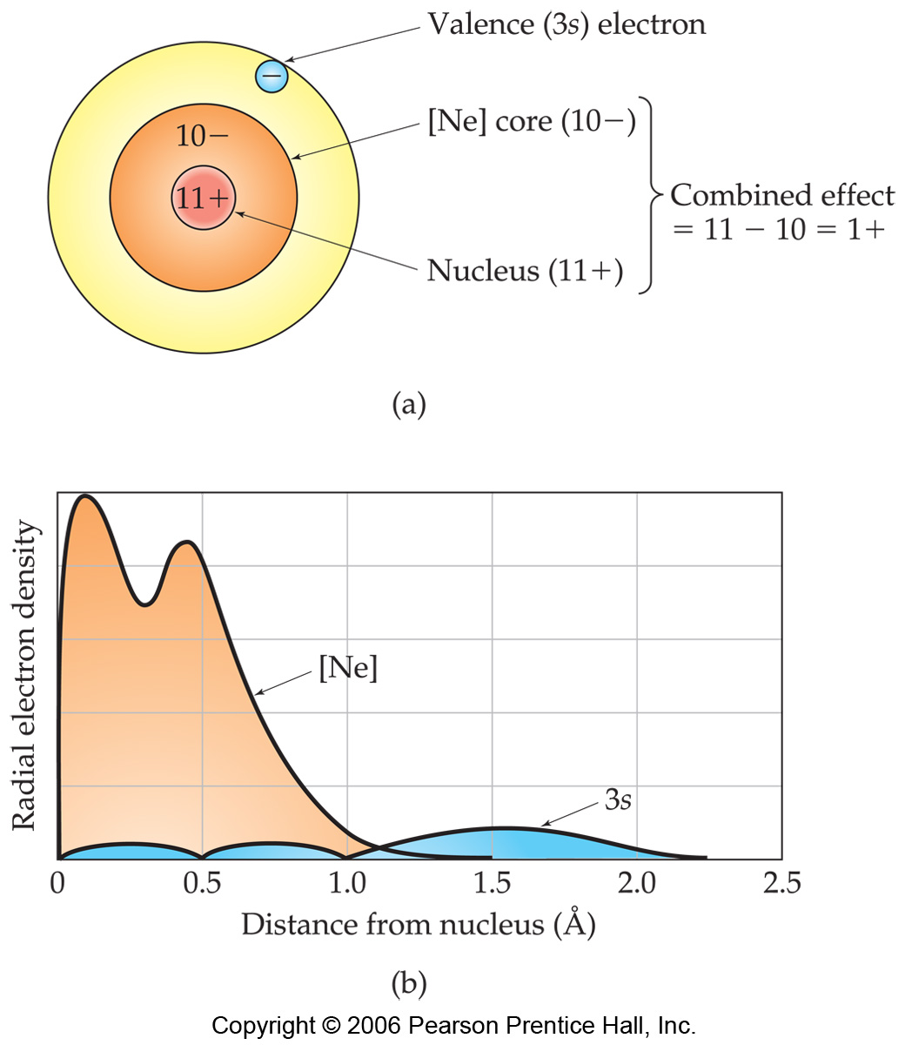
Effective Nuclear Charge
Electrons in a many-electrons atom are:
Attracted by the nucleus
Repelled by other electrons
The nuclear charge which an electron experiences is a combination of both these factors

Slide 10
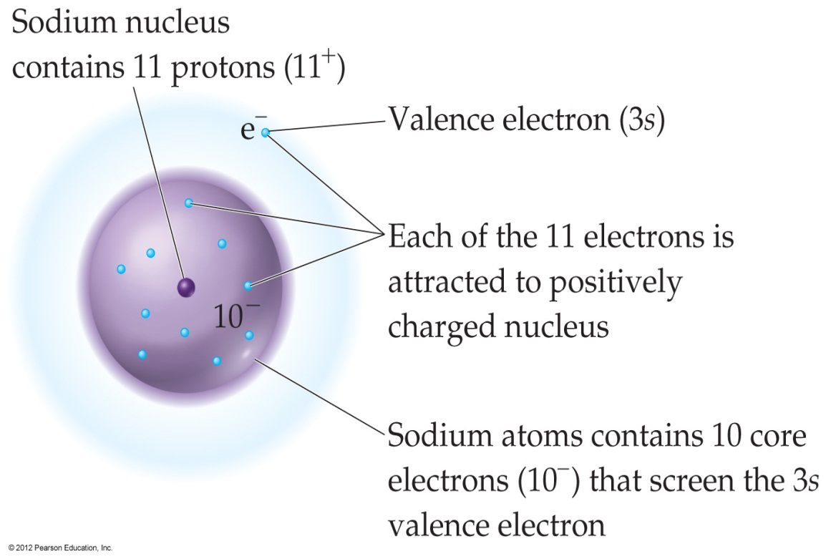
Effective Nuclear Charge
The nuclear charge = attractive force between nucleus and electrons
Z_{eff} = Z – S
Z = # of protons
S = shielding constant ≈ # of core electrons

Slide 11
Effective Nuclear Charge
The core electrons partially screen the outer electron from the attraction of the nucleus
1s²2s²2p⁶3s¹
Z_{eff} = Z – S
SHIELDING
Z_{eff} = 11 – 10
Z = # of protons
S = shielding constant ≈ # of core electrons
Z_{eff} = + 1

Slide 12
Effective Nuclear Charge for Valence Electrons
INCREASES FROM LEFT TO RIGHT ACROSS ANY PERIOD
WHY?
INCREASING

Slide 13
Let’s Compare…
# of core electrons stays the same/increases
# of protons increases = nuclear charge increases
# of valence electrons increases
Lithium
Beryllium
1s²2s¹
1s²2s²
2 core electrons
3 protons (+3)
1 valence electron
2 core electrons
4 protons (+4)
2 valence electrons

Slide 14
the 2 core electrons of Li screen (shield) the lonely valence electron from the nucleus (3+ charge)
the 2 core electrons of Be screen (shield) the 2 valence electrons from the nucleus (4+ charge)
The 2 valence electrons make no difference in screening
Lithium
Beryllium
1s²2s¹
1s²2s²
2 core electrons
3 protons (+3)
1 valence electron
2 core electrons
4 protons (+4)
2 valence electrons

Slide 15
There are 4 protons attracting 2 core electrons
The pull will be stronger than in Li → the nuclear charge increases
the 2 core electrons of Li screen (shield) the lonely valence electron from the nucleus (3+ charge)
Z_{eff} = 1+
Z_{eff} = 2+
Lithium
Beryllium
1s²2s¹
1s²2s²
2 core electrons
3 protons (+3)
1 valence electron
2 core electrons
4 protons (+4)
2 valence electrons

Slide 16
Effective Nuclear Charge for Valence Electrons
INCREASING SLIGHTLY GOING DOWN A GROUP
WHY?
Increase sing slightly

Slide 17
Effective Nuclear Charge for Valence Electrons
More diffuse core electrons are less able to screen the valence electrons
Increase sing slightly

Slide 18
Which would you expect to experience a greater effective nuclear charge, a 2p electron of Ne atom or a 3s electron of a Na atom. And WHY?
Na
Ne
1s²2s²2p⁶
1s²2s²2p⁶3s¹
10 core electrons
1 valence electrons
11 protons
2 core electrons
8 valence electron
10 protons
a 2p electron of Ne: because there is better shielding by core electrons for a 3s electron of Na

Slide 19
EXAMPLE
Which would you expect to experience a greater effective nuclear charge, a 2p electron of Ne atom or a 3s electron of a Na atom. And WHY?
Na
Ne
1s²2s²2p⁶
1s²2s²2p⁶3s¹
10 core electrons
1 valence electrons
11 protons
2 core electrons
8 valence electron
10 protons
10 protons in Ne attract only 2 core electrons
11 protons in Na attract 10 core electrons

Slide 20
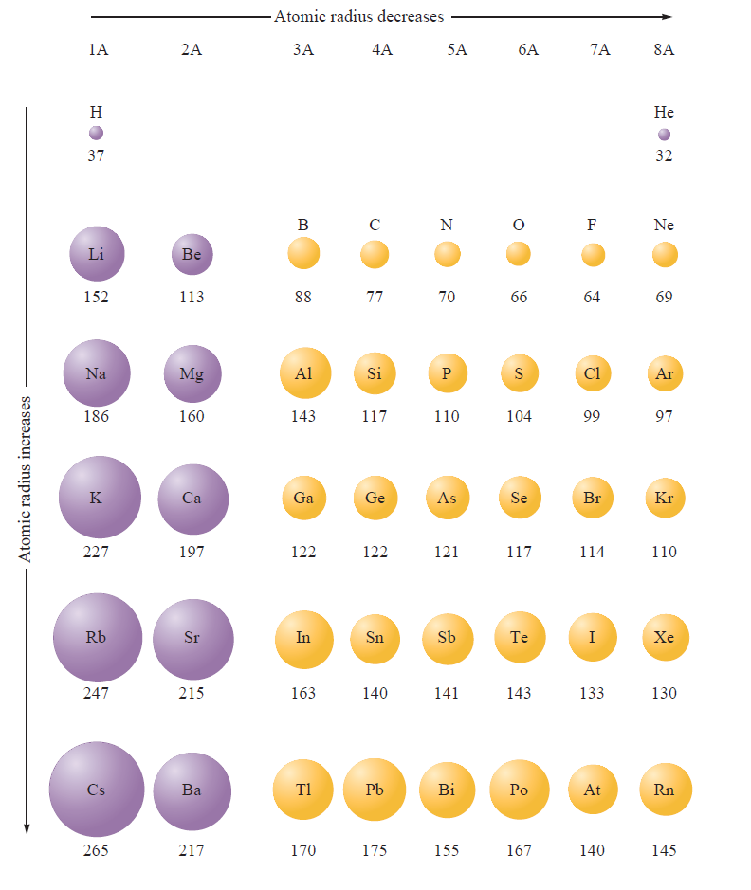
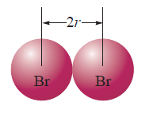
SIZES of ATOMS and IONS

Slide 21
SIZES of ATOMS and IONS

Slide 22
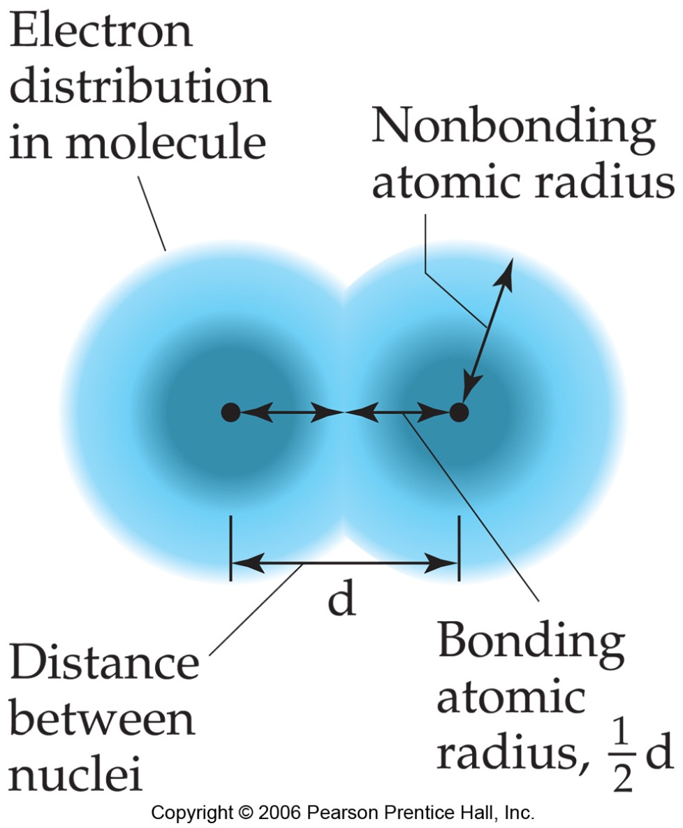
SIZES of ATOMS and IONS
Size of an atom cannot be determined exactly
The best we can do is: find out the values for atomic radii (for diatomic molecules)
Measure this distance!

Slide 23
SIZES of ATOMS and IONS
So the bonding atomic radius (also called covalent atomic radius) of each species is ½ of the distance between the nuclei
AND…
Measure this distance!

Slide 24
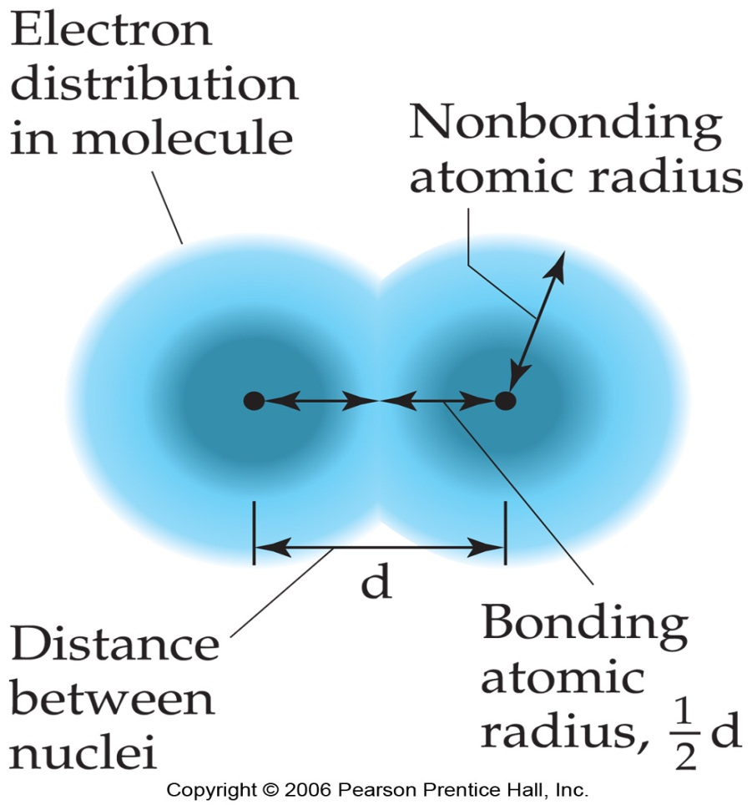
SIZES of ATOMS and IONS
bonding atomic radius
=
the “size” of an atom
Measure this distance!

Slide 25
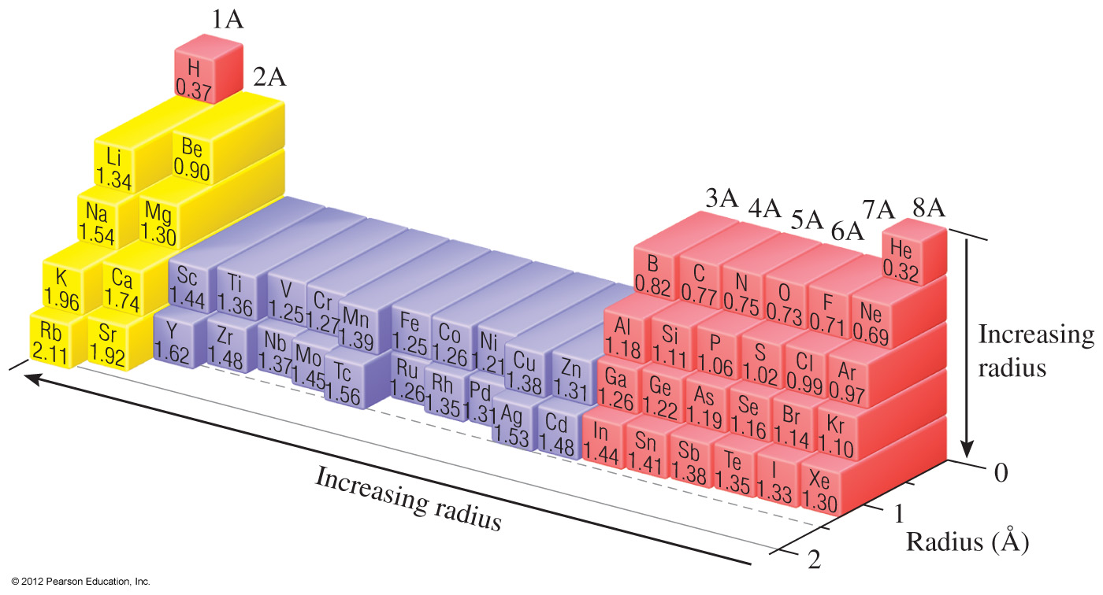
PERIODIC TRENDS IN ATOMIC RADII

Slide 26
PERIODIC TRENDS IN ATOMIC RADII
INCREASES FROM TOP TO BOTTOM WITHIN EACH GROUP
WHY?
INCREASING

Slide 27
Due to increasing value of n:
The outer electrons have higher probability to be further from the nucleus → radius increases
INCREASING

Slide 28
Due to increasing value of n:
Each additional inner level of electrons shields the protons from attracting the valence electrons + additional repulsion between added electrons → size increases
INCREASING

Slide 29
PERIODIC TRENDS IN ATOMIC RADII
DECREASES FROM LEFT TO RIGHT WITHIN EACH PERIOD
WHY?
DECREASING

Slide 30
2. Due to increasing # of protons and Z_{eff}:
The increase in # of protons and Z_{eff} (left to right) brings the valence electrons closer to the nucleus → the radius decreasing
DECREASING

Slide 31
2. Due to increasing # of protons and Z_{eff}:
The electrons are being added to the same outer level (going from left → right) = level of shielding by the core electrons stays the same
DECREASING

Slide 32
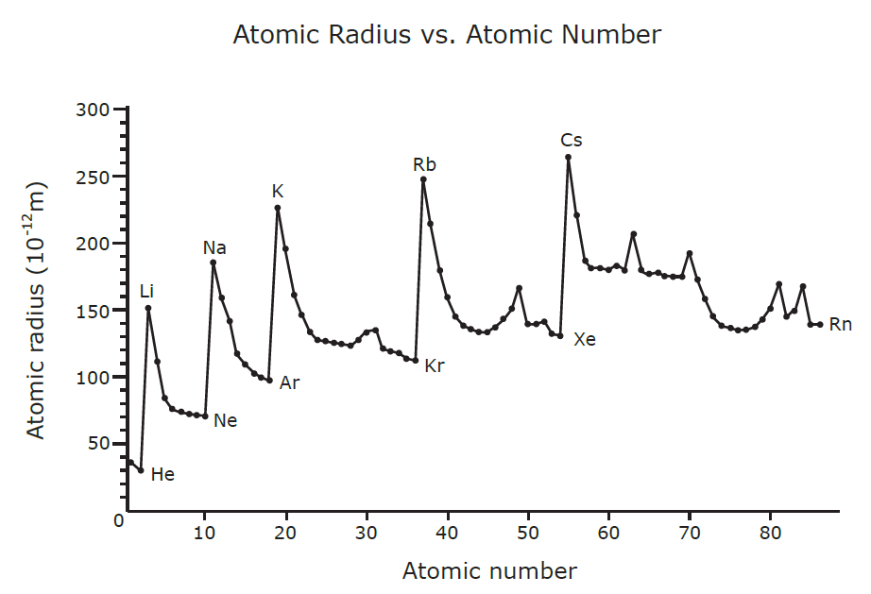
Various exceptions, especially in d sublevel elements

Slide 33
Predict the relative size of zinc and vanadium atomic radii

Slide 34
Zinc
Vanadium
[Ar]3d¹⁰4s²
[Ar]3d³4s²
18 + 10 core electrons
30 protons
2 valence electron
18 + 3 core electrons
23 protons
2 valence electrons
The 3d subshell electrons shield the valence electrons in 4s subshell
10 3d electrons in zinc shields the nucleus from attracting valence electrons much better than 3 3d electrons in vanadium
Various exceptions, especially in d sublevel elements

Slide 35
Zinc
Vanadium
[Ar]3d¹⁰4s²
[Ar]3d³4s²
10 core electrons
30 protons
2 valence electron
3 core electrons
23 protons
2 valence electrons
This extra shielding is making zinc’s atom radius as large as vanadium’s
Various exceptions, especially in d sublevel elements

Slide 36
Referring to a periodic table, arrange (as much as possible) the atoms P, S, As, and Se in order of increasing size.
S
<
P
<
Se
<
As
INCREASING
DECREASING

Slide 37
WORKSHEET EXAMPLE
Referring to a periodic table, arrange (as much as possible) the atoms Na, Mg, and Be in order of increasing size.

Slide 38
WORKSHEET EXAMPLE
Referring to a periodic table, arrange (as much as possible) the atoms Na, Mg, and Be in order of increasing size.
Be
<
Mg
Mg
<
Na
INCREASING
Be
<
Na
DECREASING

Slide 39
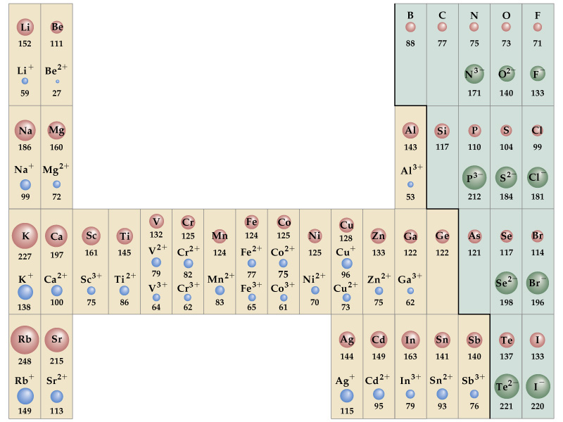
PERIODIC TRENDS IN IONIC RADII

Slide 40
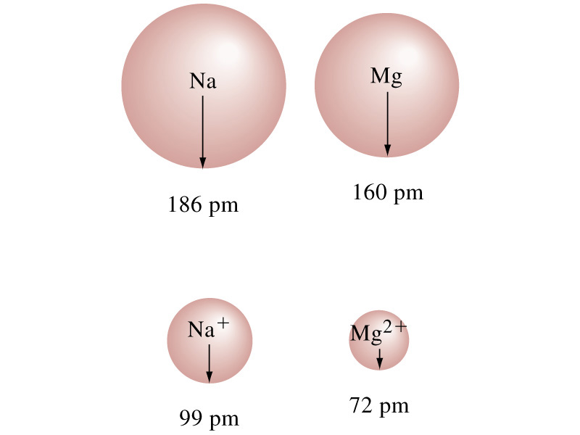
CATIONS
Smaller than their parent atoms:
The outermost electron(s) is (are) removed → repulsion between electrons decreases

Slide 41
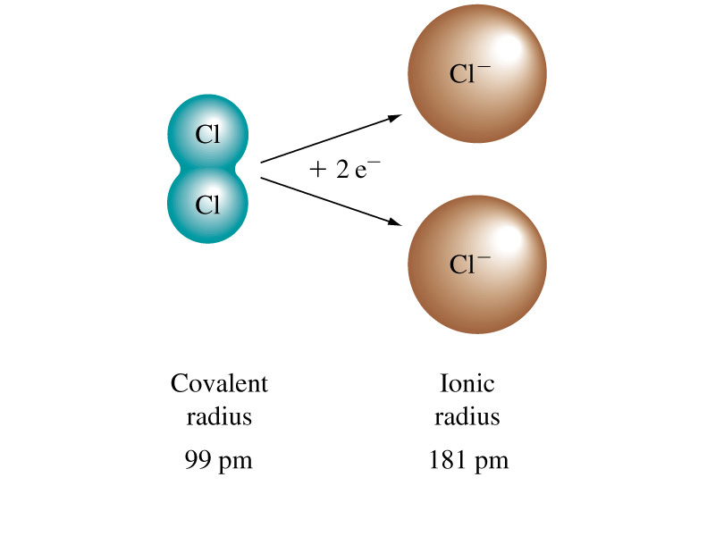
ANIONS
Larger than their parent atoms:
An electron(s) is (are) added → repulsion between electrons increase

Slide 42
IONIC RADII
INCREASE IN SIZE AS YOU GO DOWN A COLUMN (GROUP)
WHY?
INCREASING

Slide 43
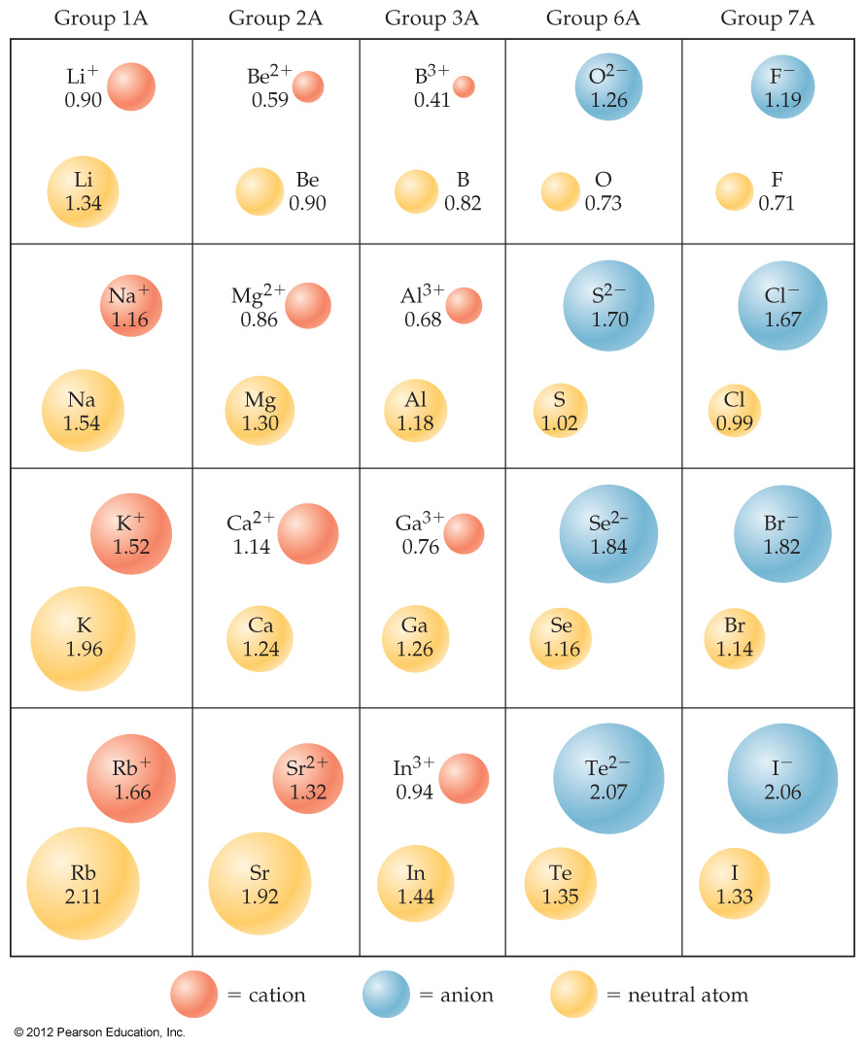
Due to increasing value of n:
The outer electrons have higher probability to be further from the nucleus → radius increases
INCREASING

Slide 44
EXAMPLE
Arrange Be²⁺, Be, Mg²⁺, and Mg in order of decreasing size.
CATIONS:
Smaller than their parent atoms
Be²⁺
<
Be
<
Mg²⁺
Mg
INCREASING

Slide 45
EXAMPLE
Arrange Be²⁺, Be, Mg²⁺, and Mg in order of decreasing size.
Mg
<
Be
<
Mg²⁺
<
Be²⁺
INCREASING

Slide 46
WORKSHEET EXAMPLE
Which of the following atoms and ions is
the smallest
the largest
S²⁻, S, O²⁻

Slide 47
WORKSHEET EXAMPLE
Which of the following atoms and ions is
the smallest
the largest
S²⁻, S, O²⁻
S²⁻

Slide 48
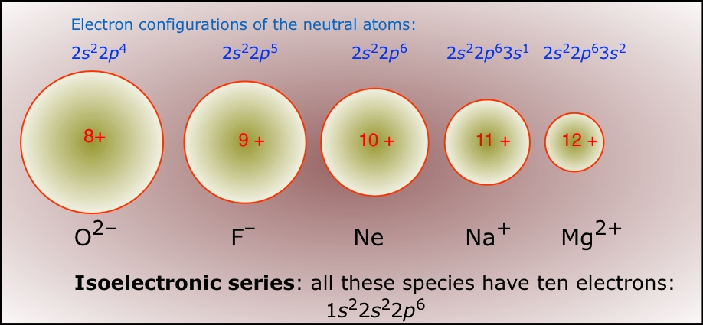
ISOELECTRONIC SERIES
A group of ions with the same number of electrons

Slide 49
ISOELECTRONIC SERIES
THE IONIC SIZE DECREASES WITH AN INCREASING ATOMIC NUMBER
WHY?
As atomic number increases → the nuclear charge increases (# protons increases for the same # of electrons

Slide 50
EXAMPLE
Arrange the ions K⁺, Ca²⁺, Cl⁻, and S²⁻ in order of decreasing size.
THE IONIC SIZE DECREASES WITH AN INCREASING ATOMIC NUMBER
S²⁻
<
Cl⁻
<
K⁺
<
Ca²⁺
16
17
19
20

Slide 51
EXAMPLE
Arrange the ions Rb⁺, Sr²⁺, and Y³⁺ in order of increasing size.

Slide 52
WORKSHEET EXAMPLE
Arrange the ions Rb⁺, Sr²⁺, and Y³⁺ in order of increasing size.
THE IONIC SIZE DECREASES WITH AN INCREASING ATOMIC NUMBER
Y³⁺
<
Sr²⁺
<
Rb⁺

Slide 53
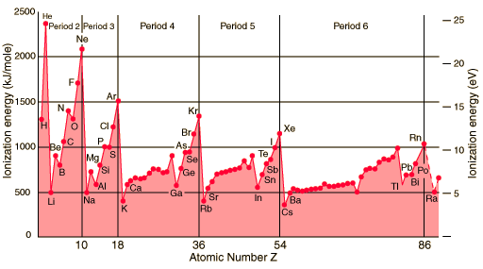
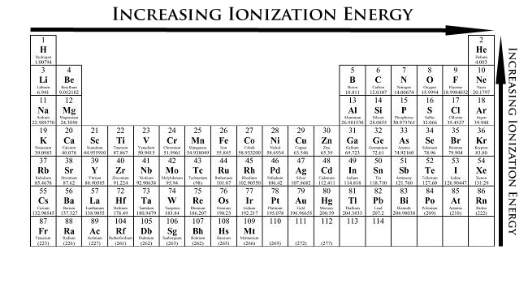
IONIZATION ENERGY

Slide 54
IONIZATION ENERGY
the amount of energy required to remove an electron from the ground state of a gaseous atom or ion
1st Ionization Energy (I₁)
2nd Ionization Energy (I₂)
energy required to remove the first electron.
energy required to remove the second electron.
Na(g) → Na⁺(g) + e⁻
Na⁺(g) → Na²⁺(g) + e⁻

Slide 55
IONIZATION ENERGY
Increases as successive electrons are removed
To remove valence electrons, not much ionization energy is needed
After all valence electrons have been removed, the ionization energy takes a quantum leap (increases dramatically)

Slide 56
IONIZATION ENERGY
Increases as successive electrons are removed
To remove core electrons, A LOT OF ionization energy is needed

Slide 57
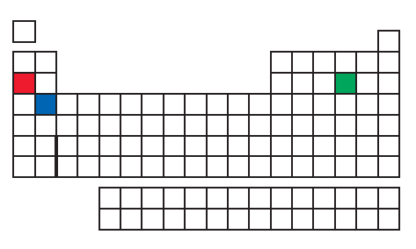
EXAMPLE
Three elements are indicated in the periodic table. Which one has the largest second ionization energy?
Na
Only 1 valence electron
The IE₂ is for the core electron = LARGE IE
S
more valence electrons
The IE₂ removes valence electron = SMALL IE
Ca
2 valence electrons
The IE₂ removes a valence electron = SMALL IE

Slide 58
WORKSHEET EXAMPLE
Which has the greater third ionization energy (I₃), calcium or sulphur?
Ca

Slide 59
1st IONIZATION ENERGY
INCREASES AS WE MOVE ACROSS A PERIOD
WHY?
INCREASING

Slide 60
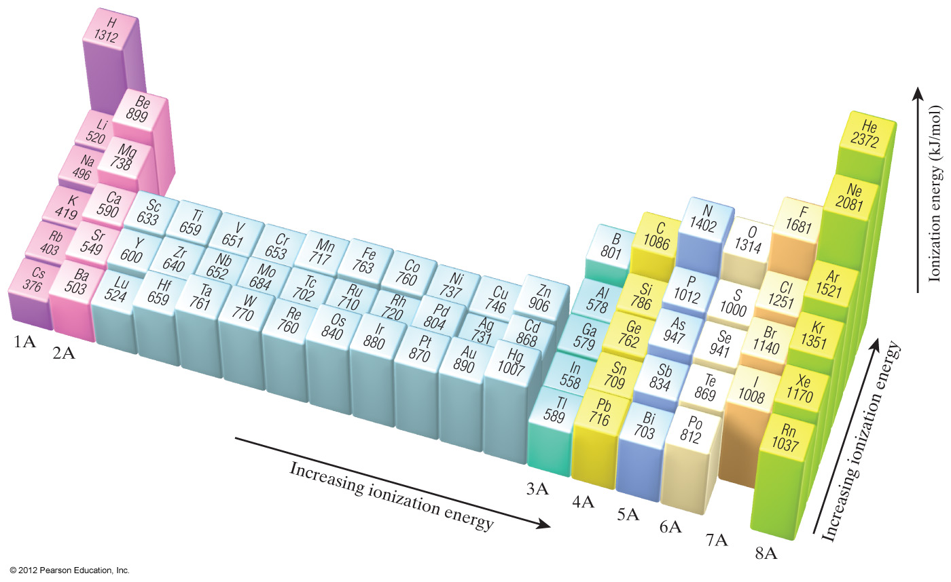
1st IONIZATION ENERGY
INCREASES AS WE MOVE ACROSS A PERIOD
It gets harder to remove an electron as you move across because → the nuclear charge (Z_{eff}) increases

Slide 61
1st IONIZATION ENERGY
DECREASES AS WE GO DOWN A GROUP
WHY?
DECREASING

Slide 62
1st IONIZATION ENERGY
DECREASES AS WE GO DOWN A GROUP
It gets easier to remove the 1st electron as you go down a group because →
the nuclear charge (Z_{eff}) within a group is practically the same, but the valence electrons are farther from the nucleus
HOWEVER…

Slide 63
Groups IIA and IIIA
In this case the electron is removed from a p orbital rather than an s orbital
The p orbital is farther from the nucleus → less energy is needed to remove electrons
1s²2s²
1s²2s²2p¹
Be
B
IE DECREASES GOING FROM IIA TO IIIA GROUP

Slide 64
Groups VA and VIA
The electron removed in O comes from a doubly occupied orbital (2p orbital)
Repulsion from the other electron in the orbital aids in its removal
[He]2s²2p³
[He]2s²2p⁴
N
O
IE DECREASES GOING FROM VA TO VIA GROUP

Slide 65
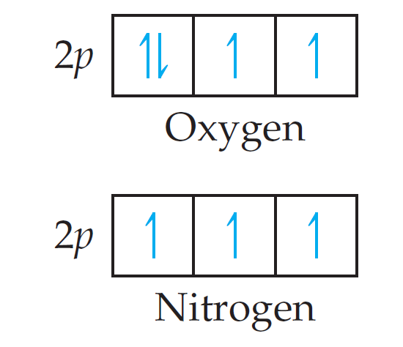
WORKSHEET EXAMPLE
Why it is easier to remove a 2p electron from an oxygen atom than from a nitrogen atom?

Slide 66
WORKSHEET EXAMPLE
Why it is easier to remove a 2p electron from an oxygen atom than from a nitrogen atom?
The electron removed in O comes from a doubly occupied orbital (2p orbital)
Repulsion from the other electron in the orbital aids in its removal

Slide 67
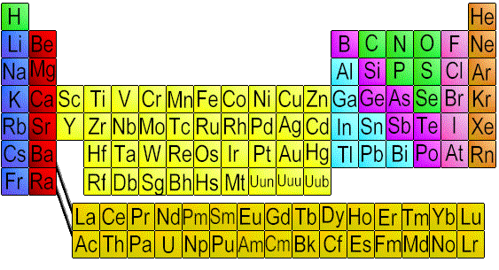
EXAMPLE
Referring to a periodic table, arrange the atoms Ne, Na, P, Ar, and K in order of increasing first ionization energy
INCREASING
DECREASING
K
<
Na
<
P
<
Ar
<
Ne

Slide 68
WORKSHEET EXAMPLE
Which has the lowest first ionization energy: B, Al, C, or Si? Which has the highest?

Slide 69
WORKSHEET EXAMPLE
Which has the lowest first ionization energy: B, Al, C, or Si? Which has the highest?
Al - lowest
C - highest

Slide 71
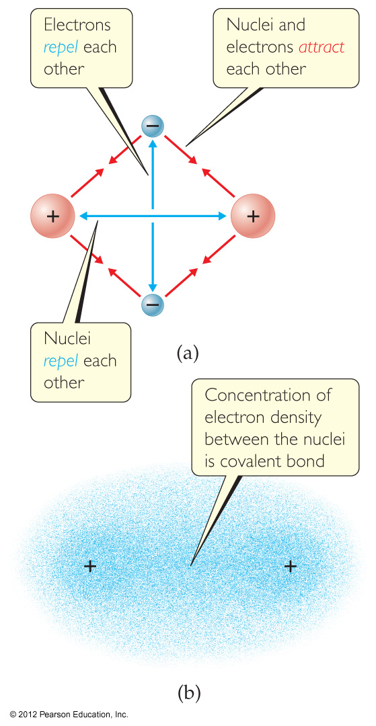
Covalent Bonding
In covalent bonds, atoms share electrons
There are several electrostatic interactions in these bonds:
Attractions between electrons and nuclei
Repulsions between electrons
Repulsions between nuclei

Slide 72
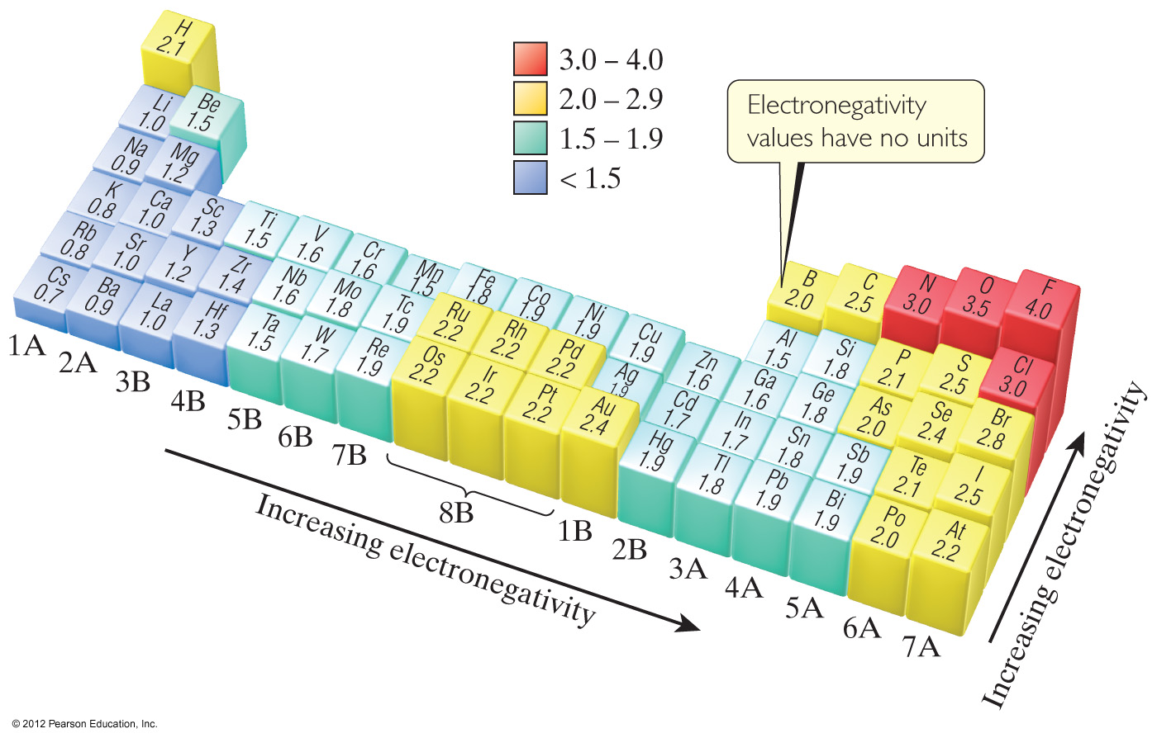
ELECTRONEGATIVITY
is the ability of a bonded atom to attract electrons to itself

Slide 73
ELECTRONEGATIVITY
Atoms with High EN = tend to pull electrons closer to nucleus

Slide 74
ELECTRONEGATIVITY
Atoms with Lower EN = have their bonded electrons pulled further away from the nucleus

Slide 75
ELECTRONEGATIVITY
INCREASING FROM LEFT TO RIGHT ACROSS ANY PERIOD
WHY?
INCREASING

Slide 76
ELECTRONEGATIVITY
Number of protons increases, atomic radius decreases, ionization energy increases
INCREASING

Slide 77
ELECTRONEGATIVITY
DECREASING as we go down a group of the periodic table.
WHY?
DECREASING

Slide 78
ELECTRONEGATIVITY
Shielding increases, atomic radius increases, ionization energy decreases
DECREASING

Slide 79
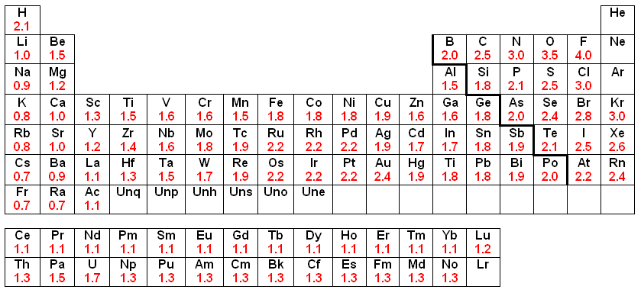
ELECTRONEGATIVITY
MEMORIZE THE VALUES OF ELECTRONEGATIVITY FOR THE FIRST 3 PERIODS

Slide 81
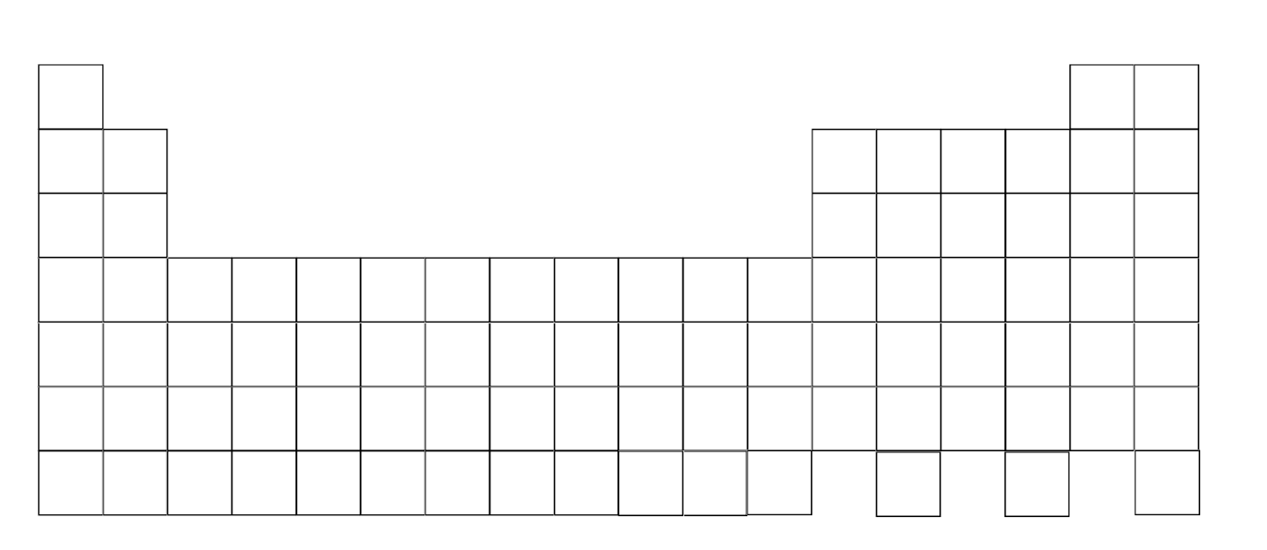
Atomic Size decreases
Electronegativity increases
Ionization Energy increases
Electronegativity increases
Atomic Size decreases
Ionization Energy increases

Slide 83
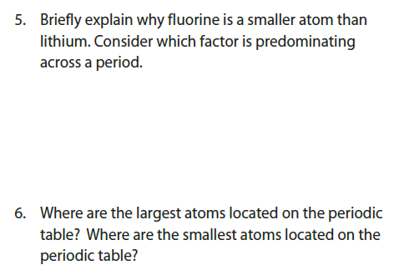

Slide 84
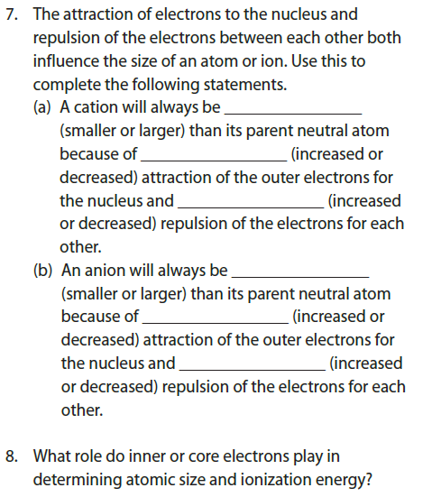
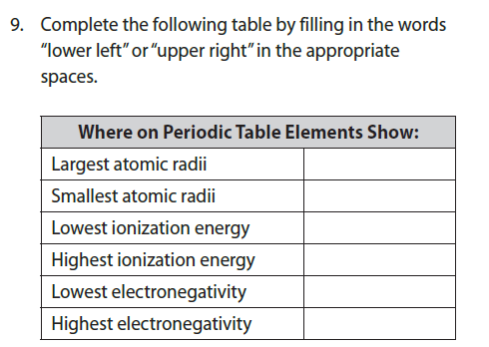

Slide 87
HOMEWORK
PAGE: 309 - 310
PROBLEMS: all

