Slide 1
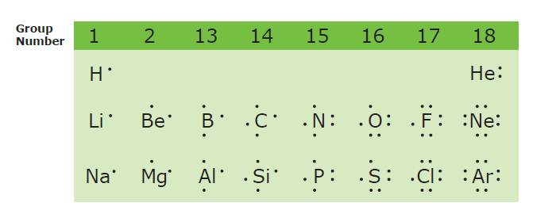
6.4 LEWIS STRUCTURE DIAGRAMS

Slide 2
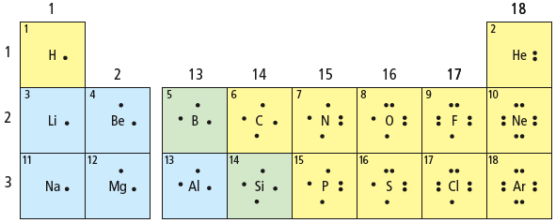
LEWIS DIAGRAMS - REVIEW
Show only an atom’s valence electrons and the chemical symbol.

Slide 3
LEWIS DIAGRAMS

Slide 4
Rule # 1
Dots representing valence electrons are placed around the element symbols

Slide 5
Rule # 2
Electron dots are placed singly until the fifth electron is reached then they are paired

Slide 6
Lewis Diagrams of IONS and IONIC BONDS
  For positive ions, one electron dot is removed from the valence shell for each positive charge.
  For negative ions, one electron dot is added to each valence shell for each negative charge.
  Square brackets are placed around each ion to indicate transfer of electrons.

Slide 7
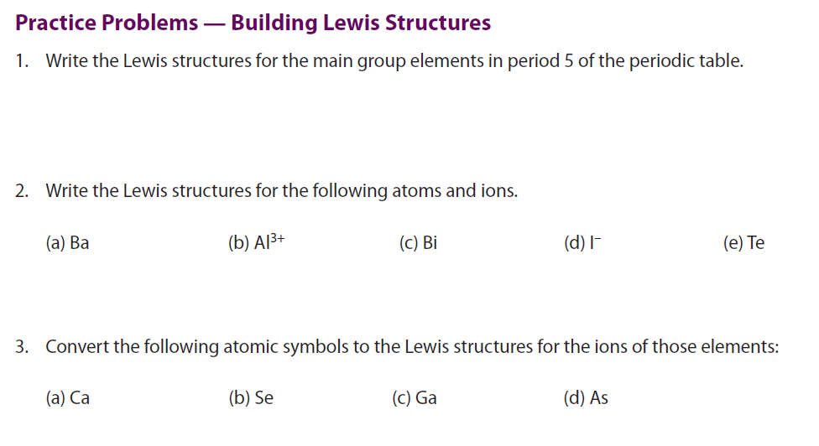

Slide 8
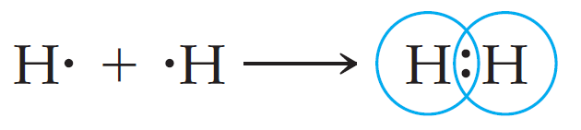

LEWIS STRUCTURE DIAGRAMS for MOLECULES
Lewis structures are representations of molecules showing all valence electrons:
    bonding and
    nonbonding

Slide 9
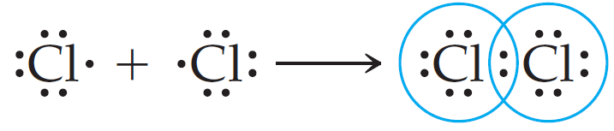

LEWIS STRUCTURE DIAGRAMS for MOLECULES
Lewis structures are representations of molecules showing all valence electrons:
    bonding and
    nonbonding
a lone pair

Slide 10

Lewis Structures and Multiple Bonds
When two electron pairs are shared, two lines are drawn, i.e. double bond
::O :: C :: O::
or
::O = C = O::

Slide 11
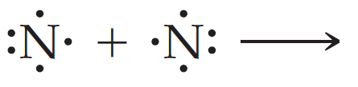
Lewis Structures and Multiple Bonds
When three electron pairs are shared, three lines are drawn, i.e. triple bond
:N ::: N:
or
:N ≡ N:

Slide 12
BOND LENGTHS
The length of the bond between two atoms decreases as the number of shared electrons increases
N – N
>
N = N
>
N ≡ N
BOND STRENGTH?

Slide 13
STEPS TO FOLLOW…
Find the sum of valence electrons of all atoms in the polyatomic ion or molecule
If it is anion → add an electron(s)
If it is cation → subtract an electron(s)
PCl₃
5 + 21 valence electrons
= 26 v.e.

Slide 14
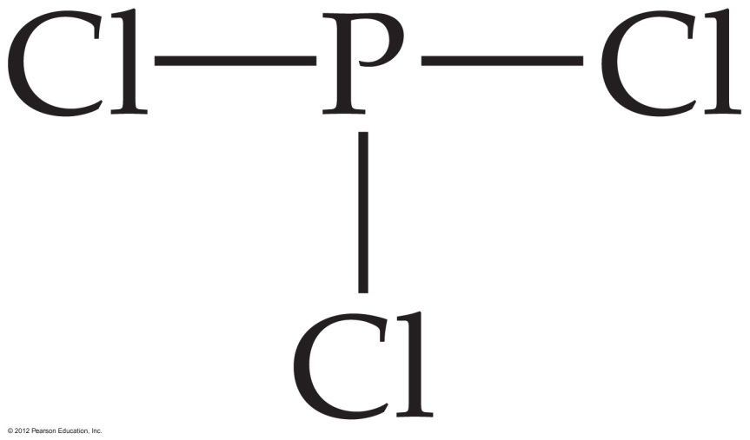
STEPS TO FOLLOW…
2. Write the symbols for the atoms
  Make one of the atoms a central atom (usually the least electronegative atom)
  connect the central atom with the other atoms by single bonds
5 + 21 valence electrons
= 26 v.e.

Slide 15
STEPS TO FOLLOW…
2. Write the symbols for the atoms
  Subtract the bonding electrons from your total number of valence electrons
5 + 21 valence electrons
= 26 v.e.

Slide 16
STEPS TO FOLLOW…
2. Write the symbols for the atoms
  Subtract the bonding electrons from your total number of valence electrons
26 – 6 valence electrons
= 20 v.e. left

Slide 17
STEPS TO FOLLOW…
3. Fill the octets of the outer atoms
20 valence electrons

Slide 18
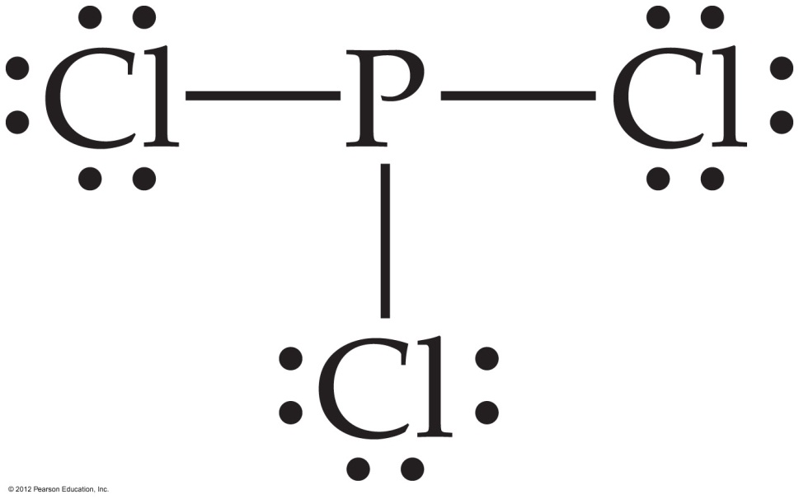
STEPS TO FOLLOW…
3. Fill the octets of the outer atoms
20 valence electrons

Slide 19
STEPS TO FOLLOW…
  Subtract the added electrons from your total number of valence electrons
20 valence electrons

Slide 20
STEPS TO FOLLOW…
  Subtract the added electrons from your total number of valence electrons
20 – 18 valence electrons
= 2 v.e. left

Slide 21
STEPS TO FOLLOW…
4. Fill the octet of the central atom
2 valence electrons

Slide 22
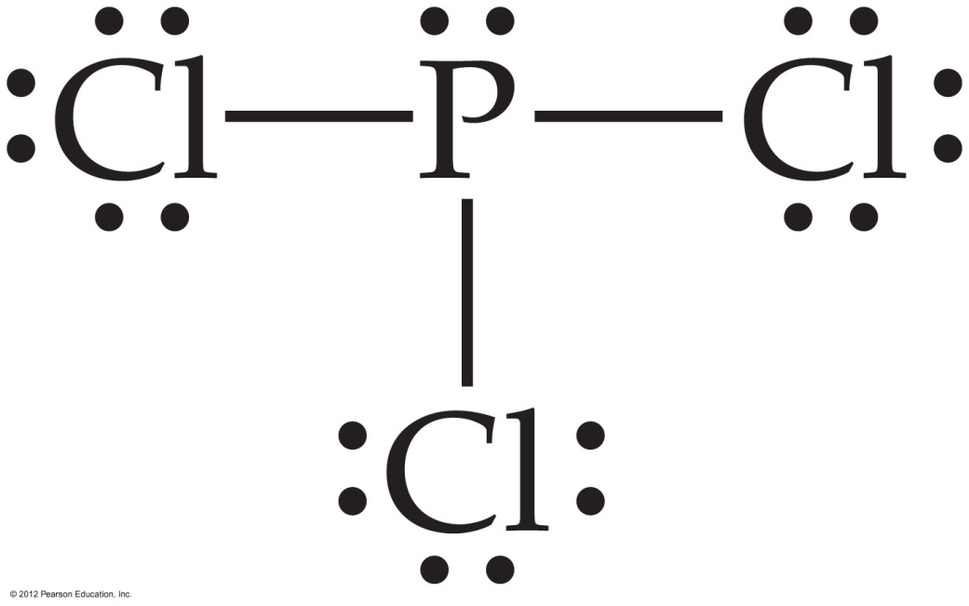
STEPS TO FOLLOW…
4. Fill the octet of the central atom
0 valence electrons

Slide 23
EXAMPLE
Draw Lewis Structures for
H₂O
CH₄
CH₂Cl₂
NH₄⁺

Slide 24
WORKSHEET EXAMPLE
Draw Lewis Structures for
CH₂Cl₂
C₂H₄
BrO₃⁻

Slide 25
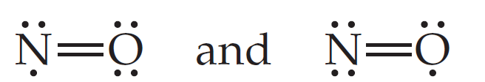
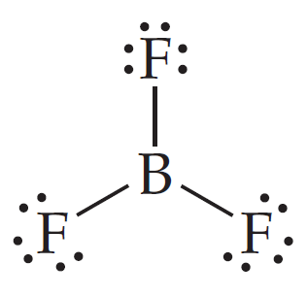
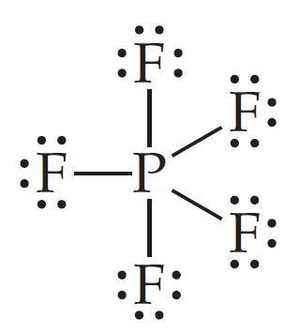
WORKSHEET EXAMPLE
Draw Lewis Structures for
NO
BF₃
PF₅

Slide 26
EXCEPTIONTS TO THE OCTET RULE
1. For molecules and polyatomic ions containing an odd number of valence electrons
2. For molecules and polyatomic ions in which an atom has fewer than an octet of valence electrons

Slide 27
EXCEPTIONTS TO THE OCTET RULE
3. For molecules and polyatomic ions in which an atom has more than an octet of valence electrons

Slide 28
1. For molecules and polyatomic ions containing an odd number of valence electrons
Complete pairing of valence electrons is impossible due to the odd number of valence electrons
e.g. ClO₂, NO, NO₂, O₂⁻

Slide 29
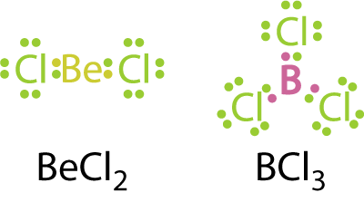

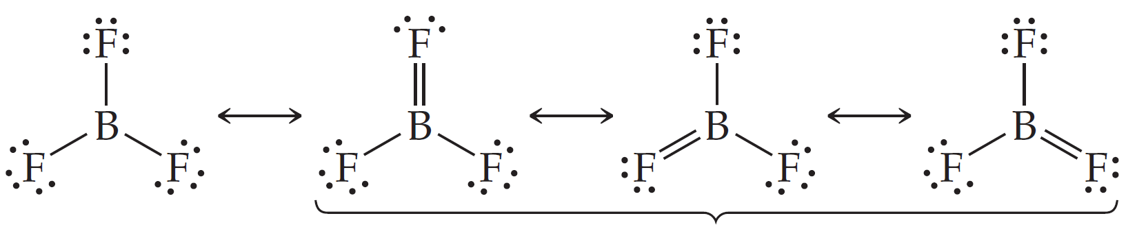
2. For molecules and polyatomic ions in which an atom has fewer than an octet of valence electrons
Not very common
Mostly boron, beryllium, aluminum compounds

Slide 30
3. For molecules and polyatomic ions in which an atom has more than an octet of valence electrons
Very common
Such molecules/ions are called HYPERVALENT
Only for atoms of 3rd period or higher
WHY?
They have available and unfilled d orbitals for bonding
2. Their central atom (P, S, I, Xe…) is large enough to be bonded to even five different smaller atoms (Cl, F or O)

Slide 31
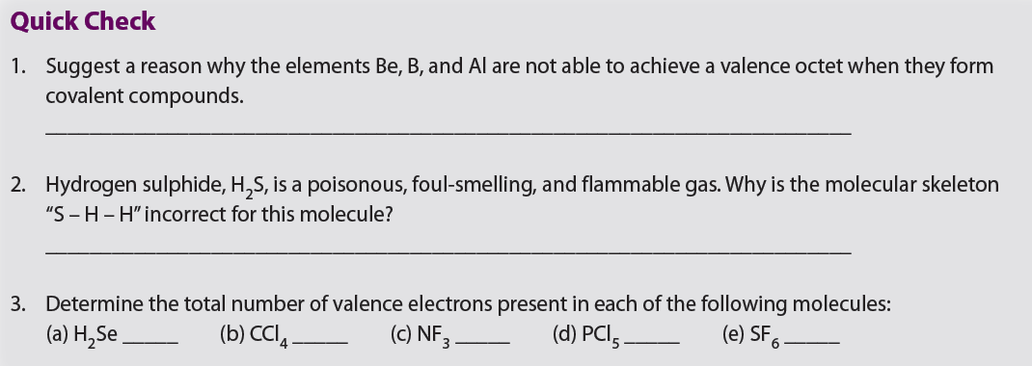


Slide 32
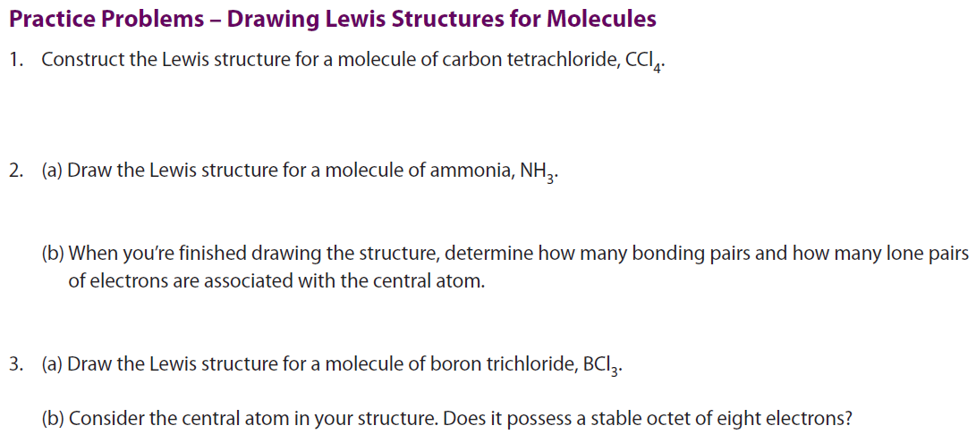

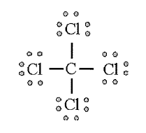
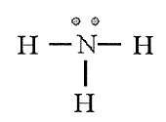

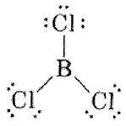


Slide 33
Draw a Lewis structure of carbon dioxide
Valence electrons: 16 electrons

Slide 34


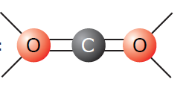

Draw a Lewis structure of carbon dioxide
5. If you run out of electrons before the central atom has an octet…
…form multiple bonds until it does

Slide 35


Draw a Lewis Structure of hydrogen cyanide
5. If you run out of electrons before the central atom has an octet…
…form multiple bonds until it does

Slide 36
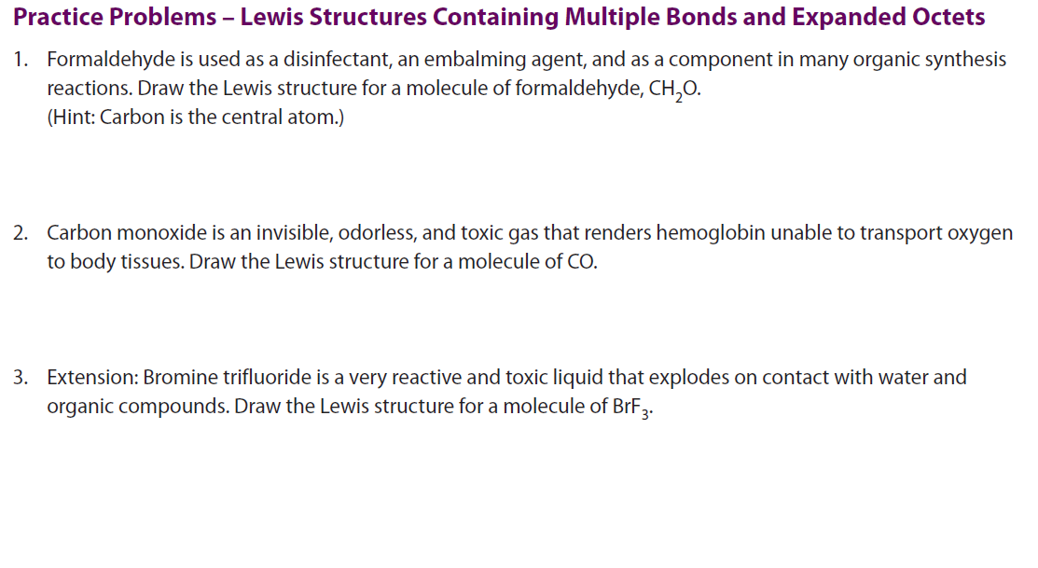


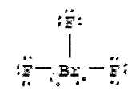

Slide 37
HOMEWORK/CLASSWORK
6.4 Review Questions
  all

Slide 38
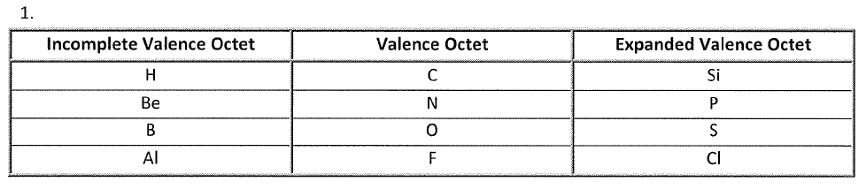
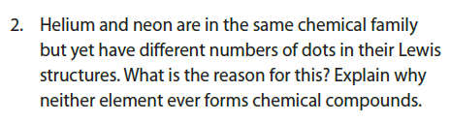
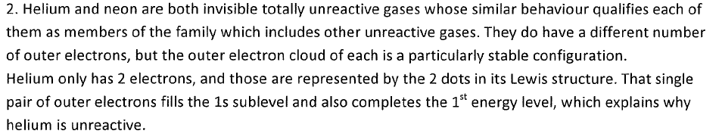

Slide 39
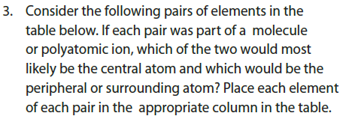
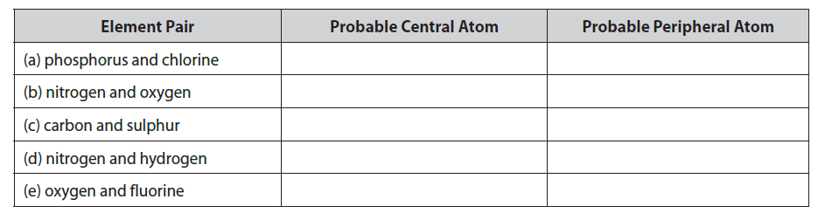

Slide 40
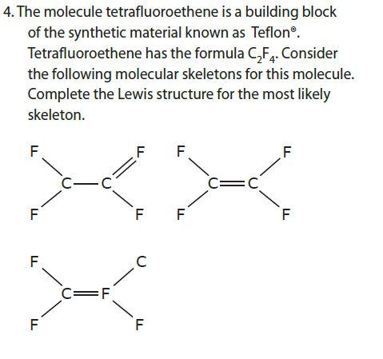
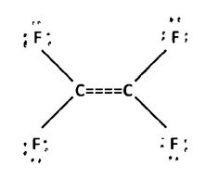

Slide 41
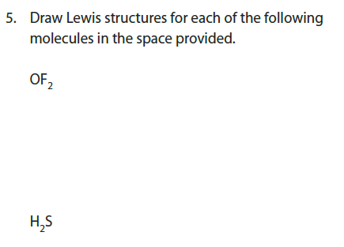

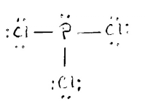


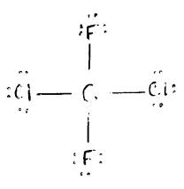


Slide 42
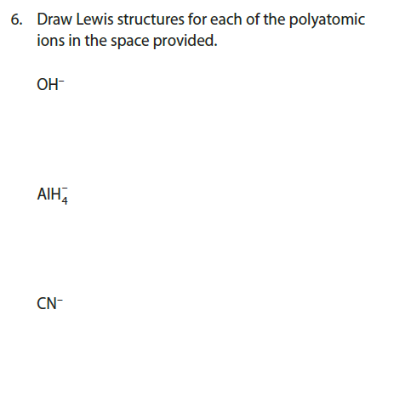
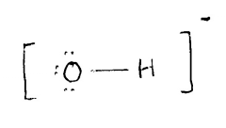
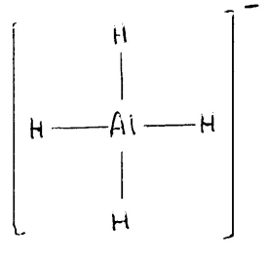
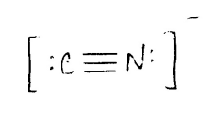

Slide 43

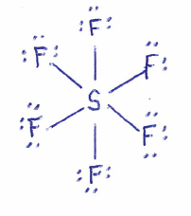
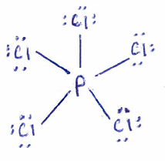




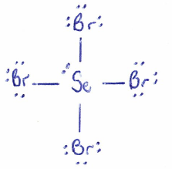
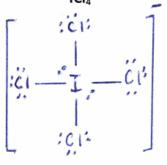

Slide 44
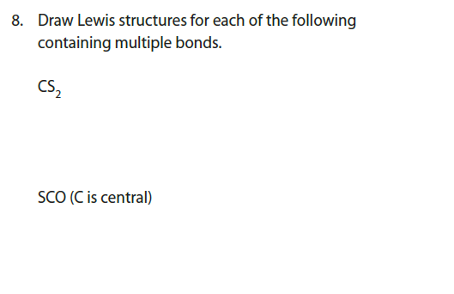

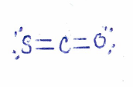

Slide 45





