Slide 1
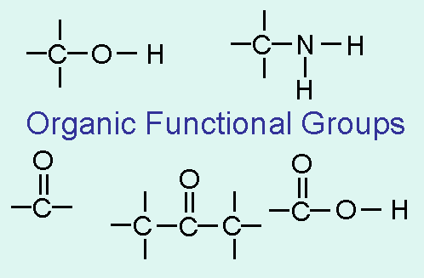
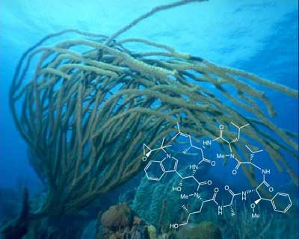
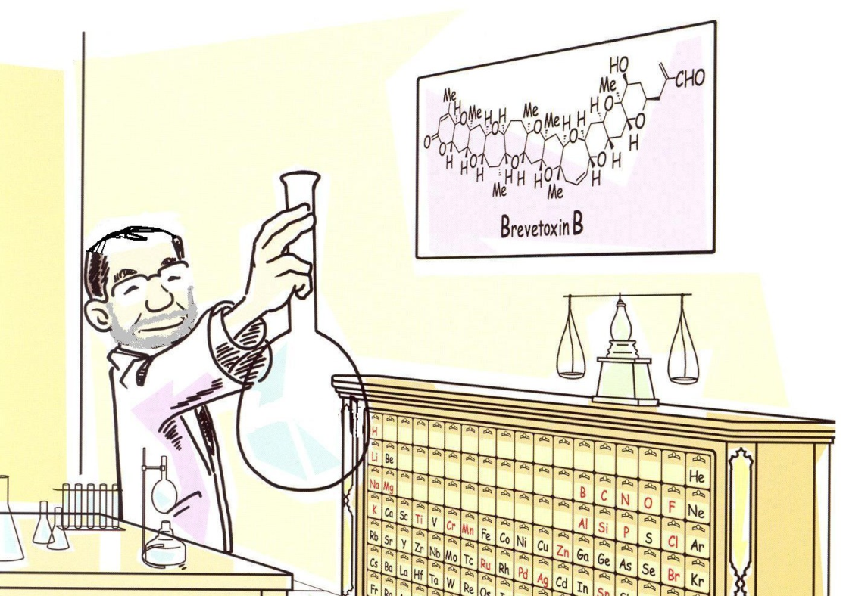
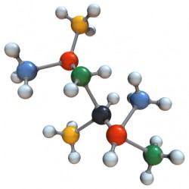
ORGANIC CHEMISTRY

Slide 2


ORGANIC CHEMISTRY
The chemistry of CARBON containing compounds
The majority of organic compounds include CARBON – CARBON chains
Most of the time HYDROGEN is present in organic molecules
Also, OXYGEN, NITROGEN and HALOGENS (FLUORINE, CHLORINE, BROMINE, IODINE)

Slide 3
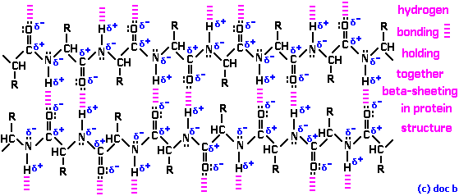
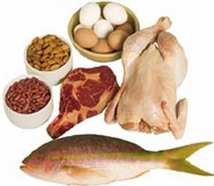
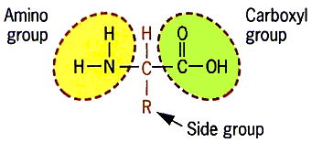
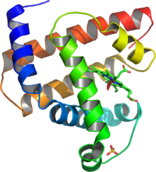
WHY IS ORGANIC CHEMISTRY IMPORTANT?
Organic chemicals are all around us and in all living things!
Proteins

Slide 4
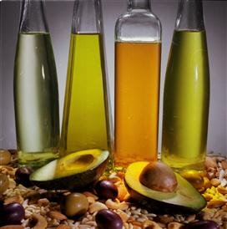
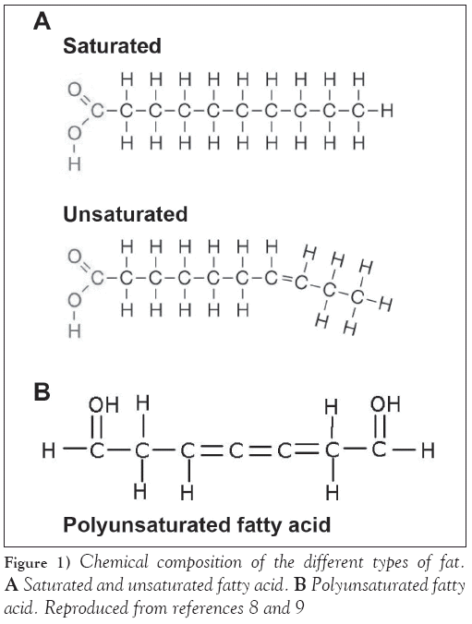
WHY IS ORGANIC CHEMISTRY IMPORTANT?
Organic chemicals are all around us and in all living things!
Proteins, Fats

Slide 5
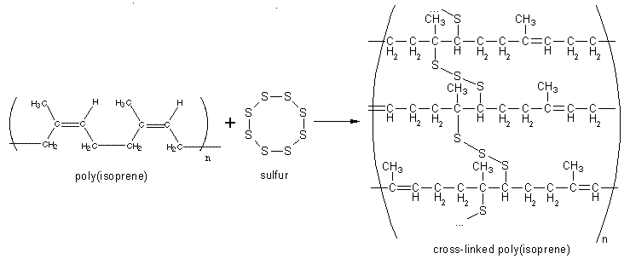
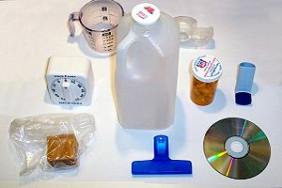

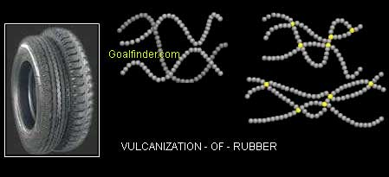
WHY IS ORGANIC CHEMISTRY IMPORTANT?
Organic chemicals are all around us and in all living things!
Proteins, Fats, Plastics

Slide 6

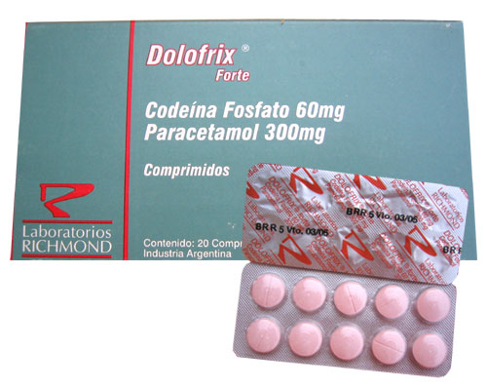
WHY IS ORGANIC CHEMISTRY IMPORTANT?
Organic chemicals are all around us and in all living things!
Proteins, Fats, Plastics, Drugs

Slide 7
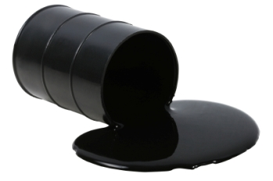

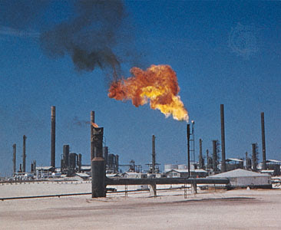
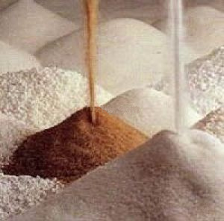
WHY IS ORGANIC CHEMISTRY IMPORTANT?
Organic chemicals are all around us and in all living things!
Proteins, Fats, Plastics, Drugs, Petroleum, Benzene

Slide 8
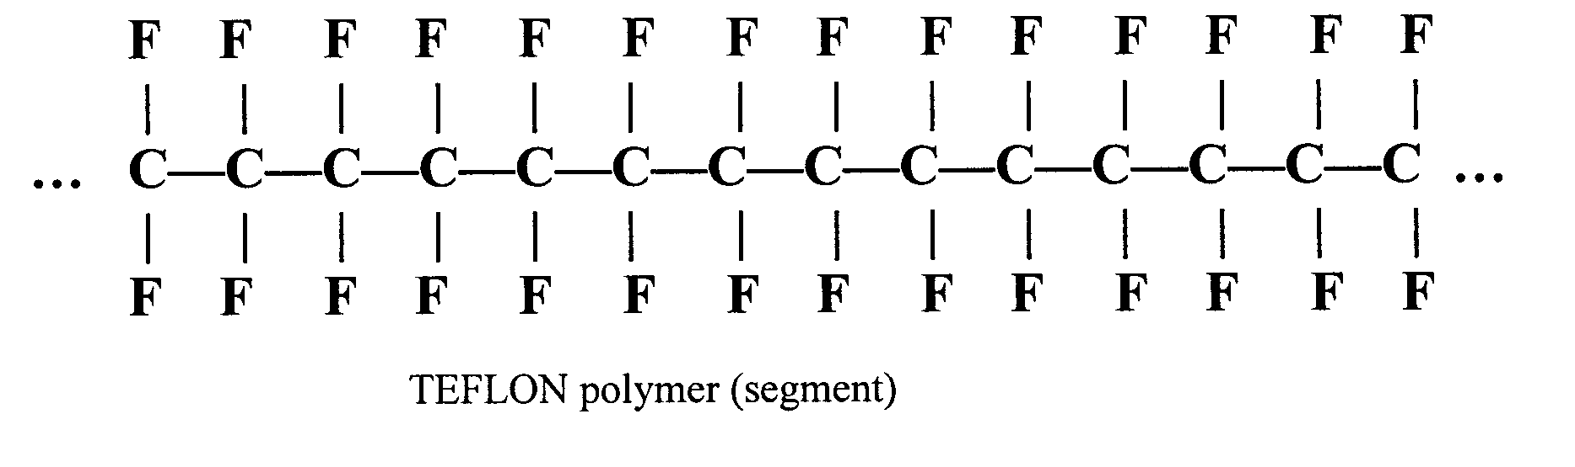
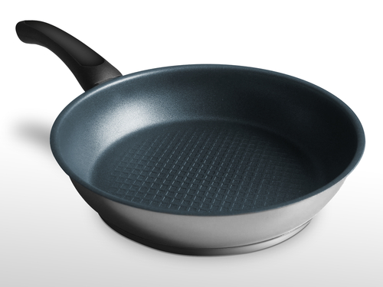

WHY IS ORGANIC CHEMISTRY IMPORTANT?
Organic chemicals are all around us and in all living things!
Proteins, Fats, Plastics, Drugs, Petroleum, Benzene,
Teflon

Slide 9
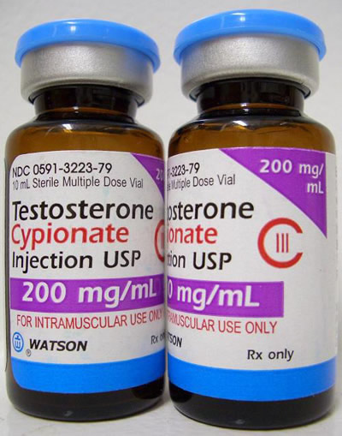
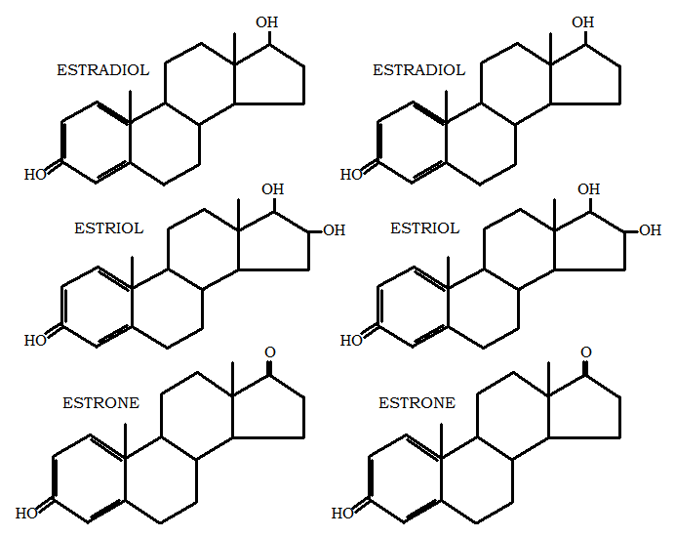
WHY IS ORGANIC CHEMISTRY IMPORTANT?
Organic chemicals are all around us and in all living things!
Proteins, Fats, Plastics, Drugs, Petroleum, Benzene,
Teflon, Hormones

Slide 10
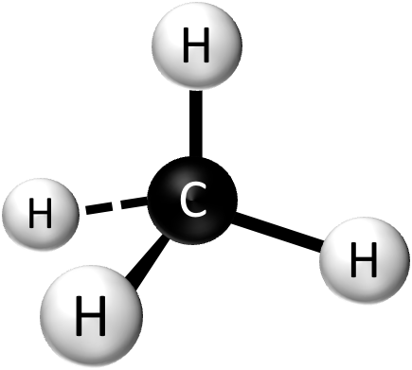
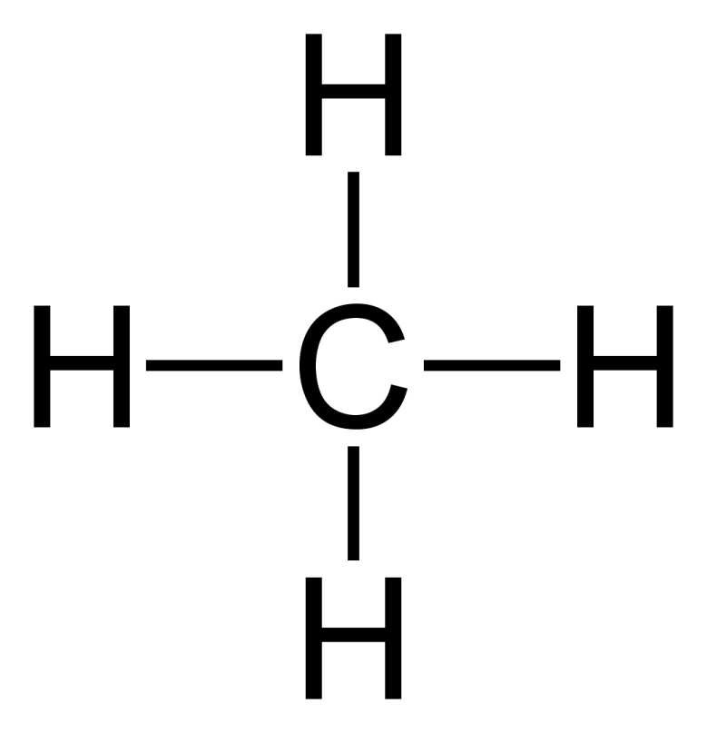
SINGLE, DOUBLE, and TRIPLE BONDS FOR CARBON
HOW MANY BONDS CAN A CARBON ATOM HAVE?
4

Slide 11

SINGLE, DOUBLE, and TRIPLE BONDS FOR CARBON
A CARBON atom has always 4 bonds
But depending on a compound, they can be SINGLE,

Slide 12
SINGLE, DOUBLE, and TRIPLE BONDS FOR CARBON
A CARBON atom has always 4 bonds
But depending on a compound, they can be SINGLE, DOUBLE

Slide 13
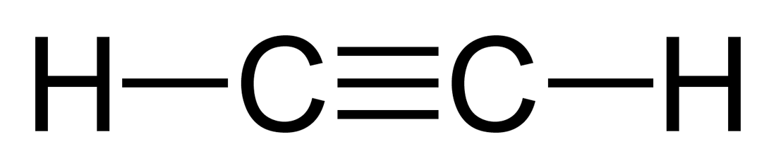
SINGLE, DOUBLE, and TRIPLE BONDS FOR CARBON
A CARBON atom has always 4 bonds
But depending on a compound, they can be SINGLE, DOUBLE or TRIPLE

Slide 14

ALKANES – SATURATED HYDROCARBONS
Compounds containing only CARBONS and HYDROGENS
AND single CARBON – CARBON bonds
They are called SATURATED HYDROCARBONS because each CARBON atom is bonded to a maximum number of other atoms (there is no room for other atoms to bond to the carbon skeleton)
YOU CAN REPRESENT A HYDROCARBON IN SEVERAL WAYS

Slide 15
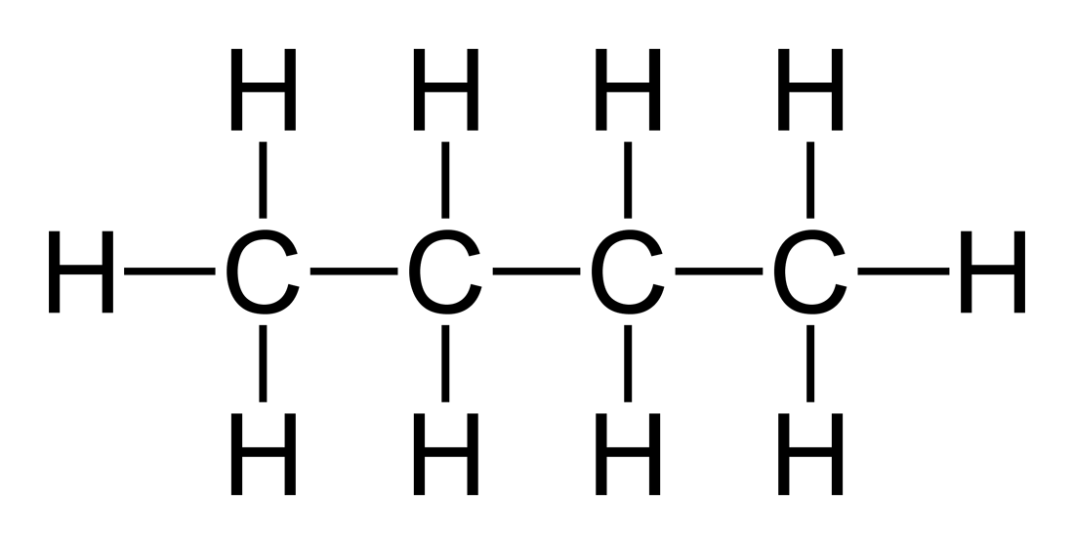
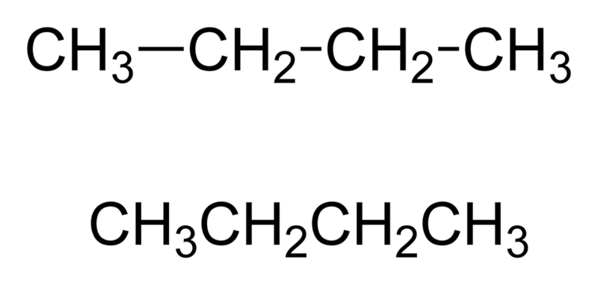
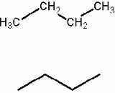
FULL (KEKULE)
STRUCTURE
CONDENSED
STRUCTURE
SHORTHAND
STRUCTURE
MOLECULAR
FORMULA
C₄H₁₀

Slide 16
FULL (KEKULE)
STRUCTURE
REPRESENT ALL POSSIBLE WAYS
FOR FOLLOWING HYDROCARBONS (ALKANES):
C₂H₆
C₃H₈
C₇H₁₆
CONDENSED
STRUCTURE
SHORTHAND
STRUCTURE

Slide 17
FULL (KEKULE)
STRUCTURE
CONDENSED
STRUCTURE
CH₃ – CH₃
SHORTHAND
STRUCTURE
MOLECULAR
FORMULA
C₂H₆

Slide 18
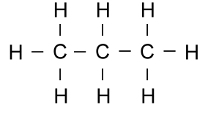
FULL (KEKULE)
STRUCTURE
CONDENSED
STRUCTURE
CH₃ – CH₂ – CH₃
SHORTHAND
STRUCTURE
MOLECULAR
FORMULA
C₃H₈

Slide 19


FULL (KEKULE)
STRUCTURE
CONDENSED
STRUCTURE
SHORTHAND
STRUCTURE
MOLECULAR
FORMULA
C₇H₁₆

Slide 20
FULL (KEKULE)
STRUCTURE
HOMEWORK:
REPRESENT ALL POSSIBLE WAYS
FOR FOLLOWING HYDROCARBONS (ALKANES):
CH₄
C₉H₂₀
C₈H₁₈
CONDENSED
STRUCTURE
SHORTHAND
STRUCTURE

Slide 21
ALKANES – SATURATED HYDROCARBONS
Compounds containing only CARBONS and HYDROGENS
AND single CARBON – CARBON bonds
THEY CAN BE:
UNBRANCHED
(STRAIGHT CHAINS)
BRANCHED
(SIDE CHAINS)
CH₃ – CH₂ – CH₃

Slide 22
NAMING OF UNBRANCHED
(STRAIGHT CHAIN) ALKANES
You just have to know the first ten alkanes
The naming is based on the number of carbons
NUMBER OF CARBONS | NAME | MOLECULAR FORMULA | CONDENSED FORMULA

Slide 23
NAMING OF UNBRANCHED
(STRAIGHT CHAIN) ALKANES
NUMBER OF CARBONS | NAME | MOLECULAR FORMULA | CONDENSED FORMULA
1

Slide 24
NAMING OF UNBRANCHED
(STRAIGHT CHAIN) ALKANES
NUMBER OF CARBONS | NAME | MOLECULAR FORMULA | CONDENSED FORMULA
1 | methane

Slide 25
NAMING OF UNBRANCHED
(STRAIGHT CHAIN) ALKANES
NUMBER OF CARBONS | NAME | MOLECULAR FORMULA | CONDENSED FORMULA
1 | methane | CH₄

Slide 26
NAMING OF UNBRANCHED
(STRAIGHT CHAIN) ALKANES
NUMBER OF CARBONS | NAME | MOLECULAR FORMULA | CONDENSED FORMULA
1 | methane | CH₄ | CH₄

Slide 27
NAMING OF UNBRANCHED
(STRAIGHT CHAIN) ALKANES
NUMBER OF CARBONS | NAME | MOLECULAR FORMULA | CONDENSED FORMULA
1 | methane | CH₄ | CH₄
2

Slide 28
NAMING OF UNBRANCHED
(STRAIGHT CHAIN) ALKANES
NUMBER OF CARBONS | NAME | MOLECULAR FORMULA | CONDENSED FORMULA
1 | methane | CH₄ | CH₄
2 | ethane

Slide 29
NAMING OF UNBRANCHED
(STRAIGHT CHAIN) ALKANES
NUMBER OF CARBONS | NAME | MOLECULAR FORMULA | CONDENSED FORMULA
1 | methane | CH₄ | CH₄
2 | ethane | C₂H₆

Slide 30
NAMING OF UNBRANCHED
(STRAIGHT CHAIN) ALKANES
NUMBER OF CARBONS | NAME | MOLECULAR FORMULA | CONDENSED FORMULA
1 | methane | CH₄ | CH₄
2 | ethane | C₂H₆ | CH₃ – CH₃

Slide 31
NAMING OF UNBRANCHED
(STRAIGHT CHAIN) ALKANES
NUMBER OF CARBONS | NAME | MOLECULAR FORMULA | CONDENSED FORMULA
1 | methane | CH₄ | CH₄
2 | ethane | C₂H₆ | CH₃ – CH₃
3

Slide 32
NAMING OF UNBRANCHED
(STRAIGHT CHAIN) ALKANES
NUMBER OF CARBONS | NAME | MOLECULAR FORMULA | CONDENSED FORMULA
1 | methane | CH₄ | CH₄
2 | ethane | C₂H₆ | CH₃ – CH₃
3 | propane

Slide 33
NAMING OF UNBRANCHED
(STRAIGHT CHAIN) ALKANES
NUMBER OF CARBONS | NAME | MOLECULAR FORMULA | CONDENSED FORMULA
1 | methane | CH₄ | CH₄
2 | ethane | C₂H₆ | CH₃ – CH₃
3 | propane | C₃H₈

Slide 34
NAMING OF UNBRANCHED
(STRAIGHT CHAIN) ALKANES
NUMBER OF CARBONS | NAME | MOLECULAR FORMULA | CONDENSED FORMULA
1 | methane | CH₄ | CH₄
2 | ethane | C₂H₆ | CH₃ – CH₃
3 | propane | C₃H₈ | CH₃ – CH₂ – CH₃

Slide 35
NAMING OF UNBRANCHED
(STRAIGHT CHAIN) ALKANES
NUMBER OF CARBONS | NAME | MOLECULAR FORMULA | CONDENSED FORMULA
1 | methane | CH₄ | CH₄
2 | ethane | C₂H₆ | CH₃ – CH₃
3 | propane | C₃H₈ | CH₃ – CH₂ – CH₃
4

Slide 36
NAMING OF UNBRANCHED
(STRAIGHT CHAIN) ALKANES
NUMBER OF CARBONS | NAME | MOLECULAR FORMULA | CONDENSED FORMULA
1 | methane | CH₄ | CH₄
2 | ethane | C₂H₆ | CH₃ – CH₃
3 | propane | C₃H₈ | CH₃ – CH₂ – CH₃
4 | butane

Slide 37
NAMING OF UNBRANCHED
(STRAIGHT CHAIN) ALKANES
NUMBER OF CARBONS | NAME | MOLECULAR FORMULA | CONDENSED FORMULA
1 | methane | CH₄ | CH₄
2 | ethane | C₂H₆ | CH₃ – CH₃
3 | propane | C₃H₈ | CH₃ – CH₂ – CH₃
4 | butane | C₄H₁₀

Slide 38
NAMING OF UNBRANCHED
(STRAIGHT CHAIN) ALKANES
NUMBER OF CARBONS | NAME | MOLECULAR FORMULA | CONDENSED FORMULA
1 | methane | CH₄ | CH₄
2 | ethane | C₂H₆ | CH₃ – CH₃
3 | propane | C₃H₈ | CH₃ – CH₂ – CH₃
4 | butane | C₄H₁₀ | CH₃ – CH₂ – CH₂ – CH₃

Slide 39
NAMING OF UNBRANCHED
(STRAIGHT CHAIN) ALKANES
NUMBER OF CARBONS | NAME | MOLECULAR FORMULA | CONDENSED FORMULA
1 | methane | CH₄ | CH₄
2 | ethane | C₂H₆ | CH₃ – CH₃
3 | propane | C₃H₈ | CH₃ – CH₂ – CH₃
4 | butane | C₄H₁₀ | CH₃ – CH₂ – CH₂ – CH₃
5

Slide 40
NAMING OF UNBRANCHED
(STRAIGHT CHAIN) ALKANES
NUMBER OF CARBONS | NAME | MOLECULAR FORMULA | CONDENSED FORMULA
1 | methane | CH₄ | CH₄
2 | ethane | C₂H₆ | CH₃ – CH₃
3 | propane | C₃H₈ | CH₃ – CH₂ – CH₃
4 | butane | C₄H₁₀ | CH₃ – CH₂ – CH₂ – CH₃
5 | pentane

Slide 41
NAMING OF UNBRANCHED
(STRAIGHT CHAIN) ALKANES
NUMBER OF CARBONS | NAME | MOLECULAR FORMULA | CONDENSED FORMULA
1 | methane | CH₄ | CH₄
2 | ethane | C₂H₆ | CH₃ – CH₃
3 | propane | C₃H₈ | CH₃ – CH₂ – CH₃
4 | butane | C₄H₁₀ | CH₃ – CH₂ – CH₂ – CH₃
5 | pentane | C₅H₁₂

Slide 42
NAMING OF UNBRANCHED
(STRAIGHT CHAIN) ALKANES
NUMBER OF CARBONS | NAME | MOLECULAR FORMULA | CONDENSED FORMULA
1 | methane | CH₄ | CH₄
2 | ethane | C₂H₆ | CH₃ – CH₃
3 | propane | C₃H₈ | CH₃ – CH₂ – CH₃
4 | butane | C₄H₁₀ | CH₃ – CH₂ – CH₂ – CH₃
5 | pentane | C₅H₁₂ | CH₃ – CH₂ – CH₂ – CH₂ – CH₃

Slide 43
NAMING OF UNBRANCHED
(STRAIGHT CHAIN) ALKANES
NUMBER OF CARBONS | NAME | MOLECULAR FORMULA | CONDENSED FORMULA
6
7
8
9
10

Slide 44
NAMING OF UNBRANCHED
(STRAIGHT CHAIN) ALKANES
NUMBER OF CARBONS | NAME | MOLECULAR FORMULA | CONDENSED FORMULA
6 | hexane

Slide 45
NAMING OF UNBRANCHED
(STRAIGHT CHAIN) ALKANES
NUMBER OF CARBONS | NAME | MOLECULAR FORMULA | CONDENSED FORMULA
6 | hexane | C₆H₁₄

Slide 46
NAMING OF UNBRANCHED
(STRAIGHT CHAIN) ALKANES
NUMBER OF CARBONS | NAME | MOLECULAR FORMULA | CONDENSED FORMULA
6 | hexane | C₆H₁₄ | CH₃ – CH₂ – CH₂ – CH₂ – CH₂ – CH₃

Slide 47
NAMING OF UNBRANCHED
(STRAIGHT CHAIN) ALKANES
NUMBER OF CARBONS | NAME | MOLECULAR FORMULA | CONDENSED FORMULA
6 | hexane | C₆H₁₄ | CH₃ – CH₂ – CH₂ – CH₂ – CH₂ – CH₃
7

Slide 48
NAMING OF UNBRANCHED
(STRAIGHT CHAIN) ALKANES
NUMBER OF CARBONS | NAME | MOLECULAR FORMULA | CONDENSED FORMULA
6 | hexane | C₆H₁₄ | CH₃ – CH₂ – CH₂ – CH₂ – CH₂ – CH₃
7 | heptane

Slide 49
NAMING OF UNBRANCHED
(STRAIGHT CHAIN) ALKANES
NUMBER OF CARBONS | NAME | MOLECULAR FORMULA | CONDENSED FORMULA
6 | hexane | C₆H₁₄ | CH₃ – CH₂ – CH₂ – CH₂ – CH₂ – CH₃
7 | heptane | C₇H₁₆

Slide 50
NAMING OF UNBRANCHED
(STRAIGHT CHAIN) ALKANES
NUMBER OF CARBONS | NAME | MOLECULAR FORMULA | CONDENSED FORMULA
6 | hexane | C₆H₁₄ | CH₃ – CH₂ – CH₂ – CH₂ – CH₂ – CH₃
7 | heptane | C₇H₁₆ | CH₃ – CH₂ – CH₂ – CH₂ – CH₂ – CH₂ – CH₃

Slide 51
NAMING OF UNBRANCHED
(STRAIGHT CHAIN) ALKANES
NUMBER OF CARBONS | NAME | MOLECULAR FORMULA | CONDENSED FORMULA
6 | hexane | C₆H₁₄ | CH₃ – CH₂ – CH₂ – CH₂ – CH₂ – CH₃
7 | heptane | C₇H₁₆ | CH₃ – CH₂ – CH₂ – CH₂ – CH₂ – CH₂ – CH₃
8

Slide 52
NAMING OF UNBRANCHED
(STRAIGHT CHAIN) ALKANES
NUMBER OF CARBONS | NAME | MOLECULAR FORMULA | CONDENSED FORMULA
6 | hexane | C₆H₁₄ | CH₃ – CH₂ – CH₂ – CH₂ – CH₂ – CH₃
7 | heptane | C₇H₁₆ | CH₃ – CH₂ – CH₂ – CH₂ – CH₂ – CH₂ – CH₃
8 | octane

Slide 53
NAMING OF UNBRANCHED
(STRAIGHT CHAIN) ALKANES
NUMBER OF CARBONS | NAME | MOLECULAR FORMULA | CONDENSED FORMULA
6 | hexane | C₆H₁₄ | CH₃ – CH₂ – CH₂ – CH₂ – CH₂ – CH₃
7 | heptane | C₇H₁₆ | CH₃ – CH₂ – CH₂ – CH₂ – CH₂ – CH₂ – CH₃
8 | octane | C₈H₁₈

Slide 54
NAMING OF UNBRANCHED
(STRAIGHT CHAIN) ALKANES
NUMBER OF CARBONS | NAME | MOLECULAR FORMULA | CONDENSED FORMULA
6 | hexane | C₆H₁₄ | CH₃ – CH₂ – CH₂ – CH₂ – CH₂ – CH₃
7 | heptane | C₇H₁₆ | CH₃ – CH₂ – CH₂ – CH₂ – CH₂ – CH₂ – CH₃
8 | octane | C₈H₁₈ | CH₃ – CH₂ – CH₂ – CH₂ – CH₂ – CH₂ – CH₂ – CH₃

Slide 55
NAMING OF UNBRANCHED
(STRAIGHT CHAIN) ALKANES
NUMBER OF CARBONS | NAME | MOLECULAR FORMULA | CONDENSED FORMULA
6 | hexane | C₆H₁₄ | CH₃ – CH₂ – CH₂ – CH₂ – CH₂ – CH₃
7 | heptane | C₇H₁₆ | CH₃ – CH₂ – CH₂ – CH₂ – CH₂ – CH₂ – CH₃
8 | octane | C₈H₁₈ | CH₃ – CH₂ – CH₂ – CH₂ – CH₂ – CH₂ – CH₂ – CH₃
9

Slide 56
NAMING OF UNBRANCHED
(STRAIGHT CHAIN) ALKANES
NUMBER OF CARBONS | NAME | MOLECULAR FORMULA | CONDENSED FORMULA
6 | hexane | C₆H₁₄ | CH₃ – CH₂ – CH₂ – CH₂ – CH₂ – CH₃
7 | heptane | C₇H₁₆ | CH₃ – CH₂ – CH₂ – CH₂ – CH₂ – CH₂ – CH₃
8 | octane | C₈H₁₈ | CH₃ – CH₂ – CH₂ – CH₂ – CH₂ – CH₂ – CH₂ – CH₃
9 | nonane

Slide 57
NAMING OF UNBRANCHED
(STRAIGHT CHAIN) ALKANES
NUMBER OF CARBONS | NAME | MOLECULAR FORMULA | CONDENSED FORMULA
6 | hexane | C₆H₁₄ | CH₃ – CH₂ – CH₂ – CH₂ – CH₂ – CH₃
7 | heptane | C₇H₁₆ | CH₃ – CH₂ – CH₂ – CH₂ – CH₂ – CH₂ – CH₃
8 | octane | C₈H₁₈ | CH₃ – CH₂ – CH₂ – CH₂ – CH₂ – CH₂ – CH₂ – CH₃
9 | nonane | C₉H₂₀

Slide 58
NAMING OF UNBRANCHED
(STRAIGHT CHAIN) ALKANES
NUMBER OF CARBONS | NAME | MOLECULAR FORMULA | CONDENSED FORMULA
6 | hexane | C₆H₁₄ | CH₃ – CH₂ – CH₂ – CH₂ – CH₂ – CH₃
7 | heptane | C₇H₁₆ | CH₃ – CH₂ – CH₂ – CH₂ – CH₂ – CH₂ – CH₃
8 | octane | C₈H₁₈ | CH₃ – CH₂ – CH₂ – CH₂ – CH₂ – CH₂ – CH₂ – CH₃
9 | nonane | C₉H₂₀ | CH₃ – CH₂ – CH₂ – CH₂ – CH₂ – CH₂ – CH₂ – CH₂ – CH₃

Slide 59
NAMING OF UNBRANCHED
(STRAIGHT CHAIN) ALKANES
NUMBER OF CARBONS | NAME | MOLECULAR FORMULA | CONDENSED FORMULA
6 | hexane | C₆H₁₄ | CH₃ – CH₂ – CH₂ – CH₂ – CH₂ – CH₃
7 | heptane | C₇H₁₆ | CH₃ – CH₂ – CH₂ – CH₂ – CH₂ – CH₂ – CH₃
8 | octane | C₈H₁₈ | CH₃ – CH₂ – CH₂ – CH₂ – CH₂ – CH₂ – CH₂ – CH₃
9 | nonane | C₉H₂₀ | CH₃ – CH₂ – CH₂ – CH₂ – CH₂ – CH₂ – CH₂ – CH₂ – CH₃
10

Slide 60
NAMING OF UNBRANCHED
(STRAIGHT CHAIN) ALKANES
NUMBER OF CARBONS | NAME | MOLECULAR FORMULA | CONDENSED FORMULA
6 | hexane | C₆H₁₄ | CH₃ – CH₂ – CH₂ – CH₂ – CH₂ – CH₃
7 | heptane | C₇H₁₆ | CH₃ – CH₂ – CH₂ – CH₂ – CH₂ – CH₂ – CH₃
8 | octane | C₈H₁₈ | CH₃ – CH₂ – CH₂ – CH₂ – CH₂ – CH₂ – CH₂ – CH₃
9 | nonane | C₉H₂₀ | CH₃ – CH₂ – CH₂ – CH₂ – CH₂ – CH₂ – CH₂ – CH₂ – CH₃
10 | decane

Slide 61
NAMING OF UNBRANCHED
(STRAIGHT CHAIN) ALKANES
NUMBER OF CARBONS | NAME | MOLECULAR FORMULA | CONDENSED FORMULA
6 | hexane | C₆H₁₄ | CH₃ – CH₂ – CH₂ – CH₂ – CH₂ – CH₃
7 | heptane | C₇H₁₆ | CH₃ – CH₂ – CH₂ – CH₂ – CH₂ – CH₂ – CH₃
8 | octane | C₈H₁₈ | CH₃ – CH₂ – CH₂ – CH₂ – CH₂ – CH₂ – CH₂ – CH₃
9 | nonane | C₉H₂₀ | CH₃ – CH₂ – CH₂ – CH₂ – CH₂ – CH₂ – CH₂ – CH₂ – CH₃
10 | decane | C₁₀H₂₂

Slide 62
NAMING OF UNBRANCHED
(STRAIGHT CHAIN) ALKANES
NUMBER OF CARBONS | NAME | MOLECULAR FORMULA | CONDENSED FORMULA
6 | hexane | C₆H₁₄ | CH₃ – CH₂ – CH₂ – CH₂ – CH₂ – CH₃
7 | heptane | C₇H₁₆ | CH₃ – CH₂ – CH₂ – CH₂ – CH₂ – CH₂ – CH₃
8 | octane | C₈H₁₈ | CH₃ – CH₂ – CH₂ – CH₂ – CH₂ – CH₂ – CH₂ – CH₃
9 | nonane | C₉H₂₀ | CH₃ – CH₂ – CH₂ – CH₂ – CH₂ – CH₂ – CH₂ – CH₂ – CH₃
10 | decane | C₁₀H₂₂ | CH₃ – CH₂ – CH₂ – CH₂ – CH₂ – CH₂ – CH₂ – CH₂ – CH₂ – CH₃

Slide 63
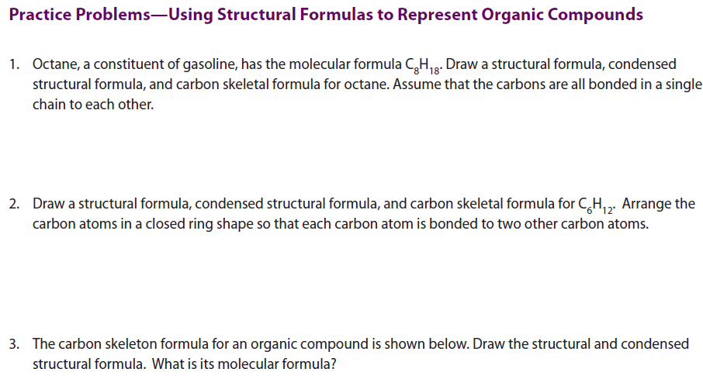
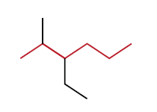

Slide 64
General formula for alkanes?
C_{n}H_{2n+2}

Slide 65
EASY WAY TO REMEMBER THE FIRST 4 ?
Meth -
Eth -
Prop -
But -
Monkeys
Eat
Peeled
Bananas

Slide 66
ALKANES – SATURATED HYDROCARBONS
Compounds containing only CARBONS and HYDROGENS
AND single CARBON – CARBON bonds
THEY CAN BE:
UNBRANCHED
(STRAIGHT CHAINS)
BRANCHED
(SIDE CHAINS)

Slide 67
NAMING OF BRANCHED
(SIDE CHAINS – substituent groups) ALKANES
A hydrocarbon chain can have “side branches”
These branches are also hydrocarbon chains
These side branches are called:
ALKYL GROUPS
ALKYL GROUPS has lost ONE
HYDROGEN atom

Slide 68
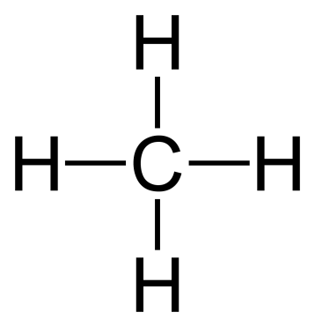
ALKYL GROUPS
METHANE
METHYL
Losing ONE HYDROGEN atom
CH₄
CH₃ –
ETHANE
ETHYL
Losing ONE HYDROGEN atom
CH₃ – CH₂ –
CH₃ – CH₃

Slide 69
These alkyl groups can connect to another hydrocarbon chains!
METHANE
METHYL
Losing ONE HYDROGEN atom
CH₄
CH₃ –
ETHANE
ETHYL
Losing ONE HYDROGEN atom
CH₃ – CH₂ –
CH₃ – CH₃

Slide 70
ALKYL GROUPS
ORIGINAL HYDRO CARBON | CONDENSED FORMULA of ORIGINAL HYDROCARBON | ALKYL GROUP | CONDENSED FORMULA of ALKYL GROUP
methane | CH₄
ethane | CH₃ – CH₃
propane | CH₃ – CH₂ – CH₃
butane | CH₃ – CH₂ – CH₂ – CH₃
pentane | CH₃ – CH₂ – CH₂ – CH₂ – CH₃

Slide 71
ALKYL GROUPS
ORIGINAL HYDRO CARBON | CONDENSED FORMULA of ORIGINAL HYDROCARBON | ALKYL GROUP | CONDENSED FORMULA of ALKYL GROUP
methane | CH₄ | methyl
ethane | CH₃ – CH₃
propane | CH₃ – CH₂ – CH₃
butane | CH₃ – CH₂ – CH₂ – CH₃
pentane | CH₃ – CH₂ – CH₂ – CH₂ – CH₃

Slide 72
ALKYL GROUPS
ORIGINAL HYDRO CARBON | CONDENSED FORMULA of ORIGINAL HYDROCARBON | ALKYL GROUP | CONDENSED FORMULA of ALKYL GROUP
methane | CH₄ | methyl | CH₃ –
ethane | CH₃ – CH₃
propane | CH₃ – CH₂ – CH₃
butane | CH₃ – CH₂ – CH₂ – CH₃
pentane | CH₃ – CH₂ – CH₂ – CH₂ – CH₃

Slide 73
ALKYL GROUPS
ORIGINAL HYDRO CARBON | CONDENSED FORMULA of ORIGINAL HYDROCARBON | ALKYL GROUP | CONDENSED FORMULA of ALKYL GROUP
methane | CH₄ | methyl | CH₃ –
ethane | CH₃ – CH₃ | ethyl
propane | CH₃ – CH₂ – CH₃
butane | CH₃ – CH₂ – CH₂ – CH₃
pentane | CH₃ – CH₂ – CH₂ – CH₂ – CH₃

Slide 74
ALKYL GROUPS
ORIGINAL HYDRO CARBON | CONDENSED FORMULA of ORIGINAL HYDROCARBON | ALKYL GROUP | CONDENSED FORMULA of ALKYL GROUP
methane | CH₄ | methyl | CH₃ –
ethane | CH₃ – CH₃ | ethyl | CH₃ – CH₂ –
propane | CH₃ – CH₂ – CH₃
butane | CH₃ – CH₂ – CH₂ – CH₃
pentane | CH₃ – CH₂ – CH₂ – CH₂ – CH₃

Slide 75
ALKYL GROUPS
ORIGINAL HYDRO CARBON | CONDENSED FORMULA of ORIGINAL HYDROCARBON | ALKYL GROUP | CONDENSED FORMULA of ALKYL GROUP
methane | CH₄ | methyl | CH₃ –
ethane | CH₃ – CH₃ | ethyl | CH₃ – CH₂ –
propane | CH₃ – CH₂ – CH₃ | propyl
butane | CH₃ – CH₂ – CH₂ – CH₃
pentane | CH₃ – CH₂ – CH₂ – CH₂ – CH₃

Slide 76
ALKYL GROUPS
ORIGINAL HYDRO CARBON | CONDENSED FORMULA of ORIGINAL HYDROCARBON | ALKYL GROUP | CONDENSED FORMULA of ALKYL GROUP
methane | CH₄ | methyl | CH₃ –
ethane | CH₃ – CH₃ | ethyl | CH₃ – CH₂ –
propane | CH₃ – CH₂ – CH₃ | propyl | CH₃ – CH₂ – CH₂ –
butane | CH₃ – CH₂ – CH₂ – CH₃
pentane | CH₃ – CH₂ – CH₂ – CH₂ – CH₃

Slide 77
ALKYL GROUPS
ORIGINAL HYDRO CARBON | CONDENSED FORMULA of ORIGINAL HYDROCARBON | ALKYL GROUP | CONDENSED FORMULA of ALKYL GROUP
methane | CH₄ | methyl | CH₃ –
ethane | CH₃ – CH₃ | ethyl | CH₃ – CH₂ –
propane | CH₃ – CH₂ – CH₃ | propyl | CH₃ – CH₂ – CH₂ – CH₃ – CH– CH₃
butane | CH₃ – CH₂ – CH₂ – CH₃
pentane | CH₃ – CH₂ – CH₂ – CH₂ – CH₃

Slide 78
ALKYL GROUPS
ORIGINAL HYDRO CARBON | CONDENSED FORMULA of ORIGINAL HYDROCARBON | ALKYL GROUP | CONDENSED FORMULA of ALKYL GROUP
methane | CH₄ | methyl | CH₃ –
ethane | CH₃ – CH₃ | ethyl | CH₃ – CH₂ –
propane | CH₃ – CH₂ – CH₃ | propyl | CH₃ – CH₂ – CH₂ – CH₃ – CH– CH₃
butane | CH₃ – CH₂ – CH₂ – CH₃ | butyl
pentane | CH₃ – CH₂ – CH₂ – CH₂ – CH₃

Slide 79
ALKYL GROUPS
ORIGINAL HYDRO CARBON | CONDENSED FORMULA of ORIGINAL HYDROCARBON | ALKYL GROUP | CONDENSED FORMULA of ALKYL GROUP
methane | CH₄ | methyl | CH₃ –
ethane | CH₃ – CH₃ | ethyl | CH₃ – CH₂ –
propane | CH₃ – CH₂ – CH₃ | propyl | CH₃ – CH₂ – CH₂ – CH₃ – CH– CH₃
butane | CH₃ – CH₂ – CH₂ – CH₃ | butyl | CH₃ – CH₂ – CH₂ – CH₂ –
pentane | CH₃ – CH₂ – CH₂ – CH₂ – CH₃

Slide 80
ALKYL GROUPS
ORIGINAL HYDRO CARBON | CONDENSED FORMULA of ORIGINAL HYDROCARBON | ALKYL GROUP | CONDENSED FORMULA of ALKYL GROUP
methane | CH₄ | methyl | CH₃ –
ethane | CH₃ – CH₃ | ethyl | CH₃ – CH₂ –
propane | CH₃ – CH₂ – CH₃ | propyl | CH₃ – CH₂ – CH₂ – CH₃ – CH– CH₃
butane | CH₃ – CH₂ – CH₂ – CH₃ | butyl | CH₃ – CH₂ – CH₂ – CH₂ –
pentane | CH₃ – CH₂ – CH₂ – CH₂ – CH₃ | pentyl

Slide 81
ALKYL GROUPS
ORIGINAL HYDRO CARBON | CONDENSED FORMULA of ORIGINAL HYDROCARBON | ALKYL GROUP | CONDENSED FORMULA of ALKYL GROUP
methane | CH₄ | methyl | CH₃ –
ethane | CH₃ – CH₃ | ethyl | CH₃ – CH₂ –
propane | CH₃ – CH₂ – CH₃ | propyl | CH₃ – CH₂ – CH₂ – CH₃ – CH– CH₃
butane | CH₃ – CH₂ – CH₂ – CH₃ | butyl | CH₃ – CH₂ – CH₂ – CH₂ –
pentane | CH₃ – CH₂ – CH₂ – CH₂ – CH₃ | pentyl | CH₃ – CH₂ – CH₂ – CH₂ – CH₂ –

Slide 82
ALKYL GROUPS
ORIGINAL HYDRO CARBON | CONDENSED FORMULA of ORIGINAL HYDROCARBON | ALKYL GROUP | CONDENSED FORMULA of ALKYL GROUP
methane | CH₄ | methyl | CH₃ –
ethane | CH₃ – CH₃ | ethyl | CH₃ – CH₂ –
propane | CH₃ – CH₂ – CH₃ | propyl | CH₃ – CH₂ – CH₂ – CH₃ – CH– CH₃
butane | CH₃ – CH₂ – CH₂ – CH₃ | butyl | CH₃ – CH₂ – CH₂ – CH₂ –
pentane | CH₃ – CH₂ – CH₂ – CH₂ – CH₃ | pentyl | CH₃ – CH₂ – CH₂ – CH₂ – CH₂ –
FINISH THE REST FOR
YOURSELF!!

Slide 83
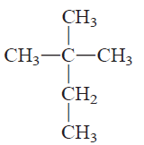
THE LONGEST CONTINUOS CHAIN OF CARBON ATOMS (A PARENT CHAIN)

Slide 84
THE LONGEST CONTINUOS CHAIN OF CARBON ATOMS (A PARENT CHAIN)
CH₃ – CH₂ – CH₂ – CH₃
CH₃ – CH₂ – CH₂ – CH₂ – CH₃
What are the possible continuous carbon chains and which one of them is the longest?

Slide 85
What are the possible continuous carbon chains?
CH₃ – CH – CH₂ – CH₃
CH₃ – CH₂ – CH – CH₂ – CH₃
CH₃ – CH – CH₂ – CH₃
CH₃ – CH – CH₂ – CH₃
CH₃ – CH₂ – CH – CH₂ – CH₃
CH₃ – CH₂ – CH – CH₂ – CH₃
CH₃ – CH – CH₂ – CH₃
CH₃ – CH – CH₂ – CH₃
CH₃ – CH₂ – CH – CH₂ – CH₃
CH₃ – CH₂ – CH – CH₂ – CH₃
CH₃ – CH – CH₂ – CH₃
CH₃ – CH – CH₂ – CH₃
CH₃ – CH₂ – CH – CH₂ – CH₃
CH₃ – CH₂ – CH – CH₂ – CH₃

Slide 86
Which one(s) is (are) the longest?
CH₃ – CH – CH₂ – CH₃
CH₃ – CH₂ – CH – CH₂ – CH₃
5 carbons
CH₃ – CH – CH₂ – CH₃
CH₃ – CH – CH₂ – CH₃
4 carbons
CH₃ – CH₂ – CH – CH₂ – CH₃
CH₃ – CH₂ – CH – CH₂ – CH₃
6 carbons
CH₃ – CH – CH₂ – CH₃
CH₃ – CH – CH₂ – CH₃
5 carbons
CH₃ – CH₂ – CH – CH₂ – CH₃
CH₃ – CH₂ – CH – CH₂ – CH₃
CH₃ – CH – CH₂ – CH₃
CH₃ – CH – CH₂ – CH₃
5 carbons
CH₃ – CH₂ – CH – CH₂ – CH₃
CH₃ – CH₂ – CH – CH₂ – CH₃
6 carbons

Slide 87
RULES FOR NAMING!
CH₃
CH₃ – CH₂ – CH₂ – CH₂ – CH₃
1. FIND and NAME THE LONGEST CONTINUOS CHAIN OF CARBON ATOMS (A PARENT CHAIN)
2. FIND and NAME THE VARIOUS ALKYL GROUPS WHICH ARE ATTACHED TO THE PARENT CHAIN
3. NUMBER THE PARENT CHAIN
4. NOTE THE CARBON ATOM AT WHICH THE ALKYL GROUPS ARE ATTACHED TO

Slide 88
1. FIND and NAME THE LONGEST CONTINUOS CHAIN OF CARBON ATOMS (A PARENT CHAIN)
CH₃
CH₃ – CH₂ – CH₂ – CH₂ – CH₃
CH₃
CH₃
CH₃ – CH – CH₂ – CH₂ – CH₃
CH₃ – CH – CH₂ – CH₂ – CH₃
5 carbons
SAME MOLECULE!
5 carbons
CH₃
CH₃ – CH – CH₂ – CH₂ – CH₃
5 carbons = pentane

Slide 89
2. FIND and NAME THE VARIOUS ALKYL GROUPS WHICH ARE ATTACHED TO THE PARENT CHAIN
CH₃
CH₃ – CH₂ – CH₂ – CH₂ – CH₃
CH₃
CH₃
CH₃ – CH – CH₂ – CH₂ – CH₃
CH₃ – CH – CH₂ – CH₂ – CH₃
5 carbons
SAME MOLECULE!
5 carbons
CH₃
CH₃ – CH – CH₂ – CH₂ – CH₃
5 carbons = pentane

Slide 90
2. FIND and NAME THE VARIOUS ALKYL GROUPS WHICH ARE ATTACHED TO THE PARENT CHAIN
CH₃
CH₃ – CH₂ – CH₂ – CH₂ – CH₃
CH₃
CH₃
CH₃ – CH – CH₂ – CH₂ – CH₃
CH₃ – CH – CH₂ – CH₂ – CH₃
5 carbons
SAME MOLECULE!
5 carbons
CH₃
1 carbon = methyl
PUT THEM TOGETHER
(Alkyl group first)
CH₃ – CH – CH₂ – CH₂ – CH₃
5 carbons = pentane

Slide 91
2. FIND and NAME THE VARIOUS ALKYL GROUPS WHICH ARE ATTACHED TO THE PARENT CHAIN
CH₃
CH₃ – CH₂ – CH₂ – CH₂ – CH₃
CH₃
CH₃
CH₃ – CH – CH₂ – CH₂ – CH₃
CH₃ – CH – CH₂ – CH₂ – CH₃
5 carbons
SAME MOLECULE!
5 carbons
CH₃
1 carbon = methyl
PUT THEM TOGETHER
(Alkyl group first)
CH₃ – CH – CH₂ – CH₂ – CH₃
5 carbons = pentane
methylpentane
methyl – pentane

Slide 92
3. NUMBER THE PARENT CHAIN
CH₃
methylpentane
CH₃ – CH – CH₂ – CH₂ – CH₃
CH₃
CH₃
OR
CH₃ – CH – CH₂ – CH₂ – CH₃
CH₃ – CH – CH₂ – CH₂ – CH₃
1
2
3
4
5
5
4
3
2
1

Slide 93
4. NOTE THE CARBON ATOM AT WHICH THE ALKYL GROUPS ARE ATTACHED TO
CH₃
methylpentane
CH₃ – CH – CH₂ – CH₂ – CH₃
CH₃
CH₃
OR
CH₃ – CH – CH₂ – CH₂ – CH₃
CH₃ – CH – CH₂ – CH₂ – CH₃
1
2
3
4
5
5
4
3
2
1
2 - methylpentane
OR
4 - methylpentane
5. Choose the lowest possible set of numbers
2 - methylpentane
2 – methyl – pentane

Slide 94
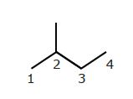
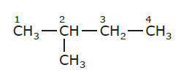
Name the following alkanes
2 – methylbutane
2 – methylbutane
2 – methyl – butane
2 – methyl – butane

Slide 95
RULES FOR NAMING!
WHAT IF YOU HAVE MORE THAN ONLY ONE ALKYL GROUP?
CH₃ – CH – CH₂ – CH₃
CH₃ – CH₂ – CH – CH₂ – CH₃

Slide 96
1. FIND and NAME THE LONGEST CONTINUOS CHAIN OF CARBON ATOMS (A PARENT CHAIN)
2. FIND and NAME THE VARIOUS ALKYL GROUPS WHICH ARE ATTACHED TO THE PARENT CHAIN
3. NUMBER THE PARENT CHAIN
4. NOTE THE CARBON ATOM AT WHICH THE ALKYL GROUPS ARE ATTACHED TO AND ARRANGE THEM ALPHABETICALLY
5. CHOOSE THE LOWEST POSSIBLE SET OF NUMBERS

Slide 97
1. FIND and NAME THE LONGEST CONTINUOS CHAIN OF CARBON ATOMS (A PARENT CHAIN)
CH₃ – CH – CH₂ – CH₃
CH₃ – CH₂ – CH – CH₂ – CH₃

Slide 98
1. FIND and NAME THE LONGEST CONTINUOS CHAIN OF CARBON ATOMS (A PARENT CHAIN)
CH₃ – CH – CH₂ – CH₃
6 carbons
CH₃ – CH₂ – CH – CH₂ – CH₃

Slide 99
1. FIND and NAME THE LONGEST CONTINUOS CHAIN OF CARBON ATOMS (A PARENT CHAIN)
CH₃ – CH – CH₂ – CH₃
6 carbons = HEXANE
CH₃ – CH₂ – CH – CH₂ – CH₃

Slide 100
2. FIND and NAME THE VARIOUS ALKYL GROUPS WHICH ARE ATTACHED TO THE PARENT CHAIN
CH₃ – CH – CH₂ – CH₃
6 carbons = HEXANE
CH₃ – CH₂ – CH – CH₂ – CH₃
1 carbon = METHYL
2 carbons = ETHYL
3. NUMBER THE PARENT CHAIN
CH₃ – CH – CH₂ – CH₃
CH₃ – CH₂ – CH – CH₂ – CH₃
3
2
1
4
5
6
CH₃ – CH – CH₂ – CH₃
OR
CH₃ – CH – CH₂ – CH₃
CH₃ – CH₂ – CH – CH₂ – CH₃
CH₃ – CH₂ – CH – CH₂ – CH₃
6
5
4
1
2
3

Slide 101
CH₃ – CH – CH₂ – CH₃
6 carbons = HEXANE
CH₃ – CH₂ – CH – CH₂ – CH₃
METHYL
2
6
3
1
4
5
METHYL
CH₃ – CH – CH₂ – CH₃
OR
CH₃ – CH – CH₂ – CH₃
CH₃ – CH₂ – CH – CH₂ – CH₃
CH₃ – CH₂ – CH – CH₂ – CH₃
6
5
4
ETHYL
1
2
3
ETHYL
4. NOTE THE CARBON ATOM AT WHICH THE ALKYL GROUPS ARE ATTACHED TO AND ARRANGE THEM ALPHABETICALLY

Slide 102
CH₃ – CH – CH₂ – CH₃
6 carbons = HEXANE
CH₃ – CH₂ – CH – CH₂ – CH₃
3 - METHYL
2
6
3
1
4
5
METHYL
CH₃ – CH – CH₂ – CH₃
OR
CH₃ – CH – CH₂ – CH₃
CH₃ – CH₂ – CH – CH₂ – CH₃
CH₃ – CH₂ – CH – CH₂ – CH₃
6
5
4
ETHYL
1
2
3
ETHYL
4. NOTE THE CARBON ATOM AT WHICH THE ALKYL GROUPS ARE ATTACHED TO AND ARRANGE THEM ALPHABETICALLY

Slide 103
CH₃ – CH – CH₂ – CH₃
6 carbons = HEXANE
CH₃ – CH₂ – CH – CH₂ – CH₃
3 - METHYL
2
6
3
1
4
5
METHYL
CH₃ – CH – CH₂ – CH₃
OR
CH₃ – CH – CH₂ – CH₃
CH₃ – CH₂ – CH – CH₂ – CH₃
CH₃ – CH₂ – CH – CH₂ – CH₃
6
5
4
4 -ETHYL
1
2
3
ETHYL
4. NOTE THE CARBON ATOM AT WHICH THE ALKYL GROUPS ARE ATTACHED TO AND ARRANGE THEM ALPHABETICALLY

Slide 104
CH₃ – CH – CH₂ – CH₃
6 carbons = HEXANE
CH₃ – CH₂ – CH – CH₂ – CH₃
3 - METHYL
2
6
3
1
4
5
4 - METHYL
CH₃ – CH – CH₂ – CH₃
OR
CH₃ – CH – CH₂ – CH₃
CH₃ – CH₂ – CH – CH₂ – CH₃
CH₃ – CH₂ – CH – CH₂ – CH₃
6
5
4
4 -ETHYL
1
2
3
ETHYL
4. NOTE THE CARBON ATOM AT WHICH THE ALKYL GROUPS ARE ATTACHED TO AND ARRANGE THEM ALPHABETICALLY

Slide 105
CH₃ – CH – CH₂ – CH₃
6 carbons = HEXANE
CH₃ – CH₂ – CH – CH₂ – CH₃
3 - METHYL
2
6
3
1
4
5
4 - METHYL
CH₃ – CH – CH₂ – CH₃
OR
CH₃ – CH – CH₂ – CH₃
CH₃ – CH₂ – CH – CH₂ – CH₃
CH₃ – CH₂ – CH – CH₂ – CH₃
6
5
4
4 -ETHYL
1
2
3
3 - ETHYL
List the ALKYL GROUPS
alphabetically and join them with the parent chain
List the ALKYL GROUPS
alphabetically and join them with the parent chain
OR
4 – ETHYL – 3 – METHYLHEXANE
3 – ETHYL – 4 – METHYLHEXANE
5. CHOOSE THE LOWEST POSSIBLE SET OF NUMBERS

Slide 106
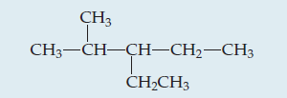
Name the following alkane
3 – ethyl – 2 – methylpentane

Slide 107
RULES FOR NAMING!
WHAT IF THERE ARE REPEATING ALKYL GROUPS?
CH₃
CH₃
CH₃ – CH₂ – CH – CH – CH₃

Slide 108
CH₃
CH₃
CH₃ – CH₂ – CH – CH₂ – CH₃
5. USE PREFIXES (DI, TRI, TETRA, ETC…) TO SHOW HOW MANY SAME ALKYL GROUPS ARE ATTACHED
6. CHOOSE THE LOWEST POSSIBLE SET OF NUMBERS

Slide 109
1. FIND and NAME THE LONGEST CONTINUOS CHAIN OF CARBON ATOMS (A PARENT CHAIN)
CH₃
CH₃
CH₃ – CH₂ – CH – CH – CH₃
5. CHOOSE THE LOWEST POSSIBLE SET OF NUMBERS

Slide 110
1. FIND and NAME THE LONGEST CONTINUOS CHAIN OF CARBON ATOMS (A PARENT CHAIN)
CH₃
CH₃
5 carbons = PENTANE
CH₃ – CH₂ – CH – CH – CH₃

Slide 111
2. FIND and NAME THE VARIOUS ALKYL GROUPS WHICH ARE ATTACHED TO THE PARENT CHAIN
CH₃
CH₃
5 carbons = PENTANE
CH₃ – CH₂ – CH – CH – CH₃
1 carbon = METHYL
1 carbon = METHYL

Slide 112
3. NUMBER THE PARENT CHAIN
CH₃
CH₃
5 carbons = PENTANE
CH₃ – CH₂ – CH – CH – CH₃
1 carbon = METHYL
1 carbon = METHYL
CH₃
CH₃
CH₃
CH₃
OR
CH₃ – CH₂ – CH – CH – CH₃
CH₃ – CH₂ – CH – CH – CH₃
5
4
3
2
1
1
2
3
4
5

Slide 113
4. NOTE THE CARBON ATOM AT WHICH THE ALKYL GROUPS ARE ATTACHED TO AND ARRANGE THEM ALPHABETICALLY
CH₃
CH₃
5 carbons = PENTANE
CH₃ – CH₂ – CH – CH – CH₃
1 carbon = METHYL
1 carbon = METHYL
CH₃
CH₃
CH₃
CH₃
OR
CH₃ – CH₂ – CH – CH – CH₃
CH₃ – CH₂ – CH – CH – CH₃
5
4
3
2
1
1
2
3
4
5
3 - METHYL
2 - METHYL
3 - METHYL
4 - METHYL
Join the ALKYL GROUPS
with the parent chain
Join the ALKYL GROUPS
with the parent chain
2 – METHYL – 3 – METHYLPENTANE
3 – METHYL – 4 – METHYLPENTANE

Slide 114
5. USE PREFIXES (DI, TRI, TETRA, ETC…) TO SHOW HOW MANY SAME ALKYL GROUPS ARE ATTACHED
CH₃
CH₃
5 carbons = PENTANE
CH₃ – CH₂ – CH – CH – CH₃
1 carbon = METHYL
1 carbon = METHYL
CH₃
CH₃
CH₃
CH₃
OR
CH₃ – CH₂ – CH – CH – CH₃
CH₃ – CH₂ – CH – CH – CH₃
5
4
3
2
1
1
2
3
4
5
3 - METHYL
2 - METHYL
3 - METHYL
4 - METHYL
Join the ALKYL GROUPS
with the parent chain
Join the ALKYL GROUPS
with the parent chain
2 – METHYL – 3 – METHYLPENTANE
3 – METHYL – 4 – METHYLPENTANE

Slide 115
5. USE PREFIXES (DI, TRI, TETRA, ETC…) TO SHOW HOW MANY SAME ALKYL GROUPS ARE ATTACHED
CH₃
CH₃
5 carbons = PENTANE
CH₃ – CH₂ – CH – CH – CH₃
1 carbon = METHYL
1 carbon = METHYL
CH₃
CH₃
CH₃
CH₃
OR
CH₃ – CH₂ – CH – CH – CH₃
CH₃ – CH₂ – CH – CH – CH₃
5
4
3
2
1
1
2
3
4
5
3 - METHYL
2 - METHYL
3 - METHYL
4 - METHYL
Join the ALKYL GROUPS
with the parent chain
2 – METHYL – 3 – METHYLPENTANE
3 – METHYL – 4 – METHYLPENTANE

Slide 116
5. USE PREFIXES (DI, TRI, TETRA, ETC…) TO SHOW HOW MANY SAME ALKYL GROUPS ARE ATTACHED
CH₃
CH₃
5 carbons = PENTANE
CH₃ – CH₂ – CH – CH – CH₃
1 carbon = METHYL
1 carbon = METHYL
CH₃
CH₃
CH₃
CH₃
OR
CH₃ – CH₂ – CH – CH – CH₃
CH₃ – CH₂ – CH – CH – CH₃
5
4
3
2
1
1
2
3
4
5
3 - METHYL
2 - METHYL
3 - METHYL
4 - METHYL
2, 3 – DIMETHYLPENTANE
Join the ALKYL GROUPS
with the parent chain
2 – METHYL – 3 – METHYLPENTANE
3 – METHYL – 4 – METHYLPENTANE

Slide 117
5. USE PREFIXES (DI, TRI, TETRA, ETC…) TO SHOW HOW MANY SAME ALKYL GROUPS ARE ATTACHED
CH₃
CH₃
5 carbons = PENTANE
CH₃ – CH₂ – CH – CH – CH₃
1 carbon = METHYL
1 carbon = METHYL
CH₃
CH₃
CH₃
CH₃
OR
CH₃ – CH₂ – CH – CH – CH₃
CH₃ – CH₂ – CH – CH – CH₃
5
4
3
2
1
1
2
3
4
5
3 - METHYL
2 - METHYL
3 - METHYL
4 - METHYL
2, 3 – DIMETHYLPENTANE
2 – METHYL – 3 – METHYLPENTANE
3 – METHYL – 4 – METHYLPENTANE

Slide 118
5. USE PREFIXES (DI, TRI, TETRA, ETC…) TO SHOW HOW MANY SAME ALKYL GROUPS ARE ATTACHED
CH₃
CH₃
5 carbons = PENTANE
CH₃ – CH₂ – CH – CH – CH₃
1 carbon = METHYL
1 carbon = METHYL
CH₃
CH₃
CH₃
CH₃
OR
CH₃ – CH₂ – CH – CH – CH₃
CH₃ – CH₂ – CH – CH – CH₃
5
4
3
2
1
1
2
3
4
5
3 - METHYL
2 - METHYL
3 - METHYL
4 - METHYL
2, 3 – DIMETHYLPENTANE
3, 4 – DIMETHYLPENTANE
2 – METHYL – 3 – METHYLPENTANE
3 – METHYL – 4 – METHYLPENTANE

Slide 119
6. CHOOSE THE LOWEST POSSIBLE SET OF NUMBERS
CH₃
CH₃
5 carbons = PENTANE
CH₃ – CH₂ – CH – CH – CH₃
1 carbon = METHYL
1 carbon = METHYL
CH₃
CH₃
CH₃
CH₃
OR
CH₃ – CH₂ – CH – CH – CH₃
CH₃ – CH₂ – CH – CH – CH₃
5
4
3
2
1
1
2
3
4
5
3 - METHYL
2 - METHYL
3 - METHYL
4 - METHYL
2, 3 – DIMETHYLPENTANE
3, 4 – DIMETHYLPENTANE
2 – METHYL – 3 – METHYLPENTANE
3 – METHYL – 4 – METHYLPENTANE

Slide 120
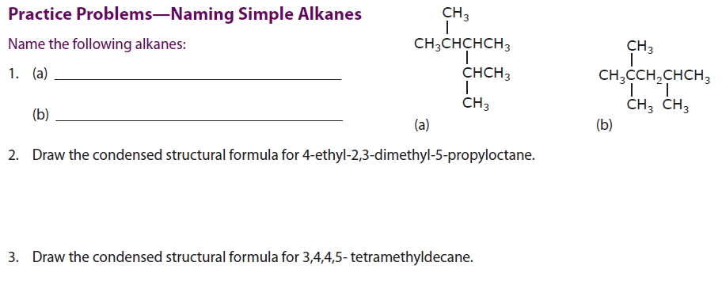

Slide 121
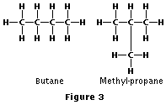
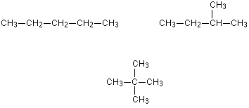
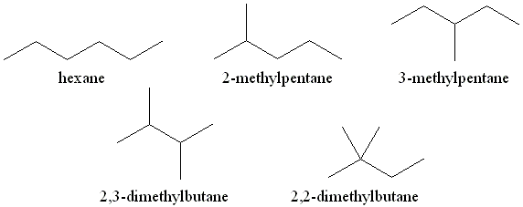
STRUCTURAL ISOMERS

Slide 122
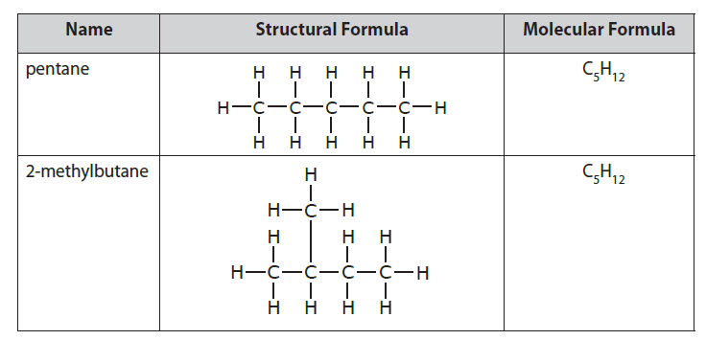
STRUCTURAL ISOMERS
What do you notice about the molecular formulas of the two substances in the table?

Slide 123
STRUCTURAL ISOMERS
Compounds which have the same molecular formula but a different arrangement of atoms
C₆H₁₄
CH₃ – CH₂ – CH₂ – CH₂ – CH₂ – CH₃
HEXANE
CH₃ – CH – CH₂ – CH₂ – CH₃
C₆H₁₄
2 – methylpentane
–
CH₃ – CH – CH – CH₃
CH₃
C₆H₁₄
–
–
CH₃
CH₃
CH₃
C₆H₁₄
–
2,3 – dimethylbutane
CH₃ – C – CH₂ – CH₃
–
2,2 – dimethylbutane
CH₃

Slide 124
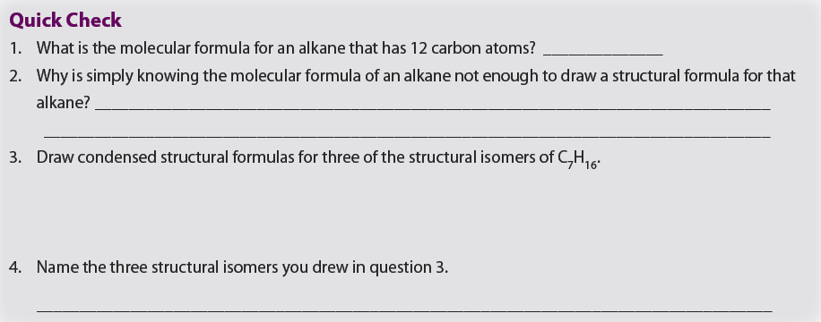

Slide 125
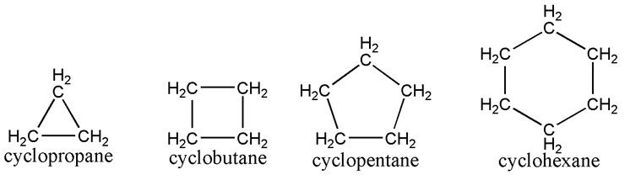
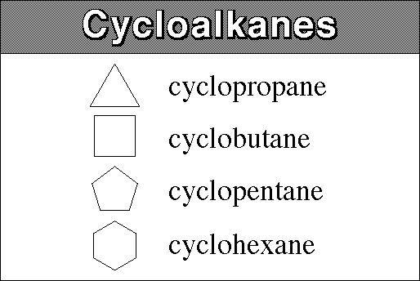
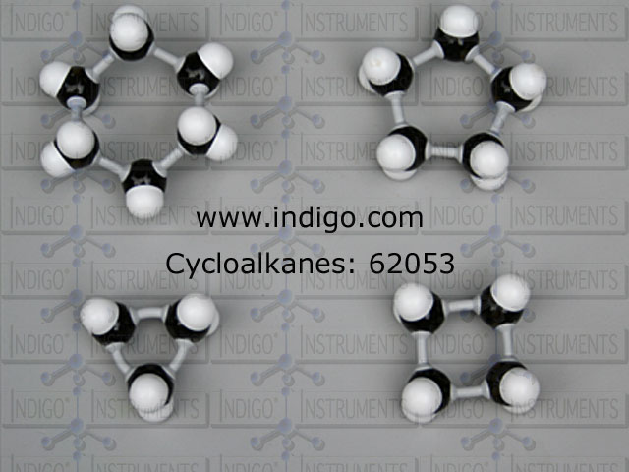
CYCLOALKANES

Slide 126
RULES FOR NAMING!
NUMBER OF CARBONS | NAME | MOLECULAR FORMULA | SHORTHAND FORMULA

Slide 127
RULES FOR NAMING!
NUMBER OF CARBONS | NAME | MOLECULAR FORMULA | SHORTHAND FORMULA
1
2
3
4
5

Slide 128
RULES FOR NAMING!
NUMBER OF CARBONS | NAME | MOLECULAR FORMULA | SHORTHAND FORMULA
1 | cyclomethane | CH₄
2 | cycloethane | C₂H₆
3
4
5

Slide 129
RULES FOR NAMING!
NUMBER OF CARBONS | NAME | MOLECULAR FORMULA | SHORTHAND FORMULA
1 | cyclomethane | CH₄
2 | cycloethane | C₂H₆
3 | cyclopropane
4
5

Slide 130
RULES FOR NAMING!
NUMBER OF CARBONS | NAME | MOLECULAR FORMULA | SHORTHAND FORMULA
1 | cyclomethane | CH₄
2 | cycloethane | C₂H₆
3 | cyclopropane | C₃H₆
4
5

Slide 131
RULES FOR NAMING!
NUMBER OF CARBONS | NAME | MOLECULAR FORMULA | SHORTHAND FORMULA
1 | cyclomethane | CH₄
2 | cycloethane | C₂H₆
3 | cyclopropane | C₃H₆
4 | cyclobutane
5

Slide 132
RULES FOR NAMING!
NUMBER OF CARBONS | NAME | MOLECULAR FORMULA | SHORTHAND FORMULA
1 | cyclomethane | CH₄
2 | cycloethane | C₂H₆
3 | cyclopropane | C₃H₆
4 | cyclobutane | C₄H₈
5

Slide 133
RULES FOR NAMING!
NUMBER OF CARBONS | NAME | MOLECULAR FORMULA | SHORTHAND FORMULA
1 | cyclomethane | CH₄
2 | cycloethane | C₂H₆
3 | cyclopropane | C₃H₆
4 | cyclobutane | C₄H₈
5

Slide 134
RULES FOR NAMING!
NUMBER OF CARBONS | NAME | MOLECULAR FORMULA | SHORTHAND FORMULA
1 | cyclomethane | CH₄
2 | cycloethane | C₂H₆
3 | cyclopropane | C₃H₆
4 | cyclobutane | C₄H₈
5 | cyclopentane

Slide 135
RULES FOR NAMING!
NUMBER OF CARBONS | NAME | MOLECULAR FORMULA | SHORTHAND FORMULA
1 | cyclomethane | CH₄
2 | cycloethane | C₂H₆
3 | cyclopropane | C₃H₆
4 | cyclobutane | C₄H₈
5 | cyclopentane | C₅H₁₀

Slide 136
RULES FOR NAMING!
NUMBER OF CARBONS | NAME | MOLECULAR FORMULA | SHORTHAND FORMULA
1 | cyclomethane | CH₄
2 | cycloethane | C₂H₆
3 | cyclopropane | C₃H₆
4 | cyclobutane | C₄H₈
5 | cyclopentane | C₅H₁₀

Slide 137
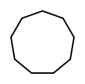
RULES FOR NAMING!
NUMBER OF CARBONS | NAME | MOLECULAR FORMULA | SHORTHAND FORMULA
6 | cyclohexane | C₆H₁₂
7 | cycloheptane | C₇H₁₄
8 | cyclooctane | C₈H₁₆
9 | cyclononane | C₉H₁₈
10 | cyclodecane | C₁₀H₂₀

Slide 138
General formula for cycloalkanes?
C_{n}H_{2n}

Slide 139
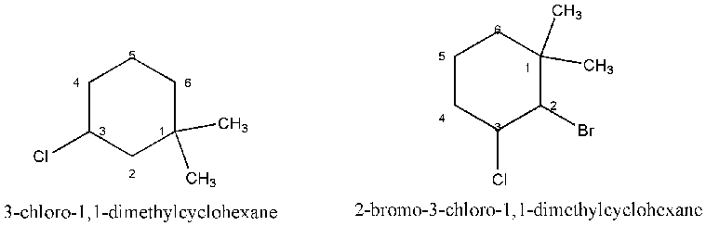
RULES FOR NAMING!
WHAT IF THERE ARE MORE ALKYL GROUPS ATTACHED TO THE RING?

Slide 140
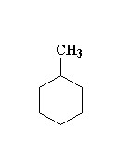
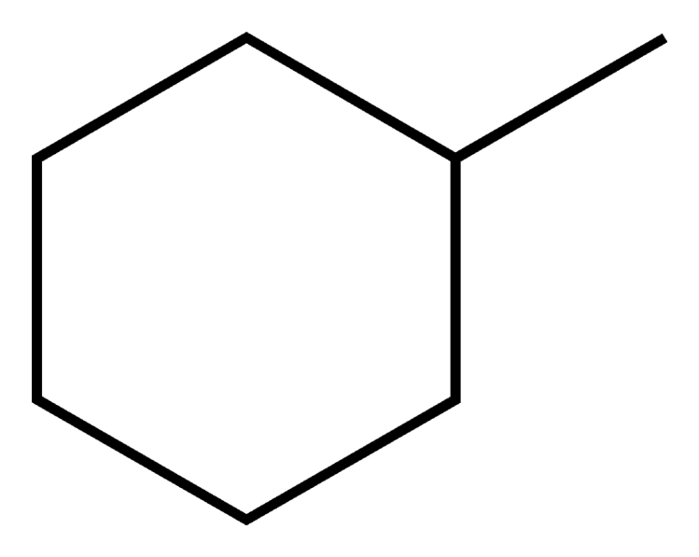
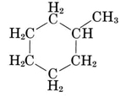
USE THE SAME RULES AS FOR ALKANES EXCEPT…
1. If there is ONLY ONE alkyl group, DON’T USE the number to indicate the position of attachment
methylcyclohexane

Slide 141
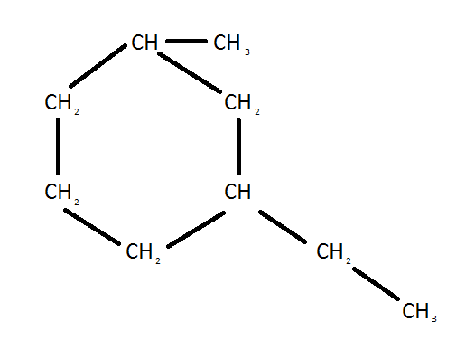
USE THE SAME RULES AS FOR ALKANES EXCEPT…
2. If there is MORE THAN ONE alkyl group, the first alkyl group is given the position “1” and the remaining alkyl groups are given numbers (CW or CCW) to produce the lowest set of numbers
3
1 – ethyl – 3 – methylcyclohexane
4
5
2
OR
1
1 – ethyl – 5 – methylcyclohexane
3
1
2

Slide 142



Name the following alkanes

Slide 143


Slide 145
ALKENES and ALKYNES

Slide 146
NAMING OF UNBRANCHED
(STRAIGHT CHAIN) ALKENES
You just have to know the first ten alkenes
The naming is based on the number of carbons
NUMBER OF CARBONS | NAME | MOLECULAR FORMULA | CONDENSED FORMULA

Slide 147
NAMING OF UNBRANCHED
(STRAIGHT CHAIN) ALKENES
NUMBER OF CARBONS | NAME | MOLECULAR FORMULA | CONDENSED FORMULA
1

Slide 148
NAMING OF UNBRANCHED
(STRAIGHT CHAIN) ALKANES
NAMING OF UNBRANCHED
(STRAIGHT CHAIN) ALKENES
NUMBER OF CARBONS | NAME | MOLECULAR FORMULA | CONDENSED FORMULA
1 | methene

Slide 149
NAMING OF UNBRANCHED
(STRAIGHT CHAIN) ALKENES
NUMBER OF CARBONS | NAME | MOLECULAR FORMULA | CONDENSED FORMULA
1 | methene | CH₄

Slide 150
NAMING OF UNBRANCHED
(STRAIGHT CHAIN) ALKANES
NAMING OF UNBRANCHED
(STRAIGHT CHAIN) ALKENES
NUMBER OF CARBONS | NAME | MOLECULAR FORMULA | CONDENSED FORMULA
1 | methene | CH₄ | CH₄

Slide 151
NAMING OF UNBRANCHED
(STRAIGHT CHAIN) ALKANES
NAMING OF UNBRANCHED
(STRAIGHT CHAIN) ALKENES
NUMBER OF CARBONS | NAME | MOLECULAR FORMULA | CONDENSED FORMULA
1 | methene | CH₄ | CH₄
2

Slide 152
NAMING OF UNBRANCHED
(STRAIGHT CHAIN) ALKANES
NAMING OF UNBRANCHED
(STRAIGHT CHAIN) ALKENES
NUMBER OF CARBONS | NAME | MOLECULAR FORMULA | CONDENSED FORMULA
1 | methane | CH₄ | CH₄
2 | ethene

Slide 153
NAMING OF UNBRANCHED
(STRAIGHT CHAIN) ALKANES
NAMING OF UNBRANCHED
(STRAIGHT CHAIN) ALKENES
NUMBER OF CARBONS | NAME | MOLECULAR FORMULA | CONDENSED FORMULA
1 | methane | CH₄ | CH₄
2 | ethene | C₂H₄

Slide 154
NAMING OF UNBRANCHED
(STRAIGHT CHAIN) ALKANES
NAMING OF UNBRANCHED
(STRAIGHT CHAIN) ALKENES
NUMBER OF CARBONS | NAME | MOLECULAR FORMULA | CONDENSED FORMULA
1 | methene | CH₄ | CH₄
2 | ethene | C₂H₄ | CH₂ = CH₂
3
4
5

Slide 155
NAMING OF UNBRANCHED
(STRAIGHT CHAIN) ALKANES
NAMING OF UNBRANCHED
(STRAIGHT CHAIN) ALKENES
NUMBER OF CARBONS | NAME | MOLECULAR FORMULA | CONDENSED FORMULA
1 | methene | CH₄ | CH₄
2 | ethene | C₂H₄ | CH₂ = CH₂
3 | propene
4
5

Slide 156
NAMING OF UNBRANCHED
(STRAIGHT CHAIN) ALKANES
NAMING OF UNBRANCHED
(STRAIGHT CHAIN) ALKENES
NUMBER OF CARBONS | NAME | MOLECULAR FORMULA | CONDENSED FORMULA
1 | methene | CH₄ | CH₄
2 | ethene | C₂H₄ | CH₂ = CH₂
3 | propene | C₃H₆
4
5

Slide 157
NAMING OF UNBRANCHED
(STRAIGHT CHAIN) ALKANES
NAMING OF UNBRANCHED
(STRAIGHT CHAIN) ALKENES
NUMBER OF CARBONS | NAME | MOLECULAR FORMULA | CONDENSED FORMULA
1 | methene | CH₄ | CH₄
2 | ethene | C₂H₄ | CH₂ = CH₂
3 | propene | C₃H₆ | CH₂ = CH – CH₃
4
5

Slide 158
NAMING OF UNBRANCHED
(STRAIGHT CHAIN) ALKANES
NAMING OF UNBRANCHED
(STRAIGHT CHAIN) ALKENES
NUMBER OF CARBONS | NAME | MOLECULAR FORMULA | CONDENSED FORMULA
1 | methene | CH₄ | CH₄
2 | ethene | C₂H₄ | CH₂ = CH₂
3 | propene | C₃H₆ | CH₂ = CH – CH₃
4 | butene
5

Slide 159
NAMING OF UNBRANCHED
(STRAIGHT CHAIN) ALKANES
NAMING OF UNBRANCHED
(STRAIGHT CHAIN) ALKENES
NUMBER OF CARBONS | NAME | MOLECULAR FORMULA | CONDENSED FORMULA
1 | methene | CH₄ | CH₄
2 | ethene | C₂H₄ | CH₂ = CH₂
3 | propene | C₃H₆ | CH₂ = CH – CH₃
4 | butene | C₄H₈
5

Slide 160
NAMING OF UNBRANCHED
(STRAIGHT CHAIN) ALKANES
NAMING OF UNBRANCHED
(STRAIGHT CHAIN) ALKENES
NUMBER OF CARBONS | NAME | MOLECULAR FORMULA | CONDENSED FORMULA
1 | methene | CH₄ | CH₄
2 | ethene | C₂H₄ | CH₂ = CH₂
3 | propene | C₃H₆ | CH₂ = CH – CH₃
4 | butene | C₄H₈ | CH₂ = CH – CH₂ – CH₃ CH₃ – CH = CH – CH₃
5

Slide 161
NAMING OF UNBRANCHED
(STRAIGHT CHAIN) ALKANES
NAMING OF UNBRANCHED
(STRAIGHT CHAIN) ALKENES
NUMBER OF CARBONS | NAME | MOLECULAR FORMULA | CONDENSED FORMULA
1 | methene | CH₄ | CH₄
2 | ethene | C₂H₄ | CH₂ = CH₂
3 | propene | C₃H₆ | CH₂ = CH – CH₃
4 | butene | C₄H₈ | CH₂ = CH – CH₂ – CH₃ CH₃ – CH = CH – CH₃
5 | pentene

Slide 162
NAMING OF UNBRANCHED
(STRAIGHT CHAIN) ALKANES
NAMING OF UNBRANCHED
(STRAIGHT CHAIN) ALKENES
NUMBER OF CARBONS | NAME | MOLECULAR FORMULA | CONDENSED FORMULA
1 | methene | CH₄ | CH₄
2 | ethene | C₂H₄ | CH₂ = CH₂
3 | propene | C₃H₆ | CH₂ = CH – CH₃
4 | butene | C₄H₈ | CH₂ = CH – CH₂ – CH₃ CH₃ – CH = CH – CH₃
5 | pentene | C₅H₁₀

Slide 163
NAMING OF UNBRANCHED
(STRAIGHT CHAIN) ALKANES
NAMING OF UNBRANCHED
(STRAIGHT CHAIN) ALKENES
NUMBER OF CARBONS | NAME | MOLECULAR FORMULA | CONDENSED FORMULA
1 | methene | CH₄ | CH₄
2 | ethene | C₂H₄ | CH₂ = CH₂
3 | propene | C₃H₆ | CH₂ = CH – CH₃
4 | butene | C₄H₈ | CH₂ = CH – CH₂ – CH₃ CH₃ – CH = CH – CH₃
5 | pentene | C₅H₁₀ | CH₂ = CH – CH₂ – CH₂ – CH₃ CH₃ – CH = CH – CH₂ – CH₃

Slide 164
NAMING OF UNBRANCHED
(STRAIGHT CHAIN) ALKANES
NAMING OF UNBRANCHED
(STRAIGHT CHAIN) ALKENES
NUMBER OF CARBONS | NAME | MOLECULAR FORMULA | CONDENSED FORMULA
6
7
8
9
10

Slide 165
NAMING OF UNBRANCHED
(STRAIGHT CHAIN) ALKANES
NAMING OF UNBRANCHED
(STRAIGHT CHAIN) ALKENES
NUMBER OF CARBONS | NAME | MOLECULAR FORMULA | CONDENSED FORMULA
6 | hexene
7
8
9
10

Slide 166
NAMING OF UNBRANCHED
(STRAIGHT CHAIN) ALKANES
NAMING OF UNBRANCHED
(STRAIGHT CHAIN) ALKENES
NUMBER OF CARBONS | NAME | MOLECULAR FORMULA | CONDENSED FORMULA
6 | hexene | C₆H₁₂
7
8
9
10

Slide 167
NAMING OF UNBRANCHED
(STRAIGHT CHAIN) ALKANES
NAMING OF UNBRANCHED
(STRAIGHT CHAIN) ALKENES
NUMBER OF CARBONS | NAME | MOLECULAR FORMULA | CONDENSED FORMULA
6 | hexene | C₆H₁₂ | CH₂ = CH – CH₂ – CH₂ – CH₂ – CH₃ CH₃ – CH = CH – CH₂ – CH₂ – CH₃ CH₃ – CH₂ – CH = CH – CH₂ – CH₃
7
8
9
10

Slide 168
NAMING OF UNBRANCHED
(STRAIGHT CHAIN) ALKANES
NAMING OF UNBRANCHED
(STRAIGHT CHAIN) ALKENES
NUMBER OF CARBONS | NAME | MOLECULAR FORMULA | CONDENSED FORMULA
6 | hexene | C₆H₁₂ | CH₂ = CH – CH₂ – CH₂ – CH₂ – CH₃ CH₃ – CH = CH – CH₂ – CH₂ – CH₃ CH₃ – CH₂ – CH = CH – CH₂ – CH₃
7 | heptene
8
9
10

Slide 169
NAMING OF UNBRANCHED
(STRAIGHT CHAIN) ALKANES
NAMING OF UNBRANCHED
(STRAIGHT CHAIN) ALKENES
NUMBER OF CARBONS | NAME | MOLECULAR FORMULA | CONDENSED FORMULA
6 | hexene | C₆H₁₂ | CH₂ = CH – CH₂ – CH₂ – CH₂ – CH₃ CH₃ – CH = CH – CH₂ – CH₂ – CH₃ CH₃ – CH₂ – CH = CH – CH₂ – CH₃
7 | heptene | C₇H₁₄
8
9
10

Slide 170
NAMING OF UNBRANCHED
(STRAIGHT CHAIN) ALKANES
NAMING OF UNBRANCHED
(STRAIGHT CHAIN) ALKENES
NUMBER OF CARBONS | NAME | MOLECULAR FORMULA | CONDENSED FORMULA
6 | hexene | C₆H₁₂ | CH₂ = CH – CH₂ – CH₂ – CH₂ – CH₃ CH₃ – CH = CH – CH₂ – CH₂ – CH₃ CH₃ – CH₂ – CH = CH – CH₂ – CH₃
7 | heptene | C₇H₁₄ | CH₂ = CH – CH₂ – CH₂ – CH₂ – CH₂ – CH₃ CH₃ – CH = CH – CH₂ – CH₂ – CH₂ – CH₃ CH₃ – CH₂ – CH = CH – CH₂ – CH₂ – CH₃
8
9
10

Slide 171
NAMING OF UNBRANCHED
(STRAIGHT CHAIN) ALKANES
NAMING OF UNBRANCHED
(STRAIGHT CHAIN) ALKENES
NUMBER OF CARBONS | NAME | MOLECULAR FORMULA | CONDENSED FORMULA
6 | hexene | C₆H₁₂ | CH₂ = CH – CH₂ – CH₂ – CH₂ – CH₃ CH₃ – CH = CH – CH₂ – CH₂ – CH₃ CH₃ – CH₂ – CH = CH – CH₂ – CH₃
7 | heptene | C₇H₁₄ | CH₂ = CH – CH₂ – CH₂ – CH₂ – CH₂ – CH₃ CH₃ – CH = CH – CH₂ – CH₂ – CH₂ – CH₃ CH₃ – CH₂ – CH = CH – CH₂ – CH₂ – CH₃
8 | octene
9
10

Slide 172
NAMING OF UNBRANCHED
(STRAIGHT CHAIN) ALKANES
NAMING OF UNBRANCHED
(STRAIGHT CHAIN) ALKENES
NUMBER OF CARBONS | NAME | MOLECULAR FORMULA | CONDENSED FORMULA
6 | hexene | C₆H₁₂ | CH₂ = CH – CH₂ – CH₂ – CH₂ – CH₃ CH₃ – CH = CH – CH₂ – CH₂ – CH₃ CH₃ – CH₂ – CH = CH – CH₂ – CH₃
7 | heptene | C₇H₁₄ | CH₂ = CH – CH₂ – CH₂ – CH₂ – CH₂ – CH₃ CH₃ – CH = CH – CH₂ – CH₂ – CH₂ – CH₃ CH₃ – CH₂ – CH = CH – CH₂ – CH₂ – CH₃
8 | octene | C₈H₁₆
9
10

Slide 173
NAMING OF UNBRANCHED
(STRAIGHT CHAIN) ALKANES
NAMING OF UNBRANCHED
(STRAIGHT CHAIN) ALKENES
NUMBER OF CARBONS | NAME | MOLECULAR FORMULA | CONDENSED FORMULA
6 | hexene | C₆H₁₂ | CH₂ = CH – CH₂ – CH₂ – CH₂ – CH₃ CH₃ – CH = CH – CH₂ – CH₂ – CH₃ CH₃ – CH₂ – CH = CH – CH₂ – CH₃
7 | heptene | C₇H₁₄ | CH₂ = CH – CH₂ – CH₂ – CH₂ – CH₂ – CH₃ CH₃ – CH = CH – CH₂ – CH₂ – CH₂ – CH₃ CH₃ – CH₂ – CH = CH – CH₂ – CH₂ – CH₃
8 | octene | C₈H₁₆ | CH₂ = CH – CH₂ – CH₂ – CH₂ – CH₂ – CH₂ – CH₃ CH₃ – CH = CH – CH₂ – CH₂ – CH₂ – CH₂ – CH₃ CH₃ – CH₂ – CH = CH – CH₂ – CH₂ – CH₂ – CH₃ CH₃ – CH₂ – CH₂ – CH = CH – CH₂ – CH₂ – CH₃
9
10

Slide 174
NAMING OF UNBRANCHED
(STRAIGHT CHAIN) ALKANES
NAMING OF UNBRANCHED
(STRAIGHT CHAIN) ALKENES
NUMBER OF CARBONS | NAME | MOLECULAR FORMULA | CONDENSED FORMULA
6 | hexene | C₆H₁₂ | CH₂ = CH – CH₂ – CH₂ – CH₂ – CH₃ CH₃ – CH = CH – CH₂ – CH₂ – CH₃ CH₃ – CH₂ – CH = CH – CH₂ – CH₃
7 | heptene | C₇H₁₄ | CH₂ = CH – CH₂ – CH₂ – CH₂ – CH₂ – CH₃ CH₃ – CH = CH – CH₂ – CH₂ – CH₂ – CH₃ CH₃ – CH₂ – CH = CH – CH₂ – CH₂ – CH₃
8 | octene | C₈H₁₆ | CH₂ = CH – CH₂ – CH₂ – CH₂ – CH₂ – CH₂ – CH₃ CH₃ – CH = CH – CH₂ – CH₂ – CH₂ – CH₂ – CH₃ CH₃ – CH₂ – CH = CH – CH₂ – CH₂ – CH₂ – CH₃ CH₃ – CH₂ – CH₂ – CH = CH – CH₂ – CH₂ – CH₃
9 | nonene
10

Slide 175
NAMING OF UNBRANCHED
(STRAIGHT CHAIN) ALKANES
NAMING OF UNBRANCHED
(STRAIGHT CHAIN) ALKENES
NUMBER OF CARBONS | NAME | MOLECULAR FORMULA | CONDENSED FORMULA
6 | hexene | C₆H₁₂ | CH₂ = CH – CH₂ – CH₂ – CH₂ – CH₃ CH₃ – CH = CH – CH₂ – CH₂ – CH₃ CH₃ – CH₂ – CH = CH – CH₂ – CH₃
7 | heptene | C₇H₁₄ | CH₂ = CH – CH₂ – CH₂ – CH₂ – CH₂ – CH₃ CH₃ – CH = CH – CH₂ – CH₂ – CH₂ – CH₃ CH₃ – CH₂ – CH = CH – CH₂ – CH₂ – CH₃
8 | octene | C₈H₁₆ | CH₂ = CH – CH₂ – CH₂ – CH₂ – CH₂ – CH₂ – CH₃ CH₃ – CH = CH – CH₂ – CH₂ – CH₂ – CH₂ – CH₃ CH₃ – CH₂ – CH = CH – CH₂ – CH₂ – CH₂ – CH₃ CH₃ – CH₂ – CH₂ – CH = CH – CH₂ – CH₂ – CH₃
9 | nonene | C₉H₁₈
10

Slide 176
NAMING OF UNBRANCHED
(STRAIGHT CHAIN) ALKANES
NAMING OF UNBRANCHED
(STRAIGHT CHAIN) ALKENES
NUMBER OF CARBONS | NAME | MOLECULAR FORMULA | CONDENSED FORMULA
6 | hexene | C₆H₁₂ | CH₂ = CH – CH₂ – CH₂ – CH₂ – CH₃ CH₃ – CH = CH – CH₂ – CH₂ – CH₃ CH₃ – CH₂ – CH = CH – CH₂ – CH₃
7 | heptene | C₇H₁₄ | CH₂ = CH – CH₂ – CH₂ – CH₂ – CH₂ – CH₃ CH₃ – CH = CH – CH₂ – CH₂ – CH₂ – CH₃ CH₃ – CH₂ – CH = CH – CH₂ – CH₂ – CH₃
8 | octene | C₈H₁₆ | CH₂ = CH – CH₂ – CH₂ – CH₂ – CH₂ – CH₂ – CH₃ CH₃ – CH = CH – CH₂ – CH₂ – CH₂ – CH₂ – CH₃ CH₃ – CH₂ – CH = CH – CH₂ – CH₂ – CH₂ – CH₃ CH₃ – CH₂ – CH₂ – CH = CH – CH₂ – CH₂ – CH₃
9 | nonene | C₉H₁₈ | CH₂ = CH – CH₂ – CH₂ – CH₂ – CH₂ – CH₂ – CH₂ – CH₃ …
10

Slide 177
NAMING OF UNBRANCHED
(STRAIGHT CHAIN) ALKANES
NAMING OF UNBRANCHED
(STRAIGHT CHAIN) ALKENES
NUMBER OF CARBONS | NAME | MOLECULAR FORMULA | CONDENSED FORMULA
6 | hexene | C₆H₁₂ | CH₂ = CH – CH₂ – CH₂ – CH₂ – CH₃ CH₃ – CH = CH – CH₂ – CH₂ – CH₃ CH₃ – CH₂ – CH = CH – CH₂ – CH₃
7 | heptene | C₇H₁₄ | CH₂ = CH – CH₂ – CH₂ – CH₂ – CH₂ – CH₃ CH₃ – CH = CH – CH₂ – CH₂ – CH₂ – CH₃ CH₃ – CH₂ – CH = CH – CH₂ – CH₂ – CH₃
8 | octene | C₈H₁₆ | CH₂ = CH – CH₂ – CH₂ – CH₂ – CH₂ – CH₂ – CH₃ CH₃ – CH = CH – CH₂ – CH₂ – CH₂ – CH₂ – CH₃ CH₃ – CH₂ – CH = CH – CH₂ – CH₂ – CH₂ – CH₃ CH₃ – CH₂ – CH₂ – CH = CH – CH₂ – CH₂ – CH₃
9 | nonene | C₉H₁₈ | CH₂ = CH – CH₂ – CH₂ – CH₂ – CH₂ – CH₂ – CH₂ – CH₃ …
10 | decene

Slide 178
NAMING OF UNBRANCHED
(STRAIGHT CHAIN) ALKANES
NAMING OF UNBRANCHED
(STRAIGHT CHAIN) ALKENES
NUMBER OF CARBONS | NAME | MOLECULAR FORMULA | CONDENSED FORMULA
6 | hexene | C₆H₁₂ | CH₂ = CH – CH₂ – CH₂ – CH₂ – CH₃ CH₃ – CH = CH – CH₂ – CH₂ – CH₃ CH₃ – CH₂ – CH = CH – CH₂ – CH₃
7 | heptene | C₇H₁₄ | CH₂ = CH – CH₂ – CH₂ – CH₂ – CH₂ – CH₃ CH₃ – CH = CH – CH₂ – CH₂ – CH₂ – CH₃ CH₃ – CH₂ – CH = CH – CH₂ – CH₂ – CH₃
8 | octene | C₈H₁₆ | CH₂ = CH – CH₂ – CH₂ – CH₂ – CH₂ – CH₂ – CH₃ CH₃ – CH = CH – CH₂ – CH₂ – CH₂ – CH₂ – CH₃ CH₃ – CH₂ – CH = CH – CH₂ – CH₂ – CH₂ – CH₃ CH₃ – CH₂ – CH₂ – CH = CH – CH₂ – CH₂ – CH₃
9 | nonene | C₉H₁₈ | CH₂ = CH – CH₂ – CH₂ – CH₂ – CH₂ – CH₂ – CH₂ – CH₃ …
10 | decene | C₁₀H₂₀

Slide 179
NAMING OF UNBRANCHED
(STRAIGHT CHAIN) ALKANES
NAMING OF UNBRANCHED
(STRAIGHT CHAIN) ALKENES
NUMBER OF CARBONS | NAME | MOLECULAR FORMULA | CONDENSED FORMULA
6 | hexene | C₆H₁₂ | CH₂ = CH – CH₂ – CH₂ – CH₂ – CH₃ CH₃ – CH = CH – CH₂ – CH₂ – CH₃ CH₃ – CH₂ – CH = CH – CH₂ – CH₃
7 | heptene | C₇H₁₄ | CH₂ = CH – CH₂ – CH₂ – CH₂ – CH₂ – CH₃ CH₃ – CH = CH – CH₂ – CH₂ – CH₂ – CH₃ CH₃ – CH₂ – CH = CH – CH₂ – CH₂ – CH₃
8 | octene | C₈H₁₆ | CH₂ = CH – CH₂ – CH₂ – CH₂ – CH₂ – CH₂ – CH₃ CH₃ – CH = CH – CH₂ – CH₂ – CH₂ – CH₂ – CH₃ CH₃ – CH₂ – CH = CH – CH₂ – CH₂ – CH₂ – CH₃ CH₃ – CH₂ – CH₂ – CH = CH – CH₂ – CH₂ – CH₃
9 | nonene | C₉H₁₈ | CH₂ = CH – CH₂ – CH₂ – CH₂ – CH₂ – CH₂ – CH₂ – CH₃ …
10 | decene | C₁₀H₂₀ | CH₂ = CH – CH₂ – CH₂ – CH₂ – CH₂ – CH₂ – CH₂ – CH₂ – CH₃ …

Slide 180
Alkenes
Hydrocarbons containing double bonds (UNSATURATED!)
General formula?
C_{n}H_{2n}

Slide 181


Alkenes
4 carbons = butene
double bond at the first carbon = 1 – butene

Slide 182


Alkenes and Geometrical Isomers
Groups attached to a double bond provide a new type of isomerism
GEOMETRICAL ISOMERISM: alkenes with the same structure, but orientation of the groups ACROSS the double bond is different =
cis – trans isomers
Name these:
2 - butene
2 - butene

Slide 183
Alkenes and Geometrical Isomers
Groups attached to a double bond provide a new type of isomerism
cis – geometry: the hydrogens are on THE SAME SIDE OF A DOUBLE BOND
trans – geometry: the hydrogens are on THE OPPOSITES SIDE OF A DOUBLE BOND
cis – trans isomers
Name these:
2 - butene
2 - butene

Slide 184
Alkenes and Geometrical Isomers
Groups attached to a double bond provide a new type of isomerism
cis – geometry: the hydrogens are on THE SAME SIDE OF A DOUBLE BOND
trans – geometry: the hydrogens are on THE OPPOSITES SIDE OF A DOUBLE BOND
cis – trans isomers
Name these:
cis - 2 - butene
2 - butene

Slide 185
Alkenes and Geometrical Isomers
Groups attached to a double bond provide a new type of isomerism
cis – geometry: the hydrogens are on THE SAME SIDE OF A DOUBLE BOND
trans – geometry: the hydrogens are on THE OPPOSITES SIDE OF A DOUBLE BOND
cis – trans isomers
Name these:
cis - 2 - butene
trans - 2 - butene

Slide 186


Slide 187







2 - methylpentane
2,2 - dimethylbutane
2,3 - dimethylbutane
3 - methylpentane

Slide 188



5
cis – 3 – hexene
trans – 3 – hexene

Slide 189
Alkynes
Hydrocarbons containing triple bonds (UNSATURATED!)
General formula?
C_{n}H_{2n - 2}

Slide 190


Alkynes
5 carbons parent chain = pentyne
Triple bond at the first carbon =
1 – pentyne
methyl at carbon 3
3 – methyl – 1 - pentyne
The rules for naming alkynes are the same as for alkanes except the parent chain name ends in “yne.”

Slide 191


Aromatic Hydrocarbons
benzene ring = 6 – carbon cycloalkene (C₆H₆)
The electrons are delocalized making each of the bonds longer than a double bond, but shorter than a single bond
Two possible representations = RESONANCE STRUCTURES (equivalent structures)
Aromatic Hydrocarbons = always contain at least one benzene ring

Slide 192










Aromatic Hydrocarbons
A benzene ring with one methyl group = toulene
A benzene ring with two methyl groups = xylene
A benzene ring can be a substituent group (a branch) = phenyl

Slide 193




Aromatic Hydrocarbons – Interesting examples

Slide 194






Aromatic Hydrocarbons – Interesting examples
aspirin

Slide 195





Slide 196
HOMEWORK
Pages: 415 – 416
Problems: all

Slide 197





Slide 198


Slide 199






Slide 200











Slide 201






Slide 202







Slide 203





