Slide 1
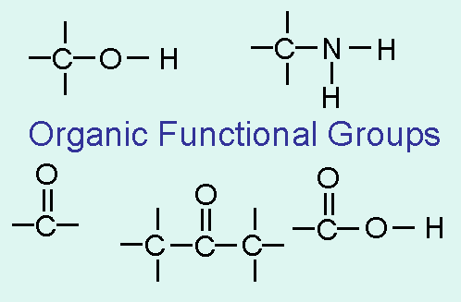
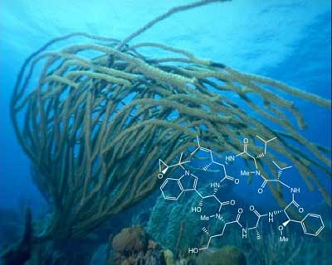
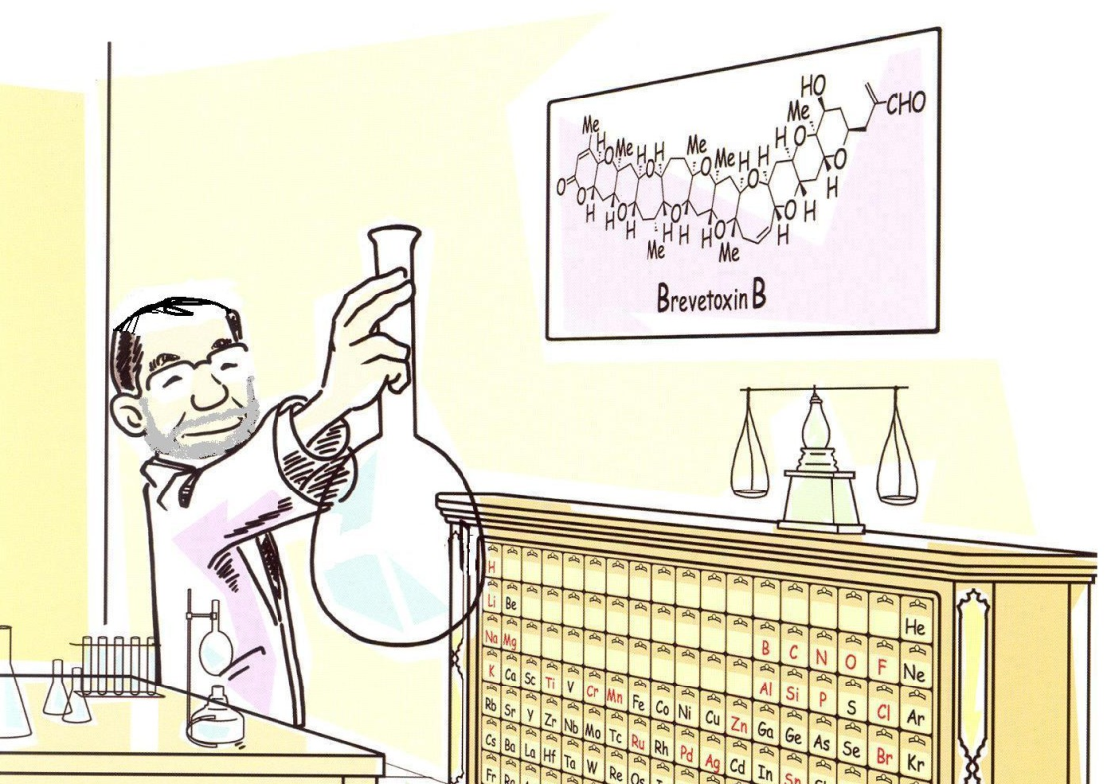
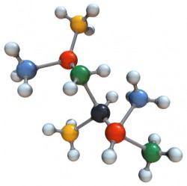
ORGANIC CHEMISTRY

Slide 2

8.2 Functional Groups
Groups of organic compounds such as alkanes, alkenes, alkynes, aromatics are called FUNCTIONAL GROUPS
It is an atom or a group of atoms that react in a characteristics manner (the same functional groups react in a similar manner)
General representation of a functional group = R
You don’t need to name all of them, but you MUST be able to identify the type of functional group

Slide 3
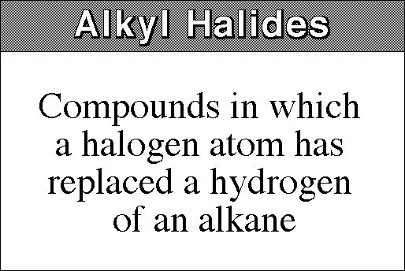
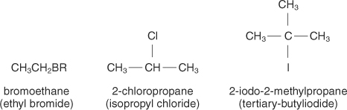
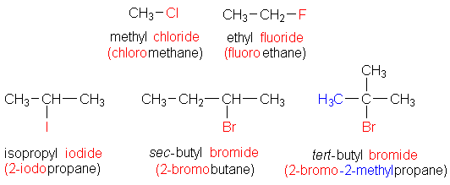
ALKYL HALIDES: R – X (X = Cl, Br, I, and F)
Must know how to NAME and IDENTIFY them

Slide 4
RULES FOR NAMING!
1. USE THE SAME RULES AS FOR ALKANES
2. Names for HALOGENS
HALOGEN | HALO GROUP
Fluorine | Fluoro
Bromine | Bromo
Chlorine | Chloro
Iodine | Iodo

Slide 5
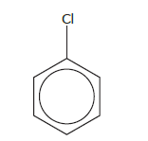
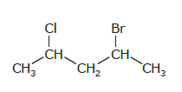
HALOGEN | HALO GROUP
Fluorine | Fluoro
Bromine | Bromo
Chlorine | Chloro
Iodine | Iodo

Slide 6
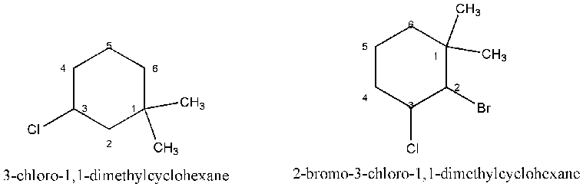

Slide 7
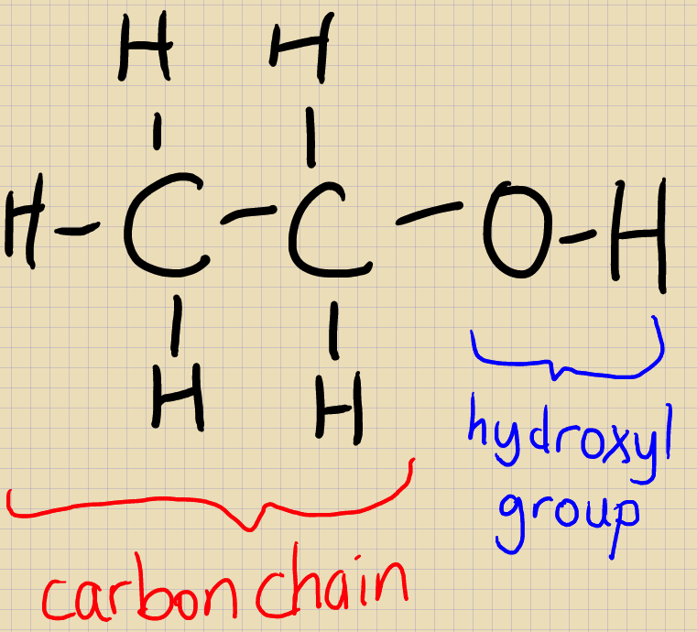
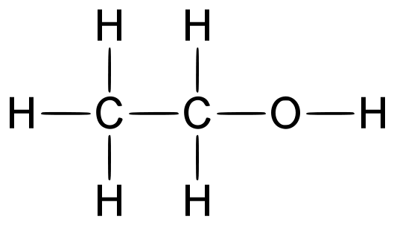
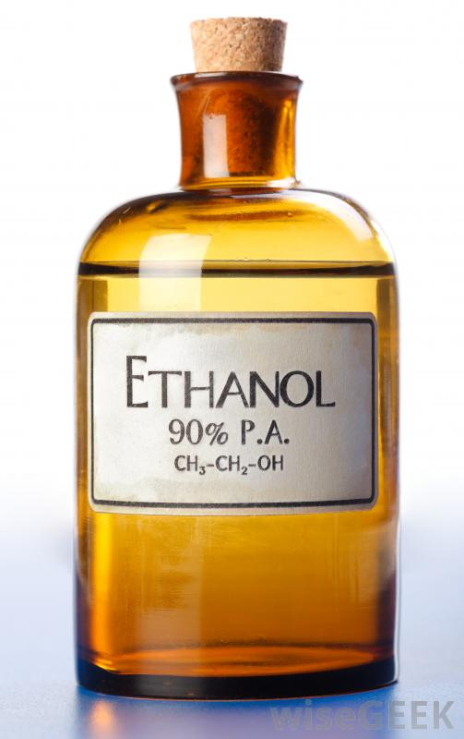
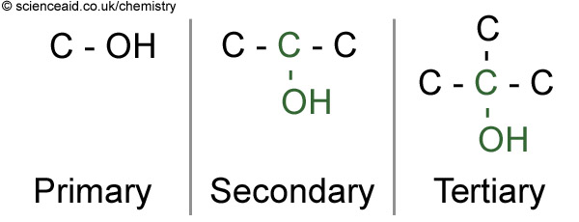
Alcohols: R – OH (OH = hydroxyl group)
Must know how to NAME and IDENTIFY them

Slide 8
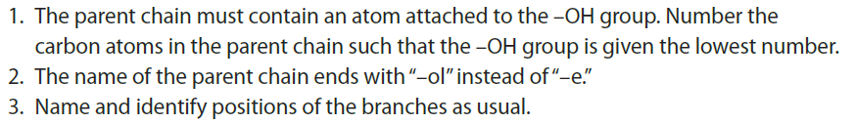
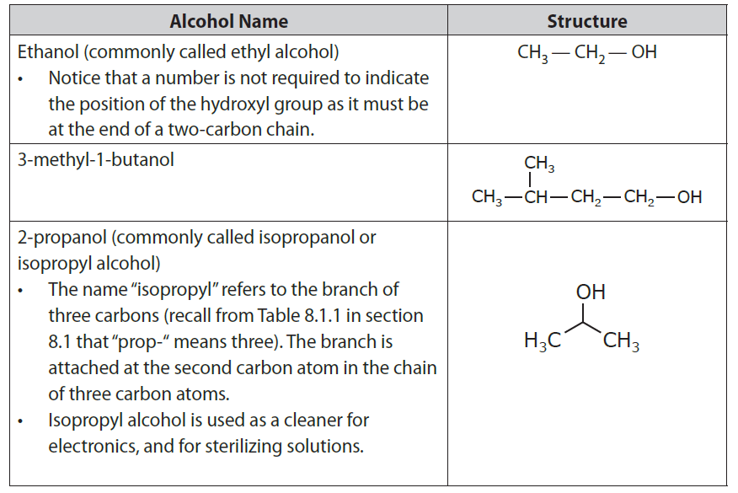
RULES FOR NAMING!

Slide 9
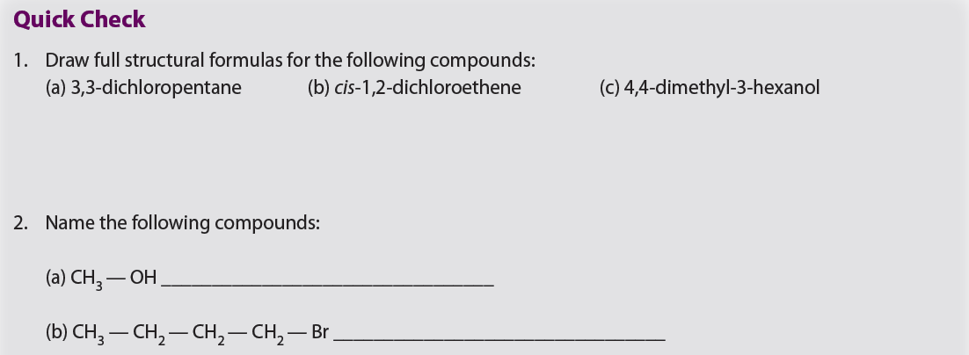


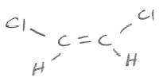
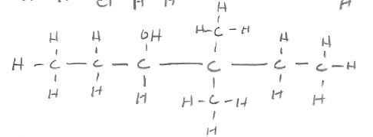


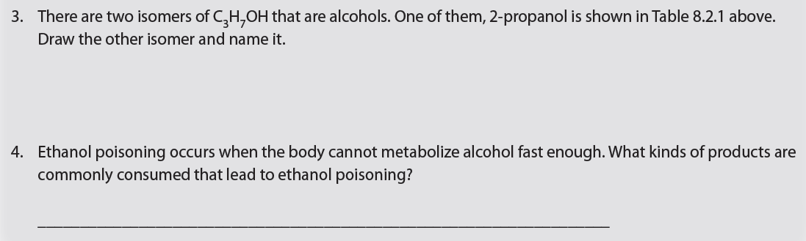


Slide 10
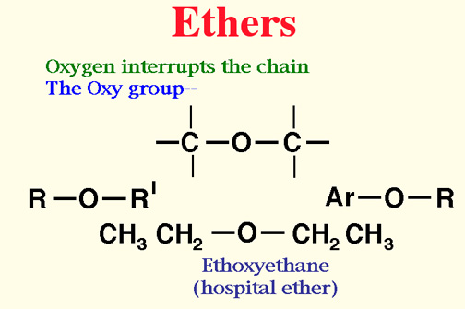
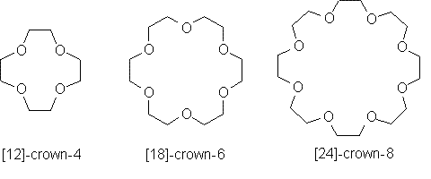
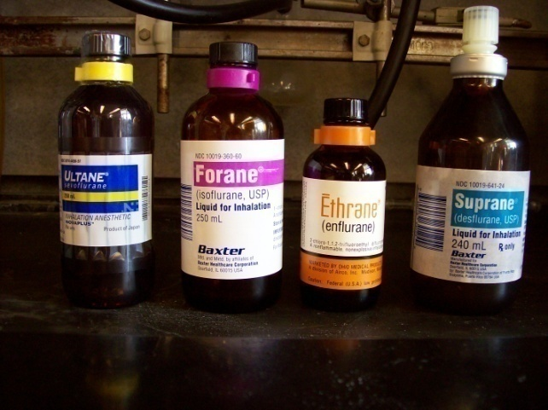
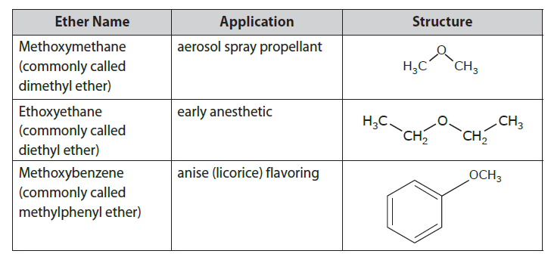
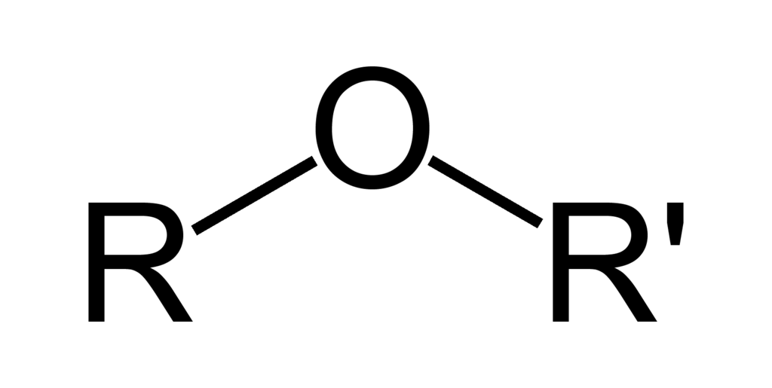
ETHERS: R – O – R’
Must know how to IDENTIFY them

Slide 11
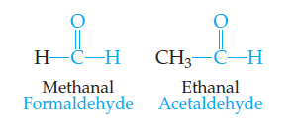
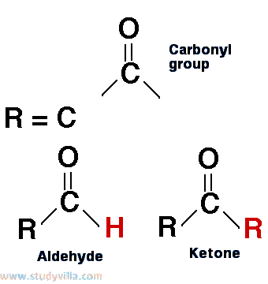
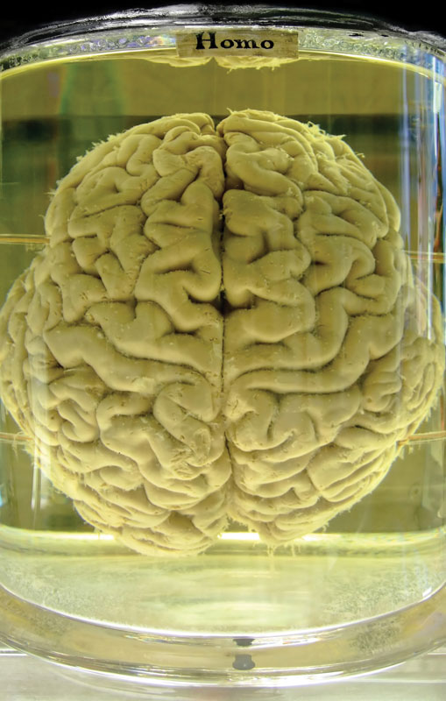

Aldehydes (contain carbonyl group)
Must know how to IDENTIFY them

Slide 12
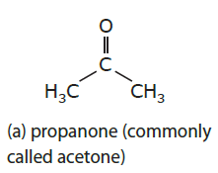
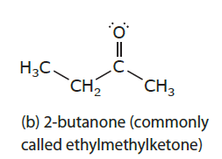
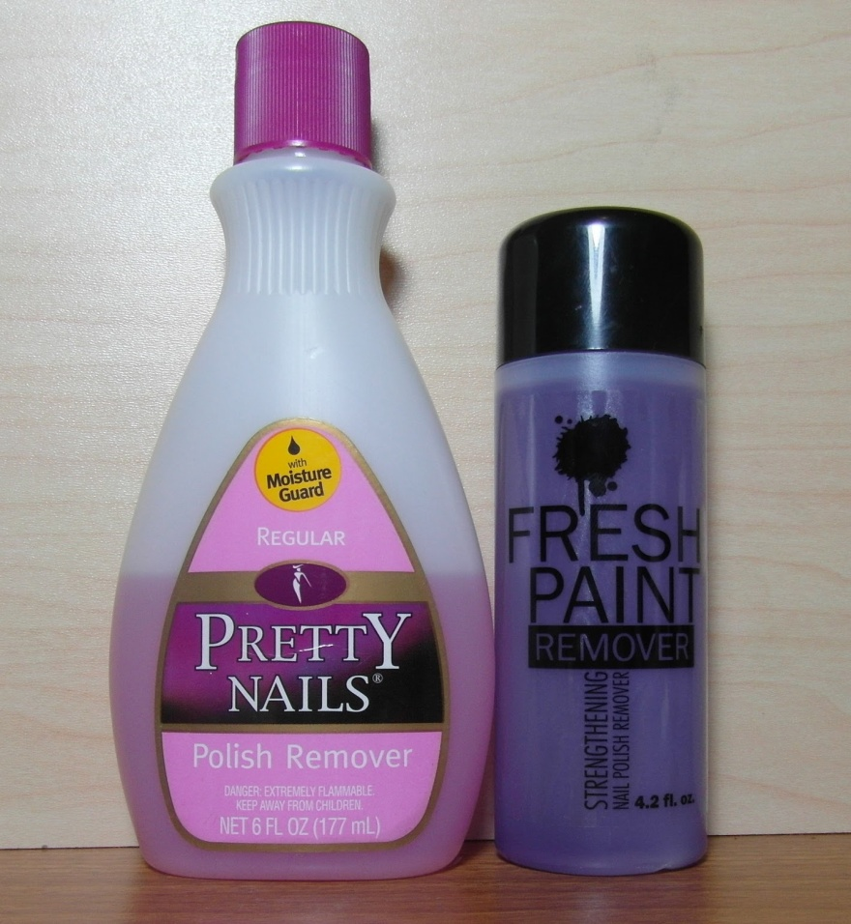
Ketones (contain carbonyl group)
Must know how to IDENTIFY them

Slide 13
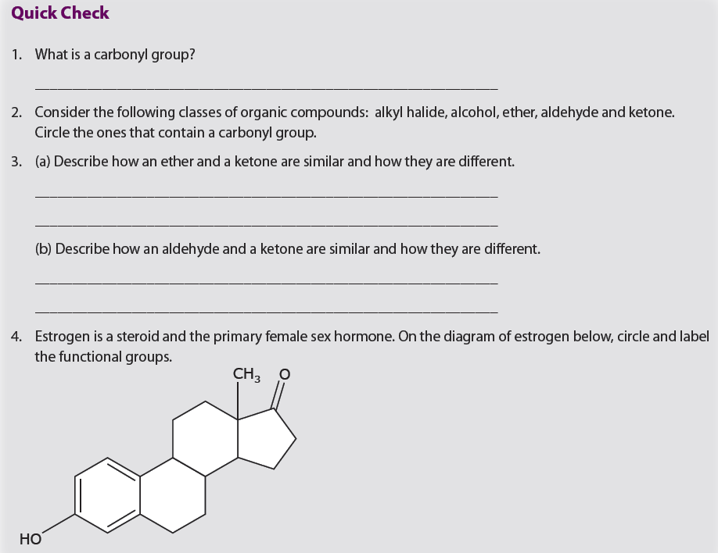
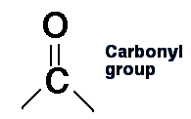
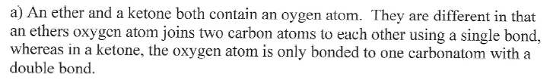
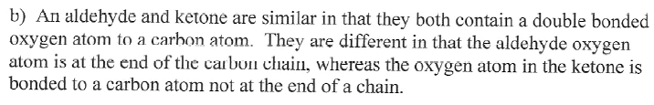
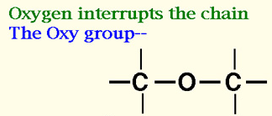
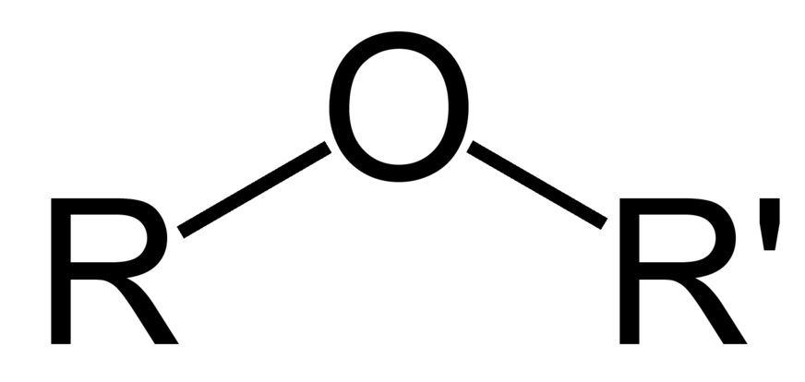

Slide 14
Ketones
Aromatics
Alcohol

Slide 15
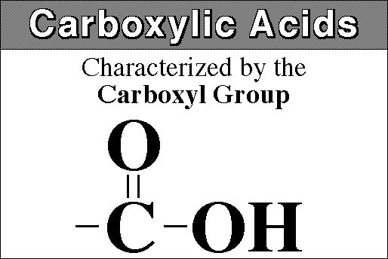
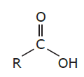
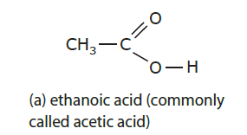
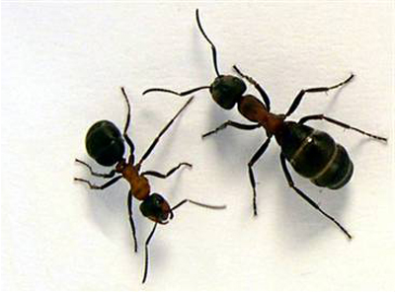
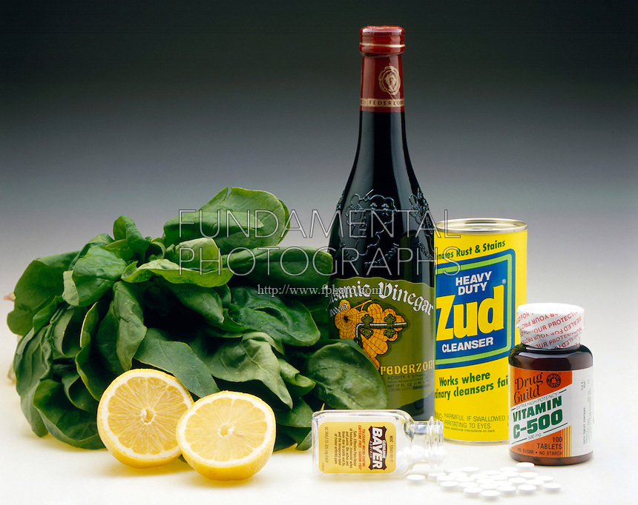
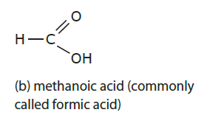
Carboxylic Acids (contain carboxyl group)
Organic acids
Must know how to IDENTIFY them

Slide 16
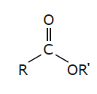
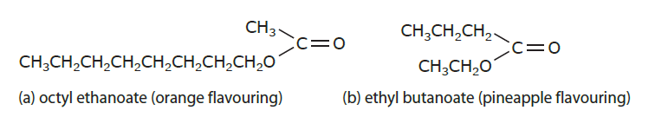
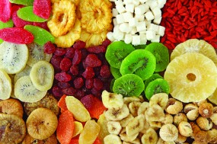
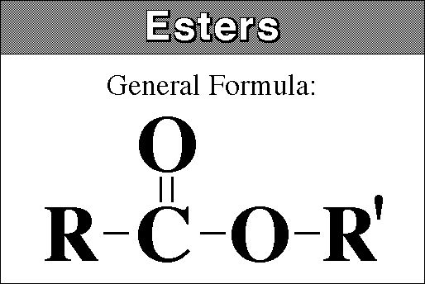
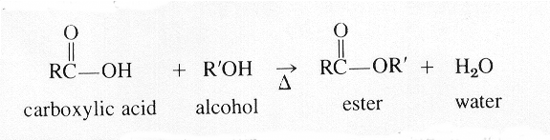
Esters
Used as flavoring agents, perfumes, DNA, explosives
Must know how to IDENTIFY them

Slide 17
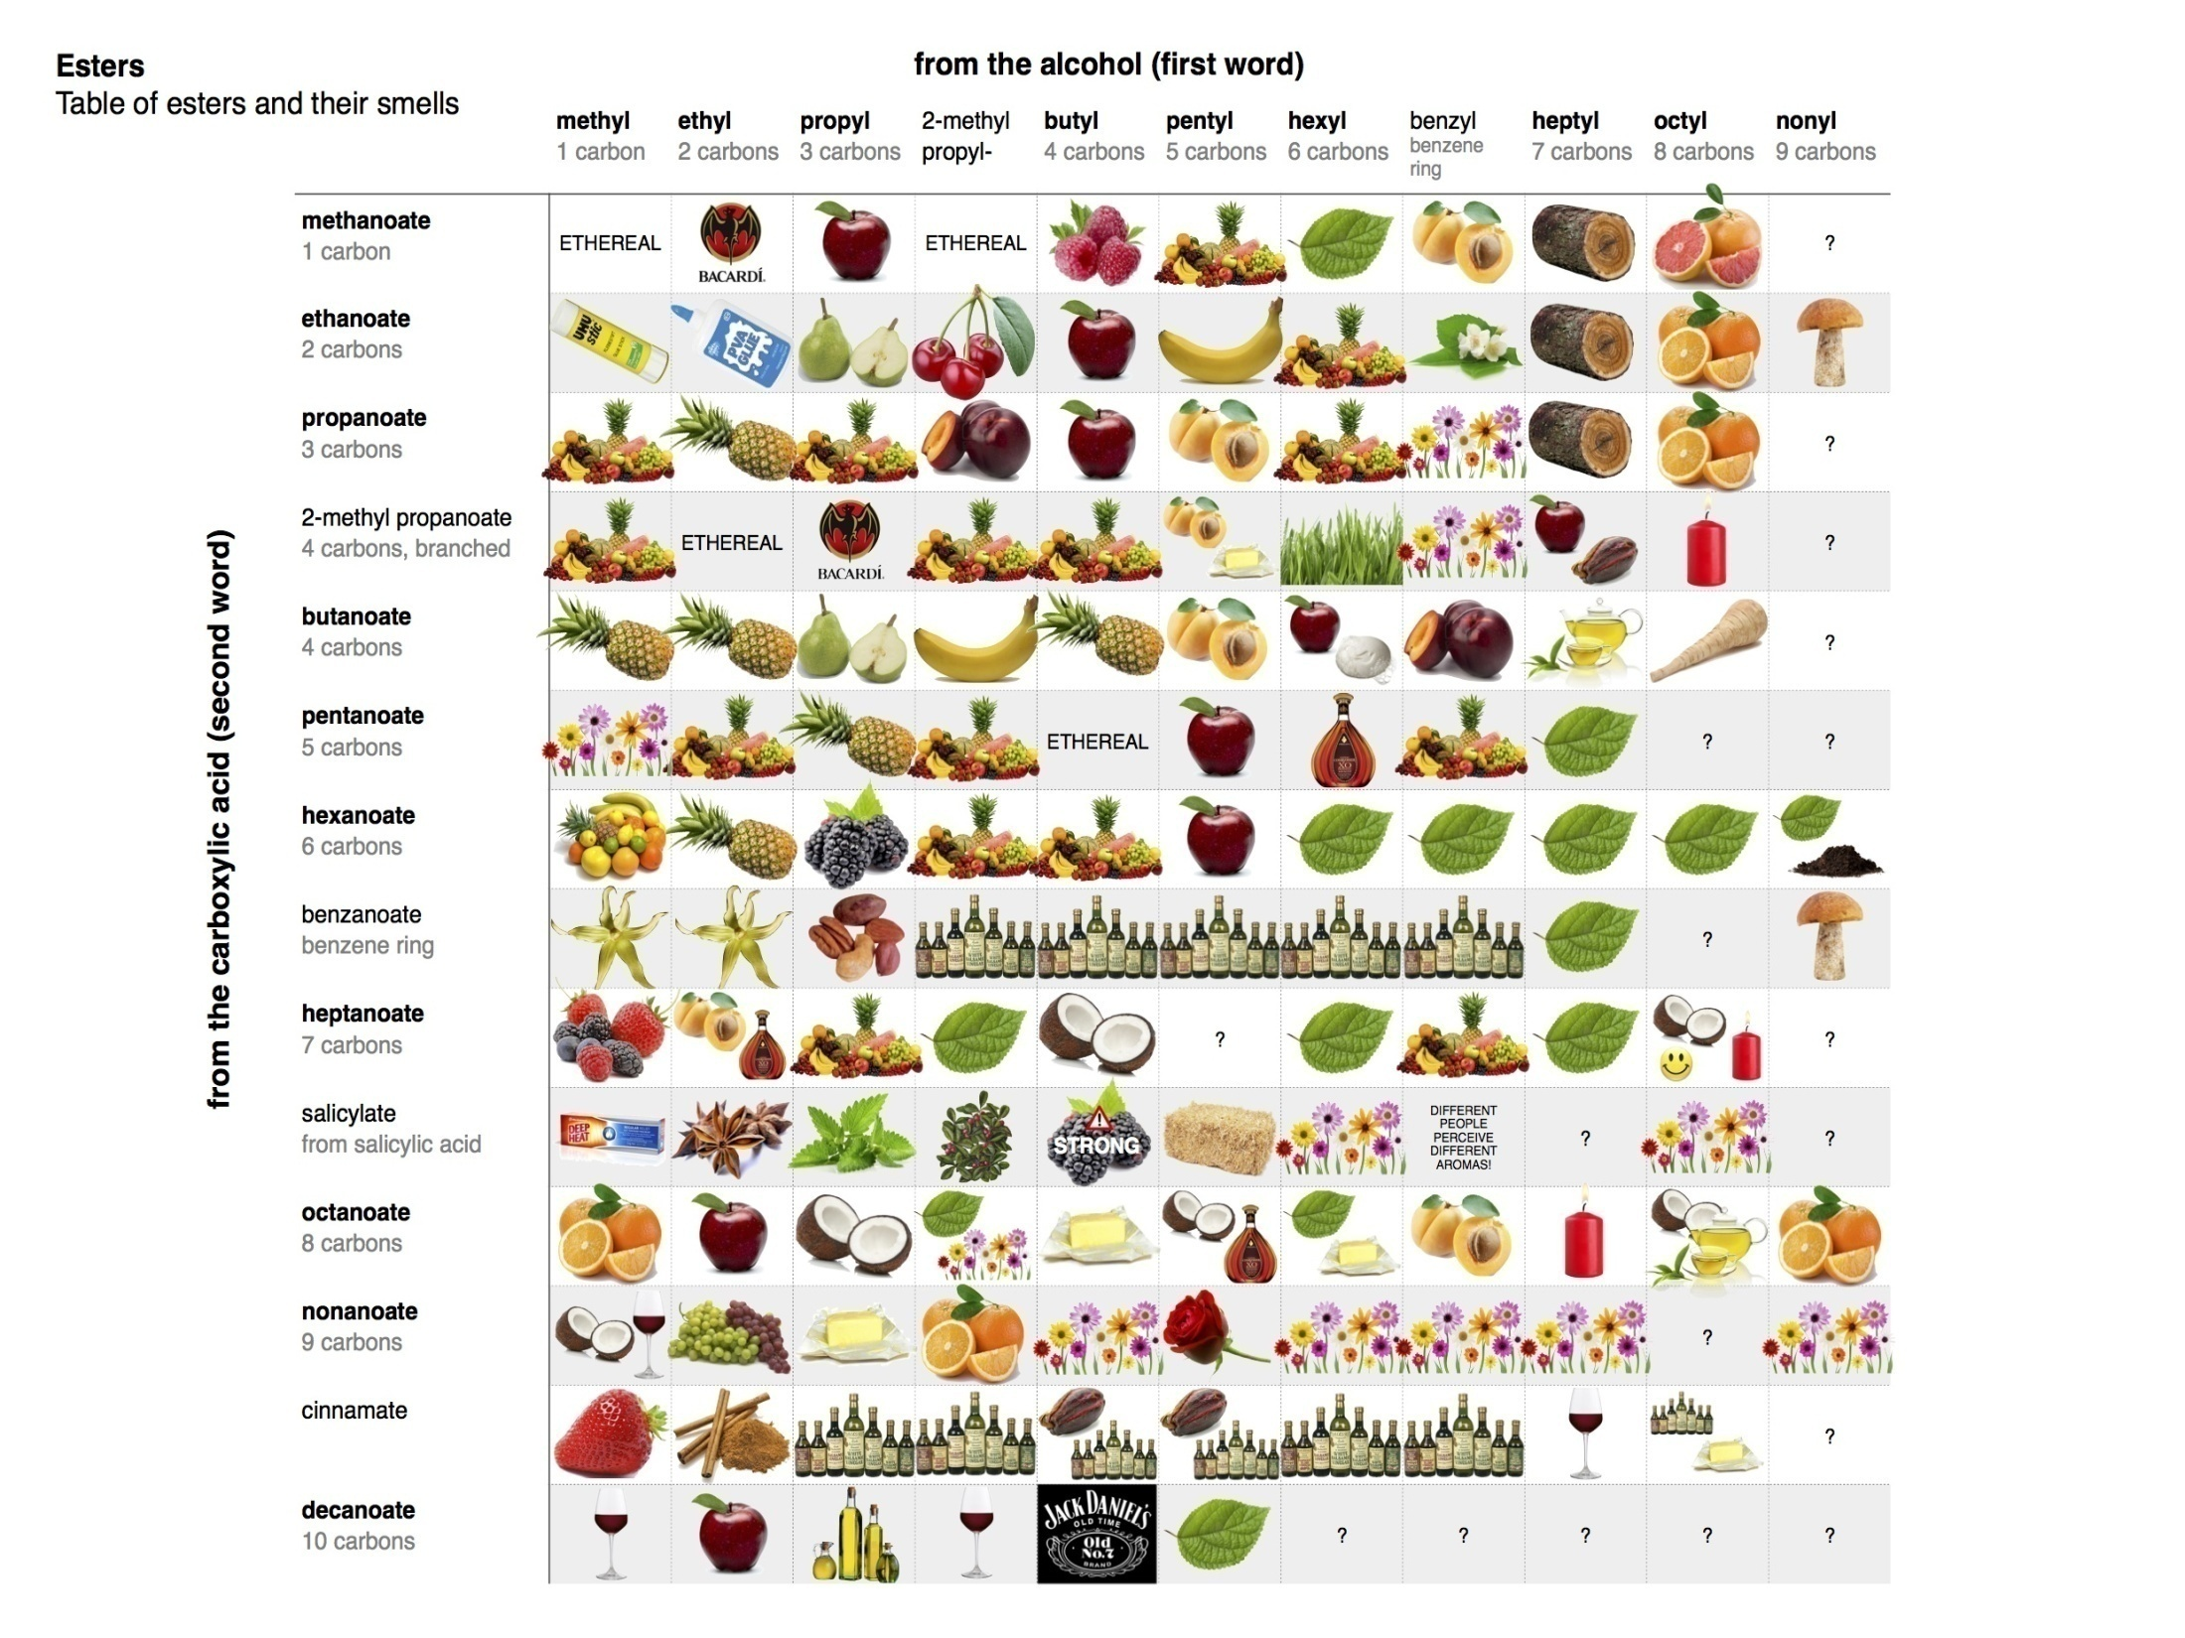
Esters
Use as flavoring agents, perfumes, DNA, explosives
Must know how to IDENTIFY them

Slide 18
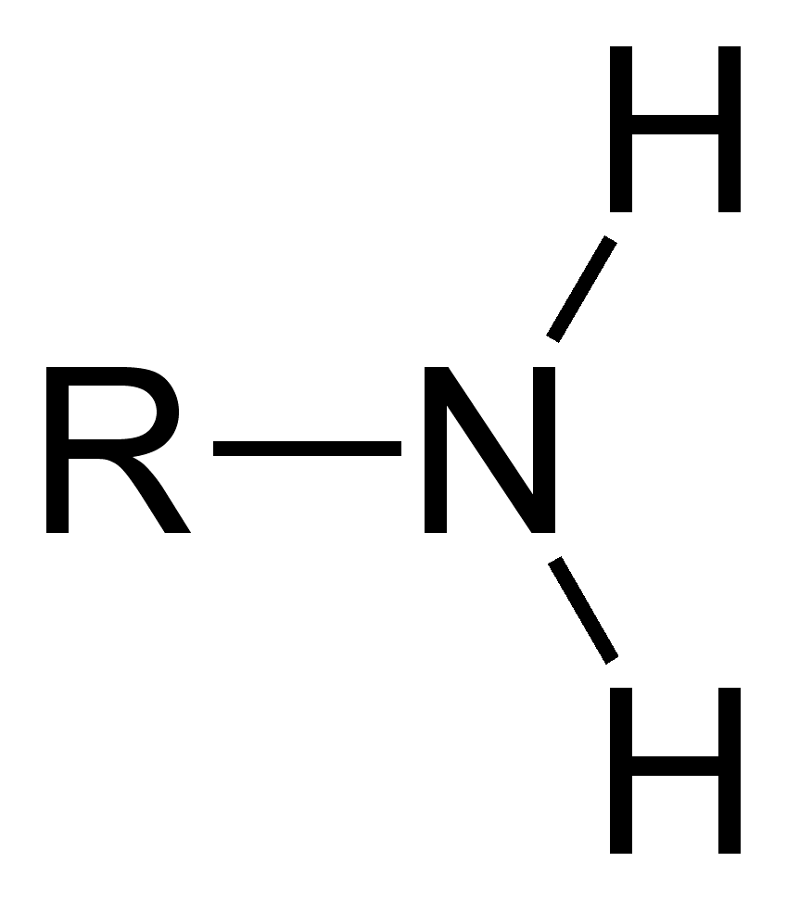





Amines
Must know how to IDENTIFY them
Used as drugs (antihistamines, decongestants) or dyes
Illegal drugs: ecstasy, crystal meth

Slide 19





Amides
Must know how to IDENTIFY them
Nitrogen bound to a carbonyl group
Used in plastics, rubber, nylon, Kevlar, acetaminophen, proteins

Slide 20



Amides
Must know how to IDENTIFY them
Nitrogen bound to a carbonyl group
Used in plastics, rubber, nylon, Kevlar, acetaminophen, proteins

Slide 21


Amides
Must know how to IDENTIFY them
Nitrogen bound to a carbonyl group
Used in plastics, rubber, nylon, Kevlar, acetaminophen, proteins

Slide 22




Slide 23

Carboxylic acid
Ester
Aromatic

Slide 24

Ester
Amine
Aromatic
Ester

Slide 25
HOMEWORK
Pages: 225
Problems: 17 - 20

