Slide 1
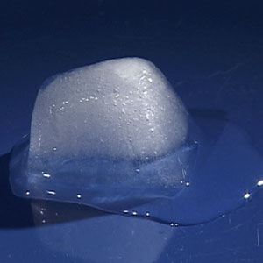
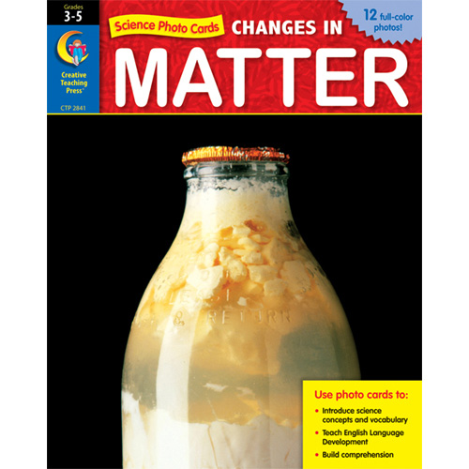
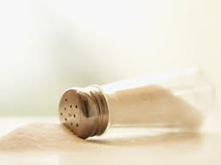
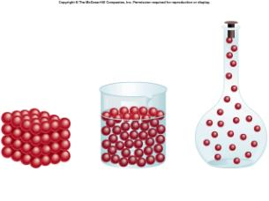
2.2 Classification of Matter
  Pages 73 - 85

Slide 2

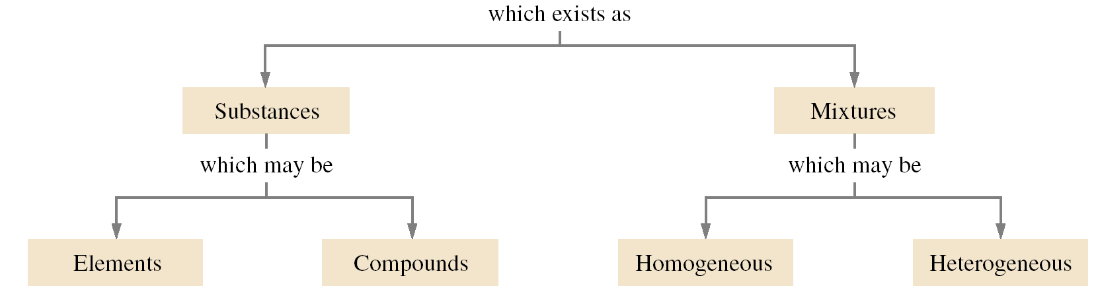
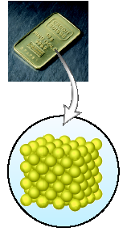
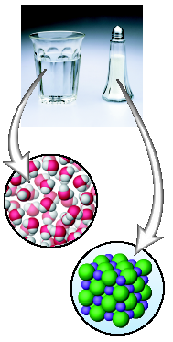
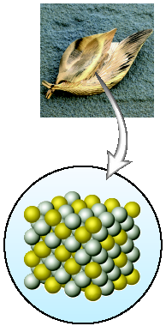
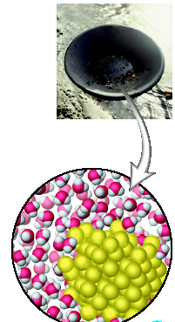
2.2 Classification of Matter

Slide 3
2.2 Classification of Matter

Slide 4

ATOMS
The atom is unit (a building block) of matter
It is the smallest possible unit of an element which retains the fundamental properties of the element

Slide 5
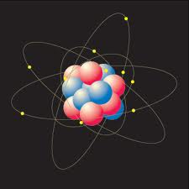
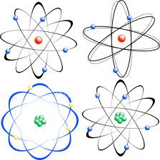
ATOMS
It consists of a dense central nucleus surrounded by a cloud of negatively charged electrons

Slide 6
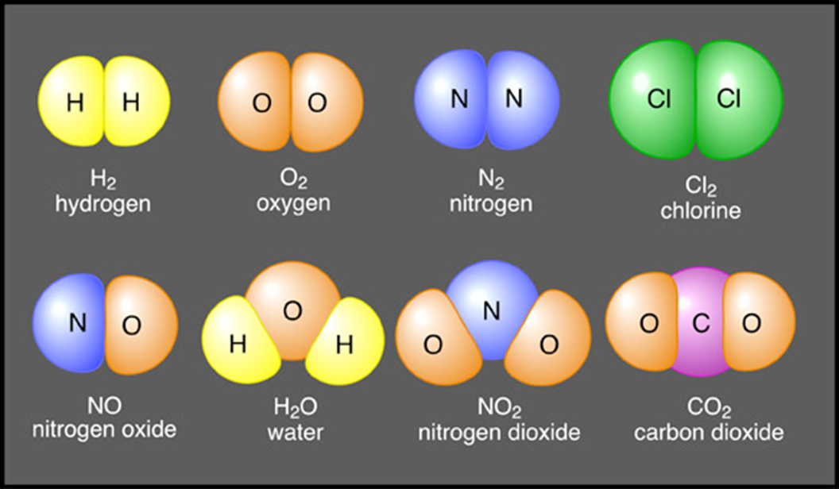
MOLECULES
A combination of two or more atoms in a definite arrangement held together by a covalent bond

Slide 7
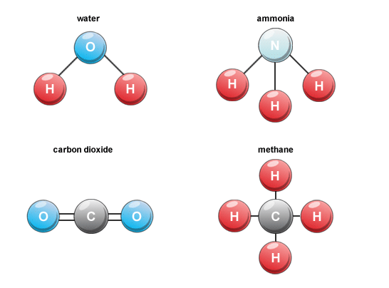
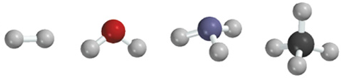
MOLECULES
A diatomic molecule contains only two atoms
A polyatomic molecule contains more than two atoms
H₂, N₂, O₂, Br₂, HCl, CO
O₃, H₂O, NH₃, CH₄

Slide 8
2.2 Classification of Matter

Slide 9
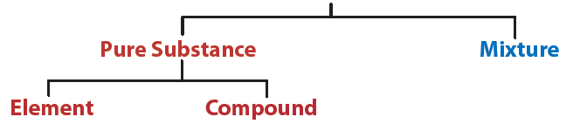
2.2 Classification of Matter

Slide 10
PURE SUBSTANCES

Slide 11
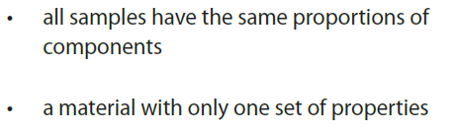
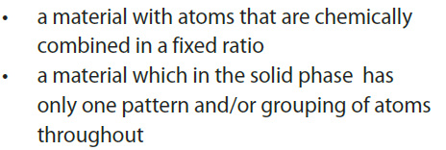
PURE SUBSTANCES

Slide 12
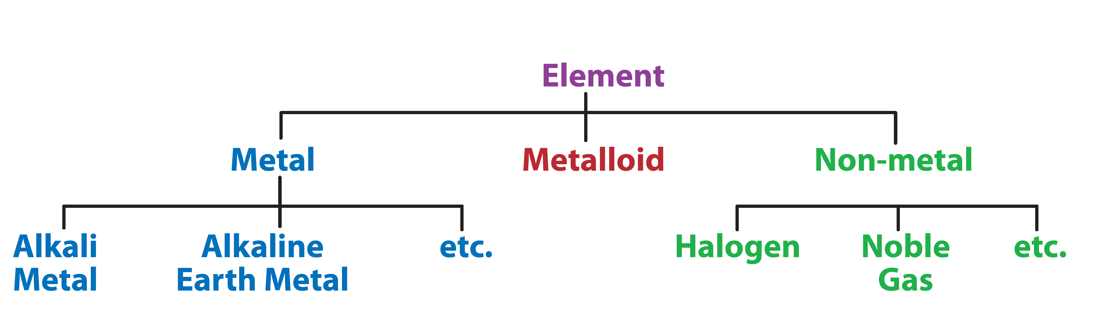
PURE SUBSTANCES - Elements

Slide 13
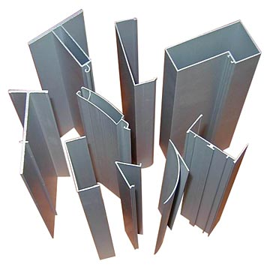
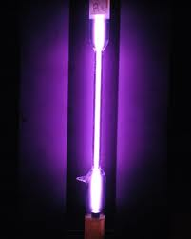
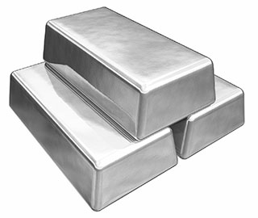
PURE SUBSTANCES - Elements
  Are made up of only ONE type of atom
  - Have a unique set of chemical and physical properties which are different than any other type of matter

Slide 14
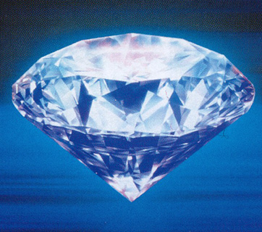

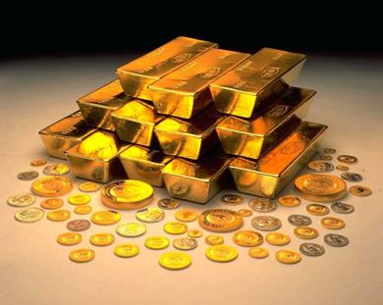
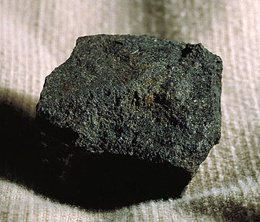
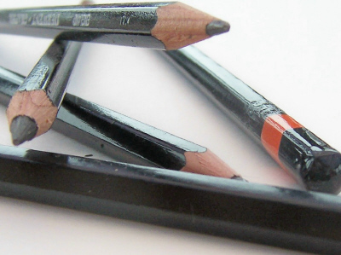
PURE SUBSTANCES - Elements
They CAN NOT be separated or decomposed into simpler substances by any physical OR chemical process.
Other examples:
Carbon
Helium
Gold
Copper
Aluminum

Slide 15
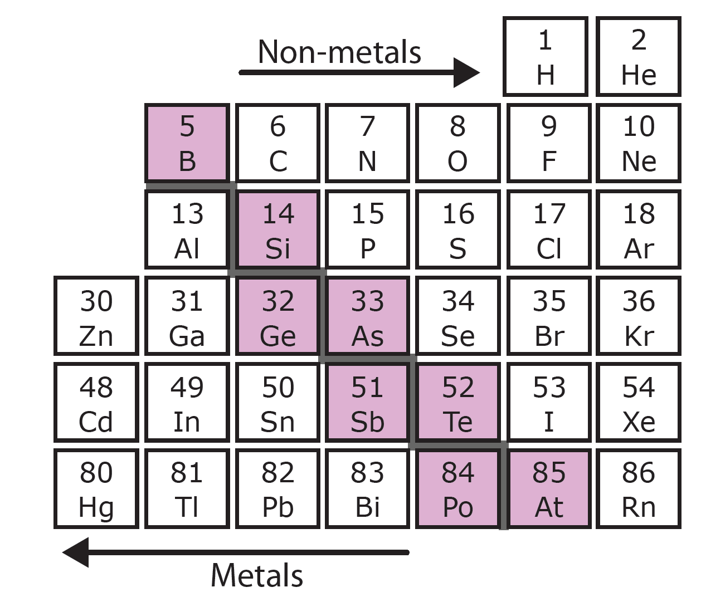
PURE SUBSTANCES - Elements
  Metals
  Non-metals
  Metalloids

Slide 16
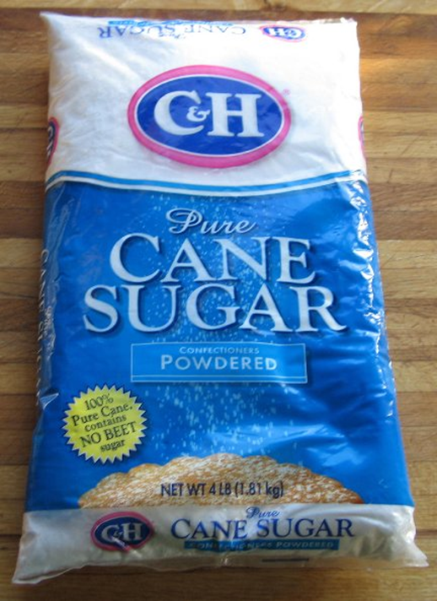
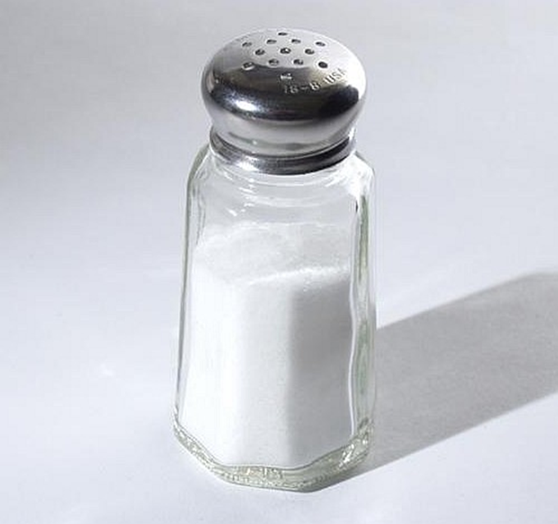
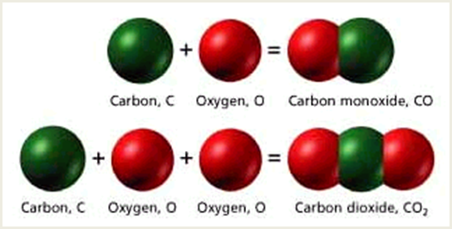
PURE SUBSTANCES - Compounds
Examples:
Carbon Dioxide (CO₂)
Water (H₂O)
Salt (NaCl)
Sucrose (C₁₂H₂₂O₁₁)

Slide 17
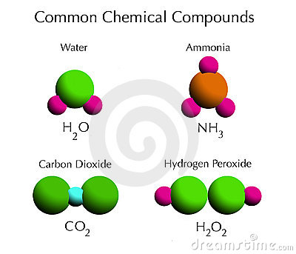
COMPOUNDS
They are created when 2 or more atoms are bonded together in a fixed proportion.

Slide 18
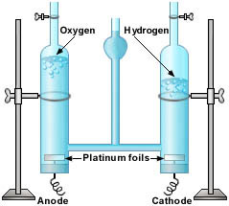
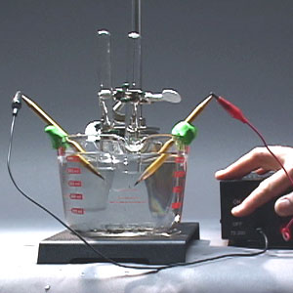
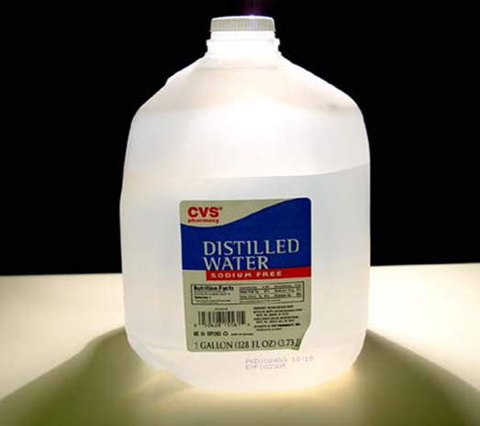
COMPOUNDS
  CAN be decomposed into simpler substances but only by chemical reactions/processes (heat or electricity)
They cannot be decomposed or separated by any physical process.
Water can be separated into Hydrogen and Oxygen by a process called Electrolysis.

Slide 19
COMPOUNDS
  2H₂0 (l) → 2H₂ (g) + O₂ (g)
They cannot be decomposed or separated by any physical process.
Water can be separated into Hydrogen and Oxygen by a process called Electrolysis.

Slide 20
COMPOUNDS
  Organic vs. Inorganic
  Binary vs. Non – Binary
  Ionic vs. Covalent
  Acids vs. Bases vs. Salts

Slide 21
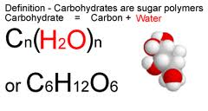
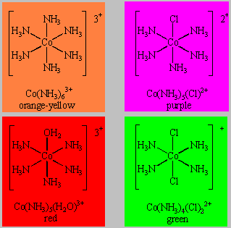
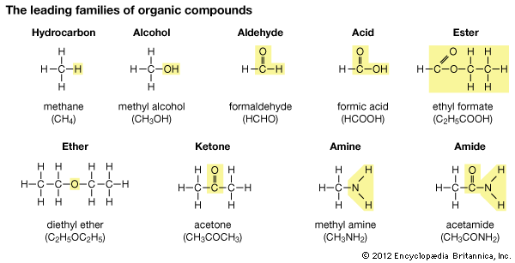
  Organic vs. Inorganic

Slide 22
  Binary vs. Non – Binary

Slide 23
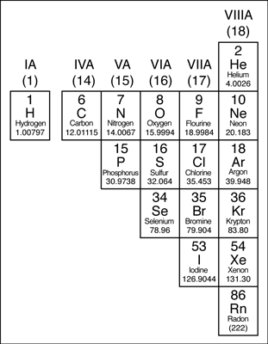
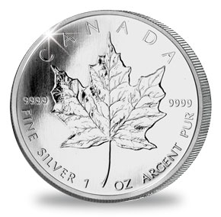
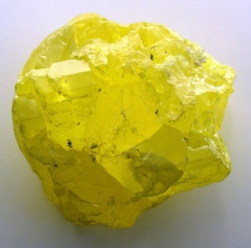
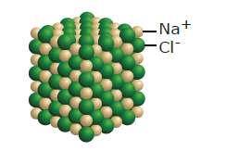

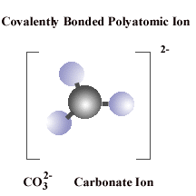
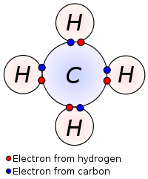
  Ionic vs. Covalent
metal
nonmetal
metal
polyatomic
ion

Slide 24
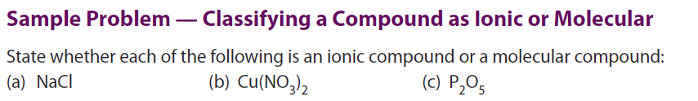
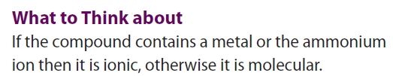

Slide 25
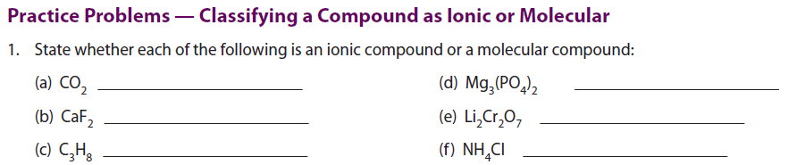
molecule
Ionic c.
Ionic c.
Ionic c.
molecule
Ionic c.

Slide 26
  Acids vs. Bases vs. Salts
Acids
Bases
Salts
HCl, H₂SO₄
HF, HNO₃
NaOH, Ca(OH)₂
KOH, NH₄OH
Produce H⁺
Produce OH⁻

Slide 27
Salts are a class of ionic compounds that can be produced when an acid and a base react
What are salts?
HA + BOH → BA + H₂O
acid + base → salt + water

Slide 28
A salt is made up of a positive ion
from a base and a negative ion from an acid.
HA + BOH → BA + H₂O
acid + base → salt + water
HCl + KOH→ KCl + H₂O

Slide 29
A salt is made up of a positive ion
from a base and a negative ion from an acid.
HA + BOH → BA + H₂O
acid + base → salt + water
Acid – Base Neutralization

Slide 30
  Acids vs. Bases vs. Salts
Acids
Bases
Salts
HCl, H₂SO₄
HF, HNO₃
NaOH, Ca(OH)₂
KOH, NH₄OH
NaCl, CaCl₂
KF
Produce H⁺
Produce OH⁻
Produced from ions of acids and bases

Slide 31
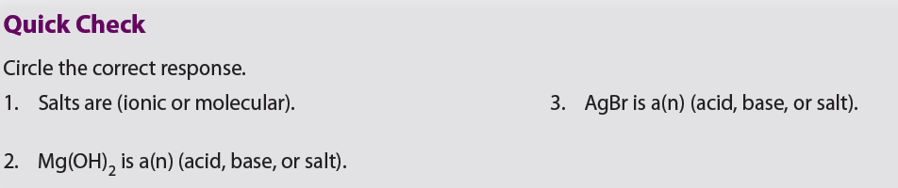
1. Ionic compounds
2. Salt
3. Salt

Slide 32
2.2 Classification of Matter
Two or more pure substances mixed together
Each substance in the mixture retains its own set of chemical and physical properties

Slide 33
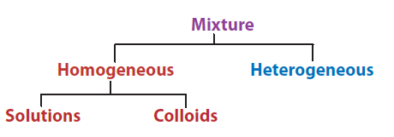
2.2 Classification of Matter

Slide 34
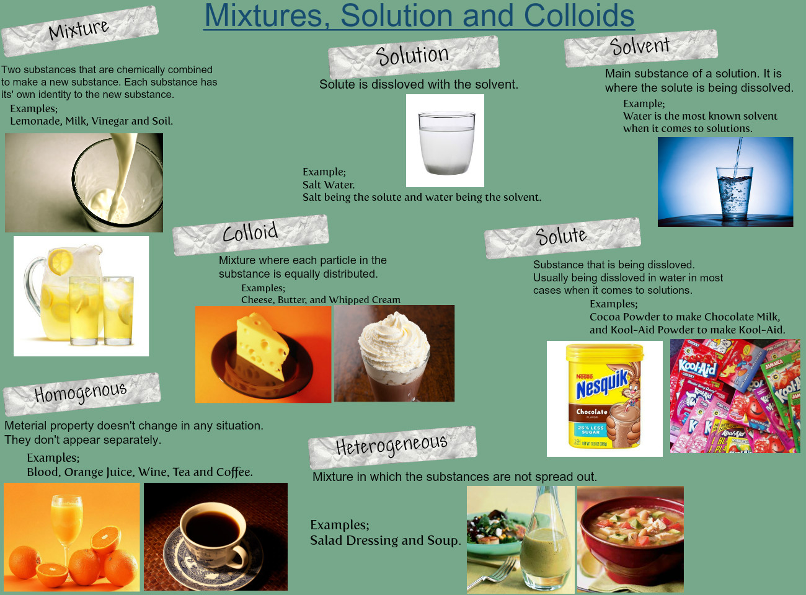

Slide 35
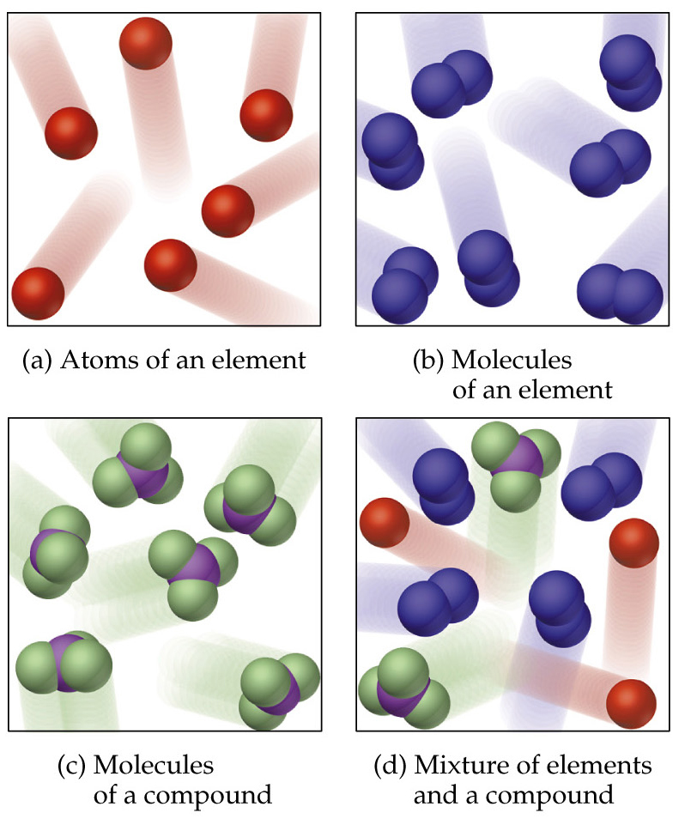
Pure Substances and Mixtures

Slide 36
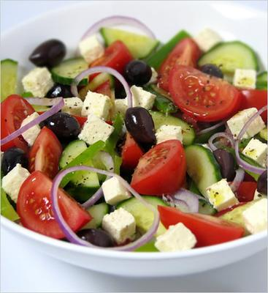



Two Types Of Mixtures

Slide 37


Slide 38




Homogeneous Mixtures
One substance is dissolved in another creating a substance that looks like one substance!
  Sugar in hot coffee
  Oxygen in the air
  Alloys (2 metals mixed)
  Milk
COLLOIDS
SOLUTIONS

Slide 39

SOLUTIONS
A type of homogenous mixture that appears the same throughout
Salt water contains salt and water, but they are mixed all the way to the atomic level

Slide 40


SOLUTIONS
Particles are < 1 nm

Slide 41


SOLUTION
Can be produced from materials in different phases
solid
solid
Solution (alloy)
Copper and Zinc can be mixed together to produce brass

Slide 42
SOLUTION
Even though it may look different, it is still copper and zinc.
Each metal retains its own properties like melting or boiling point.
Can You Name Another Alloy?

Slide 43


SOLUTION
Can be produced from materials in different phases
solid
Liquid
(H₂O)
Solution
(aqueous)

Slide 44


SOLUTION
Can be produced from materials in different phases
gas
gas
Solution
(air)

Slide 45


SOLUTION
Can be produced from materials in different phases
liquid
liquid
Solution
(amalgam)

Slide 46

SOLUTION

Slide 47

SOLUTION
SOLUTE
SOLVENT
A minor component of a mixture
It is what has been dissolved
A major component of a mixture
It is what the solute was dissolved in

Slide 48


Solvent and Solute
Identify SOLUTE and SOLVENT in each of these

Slide 49



Homogeneous Mixtures
COLLOIDS
Particles are between 1 nm and 1 μm
They are dispersed throughout a medium
Particles can be in a different phase than medium

Slide 50



Colloids
Particles
Medium
Solid
Solid (grains)
Liquid
Gas
Liquid(droplets)
Gas(bubbles)

Slide 51

Colloids

Slide 52

How Do You Know If You Have a Solution or Colloid?

Slide 53




TYNDALL EFFECT

Slide 54




Heterogeneous Mixtures
Uneven (non – uniform) distribution of substances (not the same throughout)
More than one phase and each phase has different properties
At least some particles are larger than 1 μm
Sand
Granite
Silt in Water

Slide 55


Slide 56

one that appears the same throughout
solute, solvent
dispersed phase, continuous or dispersion medium

Slide 57
CLASSWORK/HOMEWORK
Worksheets
Review Questions: all even

Slide 58
QUIZ
Two days from now

