Slide 1
2.3 Separating Mixtures (Physically)
Mechanical Means of Separation
vs.
Non - Mechanical Means of Separation
Using gravity, contact forces, motion…
Using heat, magnetism, electricity, dissolving the mixture’s components…
Picking, filtering, shaking, spinning, pouring
Dissolving, boiling, melting,

Slide 2
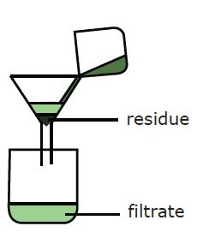
Mechanical Means of Separation
Density Separation
Decanting:
Pouring of a liquid, leaving a sediment behind
Filtration:
The mixture is poured into a folded piece of a filter paper in a funnel

Slide 3
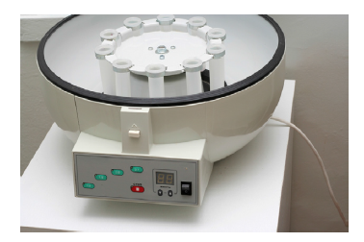
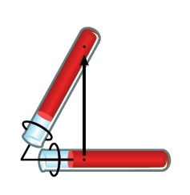
Mechanical Means of Separation
Density Separation
Centrifugation:
Spinning of a mixture enhances density separation

Slide 4
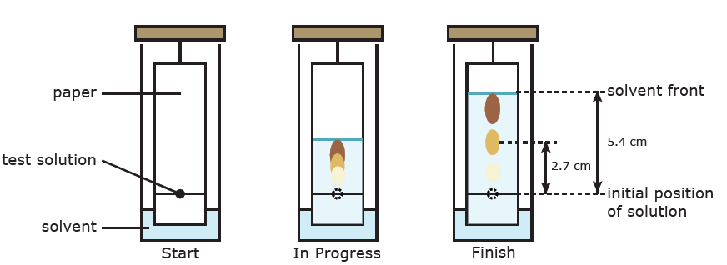
NON - Mechanical Means of Separation
Chromatography
Separates the substances in a solution

Slide 5
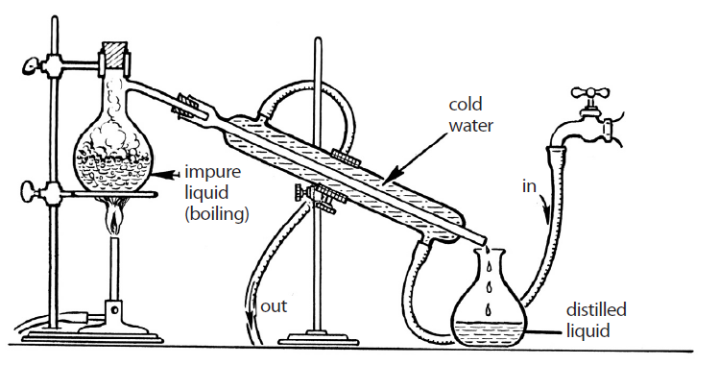
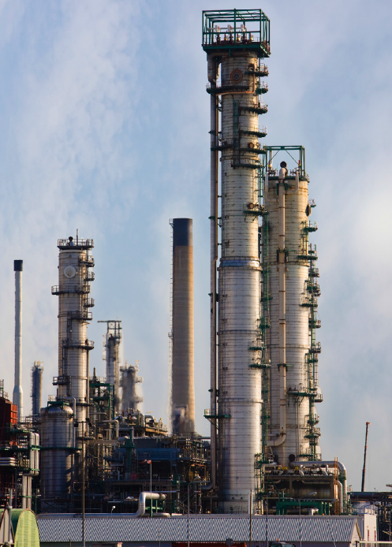
NON - Mechanical Means of Separation
Chromatography
distillation
Separates the substances in a solution
Separates the substances in a solution based on their different boiling points or vapour pressures

Slide 6
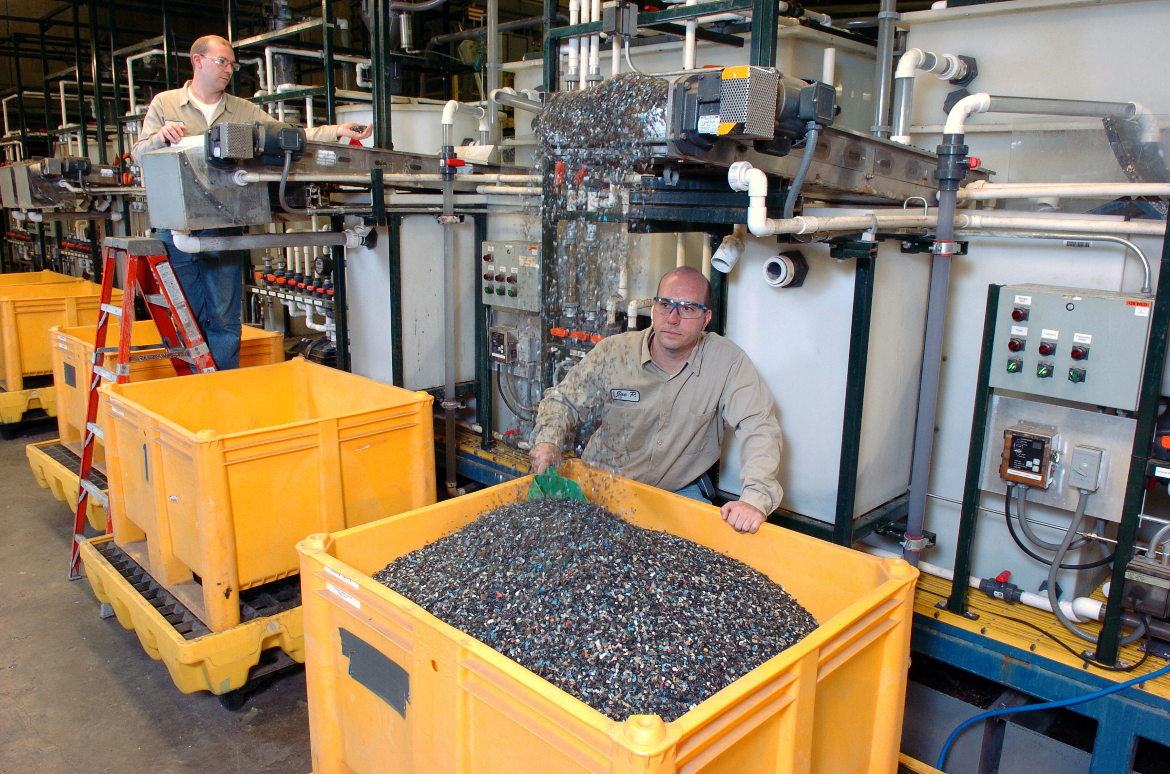
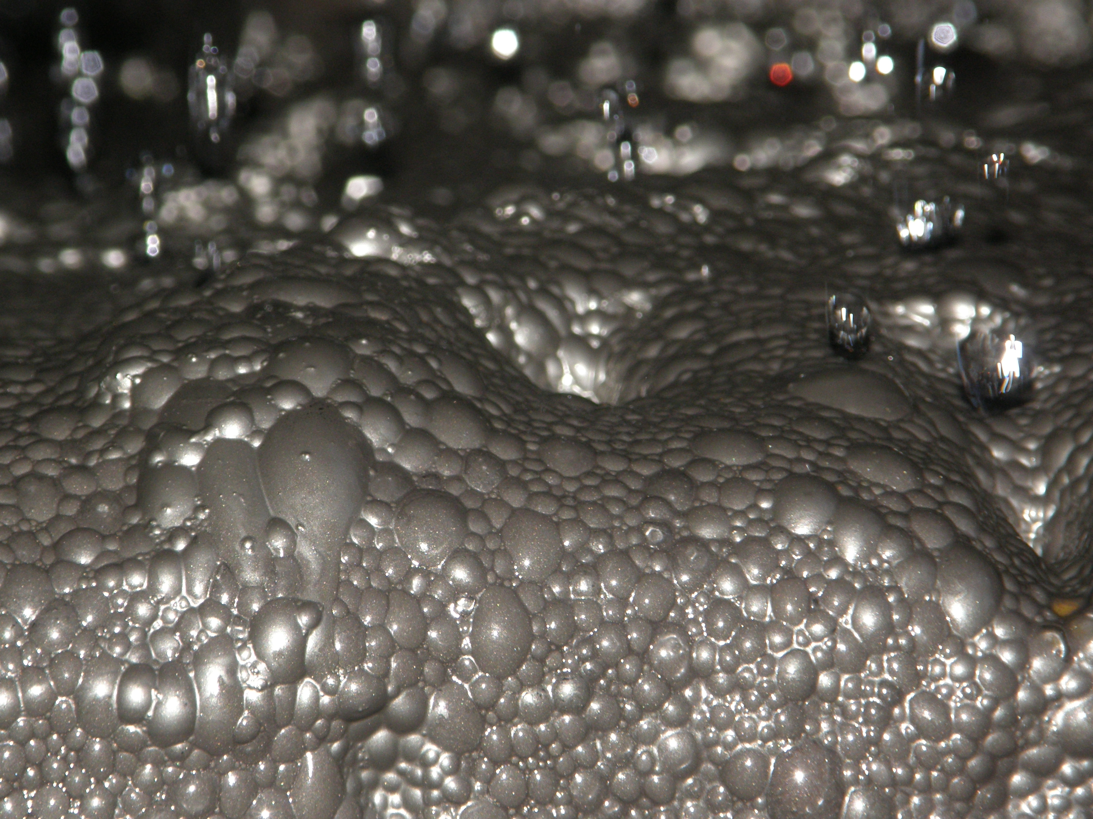
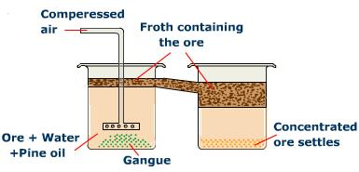
NON - Mechanical Means of Separation
Froth Flotation
Separates minerals (e.g. copper compounds) from a mixture of minerals in an ore (also for wastewater treatment, paper recycling)

Slide 7
CLASSWORK/HOMEWORK
Read: 86 - 92
Worksheets
2.3 Review Questions: 1, 4, 6, 8 - 17

Slide 8
QUIZ
Two days from now
It will include Chapters 2.1, 2.2 and 2.3

