Slide 1
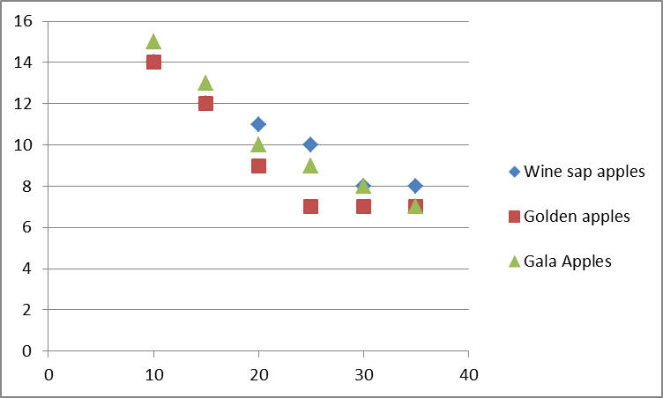
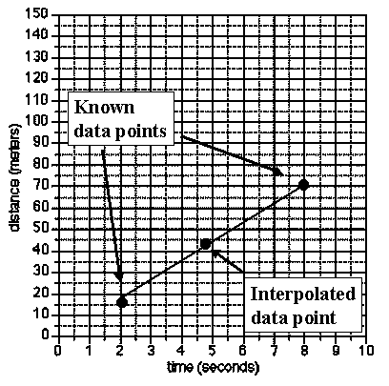
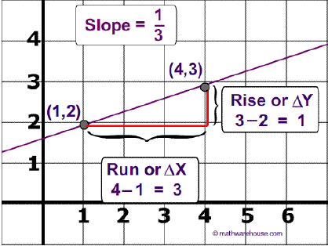
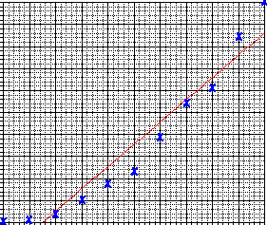
1.2 CONTINUED....
Drawing and Interpreting Graphs

Slide 2
Drawing and Interpreting Graphs
Scientific Graphs:
Most scientific graphs are made as line graphs.
The lines on scientific graphs are usually drawn either straight or curved. These lines do not have to touch all the data points, but they should at least get close to most of them.
These lines are called the best-fit lines.

Slide 3
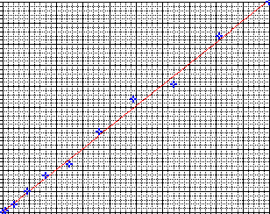
Drawing and Interpreting Graphs
Here are two examples of best-fit graph lines. One is drawn correctly, the other is not.
Best-Fit Line #1 | Best-Fit Line #2

Slide 4
Drawing and Interpreting Graphs
WHICH GRAPH IS DRAWN CORRECTLY???
Best-Fit Line #1 | Best-Fit Line #2

Slide 5
Drawing and Interpreting Graphs
Scientific Graphs:
Independent and Dependant variables

Slide 6
Drawing and Interpreting Graphs
Time (min) | Mass (grams)
0 | 2.5
1 | 4.7
2 | 5.6
3 | 6.9
4 | 7.3
5 | 8.9
6 | 9.5
Mass (grams)
Time (min)
This is data I obtained when I performed a certain chemical reaction. I observed and measured the change in mass of a chemical during 6 minutes.

Slide 7
Drawing and Interpreting Graphs
Time (min) | Mass (grams)
0 | 2.5
1 | 4.7
2 | 5.6
3 | 6.9
4 | 7.3
5 | 8.9
6 | 9.5
Mass (grams)
Time (min)
What is the dependant and what is the independent variable?

Slide 8
Drawing and Interpreting Graphs
Time (min) | Mass (grams)
0 | 2.5
1 | 4.7
2 | 5.6
3 | 6.9
4 | 7.3
5 | 8.9
6 | 9.5
Mass (grams)
Time (min)
independent variable:
it is controlled by the experimenter (a person who does the experiment)
dependent variable:
it changes with the independent variable

Slide 9
Drawing and Interpreting Graphs
Time (min) | Mass (grams)
0 | 2.5
1 | 4.7
2 | 5.6
3 | 6.9
4 | 7.3
5 | 8.9
6 | 9.5
Mass (grams)
Time (min)
independent variable:
Time (goes on x – axis)
dependent variable:
Mass (goes on y – axis)

Slide 10

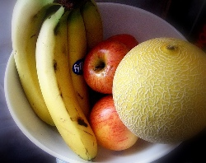
Graphing Practice Problem #1
Ethylene (C₂H₄) is a plant hormone that causes fruit to mature. The data above concerns the amount of days (from the spraying until maturity of the fruit) versus the amount of ethylene that was used .
1.) Make a graph of the data
2.) What is the dependant variable?
3.) What is the independent variable?

Slide 11
Graphing Practice Problem #1
Number of days = dependent variable
Amount of ethylene = independent variable

Slide 12
Drawing and Interpreting Graphs
Scientific Graphs:
Extrapolation
and
Interpolation

Slide 13
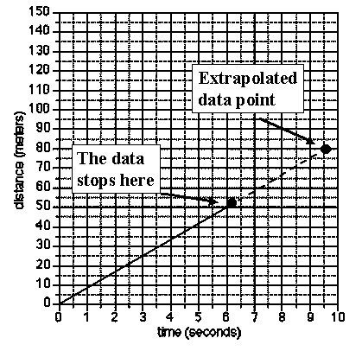
Extrapolation and Interpolation
Graphs are a useful tool in science
Graphs can "predict" data which are not measured

Slide 14
Extrapolation and Interpolation
Extrapolation: extending the graph, along the same slope, above or below measured data.

Slide 15
Extrapolation and Interpolation
Interpolation: predicting data between two measured points on the graph.

Slide 16
Graphing Practice Problem #2
The volume of a gas decreases as the temperature of the gas decreases. A sample of a gas was collected at 100 degrees Celsius and then cooled down. The changes in the volume of the sample are shown below...
1.) Make a graph of the data
2.) Make a second graph which will allow you to extrapolate data to reach a gas volume of 0 ml.
3.) The temperature at which the volume of the gas reaches zero is the theoretical temperature of Absolute Zero. From this graph, what is the Celsius Temperature for Absolute Zero Volume?

Slide 17
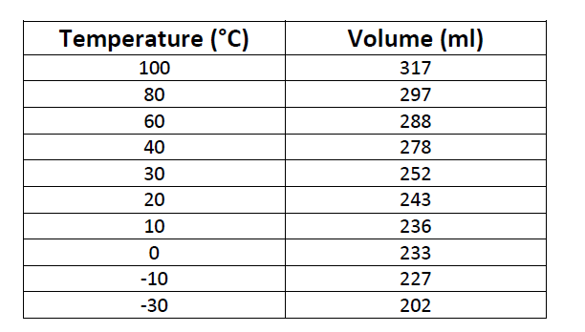
The volume of a gas decreases as the temperature of the gas decreases. A sample of a gas was collected at 100 degrees Celsius and then cooled down. The changes in the volume of the sample are shown below...
1.) Make a graph of the data
2.) Make a second graph which will allow you to extrapolate data to reach a gas volume of 0 ml.
3.) The temperature at which the volume of the gas reaches zero is the theoretical temperature of Absolute Zero. From this graph, what is the Celsius Temperature for Absolute Zero Volume?

Slide 18
V (mL)
T (˚C)

Slide 19
V (mL)
T (˚C)

Slide 20
V (mL)
≈ -270 ˚C
T (˚C)

Slide 21
Drawing and Interpreting Graphs
Slope of The Line

Slide 22
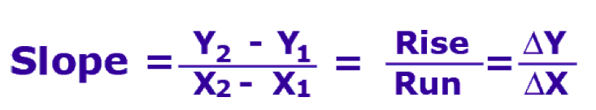
Slope of the line

Slide 23
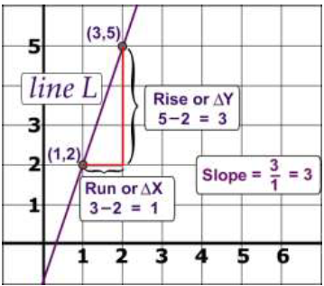
Slope of the line
What is the rise?
What is the Run?
What is the slope?
Is this a positive or negative slope?

Slide 24
Slope of the line
What is the rise?
What is the Run?
What is the slope?
Is this a positive or negative slope?

Slide 25
Graphing Practice Problem #4

Slide 26
Graphing Practice Problem #4 - Answer
1. Sketch a line with a negative slope
negative slope b) positive slope c) zero slope

Slide 27
Graphing Practice Problem #4 - Answer
1. Sketch a line with a negative slope
negative slope

Slide 28
Graphing Practice Problem #4 - Answer
1. Sketch a line with a negative slope
b) positive slope

Slide 29
Graphing Practice Problem #4 - Answer
1. Sketch a line with a negative slope
c) zero slope

Slide 30
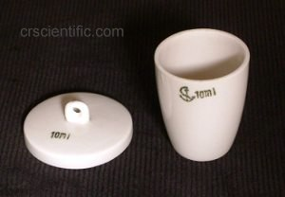
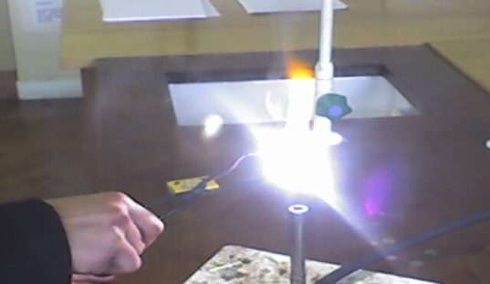
Graphing Practice Problem #4 - Answer
2. A student weighs an empty crucible. Its mass is 20.50 g. She adds some pieces of magnesium and then she weighs the crucible again. Its new mass is 25.50 g. She heats the crucible and its contents and weighs it every 5 minutes. She obtains the following data:
Time (min) | Mass of Crucible and magnesium (grams)
5 | 25.80
10 | 26.20
15 | 26.65
20 | 27.00
25 | 27.45
30 | 27.85
35 | 28.20
40 | 28.60
Plot the mass of the crucible's contents and calculate the slope. What do you think is the significance of the slope?

Slide 31
Graphing Practice Problem #4 - Answer

Slide 32
Graphing Practice Problem #4 - Answer

Slide 33
Graphing Practice Problem #4 - Answer

Slide 34
Graphing Practice Problem #4 - Answer

Slide 35
Graphing Practice Problem #4 - Answer

Slide 36
Graphing Practice Problem #4 - Answer

Slide 37
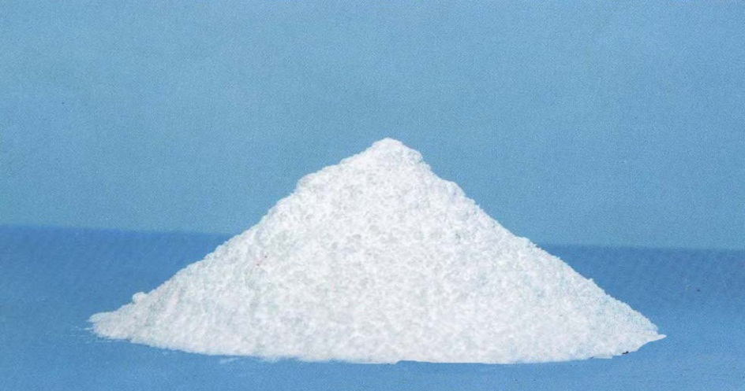

Graphing Practice Problem #4 - Answer
What do you think is the significance of the slope?
It shows us a relationship between the change in mass of a product and time
(every minute, the mass of a product increased by about 0.08g)

Slide 38
Graphing Practice Problem #4 - Answer
Bonus Question: Why was the mass of a crucible and Magnesium increasing when you burned magnesium?
The reaction was:
2 Mg _{(s)} + O_{2(g)} → 2 MgO_{(s)}
MgO is heavier than Mg!!! That is why the mass of the crucible was increasing

Slide 39
Drawing and Interpreting Graphs
Labeling the graph

Slide 40
Drawing and Interpreting Graphs
Scientific Graphs have to be labeled!
You MUST label:
Y and X - axis (what you are measuring + units)
FOR EXAMPLE

Slide 42
Drawing and Interpreting Graphs
Scientific Graphs have to be labeled!
You MUST label:
Y and X - axis(what you are measuring + units)
Y and X - axis(put numbers on them)

Slide 44
Drawing and Interpreting Graphs
Scientific Graphs have to be labeled!
You MUST label:
Y and X - axis(what you are measuring + units)
Y and X - axis(put numbers on them)
The graph (give name to your graph)

Slide 45
Change in Mass vs. Time of reaction

Slide 46
Drawing and Interpreting Graphs
Scientific Graphs have to be labeled!
You MUST label:
Y and X - axis(what you are measuring + units)
Y and X - axis(put numbers on them)
The graph (give name to your graph)
Any lines which you might have on the graph

Slide 47
Increase in Mass vs. Time of reaction
Student 2
Student 1

Slide 48
Graphing Practice Problem #5
Take a graph from Practice Problem #1 and label it correctly as we just discussed!!!
Ethylene (C₂H₄) is a plant hormone that causes fruit to mature. The data above concerns the amount of days (from the spraying until maturity of the fruit) versus the amount of ethylene that was used.
Amount of ethylene (ml/m²) | Wine sap Apples (Days to Maturity) | Golden Apples (Days to Maturity) | Gala Apples (Days to Maturity)
10 | 14 | 14 | 15
15 | 12 | 12 | 13
20 | 11 | 9 | 10
25 | 10 | 7 | 9
30 | 8 | 7 | 8
35 | 8 | 7 | 7

Slide 49
Graphing Practice Problem #5

Slide 50
The number of days to the maturity of the apples
vs. amount of ethylene used
Days to maturity (days)
Amount of ethylene (ml/m²)

Slide 51
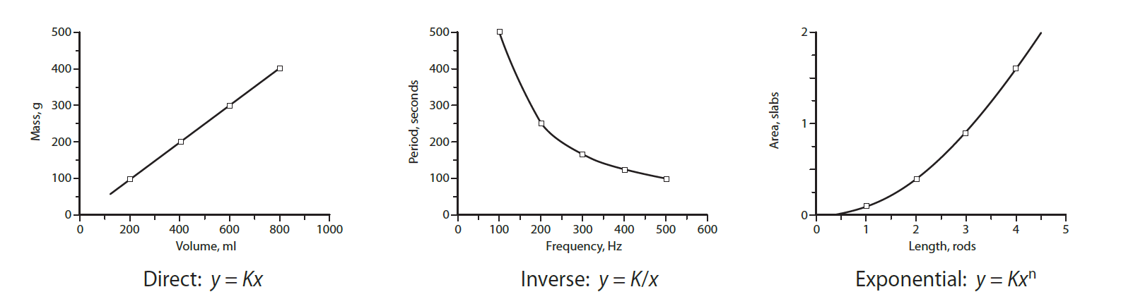
Graphing – Pictorial Representation of Data
as x increases, y increases
as x increases, y decreases
as x increases, y increases very quickly

Slide 52
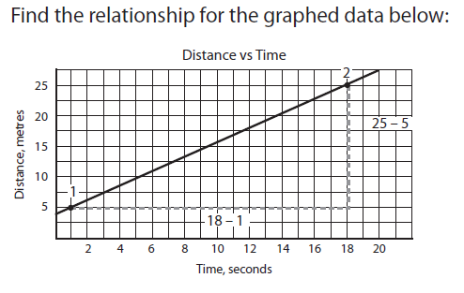

Calculate slope NOT using data points
Write the equation of the line

Slide 53
1.2 Activity: Graphing Relationship
Page 26

Slide 54
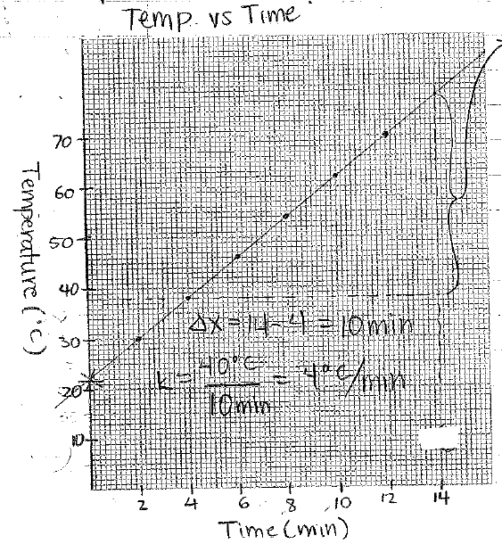
1.2 Activity: Graphing Relationship
Linear relationship
4˚C/min
42 ˚C
Temperature = (4˚C/min) time + 22 ˚C
14.5 min (use graph or the equation)
Temperature of water at the beginning (room temperature)
Uneven heating etc…

Slide 55
HOMEWORK
1.2 Review Questions
Problems: 11 and 12

Slide 56
Interpreting Data
it is also important that you be able to interpret data that are represented by a graph.

Slide 57
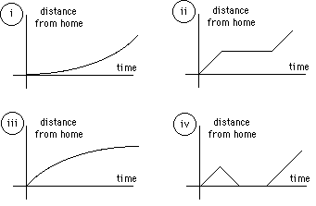
Interpreting Data
Example# 1 Identify the graph that matches each of the following stories:
I had just left home when I realized I had forgotten my books so I went back to pick them up.

Slide 58
Interpreting Data
Example # 2: Identify the graph that matches each of the following stories:
Things went fine until I had a flat tire.

Slide 59
Interpreting Data
Example # 3: Identify the graph that matches each of the following stories:
I started out calmly, but sped up when I realized I was going to be late

Slide 60
Graphing Practice Problem #3
How well can you read a graph problems?

Slide 61
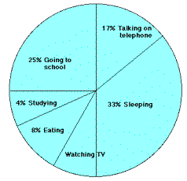
Graphing Practice Problem #3
13
33
Sleeping
Going to school
Talking on the phone, sleeping
Phone, eating
1. The graph at the right represents the typical day of a teenager. Answer these questions:
What percent of the day is spent watching TV?
How many hours are spent sleeping?
What activity takes up the least amount of time?
What activity takes up a quarter of the day?
What two activities take up 50% of the day?
What two activities take up 25% of the day

Slide 62

Graphing Practice Problem #3
2. Answer these questions about the graph
How many sets of data are represented?
On approximately what calendar date does the graph begin?
In what month does the graph reach its highest point?
2
≈ April 10
July

Slide 63
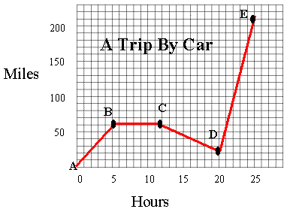
Graphing Practice Problem #3
≈200 – 20 = 180
0
50
≈50 – 20 = 30
Answer these questions
a) How many total miles did the car travel?
b) What was the average speed of the car
for the trip?
c) Describe the motion of the car between
hours 5 and 12?
d) What direction is represented by line CD?
e) How many miles were traveled in the first
two hours of the trip?
f) Which line represents the fastest speed?
260
10.4 miles/hour
The car was stopped
Going back to the origin
About 20
DE

Slide 64
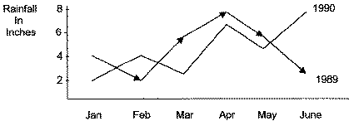
Graphing Practice Problem #3
4. Answer these questions about the graph
a. How much rain fell in Mar of 1989?
b. How much more rain fell in Feb of 1990
than in Feb of 1989?
c. Which year had the most rainfall?
d. What is the wettest month on the graph?
About 5 inches
2 more inches
1989
June 1990

