Slide 1
CHEMISTRY 11
TODAY’S OBJECTIVE:
To learn about the meaning of precision/ accuracy in science and the difference between the two
To learn about and how to report uncertainty and types of errors in measurements

Slide 2
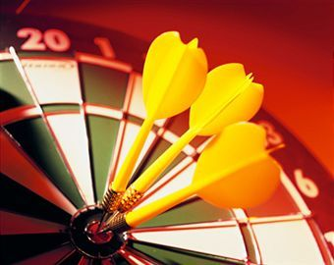
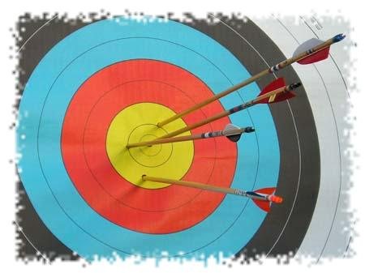
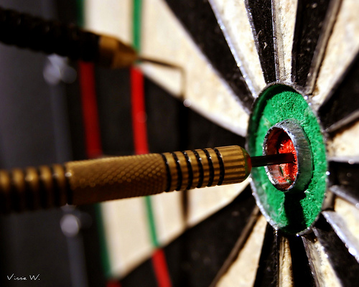
pg. 32 - 44
1.3 Measuring and Recording Significant Data

Slide 3
Precision and accuracy
In everyday language: it means the same thing
In science: precision and accuracy have different meanings
REMEMBER!!
We can never make a perfect measurement! The best we can do is to come as close as possible within the limitations of the measuring instruments.

Slide 4
Precision and accuracy
Accuracy:
is how close a measured value is to the actual (true) value
Precision:
is how close the measured values are to each other (exactness)
or
how well the measurement
can be repeated (reproducibility)

Slide 5
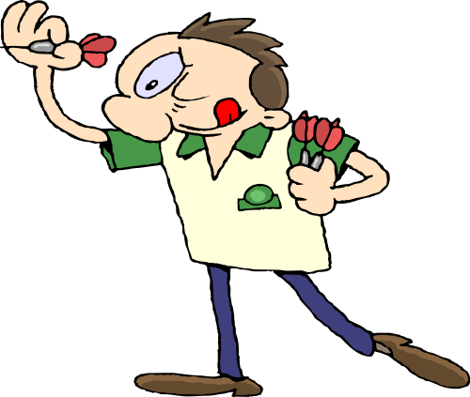
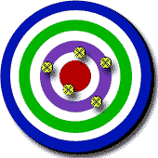
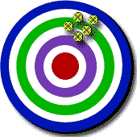
For Example:
Imagine a game of Darts:
You played 3 games and you got these results:
1
2
3
You had high accuracy but very low precision.

Slide 6
For Example:
Imagine a game of Darts:
You played 3 games and you got these results:
1
2
3
You had high accuracy but very low precision. Why?

Slide 7
For Example:
Imagine a game of Darts:
You played 3 games and you got these results:
1
2
3
1. You had high accuracy but very low precision. because you were very close to the true result (the red middle part). But your darts were not very close to each other!

Slide 8
For Example:
Imagine a game of Darts:
You played 3 games and you got these results:
1
2
3
You had low accuracy and very high precision.

Slide 9
For Example:
Imagine a game of Darts:
You played 3 games and you got these results:
1
2
3
2. You had low accuracy but very high precision. Why?

Slide 10
For Example:
Imagine a game of Darts:
You played 3 games and you got these results:
1
2
3
2. You had low accuracy but very high precision. because you were not very close to the true result (the red middle part). And your darts were very close to each other!

Slide 11
For Example:
Imagine a game of Darts:
You played 3 games and you got these results:
1
2
3
3. You had high accuracy and very high precision.

Slide 12
For Example:
Imagine a game of Darts:
You played 3 games and you got these results:
1
2
3
3. You had high accuracy and very high precision. why?

Slide 13
For Example:
Imagine a game of Darts:
You played 3 games and you got these results:
1
2
3
3. You had high accuracy and very high precision. because you were very close to the true result (the red middle part). And your darts were very close to each other!

Slide 14
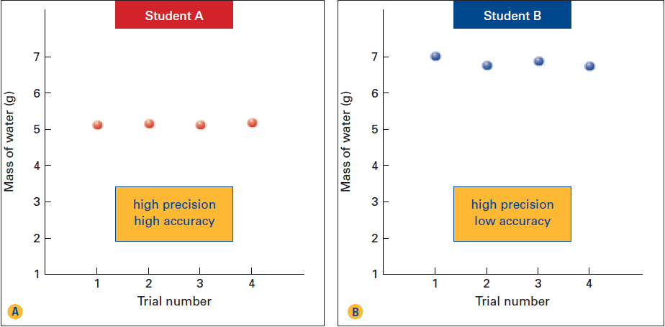
Two students performed four trials to measure the mass of 5 mL of water. The graphs show their results. The true value (result) for the mass of water is 5 g.

Slide 15
What were the accuracy and precision of the students?

Slide 17
3 STUDENTS MEASURE TEMPERATURE OUTSIDE ON A NICE, SUNNY SUMMER DAY. THE ACTUAL TEMPERATURE (actual value) WAS 30.5°C
Here are their results:
STUDENT 1: 30.5 °C, 30.9°C, 30.8°C
STUDENT 2: 30.1 °C, 30.9°C, 31.5°C
STUDENT 3: 31.5 °C, 31.4°C, 31.5°C
a) Graph all four sets of data.
b) Which results are most precise?
c) Which results are most accurate?
d) Which results have the highest accuracy and
precision?

Slide 18
Precision and accuracy
STUDENT 1: 30.5 °C, 30.9°C, 30.8°C
STUDENT 2: 30.1 °C, 30.9°C, 31.5°C
STUDENT 3: 31.5 °C, 31.4°C, 31.5°C
a) Graph all four sets of data.
b) Which results are most precise?
c) Which results are most accurate?
d) Which results have the highest accuracy and
precision?
a)
b) Student 3
c) Student 1
d) Student 1

Slide 19
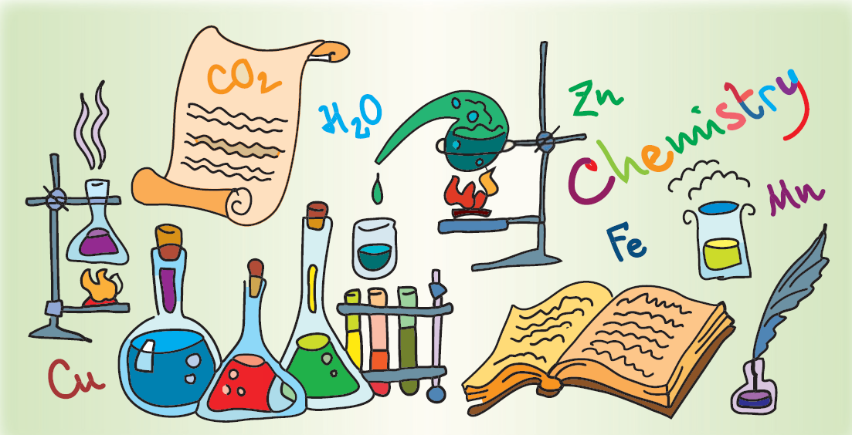
PRECISION OF LABORATORY EQUIPMENT

Slide 20
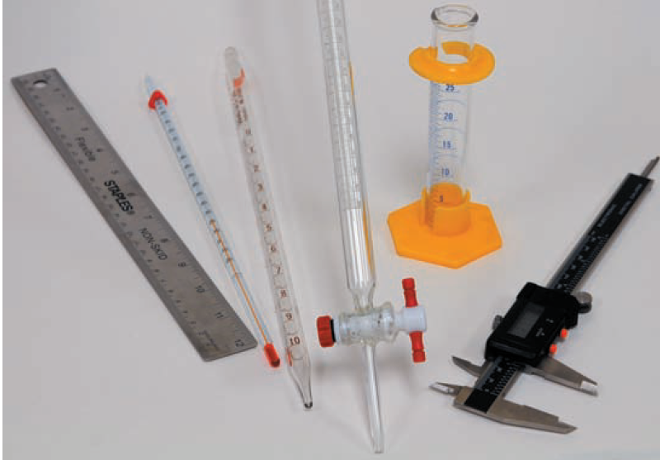
PRECISION OF LABORATORY EQUIPMENT
What quantities these do these instruments measure and what are their names?

Slide 21
They all have different precision (exactness)
But they can never give EXACT measurement = they are not perfect

Slide 22
They have a degree of UNCERTAINTY

Slide 23
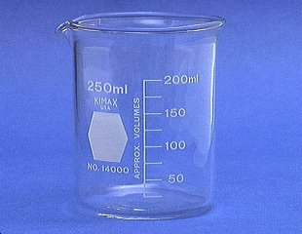
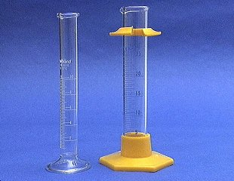
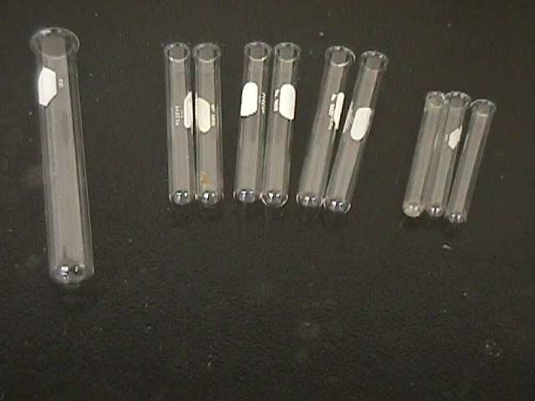
WHICH EQUIPMENT WOULD YOU USE TO DELIVER 20.5 mL OF A LIQUID?
Graduated Cylinder

Slide 24
WHICH EQUIPMENT IS THE LEAST PRECISE?
Test Tubes

Slide 25
syringe
Graduated cylinder
no

Slide 26
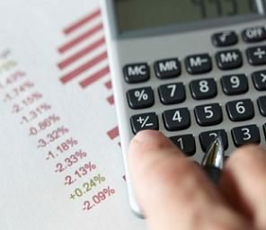
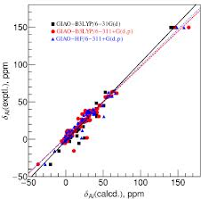
TYPE OF ERRORS IN MEASUREMENTS

Slide 27
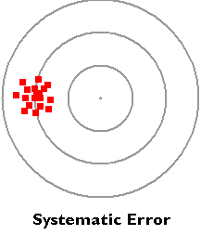
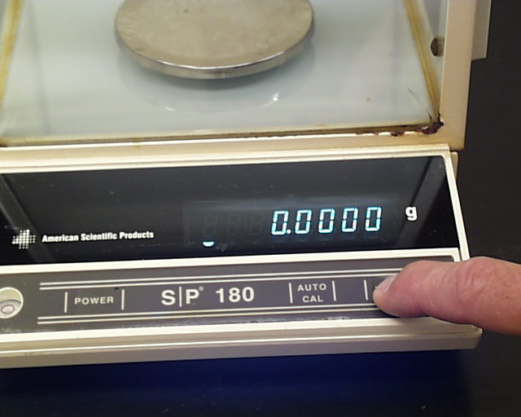
SYSTEMATIC ERROR
Your measurements are ALWAYS too low or too high in the same direction!

Slide 28
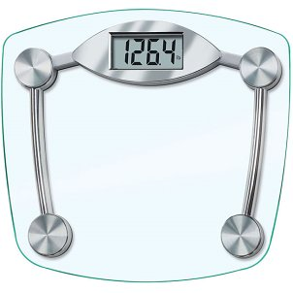
SYSTEMATIC ERROR
For example: At the beginning of an experiment, you forgot to RESET your scale to 0.0000, so your measurements are all wrong

Slide 29
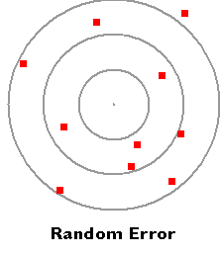
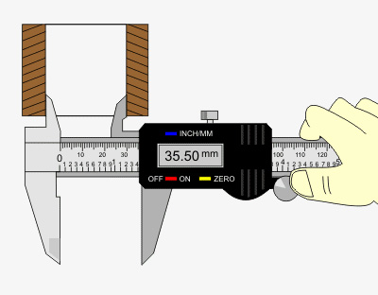
RANDOM ERROR
Your measurements are SOMETIMES too low and SOMETIMES too high in both directions!

Slide 30
RANDOM ERROR
For example: YOU make mistakes during an experiment (not being careful, spilling, losing chemicals, not reading the numbers properly etc…)

Slide 31
Groups 1 and 3 -> low precision, as the points are spread out
Groups 2 and 4 -> high precision, as the points are close to each other
Groups 1 and 2 -> low accuracy
Groups 3 and4 -> high accuracy
Groups 1 and 2 -> errors in the same direction
Groups 3 and 4 -> errors in high and low directions

Slide 32
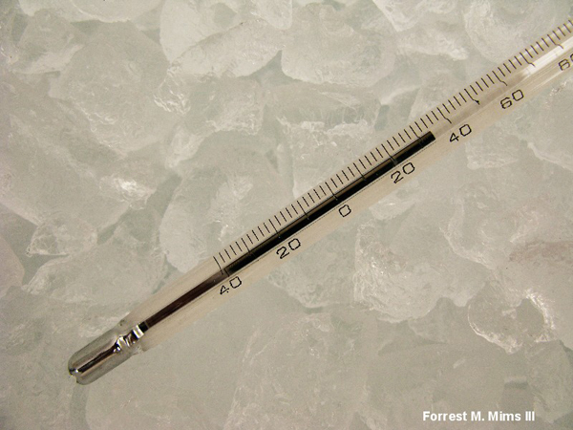
RANGE UNCERTAINTY
The most precise instruments have the smallest UNCERTAINTIES (mistakes)
To report the uncertainty, we use:

Slide 33
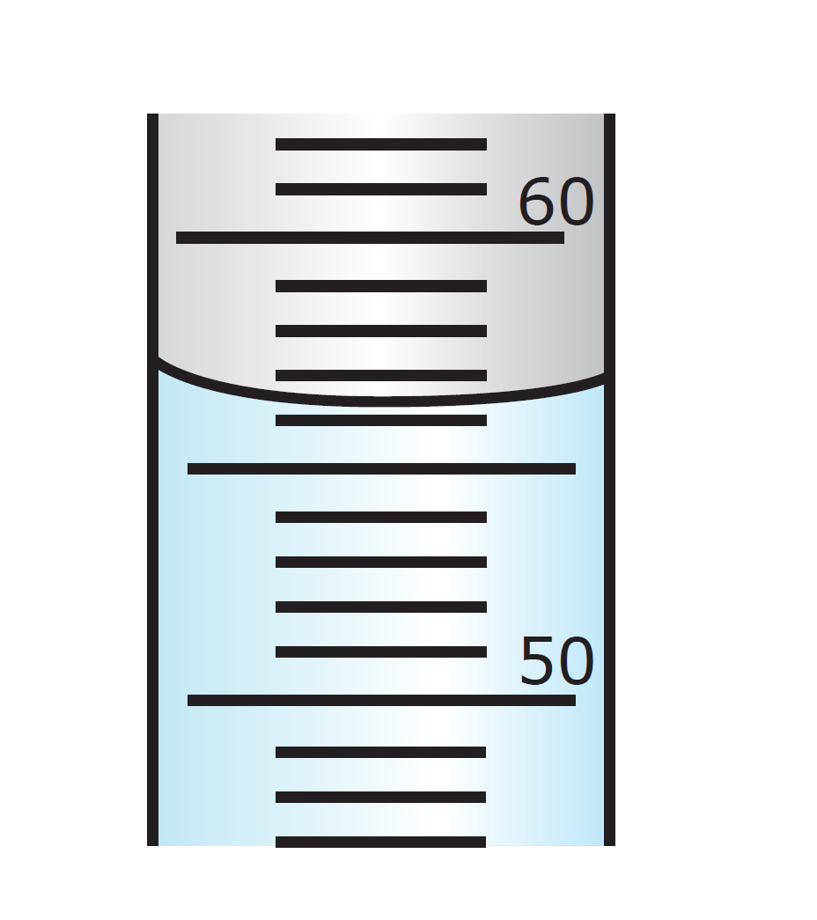
RANGE UNCERTAINTY
≈ +/– ½ of the smallest division marked on a measuring scale
Smallest division = 1 mL
Range uncertainty = +/- 0.5 mL
56.3 mL +/- 0.5 mL

Slide 34
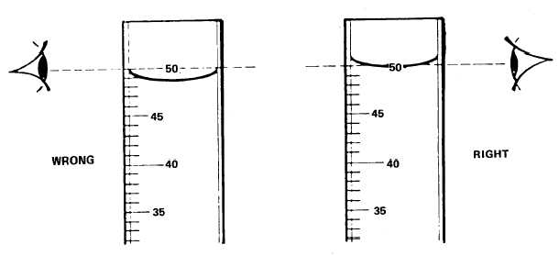
READING THE MENISCUS

Slide 35
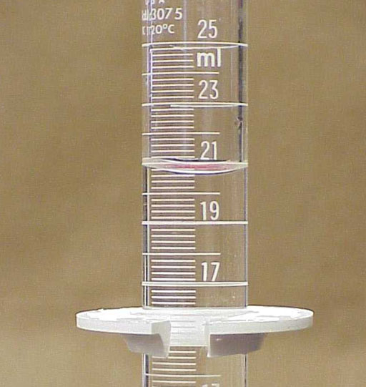
What is the RANGE UNCERTAINTY in these pictures?
26 mL +/- 1 mL

Slide 36
What is the RANGE UNCERTAINTY in these pictures?
34˚C +/- 1 ˚C

Slide 37
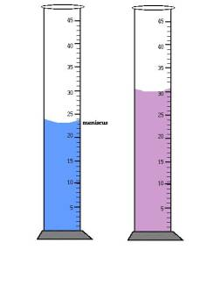
What is the RANGE UNCERTAINTY in these pictures?
23 mL +/- 0.5 mL
30 mL +/- 0.5 mL

Slide 38
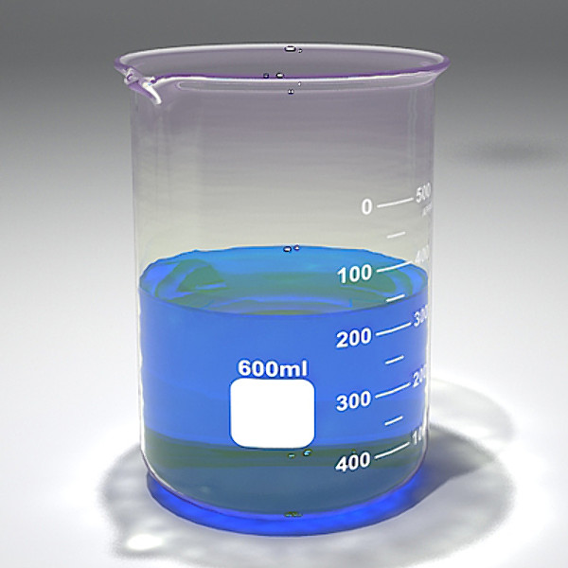
What is the RANGE UNCERTAINTY in these pictures?
350 mL +/- 25 mL

Slide 39
Adding Range Uncertainties
42.4 mL +/- 0.4 mL
12.6 mL +/- 0.4 mL

Slide 40
Multiplying Range Uncertainties
5 m +/- 1 m
8 m +/- 1 m
Step 1: Find the maximum and minimum values
Step 2:
Results →
(max + min value) +/- (max - min value)
2 2

Slide 41
TYPES OF UNCERTAINTY IN MEASUREMENTS
Absolute Uncertainty
how much higher or lower a measured value
is than an accepted (true) value
Absolute Uncertainty =
|measured – accepted value|

Slide 42
3 STUDENTS MEASURED TEMPERATURE OUTSIDE ON A NICE, SUNNY SUMMER DAY. THE ACTUAL TEMPERATURE (actual value) WAS 30.5°C
Here are their results:
STUDENT 1: 30.5 °C
STUDENT 2: 30.1 °C
STUDENT 3: 31.5 °C
The actual (accepted) value was: 30.5˚C
Absolute Uncertainty?
STUDENT 1: |30.5 – 30.5 | = no error
STUDENT 2: |30.1 – 30.5 | = 0.4 °C
STUDENT 3: |30.5 – 31.5 | = 1.0 °C
Absolute Uncertainty =
|measured – accepted value|

Slide 43
TYPES OF UNCERTAINTY IN MEASUREMENTS
Percentage Error

Slide 44
3 STUDENTS MEASURED TEMPERATURE OUTSIDE ON A NICE, SUNNY SUMMER DAY. THE ACTUAL TEMPERATURE (actual value) WAS 30.5°C
Here are their results:
STUDENT 1: 30.5 °C
STUDENT 2: 30.1 °C
STUDENT 3: 31.5 °C
The actual (accepted) value was: 30.5˚C
Percentage Error?
STUDENT 1: |(30.5 – 30.5)| / 30.5 = no error
STUDENT 2: |(30.1 – 30.5)|/ 30.5 = 1.3 °C
STUDENT 3: |(30.5 – 31.5)| / 30.5 = 3.3 °C

Slide 45
HOMEWORK
2 worksheets

Slide 46
QUIZ
2 days from now – Wednesday, February 19
Accuracy + precision
Range uncertainty + arithmetic
Absolute Uncertainty, Percentage Errors
Types of errors
Reading glassware uncertainty

