Slide 1
CHEMISTRY 11
TODAY’s OBJECTIVE:
To learn the importance of significant figures in science
To be able to tell how many sig.figs there are in a give example
To be able to manipulate sig.figs in calculations

Slide 2
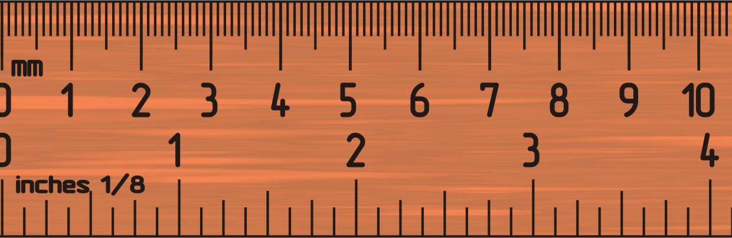
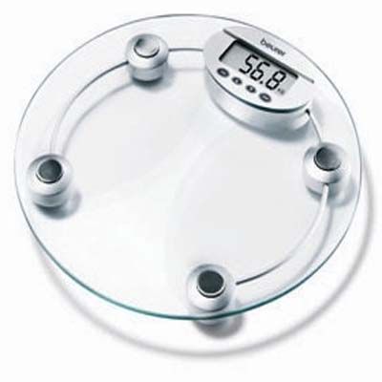
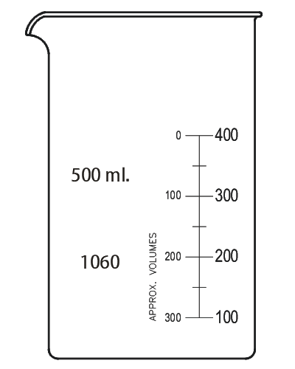
SIGNIFICANT FIGURES
Any time you measure something:
Volume
Length
Mass
Time
There is UNCERTAINTY in your measurement!!!!

Slide 3
What is the length of the line?
Is it 20.8?
Is it 20.6?
Is it 20.7?
Which digits are you certain of?

Slide 4
What is the length of the line?
Is it 20.8?
Is it 20.6?
Is it 20.7?
2

Slide 5
What is the length of the line?
Is it 20.8?
Is it 20.6?
Is it 20.7?
20

Slide 6
What is the length of the line?
Is it 20.8?
Is it 20.6?
Is it 20.7?
20.X

Slide 7
What is the length of the line??
Is it 20.8?
Is it 20.6?
Is it 20.7?
2 and 0 are CERTAIN
The last number (6,7,8??) is UNCERTAIN
But ALL three digits are SIGNIFICANT (IMPORTANT) in your measurement!!!

Slide 8
SIGNIFICANT FIGURES (DIGITS)
all of the certain figures (numbers) plus the first uncertain (estimated) figure in a measurement are called
The number of significant figures indicates the certainty of your measurement
20.X

Slide 9
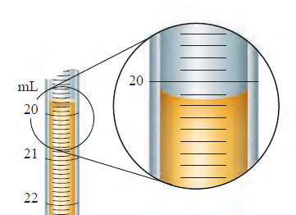
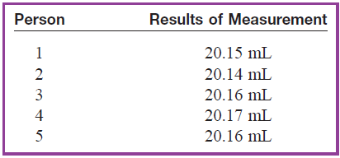
SIGNIFICANT FIGURES (DIGITS)
So, in any measurement you will do, there will ALWAYS be digits that are CERTAIN plus a digit which is UNCERTAIN

Slide 10
SIGNIFICANT FIGURES (DIGITS)
THE RULES
1.) All on-zero digits (1,2,3,4,5,6,7,8,9) are always significant.
For example: 22 has two significant digits
22.3 has three significant digits.
For example: 3 cars 10 apples,
2 in 2πr 2.54 cm = 1 inch
2.) The whole, exact numbers from definitions AND the numbers that were not obtained by measuring have unlimited number of significant figures

Slide 11
3.) Zeroes
Zeroes placed before other digits are not significant
For example: 0.046 has two significant digits
Zeroes placed between other digits are always significant
For example: 4.009 kg has four significant digits
Zeroes placed after other digits but behind a decimal point are always significant
For example: 7.90 has three significant digits

Slide 12
3.) Zeroes
Zeroes at the end of a number are significant only if they are behind a decimal point as in (c).
For example: 8200, it is not clear if the zeroes are significant or not. The number of significant digits in 8200 is at least two, but could be three or four.
To avoid uncertainty, use scientific notation to place significant zeroes behind a decimal point:
8.200 x 10³ has four significant digits
8.20 x 10³ has three significant digits
8.2 x 10³ has two significant digits

Slide 13
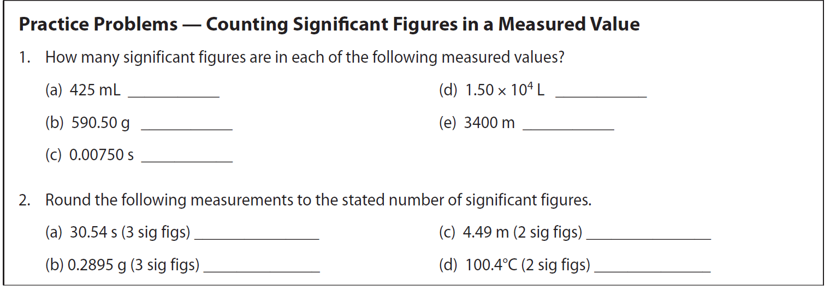
PRACTICE PROBLEMS
3
3
5
3
3
30.5
4.5
0.290
1.0 x 10²

Slide 14
Multiplication and Division with Sig.Figs.
The final result should equal the least number of significant figures in any one of the numbers being multiplied or divided
8.2 m x 9.47 m =
12 970.0 g : 530.8 mL =

Slide 15
Multiplication and Division with Sig.Figs.
The final result should equal the least number of significant figures in any one of the numbers being multiplied or divided
8.2 m x 9.47 m = 78 or 7.8 x 10¹ m²
12 970.0 g : 530.8 mL = 24.43 g/mL

Slide 16
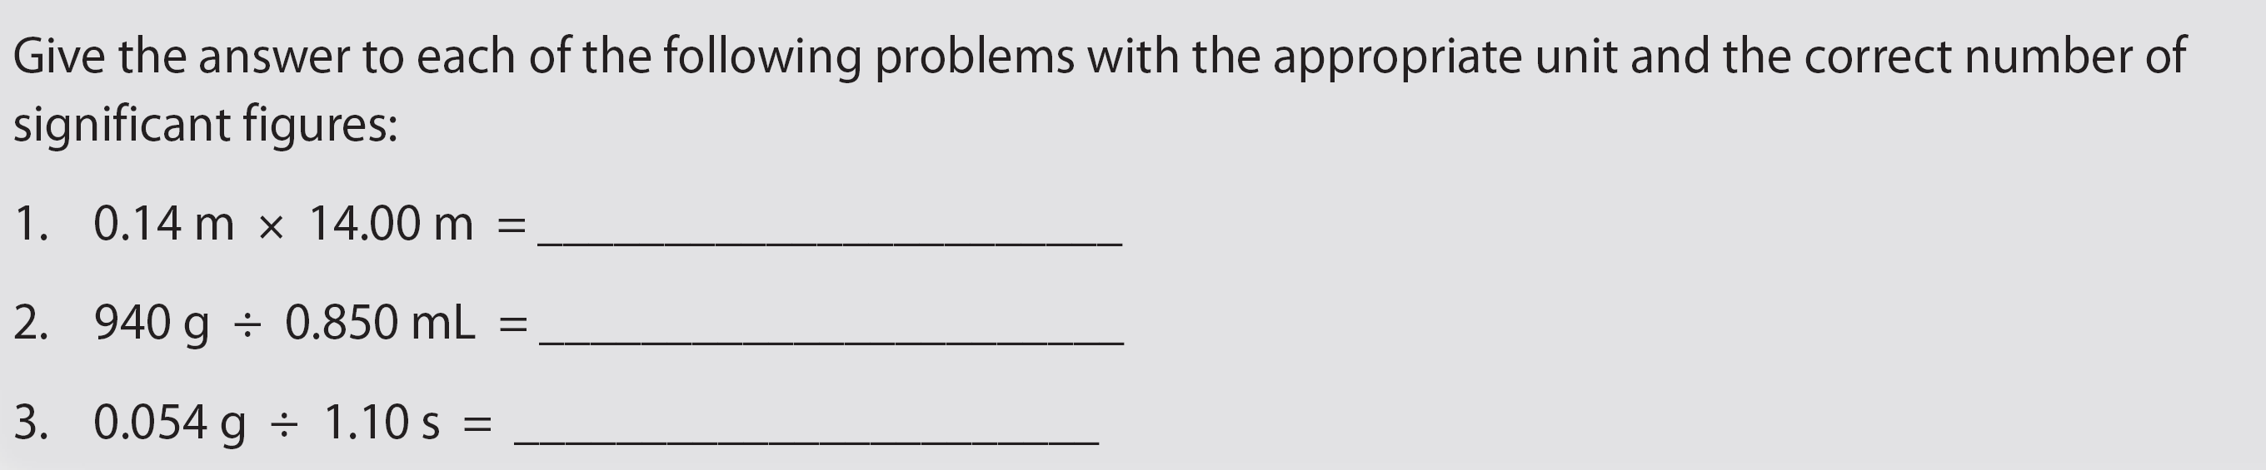
Multiplication and Division with Sig.Figs.
The final result should equal the least number of significant figures in any one of the numbers being multiplied or divided
2.0 m²
1.1 x 10³ g/mL
0.049 g/s

Slide 17

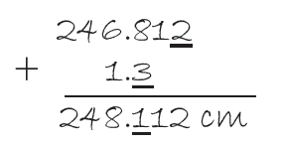

Addition and Subtraction with Sig.Figs.
The number of decimal places (not significant figures) in the answer should be the same as the least number of decimal places in any of the numbers being added or subtracted.
The tenths is less precise
(less exact)
Than the thousandths place

Slide 18
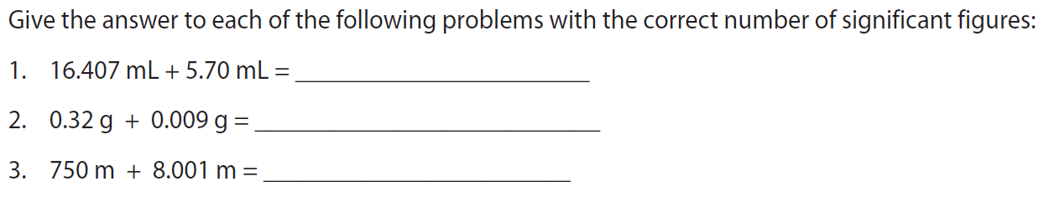
Addition and Subtraction with Sig.Figs.
The number of decimal places (not significant figures) in the answer should be the same as the least number of decimal places in any of the numbers being added or subtracted.
22.11 mL
0.33 g
760 m

Slide 19
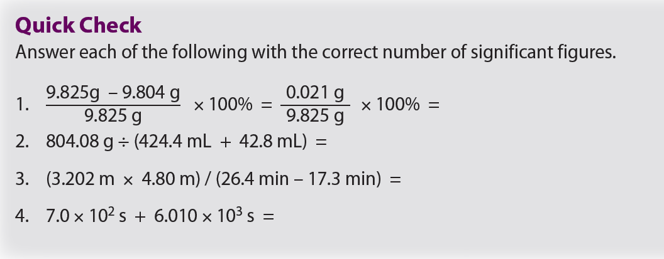
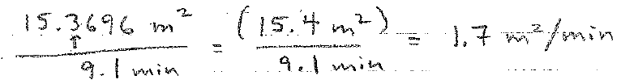
0.21 %
1.721 g/mL
1.7 m²/min
700 + 6010 = 6710 s

Slide 20
CLASSWORK
3 worksheets
Textbook problems 16, 18

Slide 21
QUIZ
In 2 days
Only Sig. Figs

